Slide 1




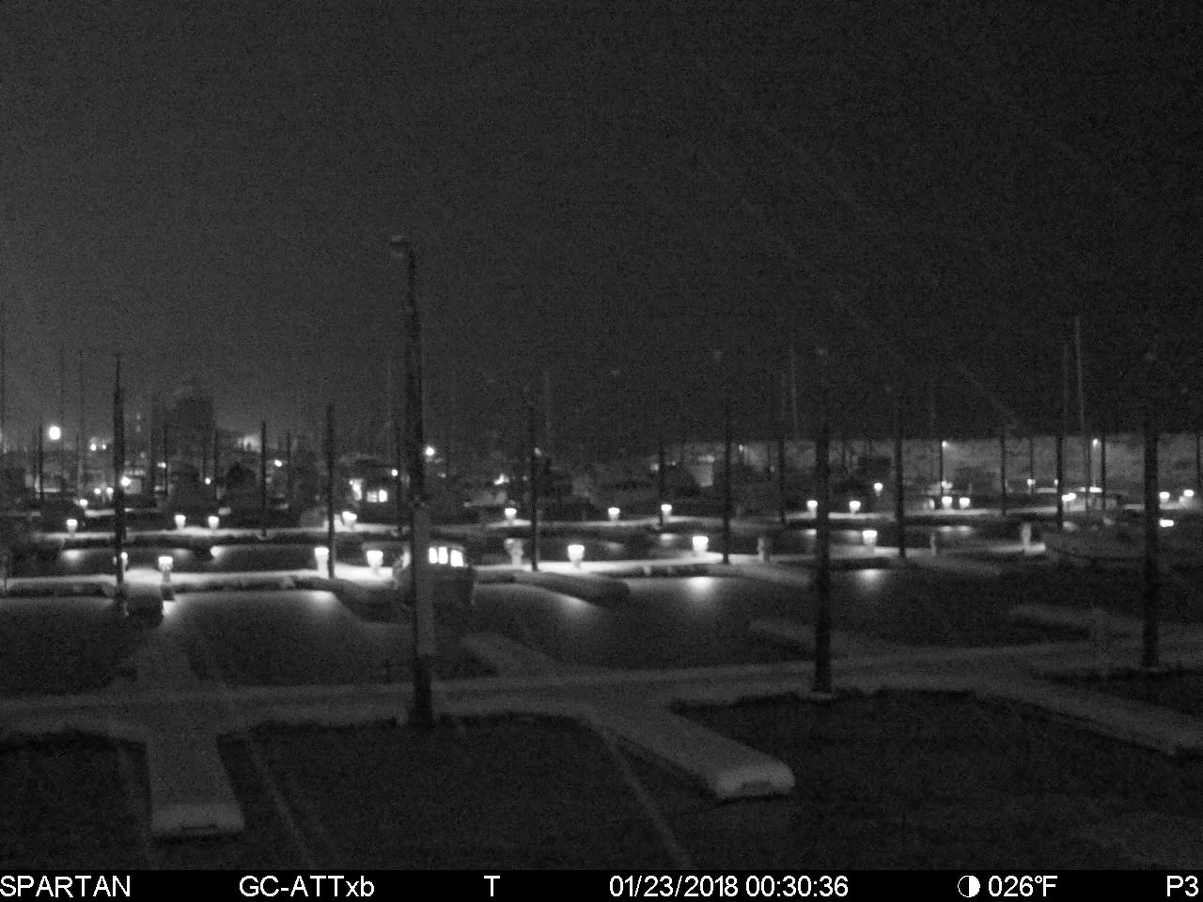
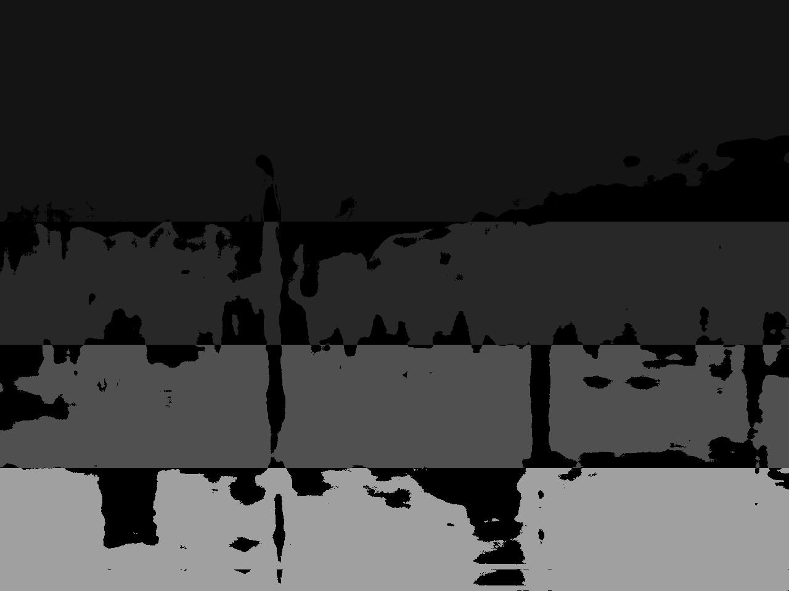
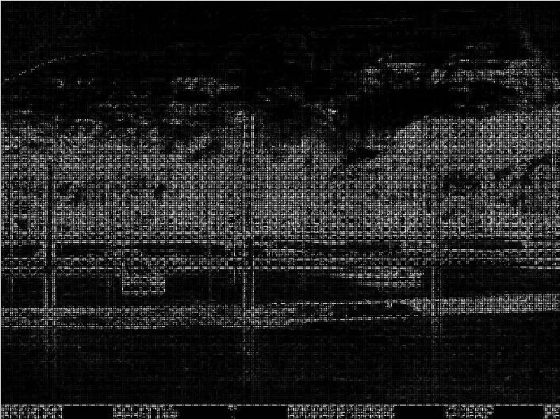

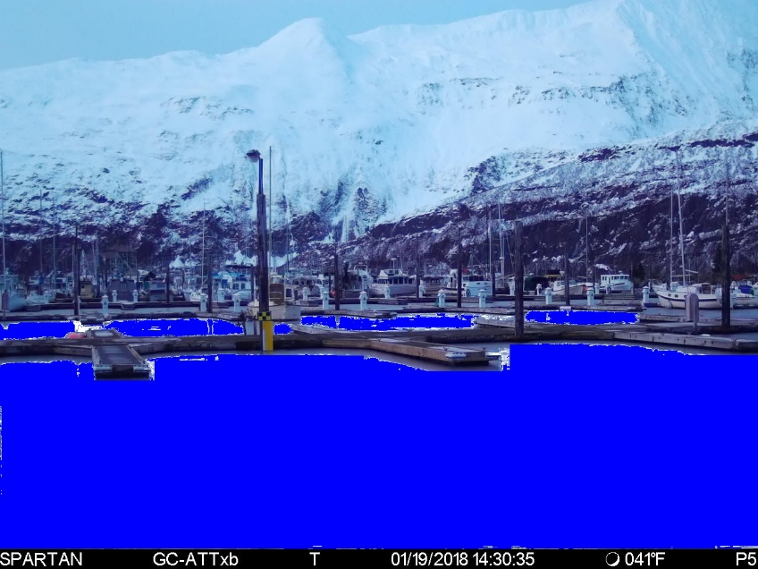
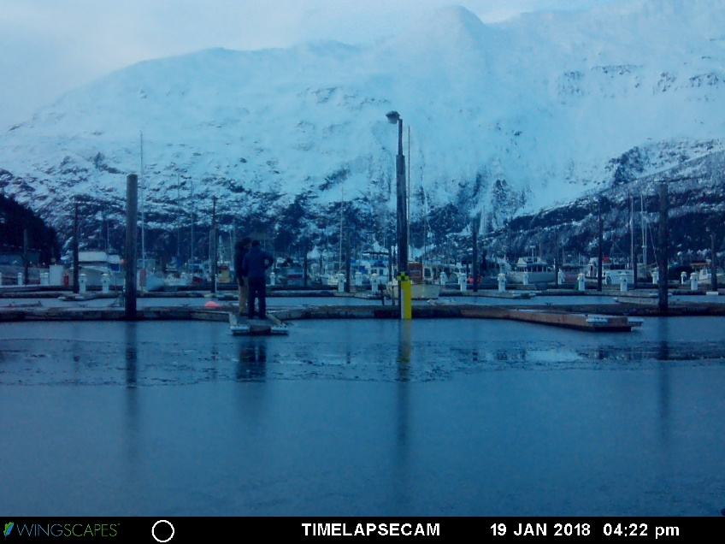
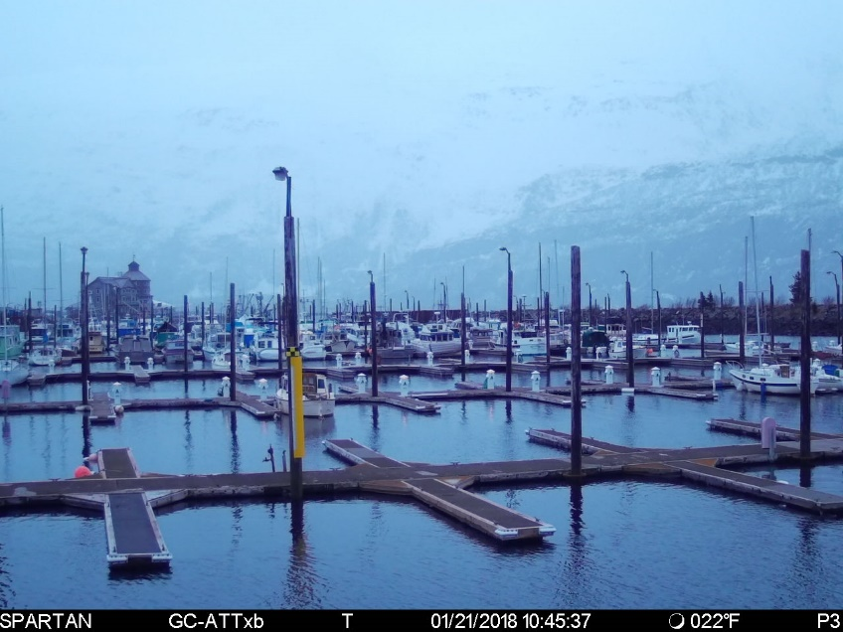
Water detection in an image using HOG and Neural Networks
Timothy Harrelson
tgharrelson@alaska.edu
Jeremy Swartwood
jswartwo@alaska.edu
Overview
Our project is to make software capable of determining where water lies in an image. These locations will then be used to determine heights of water for rivers and other bodies of water. Current processes are expensive. The proposed method will be cheaper and easier to implement and maintain.
Our method for determining where water is, uses an automated approach with supervised validation of the results. We read in training images, process their data, and using machine learning to classify where water is in an image. The process breaks down into three phases: Pre-processing, Feature Extraction, and Classification. Pre-processing is modifying the input images to be able to extract meaningful data from them. Feature Extraction takes the preprocessed images and retrieves the pertinent data that identifies water vs. non-water. Classification uses a Neural Network algorithm that takes in the extracted features and determines what is water or not water in an image.
4
.
3
Generate Histogram of
.
1
Sample
.
Lower Pass Filter
2
.
Generate Mask
Region Of Interest
Oriented Gradients
(
ROI
)
(
HOG
(
)
with
4
color regions
(
)
Average and Subtract
)
(
from each region
)
(
Using ROI
)
Load Image
Output Mask
Run Image through ANN
Save image of Water
Pixels
5
.
Learn Regions using Artificial Neural Network
(
ANN
(
)
Run HOG through ANN to learn the
4
regions
)
Pre-processing
Feature Extraction
Classification
To perform unsupervised extraction of features, the source image must be first analyzed to determine section of an image that are most likely to be water.
All Images are blurred using a low pass temporal filter.
Used K-means to group similar colors together into bands used as labels.
3. The input image is split into smaller regions.
4. Each smaller region has features extracted using a HOG^{[1]}
Regions that fall between 2 bands generated from the preprocessing are not used as data.
5. Train the Neural Network on the data.
6. Validate and test predictions from trained Neural Network.
1. Low Pass Temporal Filter
2. Bands from K-Means
3. Input Image
4. HOG Generation
6. Classified Image
Conclusion
Sources
The Neural Network using HOG features was not able to pick up and learn the differences between the bands representing water or not water.
Being able to detect water in an image initially looked to be a simpler problem than it was. Numerous issues arose depending on the environmental conditions. Examples of issues are lighting, wind, fog, season (snow), and obstructions (boats/people). More advanced technology might be required to handle these outliers.
^{[1]} Dalal, N. and Triggs, B., “Histograms of Oriented Gradients for Human Detection,” IEEE Computer Society Conference on Computer Vision and Pattern Recognition, 2005, San Diego, CA, USA
^{[2]} Dr. Cenek. Expertise and direction.

