Slide 1

A
PROJECT REPORT ON
HOME SECURITY SYSTEM
UNDER SUPERVISION OF
Er. Ganesh Datt Joshi
SUBMITTED BY
Arbind Kumar Yadav (18070120)
Bhupendra Rokaya (18070122)
Kalak Kumar Malla (18070136)
Keshab Singh Sutar (18070138)
Prakash Bahadur Kathayat (18070153)
SUBMITTED TO
Department of Computer Engineering
Dhangadhi Engineering College
National Academy of Science and Technology
DHANGADHI ENGINEERING COLLEGE
Affiliated to Pokhara University
Uttar Behadi-4 Dhangadhi, kailali, Province-07

Slide 2
Security system means something is secure through a system with the help of inter networking components & devices. Home security means securing valuable properties of home from stolen. Fingerprint lock & laser light based wall system becomes an important part of Home Security System. There are many types of security system available to secure our home. Some examples are PIR based security system, RFID based security system, digital lock system, Biometric systems, electronic code lock, laser light system etc. Fingerprint based Biometric security system & laser light security system at wall build by our group.
Introduction

Slide 3
Objectives
The project to intended to fulfill following objectives;
To design a next level of home security system using fingerprint door lock & laser light based wall
To make fastest way to lock or unlock door at wall or key less door lock
To increase the home security system digitally
To design a system that can alert home owner from entering unknown person
To provide a protection to home to ensure the safety of valuables & loved ones

Slide 4
Arduino UNO Fingerprint Sensor Solenoid Lock LCD Display Channel Relay Laser Light LDR Circuit Module Buzzer 12V Adapter
Hardware Requirement

Slide 5
Software Requirement
Arduino UNO IDE

Slide 6
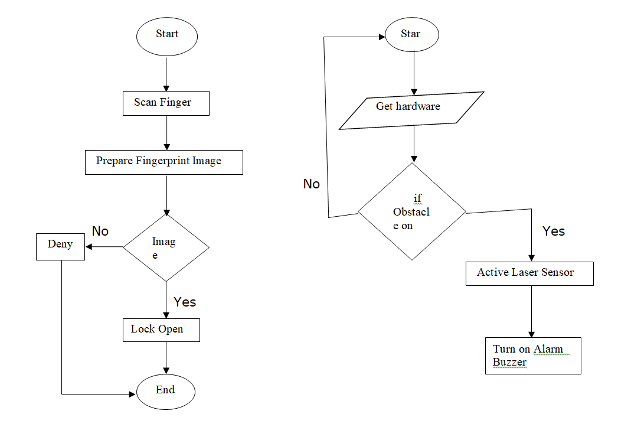
System Flowchart
Fig : Flowchart of Fingerprint system
Fig : Flowchart of Fingerprint system

Slide 7
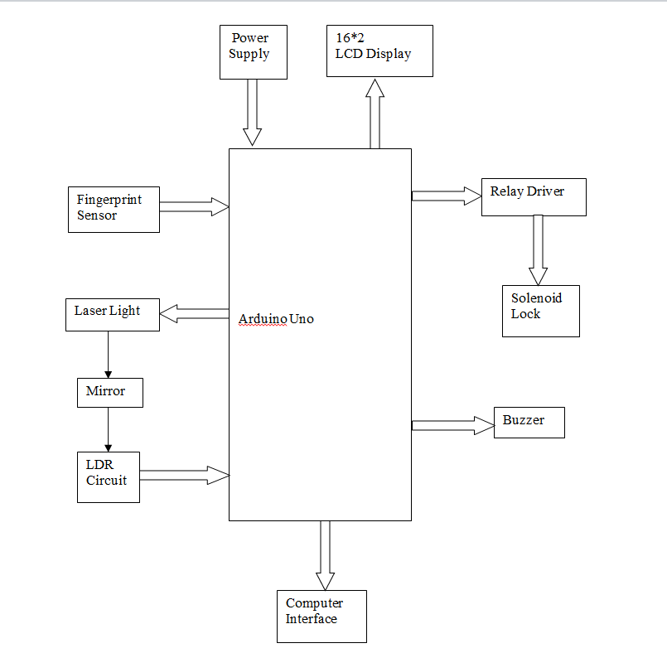
Block Diagram
Fig : Block Diagram of Home security system

Slide 8
Working Mechanism

Slide 9
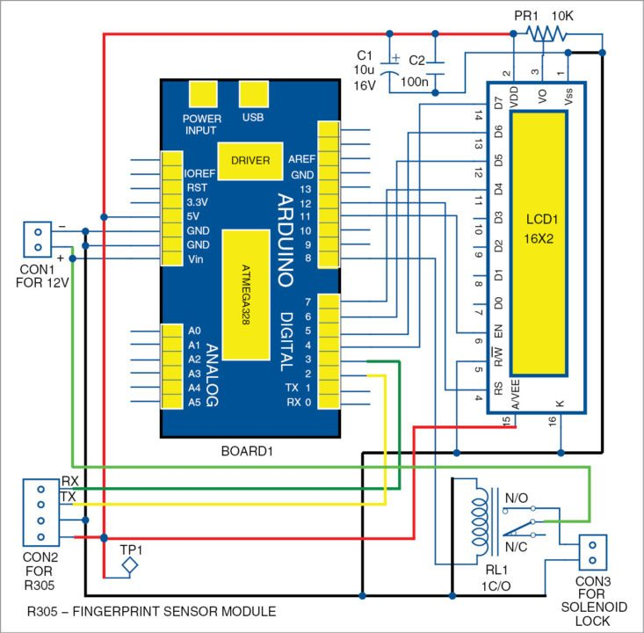
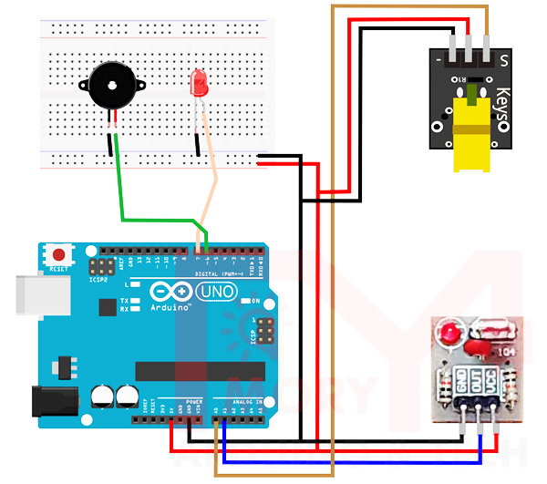
Circuit Design
Fig : Circuit Diagram of fingerprint door lock system
Fig : Circuit Diagram of laser light system

Slide 10
Advantages of Home security system
Fingerprint door lock & laser light system are more secure & fastest system than other
We can store fingerprint data more than one person
No need to remember the password or any pin number
Unauthorized person can't be guessed like that can be done for password
Can be use in home, office, banking, industry, jail, cars etc.
Laser light system require very low power & voltage

Slide 11
Future Enhancement
We will make this project to connect via smart phone to give access to an individual by administrator.
We will send fingerprint data to remote location using mobile or internet to enter another home by same person.

Slide 12
Conclusion
There are lots of security problems in traditional door lock systems & wall security system. Some systems seem to be overcoming the particular drawbacks. However, they still lack some features that makes them unsuitable for a specific condition.
The developed IOT enabled fingerprint door lock system & laser based system is dedicated to provide a complete package to home security system.
One advantage is that the fingerprint can't be guessed like that can be done for password. In this system only authorized person can lock and unlock the door. And laser light system immediately bell the ring when unknown person try to enter home from wall.
System lets the owner to add as much as 162 fingerprint models. Therefore, it is also suitable for an organizational setup.
Hence the developed system is one of the powerful solutions for providing security to the property and life of the civilian in this age of increased criminal activities.

Slide 13
ANY QUESTION ?

