Slide 1
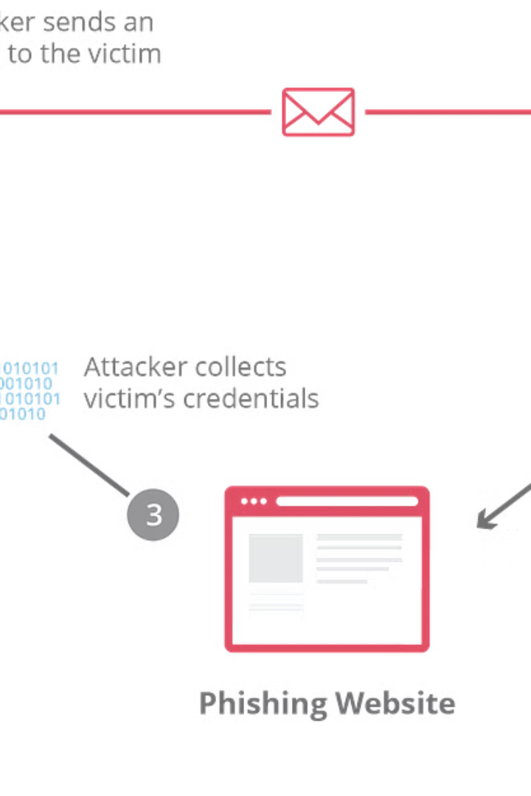

Introduction to Phishing URL Detection
Phishing URL detection is a critical aspect of cybersecurity, aimed at identifying fraudulent URLs used to steal sensitive information. The process involves analyzing URLs to distinguish between legitimate and malicious websites.

Slide 2

Real Case Scenario of a Phishing Attack
1
Deceptive Email
The attacker sends an email asking the recipient to click on a link, which leads to a forged website.
2
Fraudulent Website
The victim is directed to a website that impersonates a legitimate one, prompting them to enter sensitive information.
3
Data Theft
The attacker collects the entered data, which can lead to financial or identity theft.

Slide 3

Importance of Using Machine Learning for URL Detection
1
Adaptability
2
Efficiency
3
Enhanced Accuracy
Machine learning allows for the continuous improvement of URL detection systems to adapt to evolving phishing tactics.
It enables automated, rapid analysis of large datasets to accurately identify malicious URLs.
Machine learning algorithms can learn from patterns and anomalies, enhancing detection capabilities.

Slide 4
Machine Learning Techniques for Phishing URL Detection
Supervised Learning
Unsupervised Learning
Deep Learning
Utilizes labeled data to train models in identifying patterns indicative of phishing URLs.
Identifies patterns and anomalies without the need for predefined labels, useful for detecting new threats.
Employs neural networks to automatically extract features and classify URLs based on complex patterns.

Slide 5

Challenges in Phishing URL Detection Using Machine Learning
1
Data Imbalance
2
Adversarial Attacks
Unbalanced datasets can result in biased models, leading to misclassification of phishing URLs.
Cybercriminals can intentionally manipulate URLs to evade machine learning-based detection systems.
3
Zero-Day Attacks
New and previously unseen phishing URLs pose a challenge as existing models may fail to identify them.

Slide 6
Evaluation Metrics for Phishing URL Detection Models
Accuracy
Precision
Recall
F1 Score
ROC AUC
Confusion Matrix

Slide 7



Future Developments in Machine Learning for Phishing URL Detection
AI Advancements
Automation
Advanced Algorithms
Further integration of artificial intelligence for more robust detection capabilities.
Increased automation of threat analysis and response for real-time protection.
Development of advanced algorithms to counter ever-evolving phishing tactics.

Slide 8
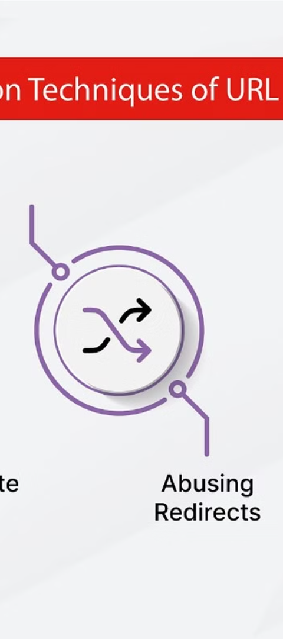



Conclusion and Key Takeaways
Enhanced Security
Machine learning plays a vital role in bolstering cybersecurity defenses against phishing threats.
Ongoing Evolution
The field of machine learning for URL detection will continue to evolve to counter emerging cyber threats.
Collaboration & Innovation
Collaborative efforts and innovative solutions are crucial for staying ahead of cybercriminal tactics.

