Slide 1

Vel Tech Rangarajan Dr. Sagunthala R&D Institute of Science and Technology
School of Computing
Department of Computer Science and Engineering
10211CS224 / FULL STACK APPLICATION DEVELOPMENT (JAVA)
PROJECT REVIEW : MILESTONE PROJECT – 1
Date: 23-03-2026
PROJECT TITLE:Academic Campus Event & Registration Portal
SDG: SDG No – SDG Title(Example: SDG 4 – Quality Education)
Presented By:
E.kalyan – VTU25414 – Reg.No.23UECS0004
Courses Handling Faculty:
Dr.M .MAGESHWARI.(TTS4041)

Slide 2
Universities need modern, accessible platforms to manage extracurriculars.
INTRODUCTION
Campus events often rely on fragmented communication like posters and manual registration processes.
Centralizing this information improves student engagement and administrative efficiency.
Universities need modern, accessible platforms to manage extracurriculars
This project is a responsive, 3-tier web application that allows students to securely discover and register for campus events.
1
2
3
4
5
6
7
8
9

Slide 3
PROBLEM STATEMENT
Currently, academic and cultural events are managed through disjointed channels, leading to low visibility.
The manual registration process causes inefficiency, potential data loss, and a poor user experience.
Organizers struggle to track participant data and manage event capacities effectively.
There is a clear need for a centralized, automated web portal to streamline event discovery and secure student registrations in real-time.
1
2
3
4
5
6
7
8
9

Slide 4
OBJECTIVE(S)
To design and develop a dynamic, full-stack web application that centralizes campus event discovery and categorization.
To implement a secure, automated registration system that captures student data seamlessly using a MySQL backend and Node.js REST API.
1
2
3
4
5
6
7
8
9

Slide 5
PROPOSED SYSTEM
A complete 3-tier architecture application (Frontend, Backend, Database).
User authentication system for secure student login and sign-up.
Interactive dashboard with real-time search and category filtering (Technical, Cultural, Seminar).
Dynamic data retrieval from a centralized MySQL database.
Automated registration form with auto-filled user details via session storage.
Eliminates manual paperwork and fragmented communication.
Provides an intuitive interface using modern HTML5, CSS3, and ES6.
1
2
3
4
5
6
7
8
9

Slide 6
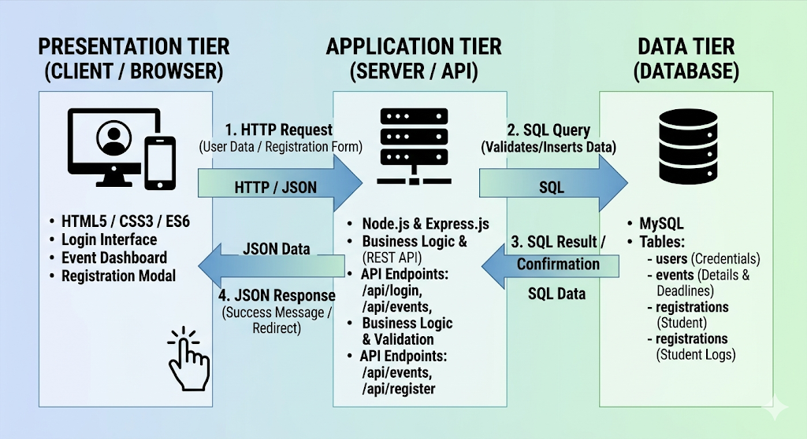
PROPOSED SYSTEM ARCHITECTURE
1
2
3
4
5
6
7
8
9

Slide 7
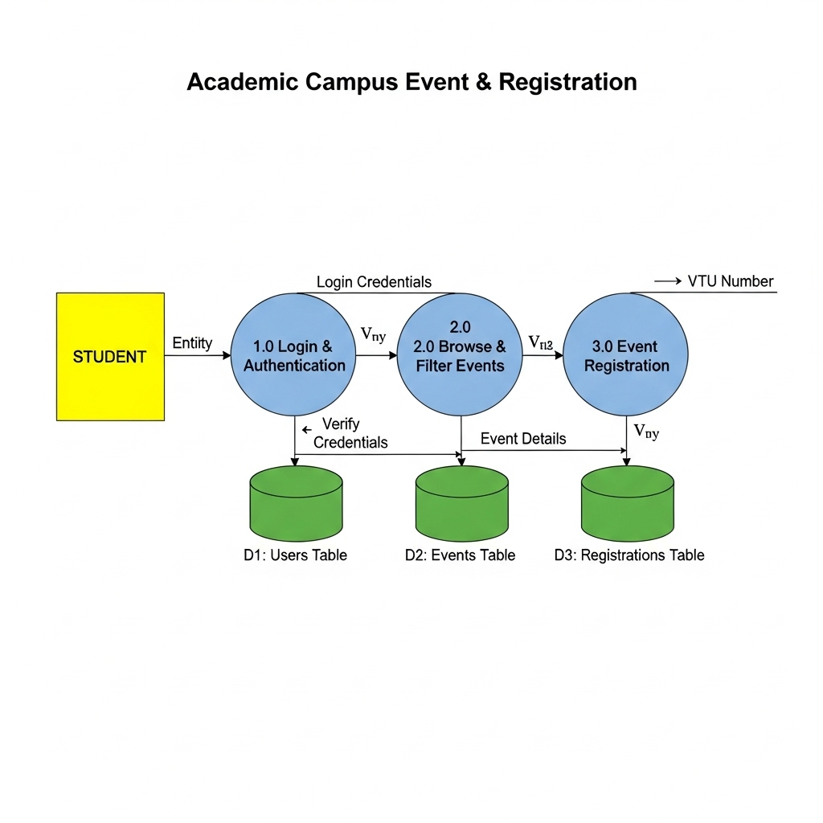
WORKFLOW
1
2
3
4
5
6
7
8
9

Slide 8
L.
MySQL or PostgreSQL.
TECHNOLOGIES USED
Frontend: HTML5, CSS3, JavaScript (React or Bootstrap for styling).
Backend: Node.js, Express.js (REST APIs)
Database: MySQL
Tools: VS Code, MySQL Workbench
Hardware/Software Requirements: Windows/macOS, Modern Web Browser, Node Runtime Environment.
1
2
3
4
5
6
7
8
9

Slide 9
MODULE DESCRIPTION
----- Example for reference only ---- (Change according to your project)
Module 1: User Management & Authentication
Handles student sign-up, secure login verification, and browser session state management.
Module 2: Dynamic Event Dashboard
. Retrieves event data, renders dynamic UI cards, and processes live search and category filtering.
Module 3: Registration Engine
Manages the modal popup, captures VTU credentials, and successfully posts data to the backend API.
Module 4: Database Management
1
2
3
4
5
6
7
8
9

Slide 10
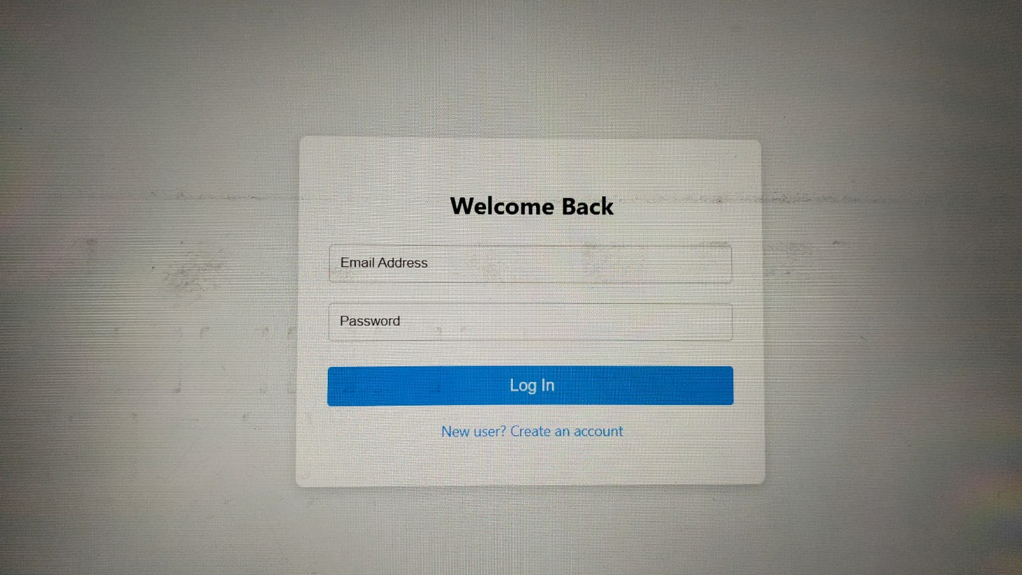
IMPLEMENTATION SCREENSHOTS
.
Login page
Secure user authentication and account creation interface
1
2
3
4
5
6
7
8(A)
9

Slide 11
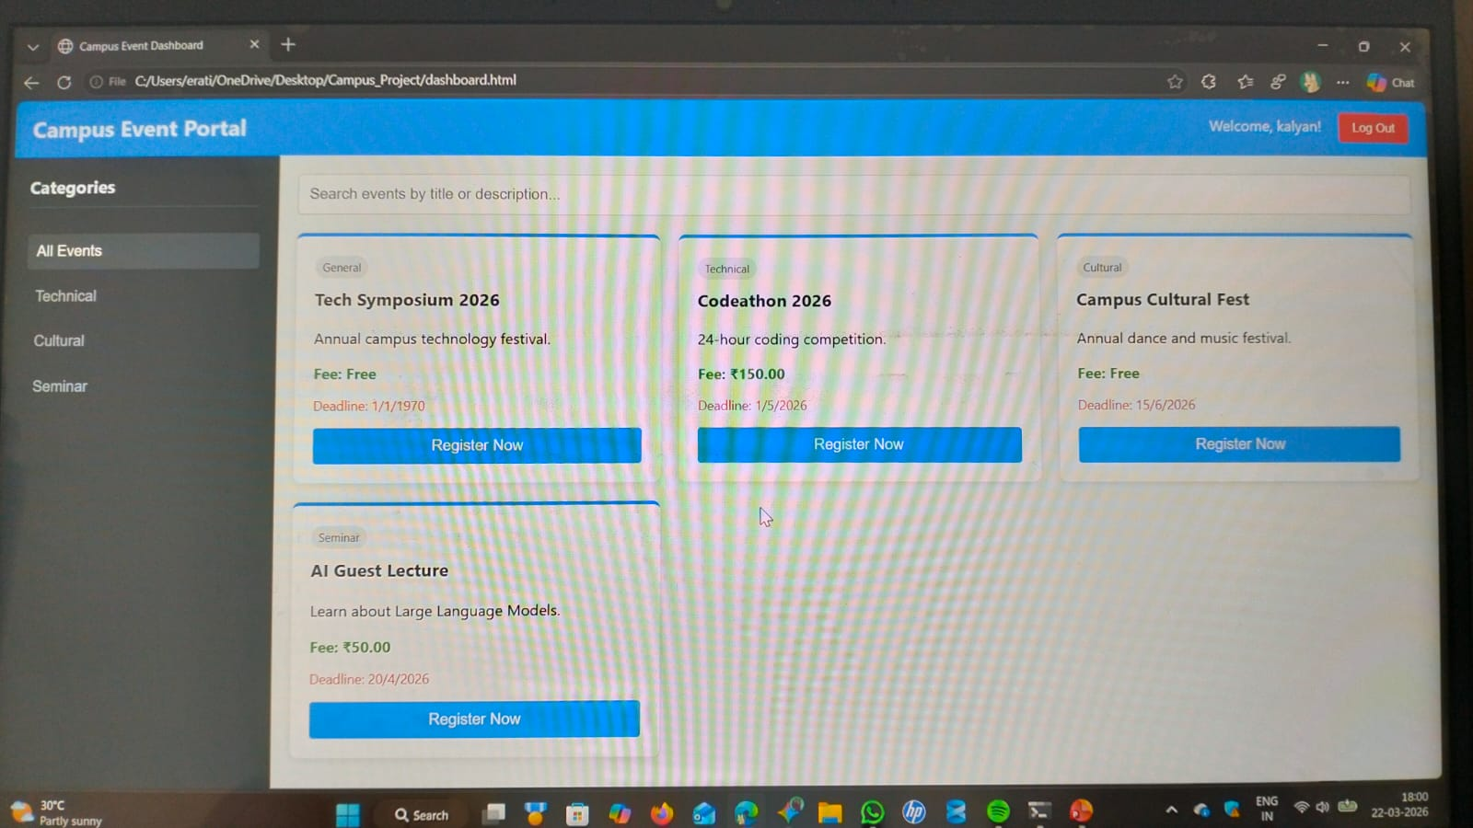
IMPLEMENTATION SCREENSHOTS
Main Dashboard
The dynamic event dashboard featuring category filtering and search capabilities.
1
2
3
4
5
6
7
8(B)
9

Slide 12
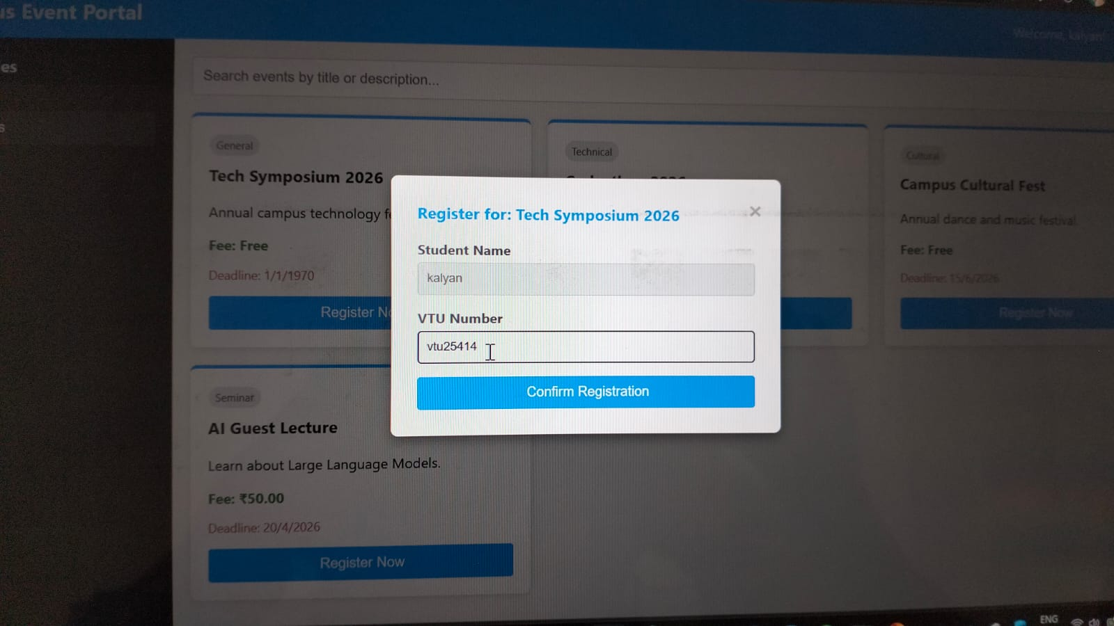
IMPLEMENTATION SCREENSHOTS
Registration Modal
Automated registration modal that auto-fills the logged-in student's details.
1
2
3
4
5
6
7
8
9

Slide 13
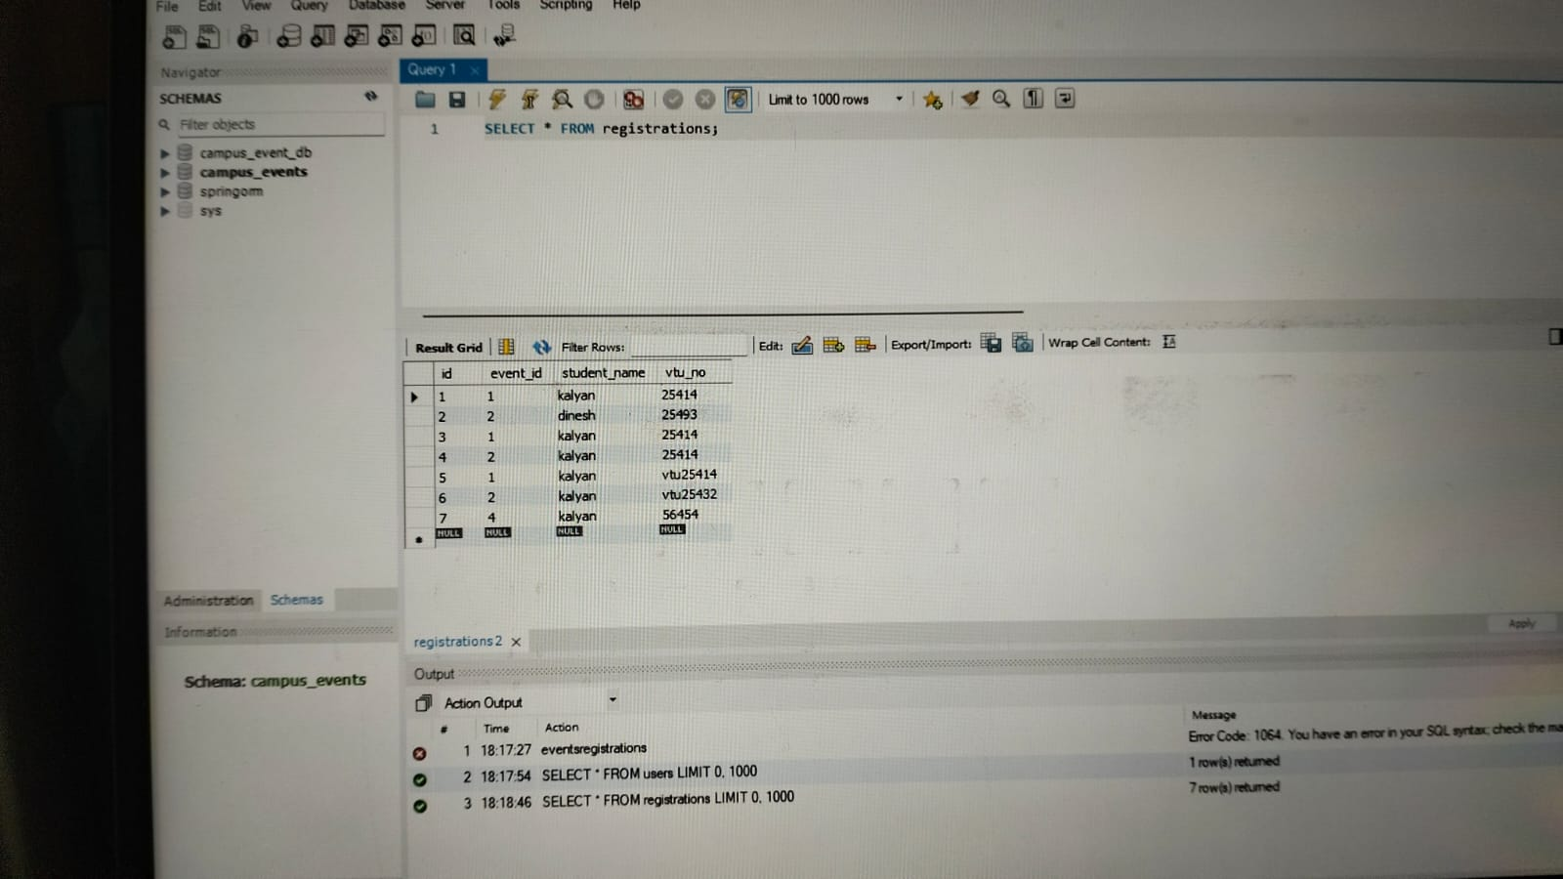
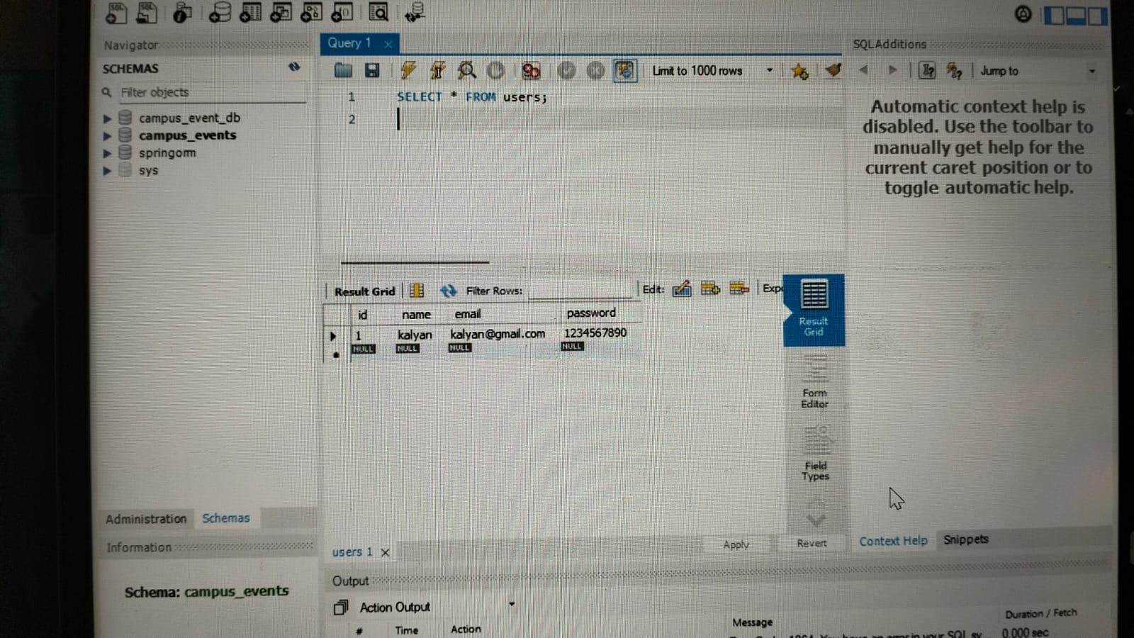
IMPLEMENTATION SCREENSHOTS
Output/Database Page
1
2
3
4
5
6
7
8(C)
9

Slide 14
ADVANTAGES & LIMITATIONS
1
Advantages:
Real-time event updates and paperless registration.
Centralized data access for both students and organizers..
Highly scalable architecture separating the frontend UI from backend data
.
Limitations:
Requires a constant internet connection to function.
Lacks an integrated payment gateway for events that require a fee.
Passwords are currently stored in plain text (can be upgraded with hashing in future iterations).
2
3
4
5
6
7
8
9

Slide 15
Thank you

