Slide 1


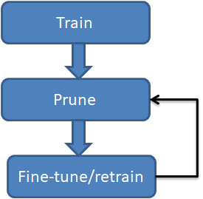
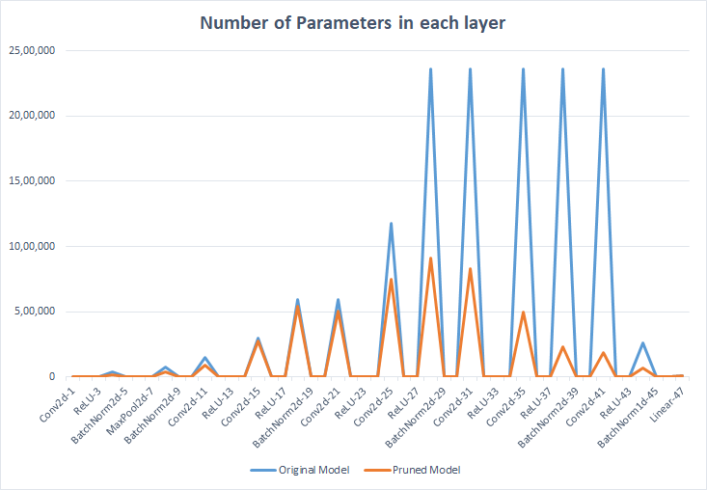
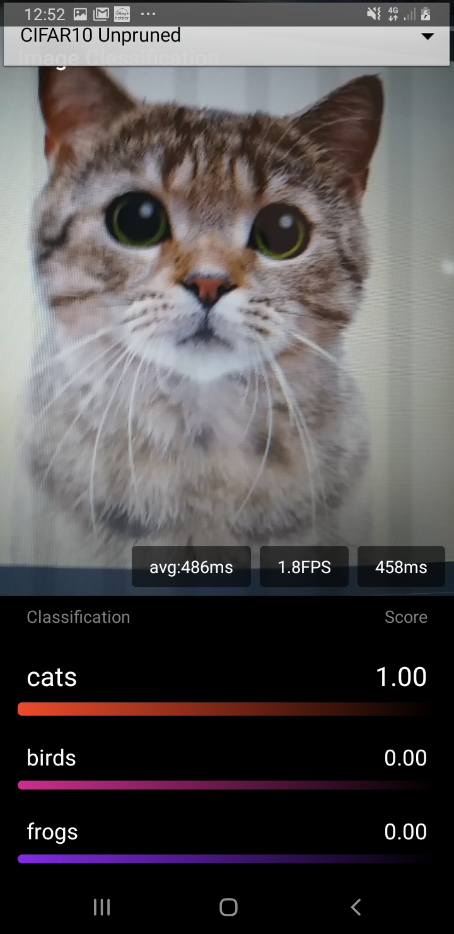
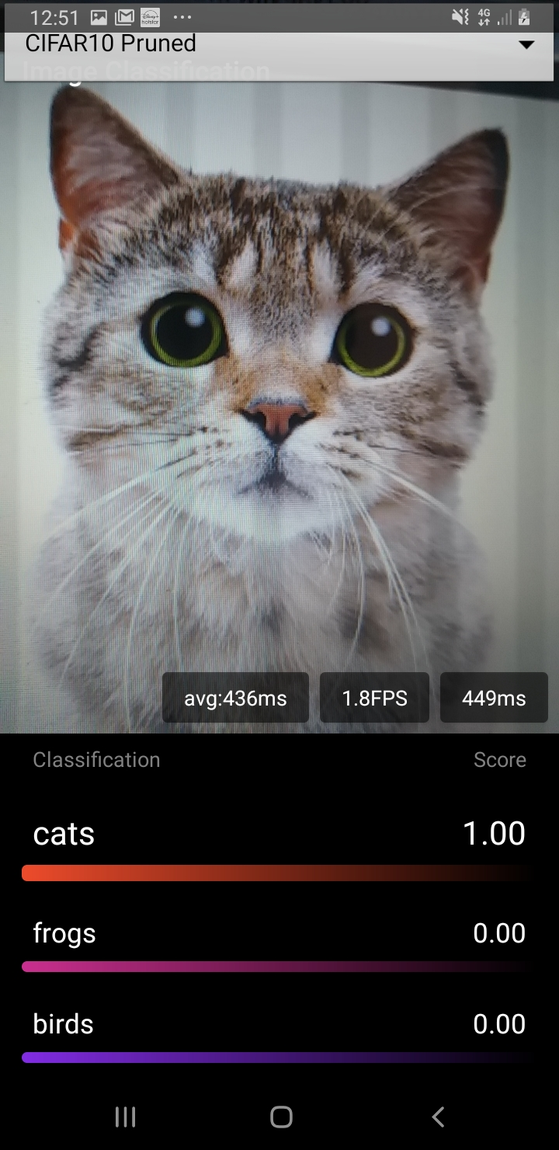
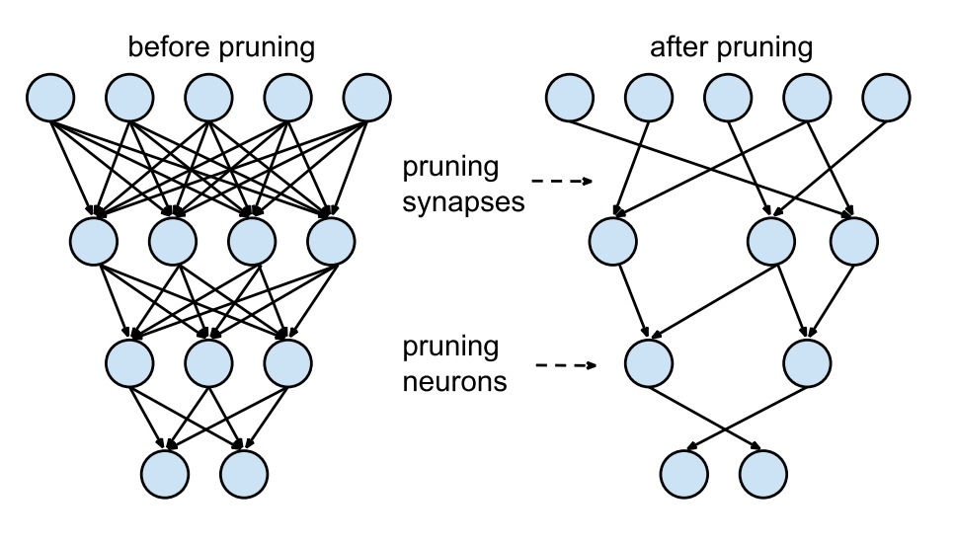

Making Deep neural network's ready for Mobile/Edge devices
Devdatta Khoche,Jinu Lilly Joseph,Jagdeeh K,
Parth Deshmukh ,NSV kalyan
Tejalal Choudhary
Abstract
There is a large difference in size of the serialized models after pruning. The size of the serialized model was decreased by a large amount after pruning.
The comparison of the original and pruned model trained using cifar 10 and cifar for various factors like accuracy drop,the percentage of floating point operations and parameters pruned,deployment accuracy, size of serialized models and average time has been performed.
With the advancements in the recent era of Deep Learning and AI, comes the need of having the state-of-the-art models on the edge devices, without loss in their originality and accuracy. This can be achieved by deploying these models on the cloud and using APIs, but this comes with a great cost of security and speed.
Deep Learning models are becoming larger in size and computationally expensive, with integration of more technologies into them which can’t fit into the frugal memory of edge devices. Deploying the state-of-the-art DNNs in edge devices is limited by the following factors:
— Computational power needed for inference and
— Size of the model itself, hence quite not portable.
We propose the redundant filter pruning method, which removes the redundant filters from each convolutional layer, and thus reduces the size of the model and the computations needed for the inference.
Introduction
The sudden boom in deep learning was acknowledged in the year 2012, which all began with the ALexNet .This 8 layered architecture revolutionized the concepts , fundamentals and the practices of deep learning. Deep learning is used to make or rather say imitate a complex human brain to solve complex problems besides only solving mathematical calculations.
Over the years, research on convolutional neural networks (CNNs) has progressed and increased rapidly, however the real-time deployment of these models in production level is usually limited by computational resources and size constraints. What has also led to extensive research in ConvNets is that the achievement of excellent accuracy on different classification tasks that need understanding abstract concepts in images. CNN are hugely popular due to their architecture — the simplest thing is there's no need for feature extraction. The system learns to do feature extraction and the core concept of CNN is, it uses convolution of image and filters to generate invariant features which are passed onto the next layer. Thanks to these ConvNets which are extremely successful in areas where large, unstructured data is involved, like image classification,Object detection and lots of more.
For this particular paper we would be using CNN which is to be deployed on the edge devices and mobile.
Vgg was introduced after AlexNet which came with improved accuracy and is a very deep neural network.There are many CNNs available, except for this specific paper we might be that specialize in the Vgg. Vgg has differing types of configurations all has its pros and cons,here we'll be going with Vgg16 , it's pretty complex with 13 Conv layers , 5 maxpool layers and three dense layers. Now the question arises “How to deploy models on these frugal devices?”
The core obstacle is the computation power of the edge device and the size of the model . CNNs which are huge usually have a significant redundancy among different filters and feature channels.
A classic CNN consist of 4 parts :-
Conventional layer
Activation operation following each Conventional layer
Pooling layer and other layers
Finally Fully Connected layer
The most important problem to tackle for the deployment is the size and computational power of the edges device. Almost every CNN consists of the many redundant filters thanks to which the computations, size and parameters of the model are overwhelmingly increased, which makes them unsuitable to be used in edge devices. Due to this, the inference time increases as it takes time for the performing an enormous number of floating point operations which is eventually not possible on the edge devices. Most of the floating point operations are carried out in the Conventional layer of the neural network.
In this paper, we focus on reducing the computation cost of well-trained CNNs by pruning filters. Compared to pruning weights across the network, filter pruning is a naturally structured way of pruning without introducing sparsity and therefore does not require using sparse libraries or any specialized hardware. The number of pruned filters correlates and corresponds directly with acceleration by reducing the number of matrix multiplications as well as the MAC operations, which is easy to tune for a target speedup. Also, instead of iteratively fine-tuning the model layer-wise, we adopt a single-shot pruning and finetune strategy to save retraining time for pruning filters across multiple layers. Finally, we observe that for Vgg16, we are able to achieve about 75% of parameter reduction without sacrificing much accuracy.
DATASET | % ACC DROP | % FLOP PRUNED | % PARAMS PRUNED | DEPLOYMENT ACCURACY (ORIG. / PRUNED) | SIZE OF SERIALIZED MODEL(MB) (ORIG. / PRUNED) | AVERAGE TIME(ms) (ORIG. / PRUNED)
CIFAR-10 | 1.16 | 51.64 | 79.55 | 93.66 / 93.69 | 60.09 / 18.93 | 486 / 436
CIFAR-100 | 1.56 | 30.04 | 48.64 | 71.57 / 72.24 | 60.27 / 30.00 | 489 / 431
Proposed Method
For deployment of the deep learning model we need to reduce the computations and the size of the model. For achieving the needful we try to remove redundant filters which almost extract the same output .This unnecessary computation is increases the computations and also increases the parameters.
We can find such similar filter with the help of the unsupervised learning algorithms that is the clustering algorithms .Clustering algorithms will cluster the similar filter filters based on
the similarity metric. Once we have clusters then we can keep one filter form the cluster and remove the rest of the filters or we can check similarity coefficient and then remove such filters.
This directly results in the reduction of the MAC operations as well as in the reduction of the size of the model hence decreasing the computions.
We have successfully pruned the model and deployed it in the mobile .
For our work we have used vgg16 as our CNN and have worked on two datasets : -
CIFAR10
CIFAR100
Clustering helps us in finding the similar filters which can be then removed on the basis of any similarity metric.
Hence this way whe achieve the target easily.
Conclusions
Modern CNNs often have large training and inference costs. In this work we present a method to prune filters with high similarity coefficient to produce CNNs with reduced computation costs without introducing any loss in the accuracy. It achieves about 79% reduction in parameters for VGG (on CIFAR-10) without significant loss in the original accuracy. We have successfully deployed working model on android device.
This pruning can be used to deploy state-of-the-art models, which are often huge, on the edge and mobile devices.
Experimental Results and Discussion
The application includes a dropdown for selecting one model from the four categories of original and pruned models trained using the datasets cifar 10 and cifar 100 respectively. The models are to be serialized before deploying to the android studio. Each model is in turn associated with a constants java class containing the set of classes of both the datasets. Upon selecting a model, the application predicts the top 3 classes as to which the image along with the associated probabilities.
The average time taken for each image is also displayed in the application. It can be inferred from the experiments that the average time taken for the pruned model is less than that of the original model trained for cifar 10 and cifar 100.
References
[1] Han, S., Mao, H., & Dally, W. J. (2015). Deep compression: Compressing deep neural networks with pruning, trained quantization and huffman coding. arXiv preprint arXiv:1510.00149.
[2] Luo, J. H., Wu, J., & Lin, W. (2017). Thinet: A filter level pruning method for deep neural network compression. In Proceedings of the IEEE international conference on computer vision (pp. 5058-5066).
[3] Krizhevsky, A., & Hinton, G. (2009). Learning multiple layers of features from tiny images. CIFAR dataset
[4] Simonyan, K., & Zisserman, A. (2014). Very deep convolutional networks for large-scale image recognition. arXiv preprint arXiv:1409.1556. VGG16
[5] Choudhary, T., Mishra, V., Goswami, A., & Sarangapani, J. (2020). A comprehensive survey on model compression and acceleration. Artificial Intelligence Review, 1-43. REVIEW PAP
Team No. - 3

