Slide 1


Making Deep neural network's ready for Mobile/Edge devices
Team members: Mentor:
Devdatta Khoche Tejalal Choudhary
Jagadeesh K
Jinu Lily Joseph
NSV Kalyan
Parth Deshmukh

Slide 2
Introduction
ConvNets are extremely successful in areas where large, unstructured data is involved, such as image classification,
Object detection and many more.
The computational requirement of CNN is very high, making deployment difficult on edge-devices.
There are two ways to make CNNs edge-devices friendly
Either incresae the device capacity or,
Make CNNs more efficient

Slide 3
Dataset Used
We have worked with two datasets:
CIFAR10 -The CIFAR-10 dataset consists of 60000 32x32 colour images in 10 classes, with 6000 images per class. There are 50000 training images and 10000 test images. The dataset is divided into five training batches and one test batch, each with 10000 images. The test batch contains exactly 1000 randomly-selected images from each class..The size of the dataset is 163 MB.
CIFAR100 - This dataset is just like the CIFAR-10, except it has 100 classes containing 600 images each. There are 500 training images and 100 testing images per class. The 100 classes in the CIFAR-100 are grouped into 20 superclasses. The size of the dataset is 161 MB.

Slide 4
Methodology / Model Used
Reducing computations and the size of the model can be done using quantization, weight-sharing, random pruning, and structured pruning.
We have used structured filter pruning to achieve the objective,which is defined as removal of the redundant filters to reduce computations.
CNN model used (VGG16)
We have worked with other clustering algorithms, like DBscan but the best we found are:-
K Means++ ,
Spherical K Means

Slide 5
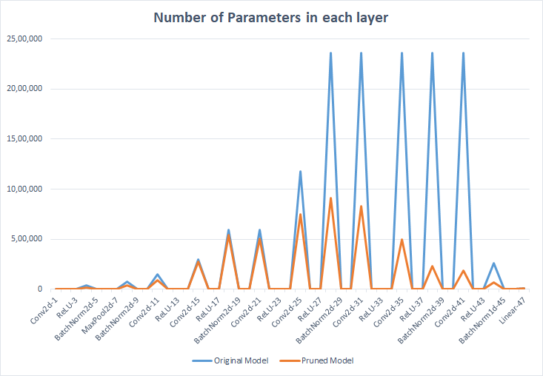
CIFAR10 Parameter comparison

Slide 6
EXPERIMENTATION RESULTS
ON VGG-16 MODEL
DATASET | % ACC DROP | % FLOP PRUNED | % PARAMS PRUNED | DEPLOYMENT ACCURACY (ORIG. / PRUNED) | SIZE OF SERIALIZED MODEL(MB) (ORIG. / PRUNED) | AVERAGE TIME(ms) (ORIG. / PRUNED)
CIFAR-10 | 0.54 | 43.26 | 75.61 | 93.66 / 93.69 | 60.09 / 18.93 | 486 / 436
CIFAR-100 | 0.96 | 21.97 | 45.82 | 71.57 / 72.24 | 60.27 / 30.00 | 489 / 431

Slide 7
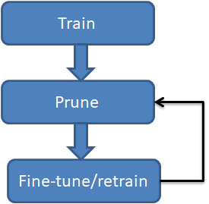
Methodology cont...
Models are deployed on mobile devices for comparisons
After pruning, we created the serialized models(.pt) of both the original and pruned models.
Application includes a drop down containing the original and pruned models of CIFAR10 and CIFAR100 respectively.
For each model selected, it displays the top 3 classes along with the associated probabilities.

Slide 8
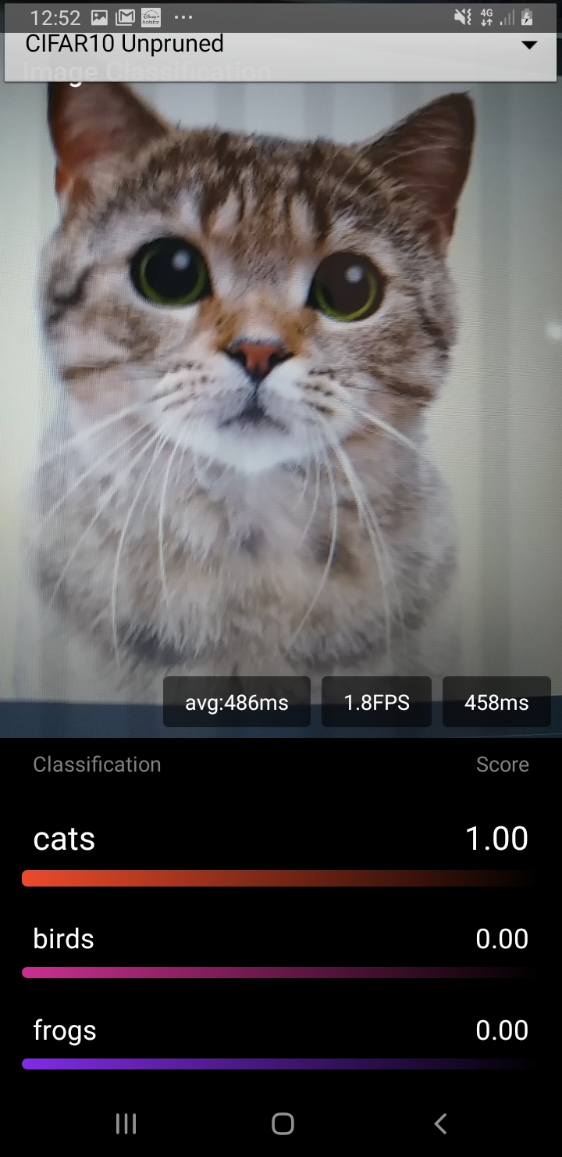
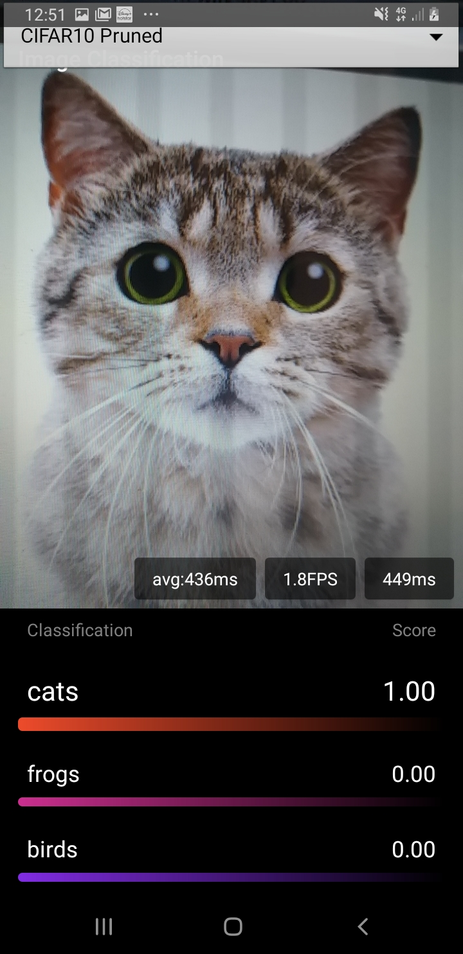
Screenshots
Original —->
Model
←— Pruned
Mode l

Slide 9
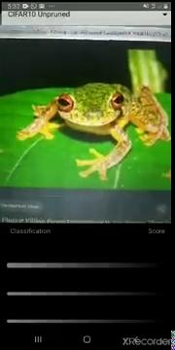
Screenshots

Slide 10
Conclusion
Modern CNNs often have large training and inference costs.
In this work we present a method to prune filters with high similarity coefficient to produce CNNs with reduced computation costs without introducing much loss in the accuracy.
It achieves about 79% reduction in parameters for VGG (on CIFAR-10) without significant loss in the original accuracy.
We have successfully deployed working model on android device.

Slide 11
References
[1] Han, S., Mao, H., & Dally, W. J. (2015). Deep compression: Compressing deep neural networks with pruning, trained quantization and huffman coding. arXiv preprint arXiv:1510.00149. [2] Luo, J. H., Wu, J., & Lin, W. (2017). Thinet: A filter level pruning method for deep neural network compression. In Proceedings of the IEEE international conference on computer vision (pp. 5058-5066). [3] Krizhevsky, A., & Hinton, G. (2009). Learning multiple layers of features from tiny images. CIFAR dataset [4] Simonyan, K., & Zisserman, A. (2014). Very deep convolutional networks for large-scale image recognition. arXiv preprint arXiv:1409.1556. VGG16 [5] Choudhary, T., Mishra, V., Goswami, A., & Sarangapani, J. (2020). A comprehensive survey on model compression and acceleration. Artificial Intelligence Review, 1-43. REVIEW PAPER

Slide 12
Thank You

