Slide 1
Human Face Recognition Using Convolutional Neural Networks and Augmented Dataset
Batch No- 1
Team Members:
N.Srikanth
Y18CS124
N.Sai Kiran
Y18CS125
Project Guide:
Sri R. MabuBasha
Assistant Professor
Department of CSE
R.V.R & J.C college of engineering
1

Slide 2
Abstract:
Face recognition plays an important role in day to day life, national security, solution for most of the security issues we had encountered before and many more.
We use convolutional neural networks(CNN) and augmented data set for face recognition.
Traditional convolutional neural network models has an average accuracy of 86.68% and under fitting or over fitting prone.
By using convolutinal neural network with augmented data set we can increase accuracy of our model and reduce the under fitting and over fitting problems.
2

Slide 3
Objectives:
Achieving high accuracy in face recognition using convolutional neural network and augmented data set.
Reducing the training and validation losses.
Over coming the under fitting and over fitting problems.
3

Slide 4
Introduction:
Face Recognition is a recognition technique used to detect faces in a photograph and recognising the individual through trained models.
Despite the point that other methods of identification can be more accurate, face recognition has always remained a significant focus of research because of its non-meddling nature and because it is people’s facile method of personal identification.
Covolutional neural networks(CNN) is a deep learning model.
CNN is a very popular algorithm to work on images classification and image processing, like object detection, face detection, posture detection and many more.
4

Slide 5

Generally neural networks performs matrix multiplication to get appropriate result, but in CNN we use a mathematical technique called convolution.
There are several layers in a CNN some are input layer, convo layer(convolution + RelU), pooling layer, flatten layer, fully connected layer, softmax layer, and output layer.
5

Slide 6
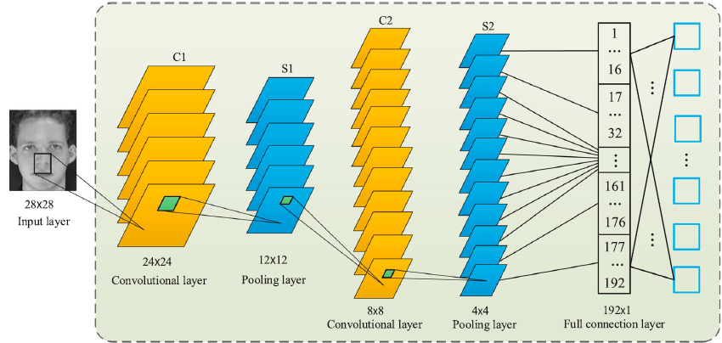

Slide 7
The developed CNN is composed of two convolutional layers (C1 and C2) and two pooling layers (S1 and S2). These layers are arranged alternately in the form of C1-S1-C2-S2
There is only one featuremap in the input layer, which is used to put the normalized face image into the CNN model.
C1 is the first convolutional layer that includes 6 feature maps, in which each neuron is convoluted with a randomly generated convolution kernel with size of 5 × 5. S1 is the first pooling layer, whose output is 6 feature maps calculated based on the output of previous layer.

Slide 8
Each element in the feature map is connected with the mean convolution kernel of the corresponding feature map in C1 layer, and the receptive fields of the elementswill
not overlapped with each other.
C2 and S2 are, respectively, the second convolutional layer and pooling layer, both of which have 12 feature maps and similar calculation steps with their previous counterparts.
Moreover, a fully connected single-layer perceptron is placed between the S2 layer and the output layer.

Slide 9
Image data augmentation is a technique that can be used to artificially expand the size of a training dataset by creating modified versions of images in the dataset.
Image data augmentation is used to expand the training dataset in order to improve the performance and ability of the model to generalize.
9

Slide 10
Steps involved:
Image Source
Data Augmentation
Face Detection
Face Normalization/
Alignment
Feature Extraction
Feature Matching & Recognition
10

Slide 11
Problem Statement:
Nowadays face recognition has a wide range of applications, as the applications increase the accuracy of the face recognition models plays an important role.
These models are build using ML algorithms like decision trees and random forest, Artificial Neural Networks, Convolutional Neural Network and other algorithms.
To train these models, we need a large set of training data to obtain a model with high accuracy which may not be possible at every situation.
To over come these drawbacks we choose the convolutional neural network with augmented data set.
11

Slide 12

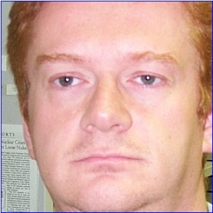
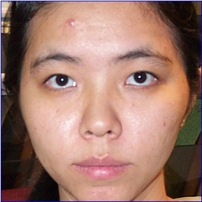
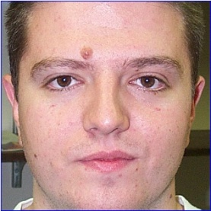
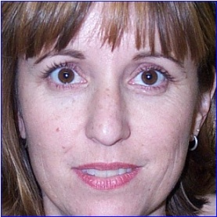
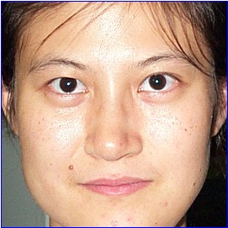
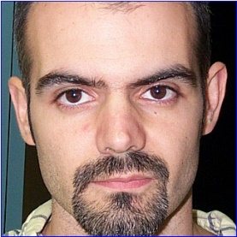
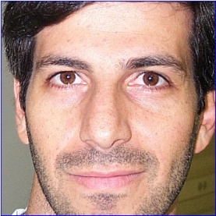
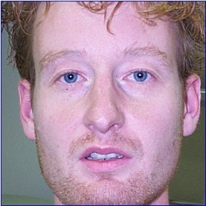
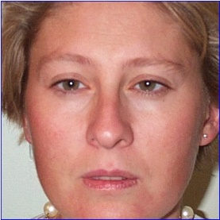
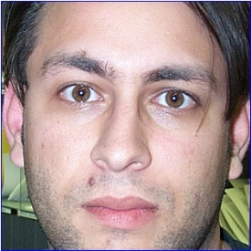

Sample face image:
Data_set : face-images
Total Images : 244
Source: Internet
12

Slide 13
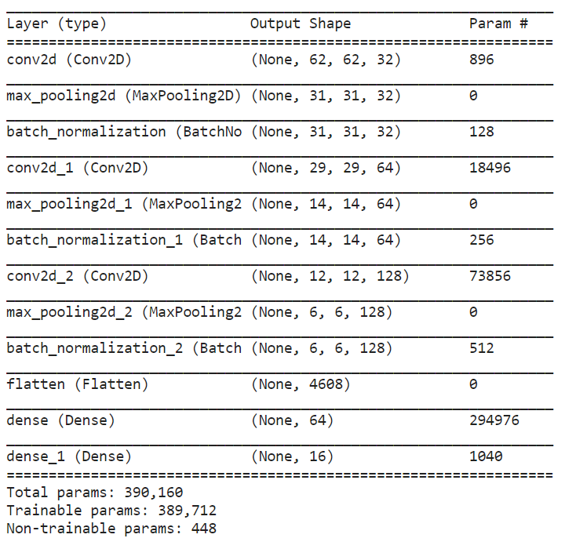
Summary of CNN model:
13

Slide 14
Variation of accuracy with different parameters:
Epochs
The number of epochs is a hyperparameter that defines the number times that the learning algorithm will work through the entire training dataset.
One epoch means that each sample in the training dataset has had an opportunity to update the internal model parameters.
Steps per epoch
Steps_per_epoch is number of batches to train. It is used to define how many batches of samples to use in one epoch.
14

Slide 15
Image Augmentation:
Image augmentation is a technique of altering the existing data to synthesis some more data for the model training process.
There are many techniques for augmentation, some of them are:
Rotation
Flipping
Blurring
Noise Addition
Random Erasing
Random Bightness Contrast and many more….
15

Slide 16
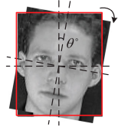
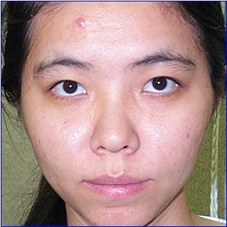
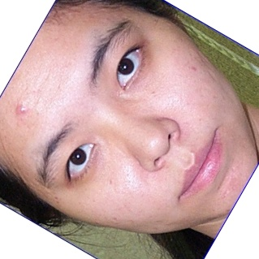
Rotation:
We rotate the original image by an arbitrary angle, as the object or person will not be changed even if we rotate the original image.
By doing this operation on our dataset we can over come the over fitting of model due to orientation of face / object.
Rotation
16

Slide 17

17

Slide 18
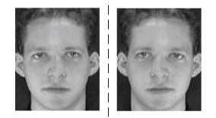
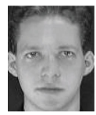
Flipping:
This flipping can be vertical or horizontal.
Vertical flipping in this all the pixel rows and columns are vertically flipped.
Horizontal flipping in this all the pixel rows and columns are horizontally flipped.
Horizontal flip
Vertical flip
18

Slide 19


Slide 20
Blurring:
Some of the conditions which cause bluring in real life :
A camera is stationary, but objects it is detecting are often moving; e.g. a camera is watching traffic
A camera is moving, but objects it is detecting are stationary.
A camera and its objects its detecting are moving.
So, to take over these we train our model with augmented images that are blurred with differet intensities.

Slide 21



Slide 22
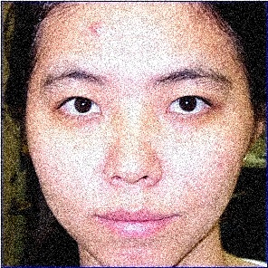
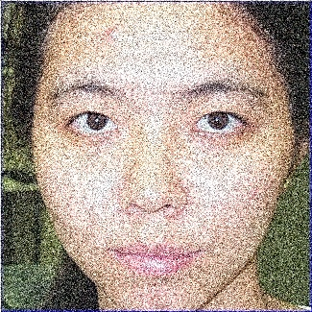
Noise Addition:
Noise that is being added due to hardware used or due to low resolution camera will cause the following problems.
Noise can reduce the accuracy of neural networks.
Noise can lead to less generalization power when testing on real-world data.
By training the model with noisy data we can improve the accuracy of the model.
22

Slide 23
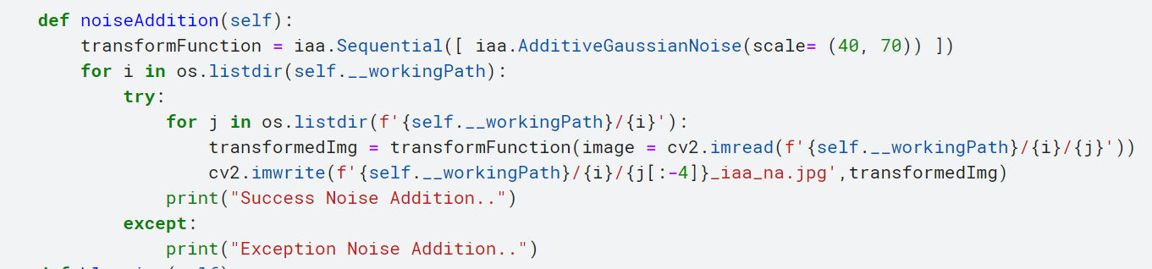
23

Slide 24

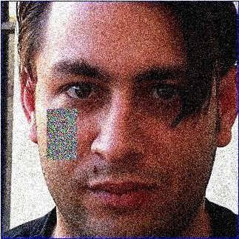
Random Erasing:
Random Erasing is proposed to randomly select a rectangle region in an image and erases its pixels with random values.
This reduces the risk of overfitting and makes the model robust to occlusion.
24

Slide 25

25

Slide 26
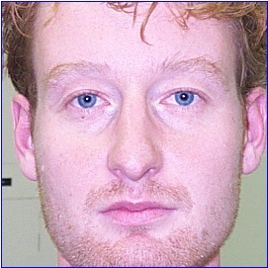
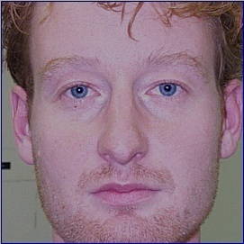


Random Brightness Contrast:
Contrast describes tones, specifically the relationship between the darkest and brightest parts of an image.
This helps us in generating training our model for different conditions like high or low light and helps us in generalising the model.
Original
Augmented
Original
Augmented
26

Slide 27

27

Slide 28
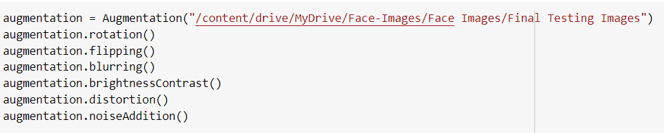
Driver Code
28

Slide 29
Data Synthesis Analysis:
Let us consider the number of images in original dataset be “ n ”.
In each step of Augmentation we can generate “ n ” new images(data).
Our data set consist of 244 images of 16 classes.
After rotation it will be 488.
After random brightness contrast it will be 976.
After random erasing it will be 1952.
After noiseaddition it will be 3904 and so on....
Augmented dataset size is 15616 we had successfully generated 15372 images from the existing dataset of 244 images.
The Augmented dataset is 64 times greater than the original dataset.
29

Slide 30
Summary :
Accuracy of CNN model depends on the hyper parameters like epochs, steps per epochs, strides e.t.c
One should be careful while selecting hyper parameters even though by increasing a parameters may lead to increase or decrease in parameters may lead to decrease in accuracy this might lead to over fitting.
Hyper parameters plays a crucial role in how our model works.
30

Slide 31
Summary :
Augmentation helps in overcoming the problem of under fitting due to less number of training dataset.
Different Augmentation techniques helps us in overcoming the overfitting problem of different conditions.
We had generated a 64 times greater dataset than the original dataset.
31

Slide 32
References:
[1] Peng Lu , Baoye Song & Lin Xu (2020): Human face recognition based on convolutional neural network and augmented dataset, Systems Science & Control Engineering, DOI: 10.1080/21642583.2020.1836526
[2] Peng, X., Ma, J., Liu, Y., He, J., Wang, W., & Wang, Y. (2019). Research on Face Recognition Based on Small Samples of CNN. 2019 IEEE International Conference on Electron Devices and Solid-State Circuits (EDSSC). doi:10.1109/edssc.2019.8754183
[3] Kim, Y., Uddin, A. F. M. S., & Bae, S.-H. (2021). Local Augment: Utilizing Local Bias Property of Convolutional Neural Networks for Data Augmentation. IEEE Access, 9, 15191–15199. doi:10.1109/access.2021.3050758
[4] Kutlugün, M. A., Şirin, Y., & Karakaya, M. A. (2019). The Effects of Augmented Training Dataset on Performance of Convolutional Neural Networks in Face Recognition System. Proceedings of the 2019 Federated Conference on Computer Science and Information Systems. doi:10.15439/2019f181
32

Slide 33

33

