Slide 1
Emotion Recognition by Textual Tweets Classification Using Voting Classifier (LR-SGD)
Guide : Mr. M. Srikanth ,
Associate Professor
P.Naveen Kumar(Y18CS131)
N.Deepak(Y18CS122)
P.Revanth(Y18CS141)

Slide 2
Abstract
The proliferation of user-generated content on social media has made opinion mining an arduous job. As a microblogging platform,Twitter is being used to collect views about products, trends, and politics. Sentiment analysis is a technique used to analyze the attitude, emotions and opinions of different people towards anything, and it can be carried out on tweets to analyze public opinion on news, policies, social movements, and personalities. By employing Machine Learning models, opinion mining can be performed without reading tweets manually. Their results could assist governments and businesses in rolling out policies, products, and events. Seven Machine Learning models are implemented for emotion recognition by classifying tweets as happy or unhappy. With an in-depth comparative performance analysis.

Slide 3
Existing System
Sentiment analysis is applied on Twitter dataset and its conclusions.
The distinct approaches and conclusions of algorithm performance were compared.
Lexicon based approaches have been explored by many researchers for emotion classification.
Previously emotion-based feature extraction using domain specific lexicon generation. They captured association of words and emotions using a unigram mixture model.

Slide 4
Proposed System
models for emotion recognition by tweet classification using Tf and TF-IDF. This research presents a voting classifier (LR-SGD) and aims to estimate the performance of famous ML classifiers on twitter datasets
Machine learning-based classifiers including support vector machine (SVM), Decision Tree Classifier (DTC), Naive Bayes (NB), Random Forest (RF), Gradient Boosting Machine (GBM) and Logistic Regression (LR) trained on Twitter dataset are compared for emotion recognition.
• A voting classifier (VC) designed to classify tweets which combines LR and SGD and outperformed using TF-IDF
The proposed model stability is further validated by applying it on two different datasets, one binary dataset (containing hatred or non-hatred classes) and other multi-class dataset (containing product reviews having 1 to 5 ratings)

Slide 5
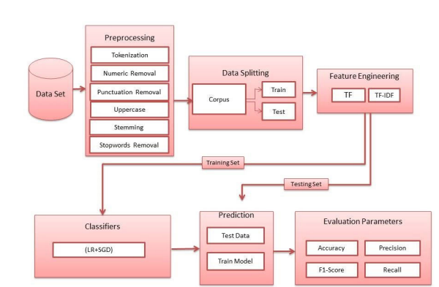

Slide 6
Descriptions of Methods
This work utilized five supervised machine learning algorithms:
Random Forest (RF)
Support Vector Machines (SVM)
Naive Bayes (NB)
Decision Tree (DT)
Voting Classifier(Logistic Regression + Stochastic Gradient Descent classifier).

Slide 7
Random Forest
RF is a tree based classifier in which input vector generated trees randomly. RF uses random features, to create multiple decision trees, to make a forest. Then class labels of test data are predicted by aggregating voting of all trees. Higher weights are assigned to the decision trees with low value error. Overall prediction accuracy is improved by considering trees with low error rate.

Slide 8
Support Vector Machine
The Support vector machine (SVM) is understood that executes properly as sentiment analysis.
SVM typifies preference, confines and makes usage of the mechanisms for the assessment and examines records.
The goal of the SVM algorithm is to create the best line or decision boundary that can segregate n-dimensional space into classes so that we can easily put the new data point in the correct category in the future.
Support-vector machines in machine learning includes focused learning models connected to learning evaluations which inspect material that is exploited to categorize, also revert inspection.

Slide 9
Naive Bayes
In machine learning, Naive Bayes classifiers are a gathering of essential "probabilistic classifiers" considering applying Bayes’ speculation with gullible opportunity assumptions between the features.
They are considered as the minimum problematic Bayesian network models.

Slide 10
Decision Tree
DT algorithm is the category of supervised ML and is being widely used in regression and classification tasks. Selection of root node of a tree of each level is its main challenge which is called as attribute selection.
In this , Gini index is used to find probability of root node by calculating sum of squares of attribute values and then subtracted by 1.

Slide 11
Voting Classifier
Voting Classifier(VC) is a cooperative learning which engages multiple individual classifiers and combines their predictions, which could attain better performance than a single classifier
The VC is a meta-classifier for joining tantamount or hypothetically exceptional ML classifiers for order through greater part throwing a voting form.
LOGISTIC REGRESSION
STOCHASTIC GRADIENT DESCENT

Slide 12
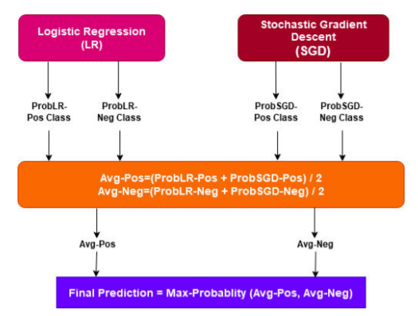
Proposed voting classifier architecture (LR-SGD)

Slide 13
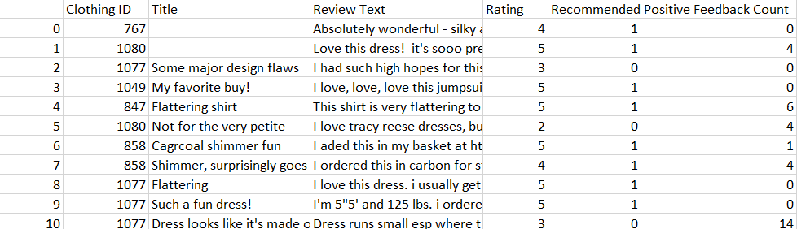
Data set

Slide 14


