Slide 1
Comparing Prediction Performance for Crash Injury Severity Among Various Machine Learning and Statistical Methods
Guided by- p. Rama Krishna Batch no- 11
P. Lakshmi Gouthami
P. Himaja
P. Lavanya

Slide 2
ABSTRACT
Crash injury severity prediction is a promising research target in traffic safety.
Traditionally, various statistical methods were used for modeling crash injury severities.
In recent years, machine learning based methods are becoming popular due to their good predictive performance.

Slide 3
The aim is focused at comparing the predictive performance, including prediction accuracy and estimation of variable importance, among various machine learning and statistical methods with distinct modeling logic for crash severity analysis.
The correct prediction rate for each crash severity level and the overall correct prediction rate were calculated.
The Main task is:
Comparison of prediction accuracy of six methods including the K-Nearest Neighbor (KNN), Decision Tree (DT), RF, SVM, OP and MNL in predicting each crash severity

Slide 4
INTRODUCTION
Crash injury severity modeling is of great interest to many traffic safety researchers.
Crash severity models can predict the severity that may be expected to occur for a crash, which helps hospitals provide proper medical care as fast as possible.
In addition, studies on crash injury severity can also help better understand what factors contribute to injury severity once a crash occurred which helps reduce crash severity and improve road safety.

Slide 5
Crash severities are usually measured by several discrete categories which are fatal, incapacitating injury, non-incapacitating injury, possible injury, and property damage only.
Traditionally, the most commonly used methods for crash injury severity analysis are statistical models.
Statistical models have advantages that they output clear formulas between dependent and explanatory variables and the results are easy to interpret.
But, statistical models have some limitations. For example, statistical modeling technique requires assumption about the distribution of data, and a linear function is used to link the dependent variable to explanatory variables.

Slide 6
To overcome the limitation of statistical models, previous studies have applied machine learning methods for crash injury severity prediction.
Machine learning models do not contain pre-assumed relationships between variables. Thus, machine learning methods have been reported to produce better fitting than statistical methods.
A major limitation associated with the aforementioned machine learning methods is that they generally work like a black-box, which does not directly report the correlation between crash injury severity and explanatory variables.

Slide 7
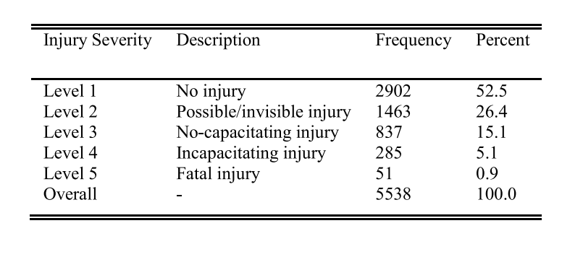
DATASET
Three-year crash data were collected at the segments of interests. A total of 5538 crashes were used for the analysis.
The injury severity data includes five levels:

Slide 8
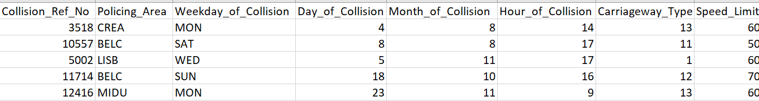
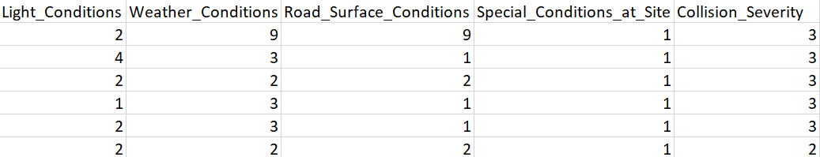

Slide 9
METHODS
Machine Learning Methods:
KNN
Decision Tree
Random Forest
Support Vector Machine
Statistical Methods:
OP Model
MNL Model

Slide 10
The four Machine Learning models are supervised learning in nature which treat crash injury severity modeling as a classification problem: the crashes are classified into different categories according to their severity level.
The machine learning models need to be trained by the labeled dataset, and then can predict the injury severity given the crash attributes.
In the two statistical models, the OP model treats crash injury severity as an ordinal variable and estimates the relationships between injury severity and explanatory factors.
The MNL model treats crash injury severity as a category variable without recognizing the ordinal feature of injury severity, but allows each severity level change independently.

Slide 11
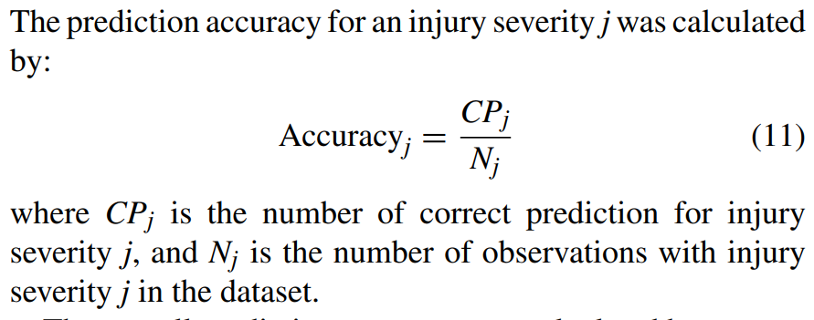
Ten experiments with differently sampled training and testing datasets will be conducted to reduce the bias associated with random separation of datasets.
For the five-level classification task, the accuracy of prediction is the most important indicator for the predicting performance.
The mean classification accuracy of ten estimates and the standard deviation will be considered for comparison analysis.

Slide 12
CONCLUSION
Focusses on the comparison of the predictive performance for crash injury severity between various machine learning and statistical models with distinct modeling logic.
Based on crash data collected at freeway diverge areas, the models were developed for predicting the injury severity associated with each crash.
The predicting accuracy of each model on the training set and testing set was calculated and compared.

Slide 13
THANK YOU

