Slide 1
Classification of Poetry Text Into the Emotional States Using Deep Learning Technique
GUIDE : SMT.M.VASAVI G Batch - 12
P.TARUNI(Y18CS134)
P.VEENA(Y18CS145)
N.MOUNIKA(Y18CS123)
u

Slide 2
CONTENTS
Abstract
Introduction
Existing Methods
System Overview
System Architecture
Dataset
Conclusion

Slide 3
ABSTRACT
The classification of emotional states from poetry or formal text has received less attention by the experts of computational intelligence in recent times as compared to informal textual content like SMS,email, chat, and online user reviews.
In this study, an emotional state classification system for poetry text is proposed using the latest and cutting edge technology of Artificial Intelligence, called Deep Learning.
For this purpose, an attention-based Bi-LSTM model is implemented on the poetry corpus.
The proposed approach classifies the text of poetry into different emotional states, like love, joy, hope, sadness, anger, etc.

Slide 4
Contd…
The proposed approach classifies the text of poetry into different emotional states, like love, joy, hope, sadness, anger, etc.
Different experiments are conducted to evaluate the efficiency of the proposed system as compared to other state-of-art methods as well as machine learning and deep learning methods.
Experimental results depict that the proposed model outperformed the baselines studies with best accuracy. Furthermore, the analysis of the statistical experiment also validates the performance of the proposed approach.

Slide 5
INTRODUCTION
The classification of opinions, sentiments and emotional states has gained the attention of experts from different fields like natural language processing, computational linguistics and computational intelligence.
There are two types of writings that can be analyzed by machine: formal and informal. The formal textual content pertains to poetry, novels, essays, novel, plays, and official/legal documentation,whereas the informal textual content is about SMS, chat, and social media posts.
Due to complex nature of the formal text (poetry), detection and classification of emotional states is a challenging task. For instance, the verse ‘‘And the sunlight clasps the earth, And the moonbeams kiss the sea:’’, taken from the poem ‘‘Love Philosophy’’ (Shelley) conveys a love emotion. The manual strategy for detecting emotional states expressed by the poet in the poetry text is difficult and time-consuming.

Slide 6
Contd…
The existing studies on the detection of emotional states from poetry text have used traditional machine learning techniques with limited datasets tagged with a small number of emotion classes.
One of the study conducted on emotion classification from poetry text has used one machine learning classifier, namely Support Vector Machine (SVM) and a BiLSTM classifier, for classifying poetry text into two emotion classes.
This gap can be bridged by investigating Attention-based C-BiLSTM model, which can take advantage of both the Convolutional Neural Network (CNN), Bidirectional Long Short Term Memory (BiLSTM), as well as, we also exploited the Attention mechanism of deep learning.

Slide 7
EXISTING METHODS
Some of the existing methods are:
Naïve-Bayes
Random Forest
Linear Support Vector Machine
Disadvantages in existing methods are:
Low accuracy
Time consuming
High complexities

Slide 8
PROPOSED METHOD
In our proposed model, we have created a system that which classifies the emotional states of the text by using the deep learning based Bi-LSTM. The proposed approach classifies the text into different emotional states, like neutral, joy, fear, sadness, anger, etc.
Advantages of Proposed Method:
High accuracy
Time Saving
Low complexities
High reliability

Slide 9
SYSTEM OVERVIEW
There are 7 major steps in building the proposed deep learning model for emotion classification from the given poetry text. This is accomplished by constructing a multi-label classification model i.e. 5 emotion classes.
The proposed system is composed of multiple modules
i) Data Acquisition
ii) Preprocessing
iii) Feature representations,
iv) Feature extraction
v) Feature encoding
vi) Context information generation
vi) classification

Slide 10
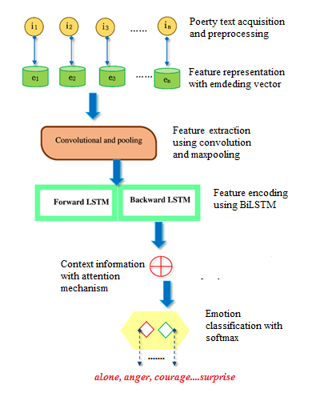
Overview of the proposed system

Slide 11
SYSTEM OVERVIEW(Cont.)
DATA ACQUISITION : To train a deep learning model one of the most important steps is to collect the data. For this purpose, we have used the poetry dataset which consists of 9142 posts.
PREPROCESSING : To implement the deep learning model, the next step is to ransform the words into numbers. So some of the basic preprocessing steps such as stop-words removal, conversion to lowercase, and tokenization, are performed. After tokenization, a vocabulary is built which transforms the sequences of words into the sequences of integers, where each integer represents a specific word in a vocabulary.

Slide 12
Contd..
3) FEATURE REPRESENTATION : To enable the model to learn, each word is further transformed into an embedding vector by using the Keras embedding layer .
4) FEATURE EXTRACTION : In this module, the proposed model extracts the n-gram features from the input received from the previous embedding layer.
5) FEATURE ENCODING : A Bidirectional LSTM model is used in the proposed system to capture both the backward and forward dependencies of a word.

Slide 13
Contd..
6) CONTEXT INFORMATION : To make the system capable of retaining contextual information, we exploited the attention mechanism in the proposed model. Using this capability, the system can understand,which tokens are useful. The attention mechanism determines which words to focus on the most, by considering only the most relevant input feature and removing the unnecessary or irrelevant information from the input feature.
7) CLASSIFICATION LAYER : The final step is to apply the softmax function, implemented in CNN architecture so that the given input text is classified into one of the 5 emotion types.

Slide 14
SYSTEM ARCHITECTURE
The proposed architecture for emotion classification in poetry text, is composed of seven layers, described as follows:
i) Embedding layer
ii) Convolution layer
iii) Maxpooling layer
iv) BiLSTM layer
v) Attention layer
vi) classification layer

Slide 15
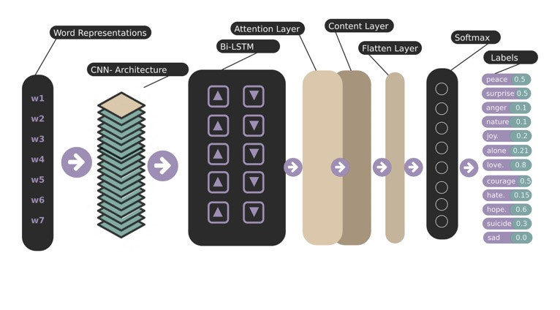
Proposed system architecture

Slide 16
Contd..
1) EMBEDDING LAYER :
There are two main problems that occur in conventional word representations (one-hot vector): losing words order along with high dimensionality. In comparison to one hot representation, the word embedding is more powerful and suitable . So this work utilizes the word embedding representation scheme. Take a text t with a n length of words(tokens), each word is mapped to its corresponding word embedding e.Now, the sentence matrix is further sent to the Convolutional layers.
Two Operations are performed by the CNN layer: Convolution and Maxpooling, to extract the features.

Slide 17
Contd..
2) CONVOLUTION OPERATION :
The convolutional layer involves a convolutional operation ‘‘∗’’, between a poetry text matrix S ∈ Rdxn and a filter matrix F ∈ Rmxk , which results in an output matrix O,known as feature map. For instance, the feature map is learned as follows:
where the bias vector is the b, the weight matrix is W and f represents the nonlinear activation function of the convolutional operation. We used Relu (Rectified nonlinear activation function) as a non-linear activation function because it speeds up the training and produces significantly better results .

Slide 18

Contd..
3) MAXPOOLING OPERATION : The output of the Convolutional layer is now passed on to the pooling layer. This layer aims to further reduce the representation by choosing the maximum value from the pool
of numbers, Thereby, discarding the unnecessary information. The pooling operation is formulated as:
4) BIDIRECTIONAL LSTM LAYER : To achieve exact predictions, it is necessary that the model should learn the long term dependency in text data.The convolutional layer lacks this capability Therefore, to include this functionality to the proposed model,we applied BiLSTM. BiLSTM allows the model to learn data from both right to left and left to right directions. Hence BiLSTM improves the classification accuracy.

Slide 19

Contd..
5) ATTENTION LAYER : Inside a sentence, there are some words, which are irrelevant, while others are decisive. To attend such informative words, the attention mechanism is introduced. Therefore, we added this layer to automatically mine the significant words.
6) FLATTEN LAYER : To transform the context matrix obtained from the previous layer into a context vector, and to prepare the input for the final classification layer, we applied the flatten layer [29]. The flatten layer operation is performed using the below eq.

Slide 20

Contd..
7) OUTPUT LAYER :
It is the final layer of our architecture that determines, either the emotion expressed in poetry text is anger, love,joy,sadness,fear and neutral. A function of softmax activation receives the output of the flatten layer and computes the probability of the emotion class label. It is computed as follows:

Slide 21
EXPERIMENTAL SETTING AND DATASET
To train our suggested model, we divide the dataset into two parts
Train data
Test data
1) Train data : We have utilized 70% of the data for training set through which the model learns and is used to fit the model. It contains both the class label and input.

Slide 22
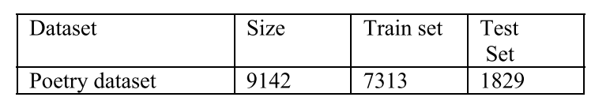
EXPERIMENTAL SETTING AND DATASET(Cont..)
2) Test data : To evaluate the results of the model on the unseen data. we have applied 30% of the dataset as testing data . When the model is completely trained, then the test
set is used. It includes only the input. The description of the
dataset is below.

Slide 23
CONCLUSION
To categorize English poetry text within multiple emotion classes, we have exploited a deep learning technique namely, Attention-based C-BiLSTM model.
For experimentation, a benchmark dataset is used with an extension into the emotion classes: anger,love,hope etc. along with their respective poems. Then this dataset is passed through the following modules, i) Data Acquisition, ii) PreProcessing, iii) Feature representation, iv) Feature extraction v) Feature encoding, vi) Context information generation, and vii) classification.
The proposed model outperformed all the models and performs best in terms of accuracy.

Slide 24


