Slide 1

Friendogram Guide: Dr. M. Sreelatha
Presented By :- Batch no:16
P.Poorna Saiteja(Y18CS140)
P.S.V.Tarun Kumar(Y18CS128)
SK.Davood Rabbani(Y18CS153)

Slide 2
INDEX
What is Friendogram
Features of the application
Technologies used
Implementation

Slide 3

What is Friendogram

Slide 4
It acts like a social media platform for sharing photos and videos.
It can be accessible via any internet connected devices.
It has a vast array of features like uploading photo .
Users can interact with content via like a user’s photo.

Slide 5
Features
Login, Register the new user account.
Follow, Unfollow, Profile views.
Post Images.
Explore user profiles.

Slide 6
Like posts of users.
View user feed.

Slide 7
Technologies Used
React Native.
NodeJs.
Redux.
React Navigation.
ES7 Pluggin.
Expo.
Firebase.

Slide 8

React Native
React Native is a JavaScript framework for building native mobile apps. It uses the React framework and offers large amount of inbuilt components and APIs.
React Native lets you build mobile apps using only JavaScript. It uses the same design as React, letting you compose a rich mobile UI from declarative components.
Following are the features of React Native −
React − This is a Framework for building web and mobile apps using JavaScript.
Native − You can use native components controlled by JavaScript.
Platforms − React Native supports IOS and Android platform.

Slide 9

NodeJs
Node.js is an open-source and cross-platform JavaScript runtime environment. It is a popular tool for almost any kind of project!
Node.js runs the V8 JavaScript engine, the core of Google Chrome, outside of the browser. This allows Node.js to be very performant.
A Node.js app runs in a single process, without creating a new thread for every request. Node.js provides a set of asynchronous I/O primitives in its standard library that prevent JavaScript code from blocking.
Libraries in Node.js are written using non-blocking paradigms, making blocking behavior the exception rather than the norm.

Slide 10
When Node.js performs an I/O operation, like reading from the network, accessing a database or the filesystem, instead of blocking the thread and wasting CPU cycles waiting, Node.js will resume the operations when the response comes back.
This allows Node.js to handle thousands of concurrent connections with a single server without introducing the burden of managing thread concurrency, which could be a significant source of bugs.
Node.js has a unique advantage because millions of frontend developers that write JavaScript for the browser are now able to write the server-side code in addition to the client-side code without the need to learn a completely different language.

Slide 11

Redux
Redux is a predictable state container for Java
It manages application’s state with a single global object called Store. Redux fundamental principles help in maintaining consistency throughout application, which makes debugging and testing easier .
Principles of Redux:-
Single Source of Truth: The state of your whole application is stored in an object tree within a single store. As whole application state is stored in a single tree, it makes debugging easy, and development faster.
State is Read-only: The only way to change the state is to emit an action, an object describing what happened. This means nobody can directly change the state of your application.
Changes are made with pure functions: To specify how the state tree is transformed by actions, we write pure reducers. A reducer is a central place where state modification takes place.

Slide 12
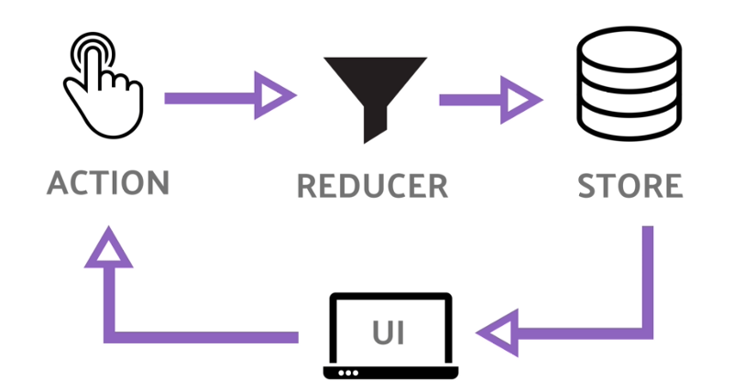
Here the UI Component triggers an event. It then dispatch an action when this event occur. A reducer uses this action to update the Store. Finally the component feeds directly from the updates to store.

Slide 13
React Navigation
React Navigation's native stack navigator provides a way for our app to transition between screens and manage navigation history. If our app uses only one stack navigator then it is conceptually similar to how a web browser handles navigation state - our app pushes and pops items from the navigation stack as users interact with it, and this results in the user seeing different screens.
A key difference between how this works in a web browser and in React Navigation is that React Navigation's native stack navigator provides the gestures and animations that you would expect on Android and iOS when navigating between routes in the stack.

Slide 14
ES7 Pluggin
It was released in June 2016.
It Provides Javascript and React/Redux snippets.
It also consists of Babel Pluggin features for Vscode.
These snippets are used to speed up workflow. They’re basically shortcuts that allow us to type in a few letters, which will then output code that we use constantly in our React applications.

Slide 15

Expo
Expo is a framework and a platform for universal React applications.
It is a set of tools and services built around React Native and native platforms that help you develop, build, deploy, and quickly iterate on iOS, Android, and web apps from the same JavaScript/TypeScript codebase.
It provides a list of tools that simplify the creation and testing of React Native app.
It is fast and very simple to install.
It doesn’t require any Android Studio/Xcode.
It is a Developer friendly and has a simpler project structure.

Slide 16
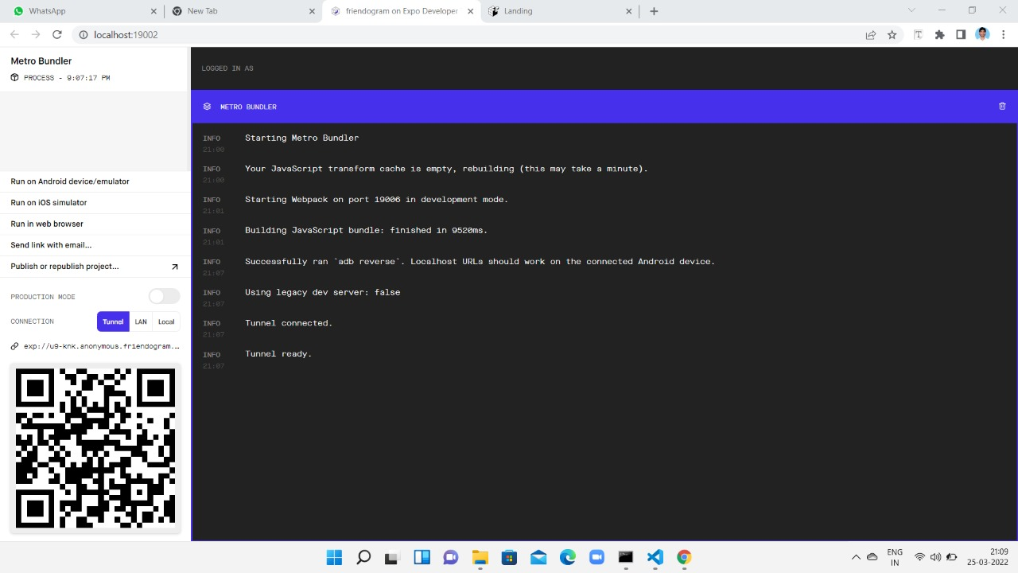

Slide 17

Firebase
Firebase is a backend platform for building Web, Android and IOS applications. It offers real time database, different APIs, multiple authentication types and hosting platform.
Firebase can power app's backend, including data storage, user authentication, static hosting.
Firebase Features:-
Real-time Database − Firebase supports JSON data and all users connected to it receive live updates after every change.
Authentication − We can use anonymous, password or different social authentications.
Hosting − The applications can be deployed over secured connection to Firebase servers.

Slide 18
Implementation

Slide 19


