Slide 1
Analysis and Detection of Autism Spectrum Disorder Using Machine Learning Techniques
Guide : Sri. P. Siva Prasad
Batch No: 17
V.Susmitha Triveni(Y18CS169)
V.Chandrika(Y18CS174)
V.Durga Bhavani(Y18CS178)

Slide 2
Contents
Abstract
Introduction
Proposed Method
Dataset
Architecture
Conclusion

Slide 3
Abstract
Autism Spectrum Disorder(ASD) is a neuro-disorder in which a person has lifelong effect on interaction and communication with others.
Autism can be diagnosed at any stage in once life and said to be a “behavioral disease” because in the first two years of life symptoms usually appear .
According to ASD,problem starts with childhood and continues to keep going on into adolescence and adulthood.

Slide 4
Abstract
Propelled with the rise in use of machine learning techniques in the research dimensions of medical diagnosis, there is an attempt to explore the possibility to use Naïve Bayes, Support Vector Machine, Random Forest, KNN, Linear Discriminant Analysis for predicting and analysis of ASD problems in a child, adolescents , adults and toddler.
The proposed techniques are evaluated on publicly available four different non-clinically ASD datasets.

Slide 5
Introduction
The problem of autism spectrum disorder (ASD) have been growing nowadays among all ages of the human population.
Early detection of this neurological disease can greatly assist in the maintenance of the person’s mental and physical health.
The symptoms of this problem may be started at the age of three years and may continue for the lifetime.
It is not possible to complete treat the patient suffering from this disease, however its effects can be reduced for some time if the symptoms are early detected

Slide 6
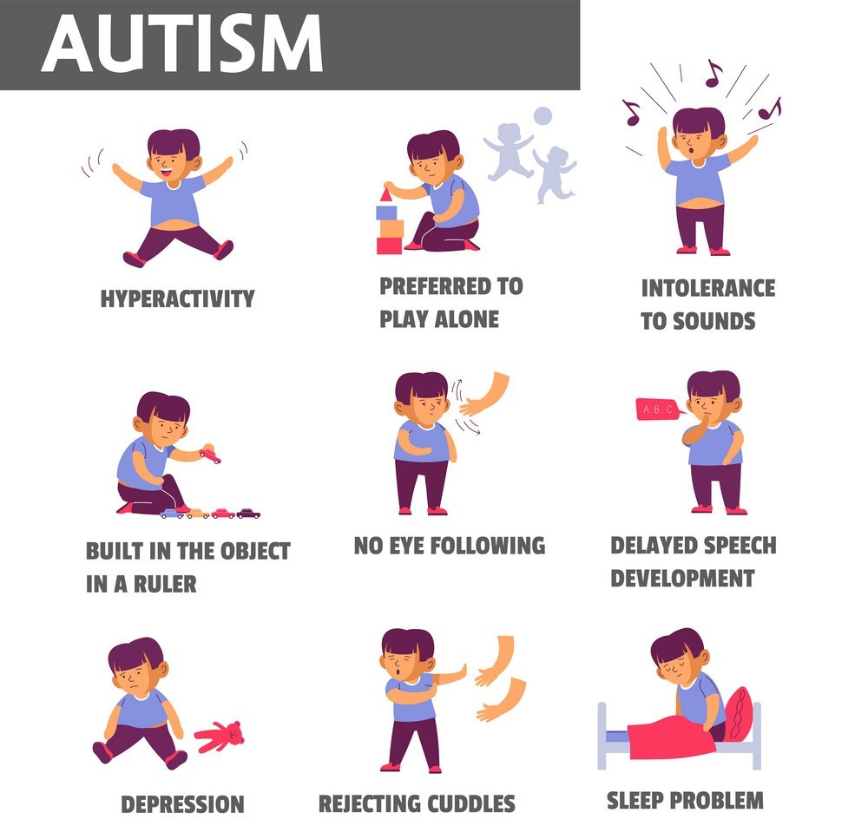
Introduction
There is some risk factor which influences ASD like as low birth weight, a sibling with ASD and having old parents, etc.
The problems of Autism disorder
include:
Inappropriate laughing and giggling
No sensitivity of pain
Not able to make eye contact properly
No proper response to sound
May not have a wish for cuddling
Not able to express their gestures
Want to live alone
Using echo words

Slide 7
Introduction
People with ASD also have difficulty with constrained interests and consistently repetition of behaviors.
The following list presents specific examples of the types of behaviors:
Repeating certain behaviors like repeating words or phrases much time
The Person will be upset when a routine is going to change
Having a little interest in certain matters of the topic like numbers, facts, etc.
Less sensitive than another person in some cases like light, noise, etc.

Slide 8
Proposed Method
Import the datasets
Clean the datasets i.e. preprocessing
Apply Machine learning techniques on the data for classification purpose
Obtain the results by using different metrics
Conclusion

Slide 9
DataSet
S.No | Dataset name | Sources | Attribute type | Number of Attributes | Number of Instances
1 | ASD Screening data for adult | UCI Machine Learning repository | Categorical, continuous and binary | 21 | 704
2 | ASD creening data for children | UCI Machine Learning repository | Categorical, continuous and binary | 21 | 292
3 | ASD Screening data for adolescent | UCI Machine Learning repository | Categorical, continuous and binary | 21 | 104

Slide 10
Attributes
Patient age
Nationality
Gender
The patient suffered from Jaundice problem by birth
Any family member suffered from pervasive development disorder
Who will complete the test

Slide 11
Attributes
7. The country in which the user lives
8. Screening application used by the user before or not
Screening test type
10-19 Based on the screening method answers of 10 questions
Screening score
Totally the dataset contains 20 common attributes used for the prediction.

Slide 12

Architecture

Slide 13
Data Pre-Processing
Data pre-processing is a technique in which transform the raw data into a meaningful and understandable format.
Real-world data is commonly incomplete and inconsistent because it contains lots of errors and null values.
Various Data pre-processing methods are used to handle incomplete and inconsistent data like as handling missing values, outlier detection, data discretization, data reduction (dimension and numerosity reduction), etc.
The problems of missing values in these dataset has been handled by imputation method.

Slide 14
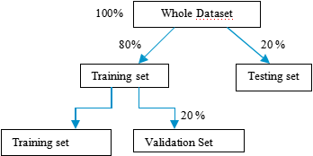
Training and testing model
The whole dataset has been split into two parts i.e. one part is training the dataset and the other one is testing dataset with specific ratio . For cross-validation purposes again training data has been split into two parts. One part is the training dataset and another part is the validation dataset into specific ratio respectively.

Slide 15
The different Machine learning algorithms that were chosen for classification are Random Forest, Naive Bayes, Support Vector Machines, Linear Discriminant Analysis, KNN etc.
Accuracy, precision, recall, f1-score, and AUC are the evaluation metrics used to analyze the model performance. The result depends on how accurate the model is trained.

Slide 16
Conclusion
Detection of Autism Spectrum Disorder was attempted using various machine learning techniques. Various performance evaluation metrics were used to analyze the performance of the models implemented for ASD detection on non-clinical dataset from three sets of age groups viz. Child, Adolescents and the Adult. We found that Multinomial Nave Bayes had the least execution time, but it was found to have an accuracy of 87 percent which is comparatively low. Support vector machines outperformed all the models and performs best in both the aspects of accuracy and that of low latency.

Slide 17


