Slide 1
Machine Learning Algorithm for Predicting Crime Hotspots
Batch no.18
Guided by Sri M. Brahmaiah
Presented by
V.Swathi (Y18CS173)
P.Srujan(Y18CS144)
V.V.N.Kumari(Y18CS172)

Slide 2
Abstract
Crimes are an increasing danger to mankind.
Prediction of hotspots plays a vital role in case investigation and to aware the citizens about dangerous locations.
Machine learning is the current mainstream prediction method.
Naïve Bayesian classifier is used in order to predict potential crime types.

Slide 3
Introduction
In order to facilitate crime prevention, several scholars have developed models to predict crime.
Spatiotemporal data related to the public security have been growing at an exponential rate during the recent years.
Most used historical crime data alone to calibrate the predictive models.
Therefore, the environmental factors of the places need to be considered besides historical crime data for the prediction of crime hotspots.

Slide 4
Most used historical crime data alone to calibrate the predictive models.
The research on crime prediction currently focuses on two major aspects:
Crime risk area prediction
Crime hotspot prediction

Slide 5
Recently machine learning algorithms have gained popularity.
The most popular methods include K-Nearest Neighbor(KNN), random forest algorithm, support vector machine (SVM), neural network and Bayesian model etc.

Slide 6
Proposed Solution
Our study aims to find spatial and temporal criminal hotspots using a set of realworld datasets of crimes.
We will try to locate the most likely crime locations and their frequent occurrence time.
Naïve Bayes

Slide 7
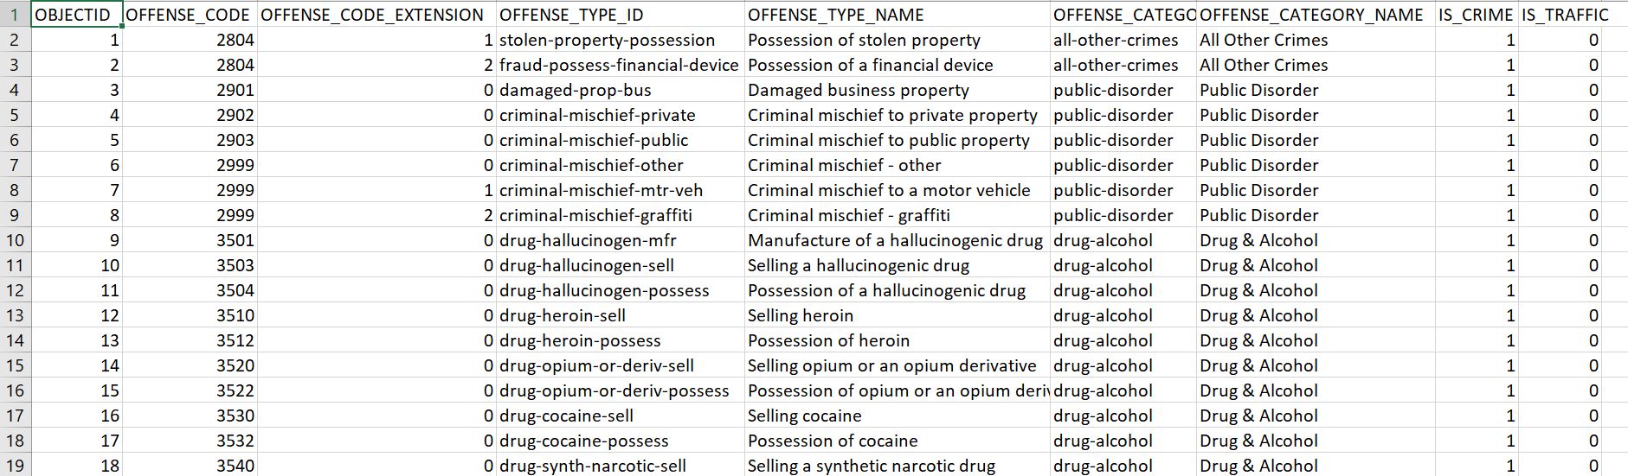
Dataset – Denver Dataset

Slide 8
Data Preprocessing

Slide 9
Data cleaning
There are some missing values in some attributes such as last_occurance_date and incident_address in Denver dataset.
But they are not of our key attributes.
All key attributes were completed with cleaned values.

Slide 10
Data Reduction
We implemented dimensionality reduction using attribute subset selection.
For example, among the available 19 attributes in Denver crimes dataset, four of them are selected.
Removed all the other irrelevant attributes from the dataset.
Data reduction in terms of number of instances.
The attribute “Is_Crime” to filter the instances and remove all the irrelevant ones.

Slide 11
Data Integration
To avoid different attribute naming, unifiy the key attribute names for both crime datasets as follow:
Crime_Type
Crime_Date
Crime_Location.

Slide 12
Data Transformation and Discretization
For the crime types feature, minimizing the type list by grouping them into six new types.
Mapped its values into 4-hour intervals.

Slide 13
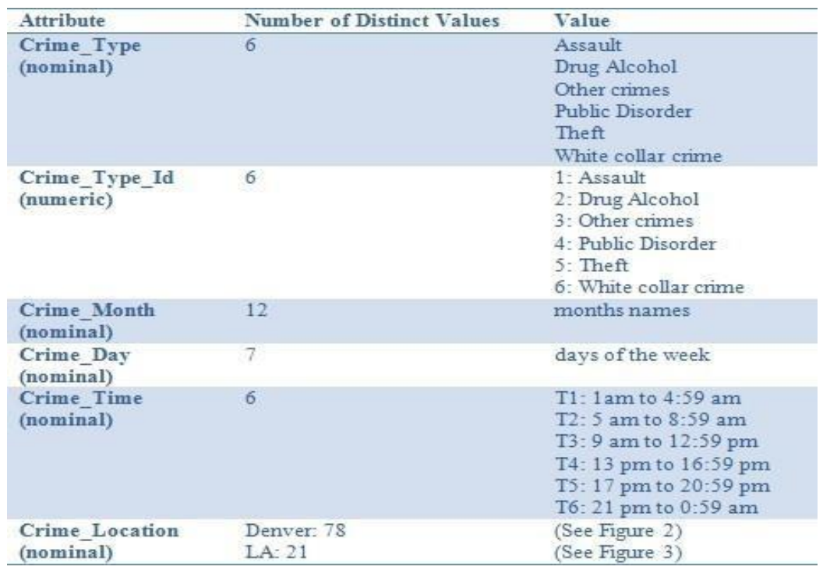

Attributes after preprocessing

Slide 14
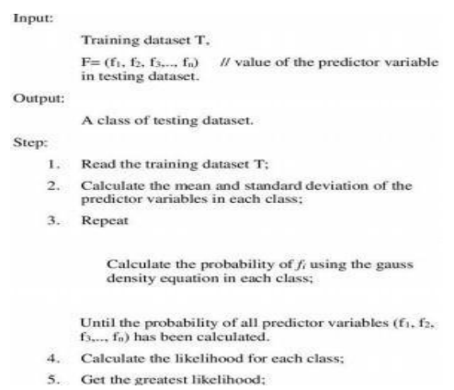
Naïve Bayes Pseudocode

Slide 15
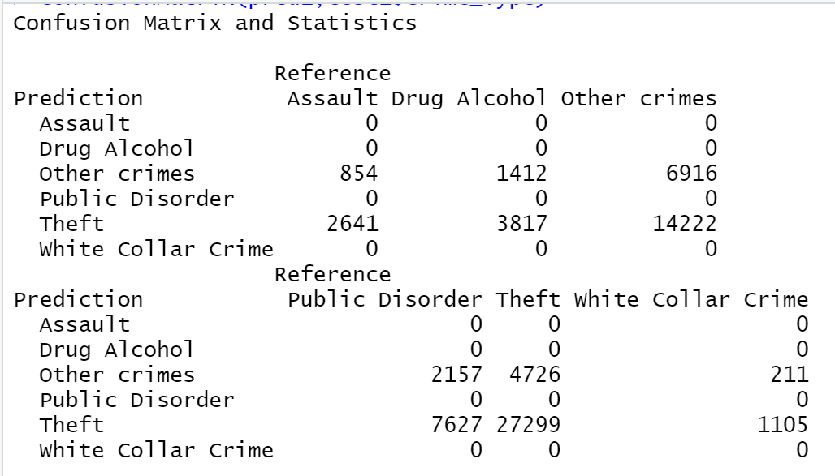

Slide 16
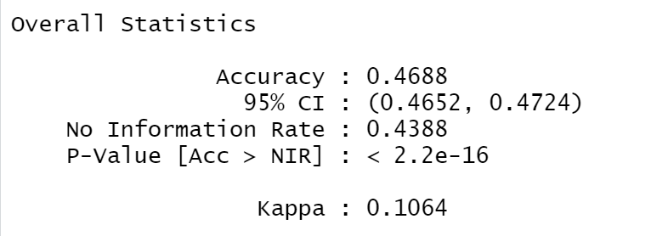

Slide 17
Conclusion
This helps people in getting to know the places with high crime occurrence.
This also helps police regarding surveillance and patrol areas.
Helps in crime prevention as it can create awareness among people to be alert in such places and times.

