Slide 1
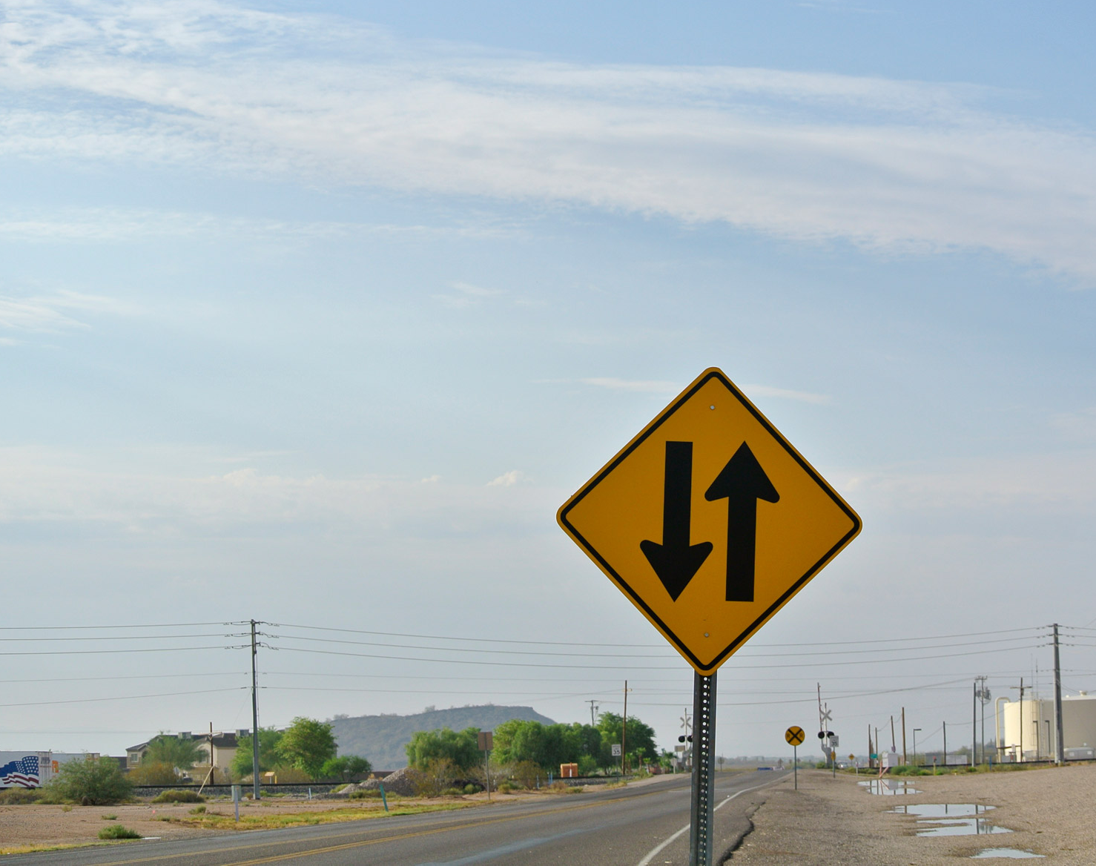
Traffic Sign Detection Using YOLOV3
Guided By
Ms. Ch. Vijaya Madhavi Lakshmi
Batch no-19
SK. Althaf Babar(Y18CS152)
P. Ashok(Y18CS142)
K. Leela Surya Teja(L19CS188)

Slide 2
ABSTRACT
It is very challenging to detect traffic signs using a high-precision real-time approach in realistic scenes with respect to driver-assistance systems for driving vehicles and autonomous driving.
To address this challenge, YOLOv3 is used to accurately achieve real-time localization and classification of small traffic signs.
According to the tests on the TT100K dataset (which is a dataset for traffic sign detection), the performance of the YOLOv3 is better than that of previous versions in detecting small traffic signs.
The detection speed of YOLOV3 is 20 FPS, and the mAP (mean Average Precision) reaches up to 86%.

Slide 3
INTRODUCTION
As an essential part of an advanced driver-assistance system and autonomous driving, traffic sign detection is required for locating traffic signs from realistic scene images and classifying them into specified categories.
For practical applications, reliable and real-time detection of small objects in complex backgrounds is required while the vehicle is running at high speeds .
Overall, traffic sign detection can be roughly divided into two categories: traditional schemes based on hand-crafted features and deep learning schemes based on convolutional neural networks (CNNs).

Slide 4
CONTD..
In the traditional approaches, three steps are often involved: obtaining regional proposals that contain traffic signs, extracting hand-crafted features from these regions, and taking these features as the inputs to the classifiers (e.g., SVM).
However, the hand-crafted features extracted by traditional algorithms are low-level, specific to specified objects and unable to well represent multi-class objects.
Therefore, the robustness of the traditional approaches is poor for detecting traffic signs in a complex environment.
In contrast, the CNNs can learn more generalized features from a large number of samples without preprocessing, and thus, they can avoid the difficulty of designing hand-crafted features.

Slide 5
CONTD..
Overall, the CNN-based detection approach can be further divided into two categories: two-stage approaches and one-stage approaches.
The two stage approaches to detecting traffic signs have high precision but these approaches require high computing complexity and they do not satisfy the real-time requirement.
In the one-stage approaches, YOLO3 is used to achieve the real time performance.

Slide 6
Existing Solutions
Yang et al. combined traditional computer vision algorithms with CNNs and presented a new traffic sign detection network. In their work, a two-stage adjustment strategy is used to extract the region proposals, and an Attention Network (AN) is introduced in the Faster-RCNN to find the potential regions of interest. The experimental results tested on the TT100k benchmark dataset showed that its mAP was 80.31%. However, the detection accuracy on small objects is quite low (49.81%).
Zhu et al. adopted the object localization in [26] to detect traffic signs. Their detection framework has three branches. Their mAP on the TT100K dataset is 87.5%. Their model can locate the objects efficiently but their detection speed should be improved

Slide 7
Proposed Solutions
We used a framework for detection of the traffic signs and this framework is called darknet framework.
We used transfer learning approach for our model to detect traffic signs and transfer learning is a machine learning method where we reuse a pre-trained model as the starting point for a model on a new task.
Initially the pre-trained weights for the object detection of cocoa dataset are used and the these weights will be updated to predict the traffic signs.
Our model can process the real time videos in an accurate and faster than previous traffic signs detection models.

Slide 8
YOLO V3 Algorithm
YOLO - You Only Look Once is an algorithm proposed by Redmond et. al in a research article published at the IEEE/CVF Conference.
YOLO proposes the use of an end-to-end neural network that makes predictions of bounding boxes and class probabilities all at once.
The YOLO algorithm works by dividing the image into N grids, each having an equal dimensional region of SxS. Each of these N grids is responsible for the detection and localization of the object it contains.
Correspondingly, these grids predict B bounding box coordinates relative to their cell coordinates, along with the object label and probability of the object being present in the cell.
This process greatly lowers the computation as both detection and recognition are handled by cells from the image.

Slide 9
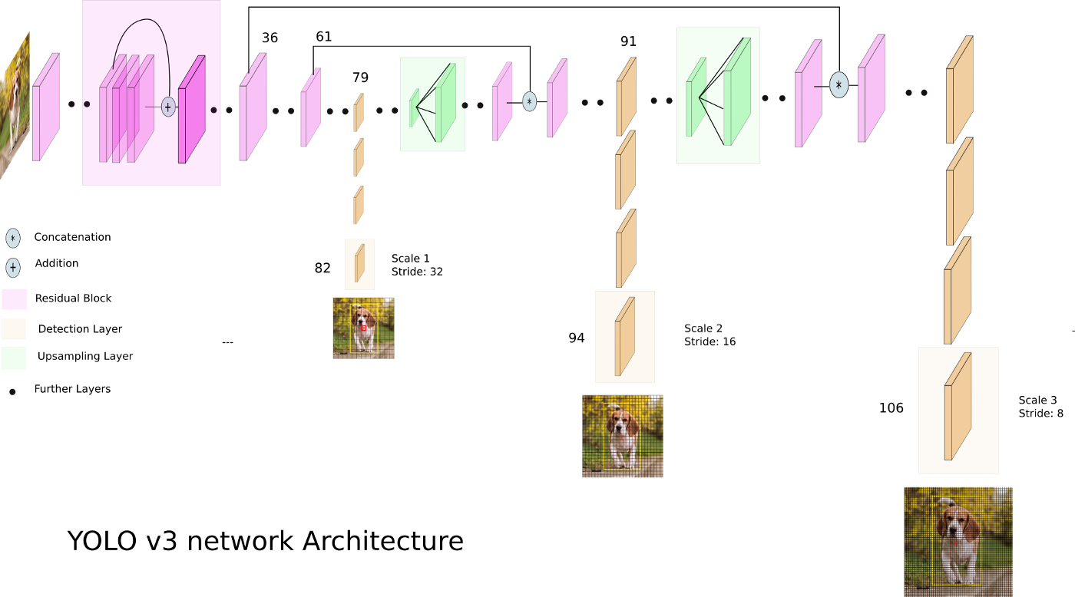
Contd...
YOLO v3 uses a variant of Darknet, which originally has 53 layer network trained on Image net. For the task of detection, 53 more layers are stacked onto it, giving us a 106 layer fully convolutional underlying architecture for YOLO v3.

Slide 10
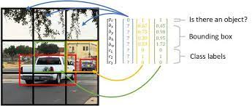
Bounding Boxes
A bounding box describes the rectangle that encloses an object. Each boundary box contains 5 elements: (x, y, w, h) - rectangle coordinates and a box confidence score.

Slide 11
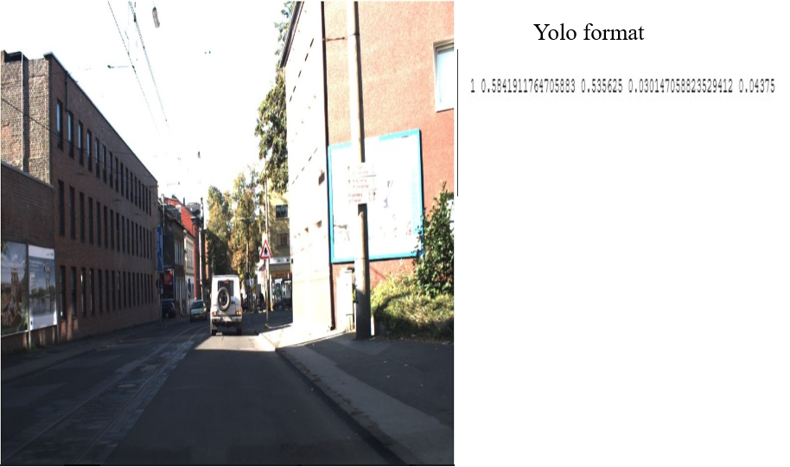
Dataset
Dataset contains 900 images of traffic signs taken from kaggle dataset which contains details of 4 classes.
By using bounding box tool, we extract the parameters of the traffic signs.
<object-class> <x> <y> <width> <height>

Slide 12
Thank You

