Slide 1
An Investigation of Credit card Default Prediction in Imbalanced datasets
Guide : Sri M. Naveen
T. Navya Sri (Y18CS164)
R. Mallikarjuna Chari(Y18CS149)
S. Roshita (Y18CS151)

Slide 2
How credit card default happens
When you accept a credit card, you agree to certain terms. For example, you agree to make your minimum payment by the due date listed on your credit card statement. If you miss the minimum payment six months in a row, your credit card will be in default. Your credit card issuer will likely close your account and report the default (to the credit bureaus).

Slide 3
Abstract
Financial threats are displaying a trend about the credit risk of commercial banks as the incredible improvement in the financial industry has arisen.
Recent studies mostly focus on enhancing the classifier performance for credit card default prediction
Overall, the Gradient Boosted Decision Tree method performs better than other traditional machine learning classifiers
The proposed model will help in commercial banks, financial organizations, loan institutes and other decision makers to predict the loan defaulter earlier.

Slide 4
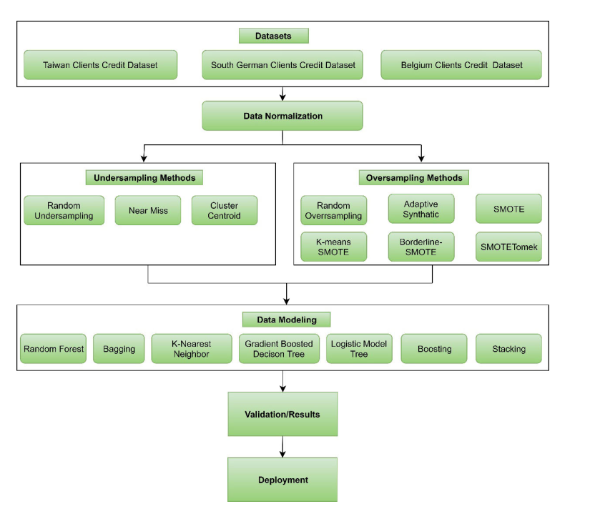
Proposed methodology

Slide 5
Methodology
The imbalanced dataset have been employed to build a model for the effective prediction of credit default clients.
After that, the data has been preprocessed to achieve effective results because real-world data leads to noisy values.
To cater to the data imbalance problem, different resampling methods have been utilized to get the best results.
After preprocessing, a Gradient Boosted Decision Tree (GBDT) model, which is an ensemble-based learning method, has been used for modeling and also compared the results with traditional machine learning models.
At last, the credit default prediction model has been deployed for the end-users to predict the default risk earlier effectively.

Slide 6
Dataset
Dataset | Total observations | Default payments | Target class
Taiwan clients credit dataset | 30000 | 6636 | yes=1, no=0

Slide 7
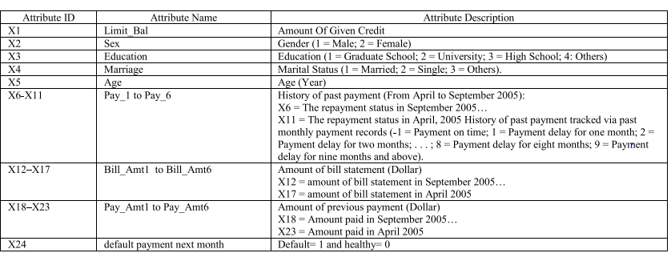
Taiwan Clients credit dataset

Slide 8
Data normalization
The major problem in the various datasets is that numerical features are all measured in different units.
Data normalization is a process of re-scaling the feature values to make the new inputs follow the standard normal distribution.
The most common normalization method is the Min-Max normalization
Xnorm = X − Xmin / Xmax − Xmin

Slide 9
Data Resampling
Any dataset can be considered as imbalanced if the number of instances between classes is not equal. Resampling methods for imbalanced learning applications typically means to add a bias to balance the dataset.

Slide 10
Resampling Methods
Random undersampling
Random undersampling is a simple undersampling based approach.
Majority class instances in the training set are randomly eliminated until the ratio between the minority, and the majority class is at the desired level.
In particular, crucial details on the decision boundary between the minority and majority class may be eliminated

Slide 11
Cluster Centroid
One major problem of using undersampling is that important information may be lost from the majority class, which can be
misclassified after classification.
To overcome this problem, the Cluster Centroids method has been introduced.
Cluster Centroids undersamples the majority class by replacing majority samples from clusters with the cluster of centroids using the K-means algorithm by considering the ratio of majority class samples to minority class samples.

Slide 12
SYNTHETIC MINORITY OVERSAMPLING TECHNIQUE
SMOTE creates synthetic minority data. It over-samples the minority class by taking k (in our case, k = 5) nearest neighbors for a given minority data sample, finding the difference between the features of it and a randomly chosen neighbors

Slide 13
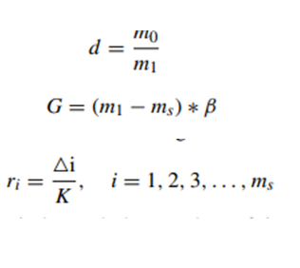
ADASYN(Adaptive Synthetic)
Adaptive Synthetic (ADAYSN) oversampling technique is based on density distribution to generate synthetic data samples for each minority class inevitably

Slide 14
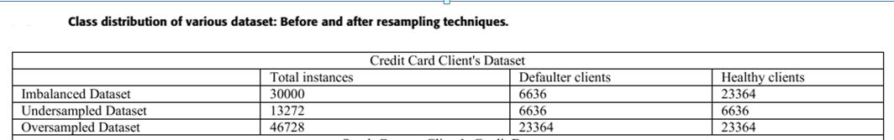


Slide 15
Gradient Boosting
The iterative machine learning method to solve the classification problem is known as gradient boosting.
This technique is based on ensemble learning in which the model is trained in such a way that errors of the previous iteration are used.
Gradient Boosting tries to maximize the predictive power of the ensemble, i.e., minimize the bias.

Slide 16
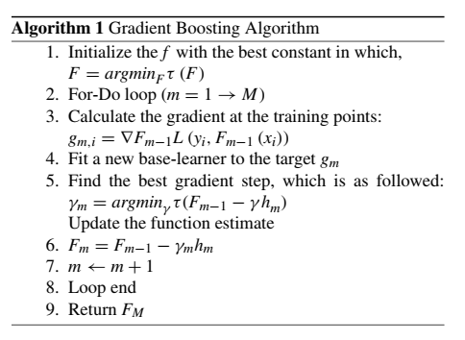
Gradient Boosting

Slide 17
Conclusion
We split our datasets into training and test data with a ratio of 70:30.
Various classifiers have been utilized to evaluate the performance of imbalanced datasets.
The performance of the GBDT method is also compared with traditional machine learning models in which the GBDT method outperformed traditional machine learning models on imbalanced datasets.
The best results have been obtained when the learning rate was set to 0.2, and the number of constructed trees was 200.

Slide 18
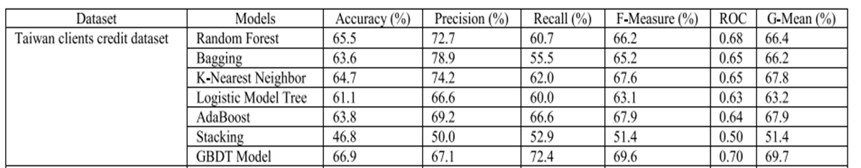

Slide 19
Future Work
The interpretable model can also deployed on the web to ease the different stakeholders. This model will help commercial banks, financial organizations, loan institutes, and other decision-makers to predict the credit defaulter earlier

Slide 20


