Slide 1
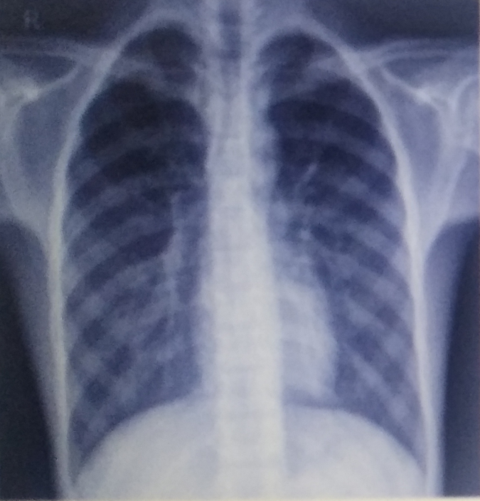
PNEUMONIA DETECTION USING CHEST X-RAYS
BATCH : 21
GUIDE : Z . Sunitha Bai
PRESENTED BY
Y18CS161 T. SIVA ASHOK KUMAR
Y18CS170 V. SRI SAI DINESH
Y18CS157 SK. KHALEEMUDDIN

Slide 2
PROBLEM STATEMENT
Pneumonia is a life-threatening infectious disease which affects one or both lungs in humans.
It is commonly caused by bacteria , viruses or fungi.
The aim is to develop an automatic pneumonia detection system that will reduce the workload of radiologists.
The pneumonia detection task involves in identifying whether a given frontal-view chest x-ray image is normal or pneumonia infected.

Slide 3
INTRODUCTION
Chest X-Ray (CXR) image analysis plays a vital role in the reliable diagnosis of pneumonia.
However, even for an experienced radiographer, it is quite challenging and time-consuming to diagnose accurately due to the fuzziness of CXR images.
Thus, developing an automatic system for detecting pneumonia would be beneficial for treating the disease without any delay.

Slide 4
KEYWORDS
Chest X-Ray (CXR)
Convolutional Neural Network (CNN)
Contrast Limited Adaptive Histogram Equalization (CLAHE)

Slide 5
EXISTING METHODS
VGG -16 (Visual Geometry Group)
VGG simplifies the process by creating 3×3 size kernels in convolutional layers and 2×2 size in max pooling layers.
In the end, it has 2 FC (Fully Connected layers) trailed by a soft-max for output.
The use of uniform and smaller filter sizes on VGG can produce more complex features and lower computing when compared to Alex Net.
This model is achieving an accuracy of 87%.

Slide 6
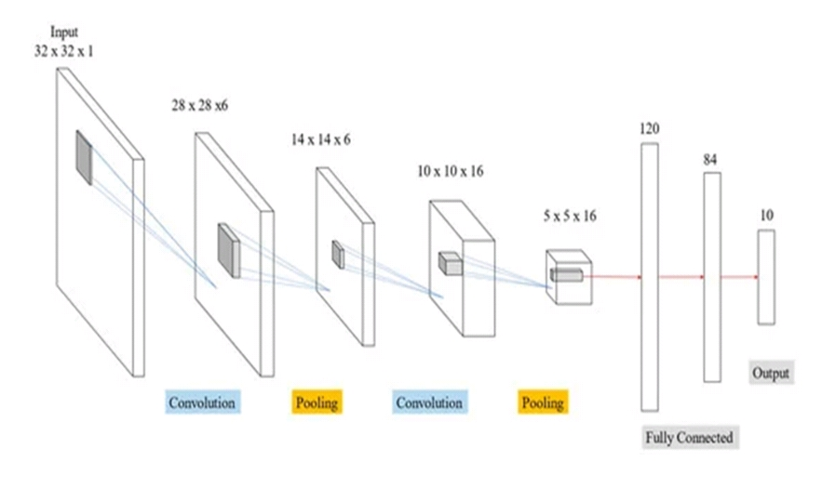

Slide 7
VGG-16 DRAWBACKS
Poor image classiﬁcation accuracy in the test results.
Small datasets with fewer training features led to signiﬁcant under-ﬁtting.

Slide 8
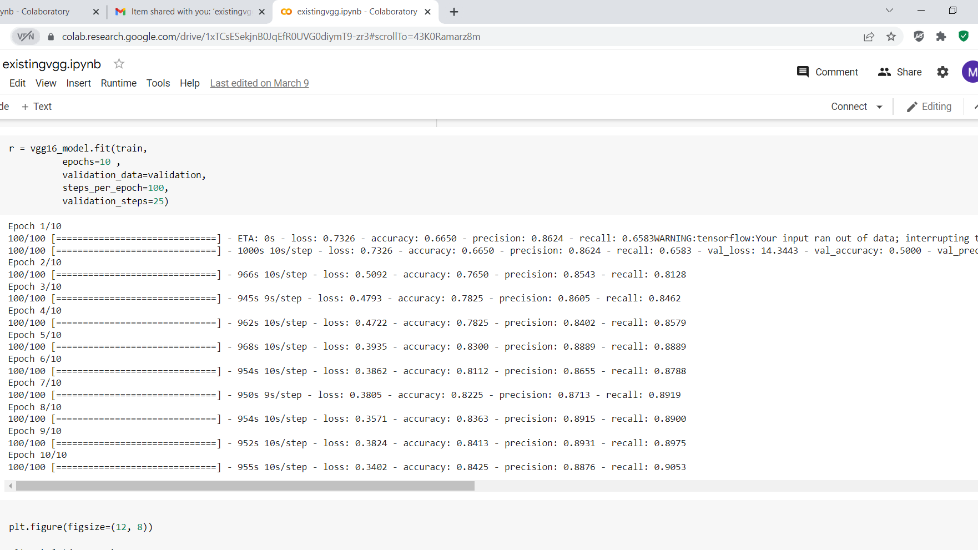
RESULTS

Slide 9
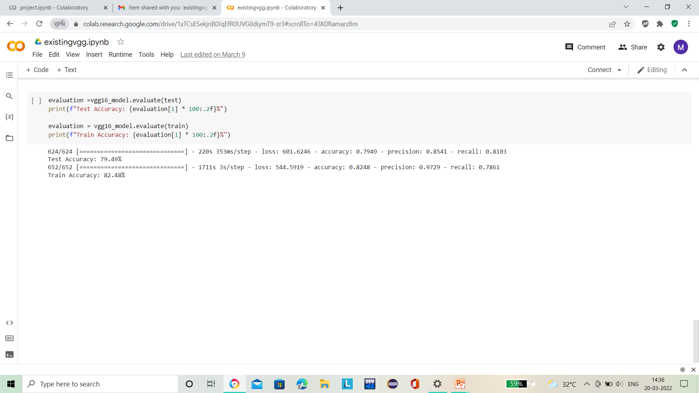

Slide 10
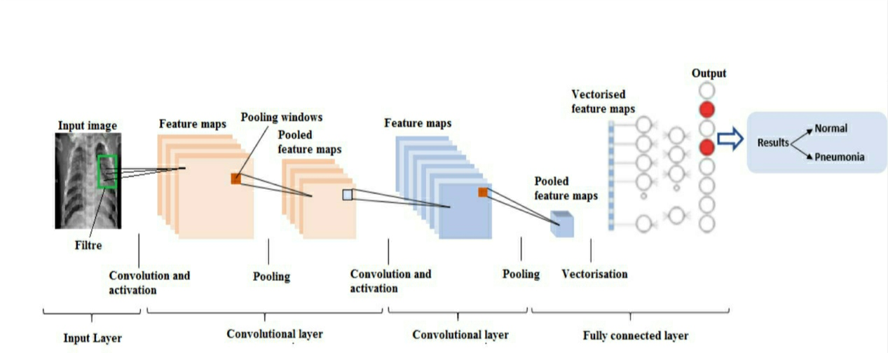
PROPOSED METHOD

Slide 11
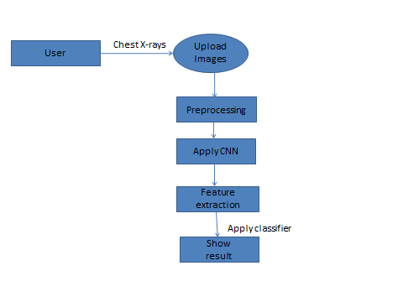
FLOWCHART

Slide 12
IMAGE PREPROCESSING
In the preprocessing step, the image is transformed into grayscale image.
Then, we reshaped the images into 224 × 224 pixels in size to maintain uniformity of the input images to the architecture.
Then,the images are normailized and after normailization,the value of a pixel resides in the range from 0 to 1.

Slide 13
CNN ARCHITECTURE
The learning model is based on CNN which is very useful for pattern recognition from images.
The network comprises an input layer, several hidden layers and an output layer.
The hidden layers consist of multiple convolution layers that learn suitable filters for important feature extraction from the given samples.
The features extracted by CNN are used by multiple dense neural networks for classification purposes.

Slide 14
Input layers: In our model the inputs are X-Ray images. The parameters are defining the image dimension (244x244).
Convolutional layers: Convolution is a linear operation that consists of the multiplication of a set of weights with the input.
Pooling Layers: The max pooling is set to 2x2 with a stride of 2.

Slide 15
ReLU layers: We have used four ReLU layers for each convolutional layer .
Fully Connected layers: Treats the input data as a simple vector and produce an output as a single vector.

Slide 16
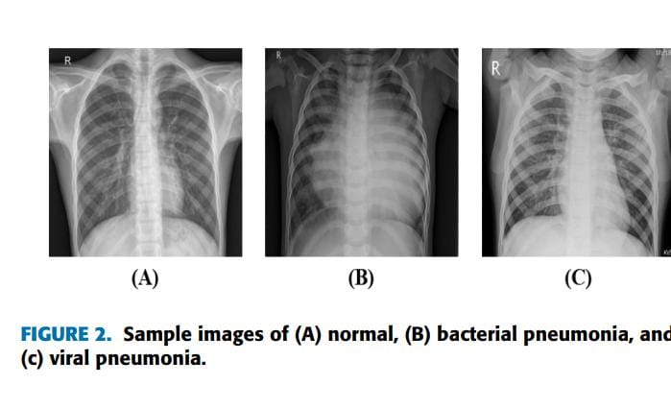

Slide 17
DATASET COLLECTION
The dataset contains a total of 1341 images of people without pneumonia and 3875 images of people with pneumonia.
For training purposes, 80% images of each class are used and the rest 20% of the images are utilized for testing purposes.
Dataset is collected from Kaggle.

Slide 18
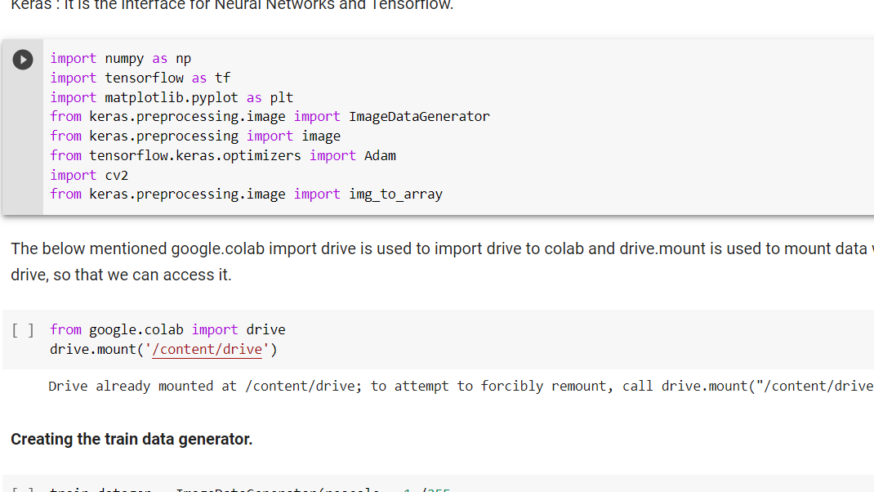
DATASET LOADING

Slide 19
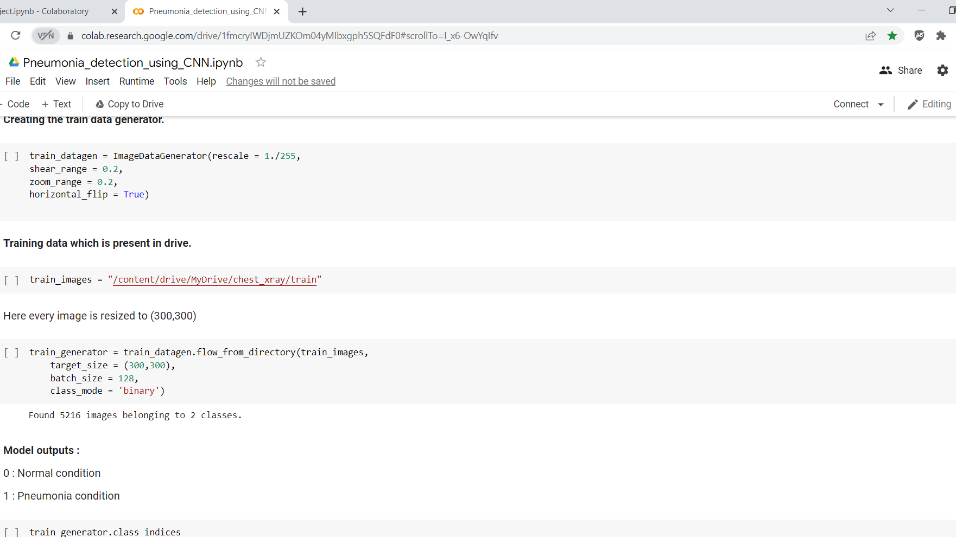
IMAGE PRE-PROCESSING

Slide 20
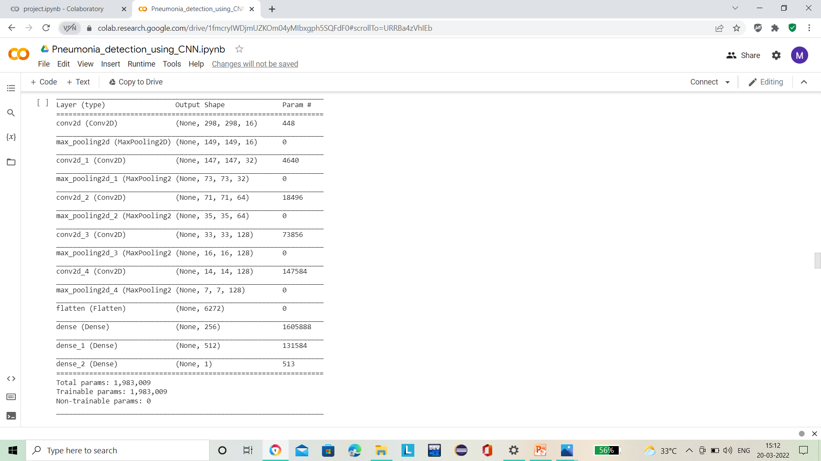
MODEL FOR CNN

Slide 21
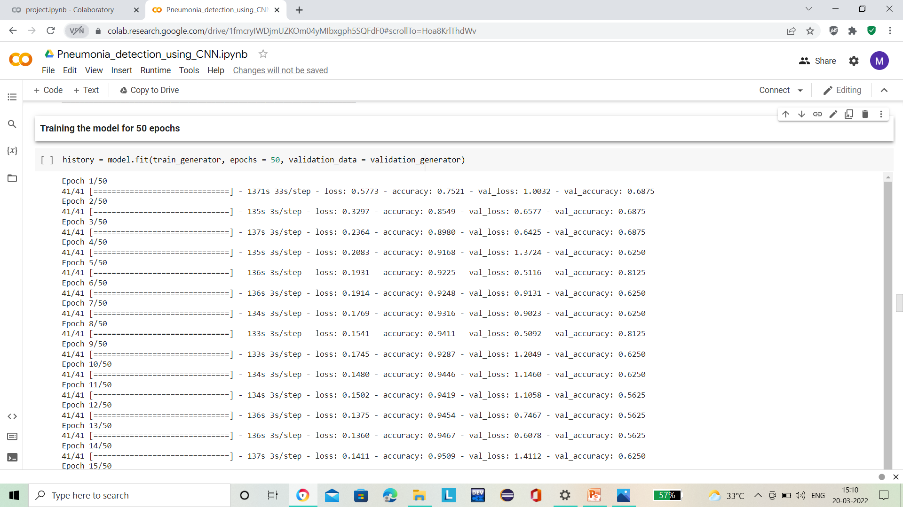
MODEL TRAINING

Slide 22
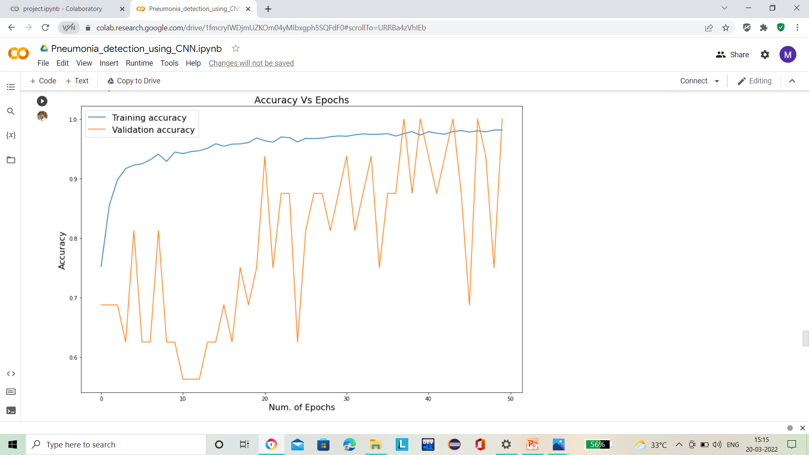
ACCURACY PLOT

Slide 23
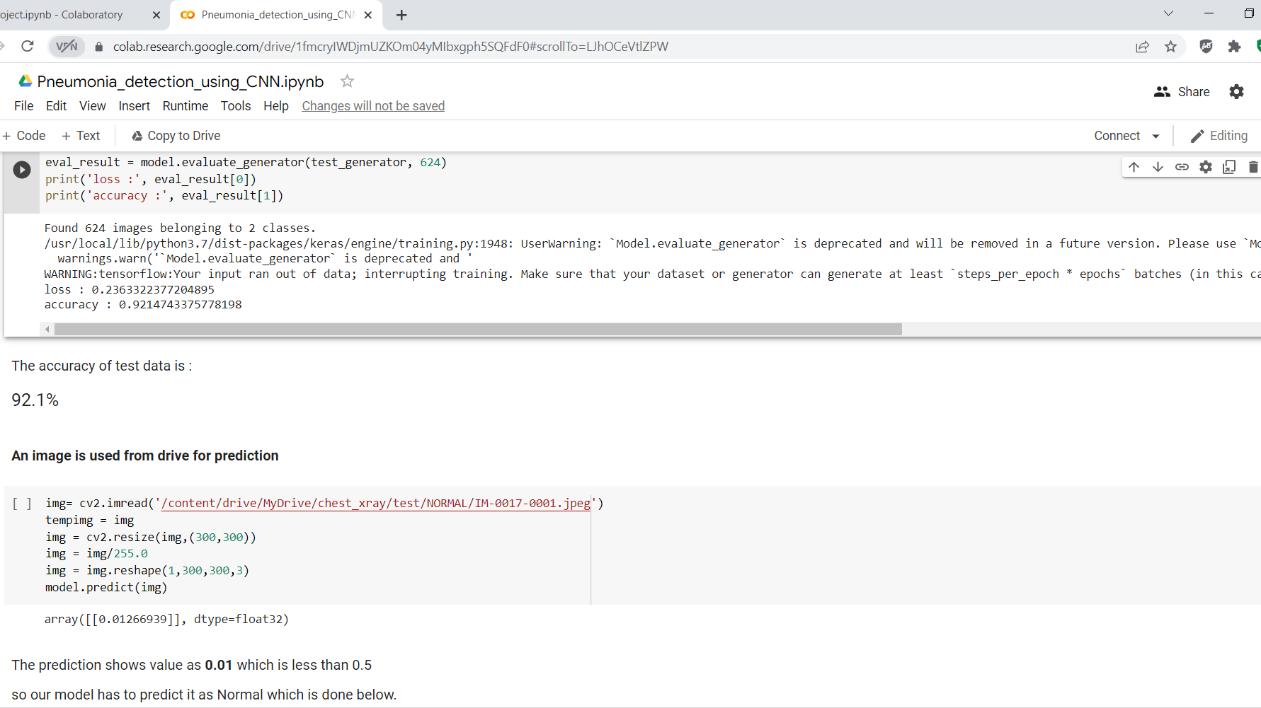
MODEL EVALUATION

Slide 24
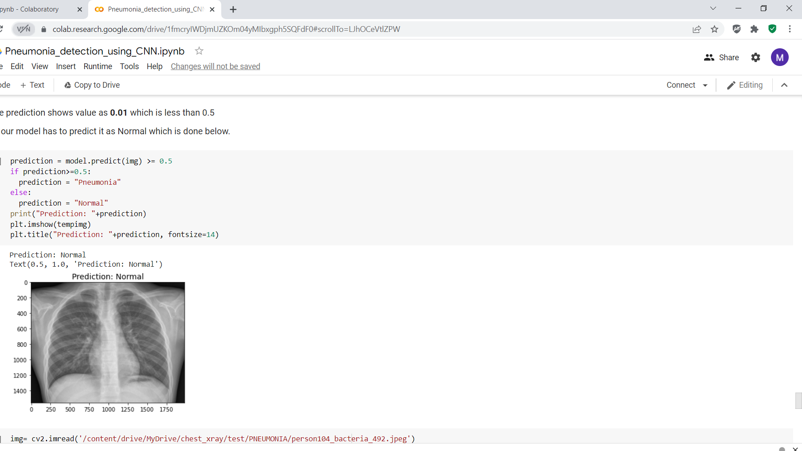
CLASSIFICATION

Slide 25
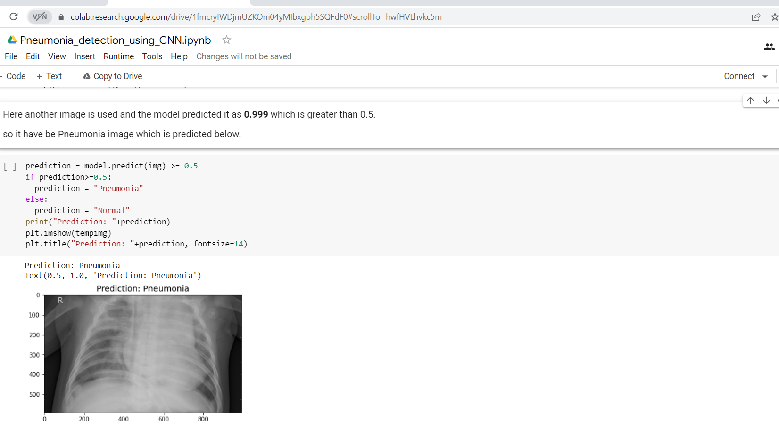

Slide 26
CONCLUSION
Throughout the process of developing the CNN model for Pneumonia prediction, we have built a model from scratch which consists of 5 layers and follows with a fully connected neural network.
Then the trained model is evaluated using separate unseen data to avoid bias prediction.
The architecture performs a better fitting to the image dataset, when compared to a standard neural network, due to the reduction in the number of parameters involved and reusability of weights.
As the result, the accuracy of the test dataset reached 95%.

Slide 27


