Slide 1
Driver Drowsiness Monitoring System using Visual Behaviour and Machine Learning
Guide : Dr.A.Sri Nagesh
BatchNo-3
V.Jahnavi – Y18CS179
K.Venkateswara Rao – Y18CS175
K.Chaitanya – L19CS186

Slide 2
Abstract
Drowsy driving is one of the major causes of road accidents and death
Hence, detection of driver’s fatigue and its indication is an active research area.
Most of the conventional methods are either vehicle based, or behavioural based or physiological based.
In this study, a low cost, real time driver’s drowsiness detection system is developed with acceptable accuracy.
In the developed system, a webcam records the video and driver’s face is detected in each frame employing image processing techniques.
Facial landmarks on the detected face are pointed and subsequently the eye aspect ratio, mouth opening ratio and nose length ratio are computed and depending on their values, drowsiness is detected based on developed adaptive thresholding.

Slide 3
Introduction
Driver drowsiness is an overcast nightmare to passengers in every country.
Hence, detection of driver’s fatigue and its indication is an active area of research due to its immense practical applicability.
If drowsiness is detected, a warning or alarm is send to the driver from the warning system.
Generally, the methods to detect drowsy drivers are classified in three types; vehicle based, behavioural based and physiological based.

Slide 4
Vehicle Based Detection
In vehicle based method, a number of metrics like steering wheel movement, accelerator or brake pattern, vehicle speed, lateral acceleration, deviations from lane position etc. are monitored continuously.
This is a nonintrusive measurement as the sensors are not attached on the driver.

Slide 5
Physiological Based Detection
In physiological based method [8,9], the physiological signals like Electrocardiogram (ECG), Electooculogram (EOG), Electroencephalogram (EEG), heartbeat, pulse rate etc. are monitored and from these metrics, drowsiness or fatigue level is detected.
This is intrusive measurement as the sensors are attached on the driver which will distract the driver
They Have proposed a webcam based system to detect driver’s fatigue from the face image only using image processing and machine earning techniques to make the system low-cost as well asportable.

Slide 6
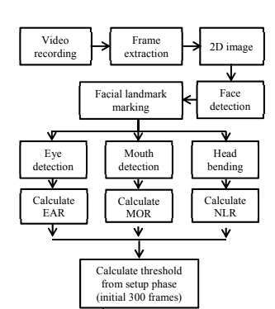
Block Diagram

Slide 7
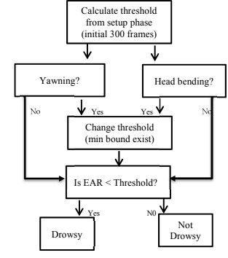

Slide 8
Proposed System
There are mainly four stages in this system:
1)Data Acquisition.
2)Face Detection.
3)Facial Landmark Marking.
4)Feature Extraction.
5)Classification.

Slide 9
Data Acquisition
The video is recorded using webcam (Sony CMU-BR300) and the frames are extracted and processed in a laptop.
After extracting the frames, image processing techniques are applied on these 2D images.

Slide 10
Face Detection
After extracting the frames, first the human faces are detected.
In this study, histogram of oriented gradients (HOG) and linear SVM method is used.
HOG descriptors are computed on images captured from the video.
A Linear SVM is Trained for the classification Tasks.
To improve the accuracy of SVM , hard negative Mining is used.

Slide 11
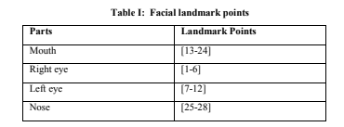
Facial Landmark Marking
After detecting the face, the next task is to find the locations of different facial features like the corners of the eyes and mouth, the tip of the nose and so on.
Image normalization is performed to reduce different effects like distance from the camera , non - uniform illumination and varying image resolution.

Slide 12
Facial Landmark Marking
The face image is resized to a width of 500 pixels and converted to grayscale image.
An ensemble of regression trees is used to estimate the landmark positions on face.
Using this method, the boundary points of eyes, mouth and the central line of the nose are marked and the number of points for eye, mouth and nose are given.

Slide 13
Fundamental Landmark Marking

Slide 14
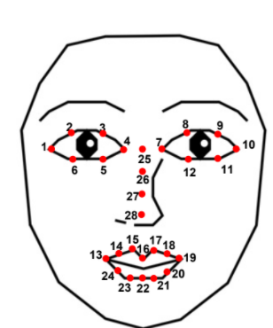
Fundamental Landmark Marking

Slide 15
Feature Extraction
After detecting the facial landmarks, the features are computed.
Features to be Extracted in this System are:
1)Eye Aspect Ratio (EAR)
2)Mouth Opening Ratio (MOR)
3)Head Bending

Slide 16

Eye Aspect Ratio (EAR)
From the eye corner points, the eye aspect ratio is calculated as the ratio of height and width of the eye.
monotonically decreasing EAR values indicate graduallyclosing eyes and it’s almost zero for completely closed eyes (eye blink). Consequently,

Slide 17

Mouth Opening Ratio
Mouth opening ratio is a parameter to detect yawning during drowsiness.

Slide 18

Head Bending
Due to drowsiness, usually driver’s head tilts (forward or backward) with respect to vertical axis.

Slide 19
Head Bending
In normal condition, our nose makes an acute angle with respect to focal plane of the camera.
This angle increases as the head moves vertically up and decreases on moving down.

Slide 20
Classification
In the beginning, adaptive thresholding is considered for classification. Later, machine learning algorithms are used to classify the data.
In the setup phase the EAR values for first three hundred (for 10s at 30 fps) frames are recorded. Out of which 150 maximum was considered as hard threshold for EAR.
For MOR , the threshold is taken experimentally from the observations.
Head bending feature is used to find the angle made
by head with respect to vertical axis in terms of ratio of
projected nose lengths.

Slide 21
Classification
Normally, NLR has values from 0.9 to 1.1 for normal upright position of head.
After computing the threshold values, the system is used for testing.
To make this thresholding more realistic, the decision for each frame depends on the last 75 frames. If at least 70 frames (out of those 75) satisfy drowsiness conditions for at least one feature, then the system gives drowsiness detection indication and the alarm.

Slide 22
Classification
Apart from using thresholding, the machine learning algorithms are used to detect drowsiness.
The EAR, MOR and NLR values are stored for the synthetic test data along with actual drowsiness annotation.
At first, principal component analysis [12] is used to transform the feature space into an independent one.
If all the three features are statistically significant at 5% level of significance, they are used for classification using Bayesian classifier , Fisher’s linear discriminant analysis and Support vector Machine

Slide 23
Conclusion
In this paper, a low cost, real time driver drowsiness monitoring system has been proposed based on visual behavior and machine learning.
The developed system works accurately with the generated synthetic data.
It has been observed that FLDA and SVM outperform Bayesian classifier.
The sensitivity of FLDA and SVM is 0.896 and 0.956 respectively whereas the specificity is 1 for both.

