Slide 1
EARLY DETECTION OF PARKINSON’S DISEASE
USING MACHINE LEARNING TECHNIQUES
Guide : Dr.N.Venkateshwarrao sir
Batch-5
P. Vamsi krishna (Y18CS137)
P. Praveen kumar (Y18CS129)
P. Vishnu sai (Y18CS139)

Slide 2
Abstract
Accurately detecting Parkinson’s disease (PD) at an early stage is certainly indispensable for slowing down its progress and providing patients the possibility of accessing to disease-modifying therapy.
Parkinson’s Disease is the second most prevalent neurodegenerative disorder after Alzheimer’s, affecting more than 10 million people worldwide. Parkinson’s is characterized primarily by the deterioration of motor and cognitive ability.
There is no single test which can be administered for diagnosis. Instead, doctors must perform a careful clinical analysis of the patient’s medical history.
Unfortunately, this method of diagnosis is highly inaccurate. A study from the National Institute of Neurological Disorders finds that early diagnosis (having symptoms for 5 years or less) is only 53% accurate. This is not much better than random guessing, but an early diagnosis is critical to effective treatment.

Slide 3
Because of these difficulties, we investigate a machine learning approach to accurately diagnose Parkinson’s, using a dataset of various speech features (a non-invasive yet characteristic tool) from the University of Oxford.
Why speech features?
Speech is very predictive and characteristic of Parkinson’s disease; almost every Parkinson’s patient experiences severe vocal degradation (inability to produce sustained phonations, tremor, hoarseness), so it makes sense to use voice to diagnose the disease. Voice analysis gives the added benefit of being non-invasive, inexpensive, and very easy to extract clinically.

Slide 4
Algorithms Employed
Support Vector Machine(SVM)
It is a supervised machine learning algorithm used for both classification and regression. Though we say regression problems as well its best suited for classification.
The objective of SVM algorithm is to find a hyperplane in an N-dimensional space that distinctly classifies the data points. The dimension of the hyperplane depends upon the number of features.
Decision Tree (DT):
Represented by a binary tree, where each root node represents an input variable and a split point, and each leaf node contains an output used to make a prediction.

Slide 5
Logistic Regression (LR):
Uses the sigmoid logistic equation with weights (coefficient values) and biases (constants) to model the probability of a certain class for binary classification. An output of 1 represents one class, and an output of 0 represents the other. Training the model will learn the optimal weights and biases.

Slide 6
Engineering goal
Produce a machine learning model to diagnose Parkinson’s disease given various features of a patient’s speech with at least 80% accuracy and/or a Matthews Correlation Coefficient of at least 0.8. Compare various algorithms and parameters to determine the best model for predicting Parkinson’s.
Dataset-1 description
Source: the University of Oxford .
195 instances (147 subjects with Parkinson’s, 48 without Parkinson’s) .
22 features (elements that are possibly characteristic of Parkinson’s, such as frequency, pitch, amplitude / period of the sound wave) .
1 label (1 for Parkinson’s, 0 for no Parkinson’s).

Slide 7
Dataset-2 description
The dataset utilized, enfolds some medical evidence and facts of patients comprising of speech recordings at various frequencies which will foretell the person suffering from Parkinson’s disease.
Source: Kaggle.
756 instances with 754 attributes.
The column descriptions are as follows:
Baseline features: Col3 to Col23
Intensity parameters: Col 24 to Col 26
Format frequencies: Col27 to Col30
Bandwidth parameters: Col31 to Col34
Vocal fold: Col35 to Col56
MFCC: Col57 to Col140
Wavelet features: Col141 to Col322
TQWT features: Col323 to Col754
Class: Col755
MFCC stands for Mel-frequency cepstral coefficients. They are curbed from a type of cepstral illustration of the audio clip.

Slide 8
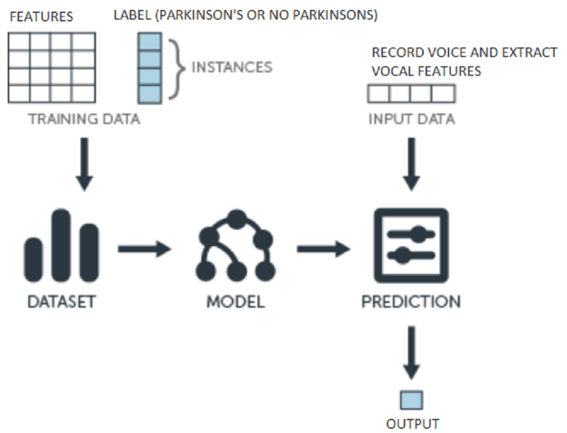
Implementation details
Project Pipeline

Slide 9
Summary of Procedure
Split the Parkinson’s Dataset into two parts: one for training, one for validation (evaluate how well the model performs) .
Train each of the following algorithms with the training set: Logistic Regression, Decision Tree, SVM with and without PCA.
Evaluate results using the validation set .
Repeat for the following training set to validation set splits: 80% training / 20% validation, 75% / 25%, and 70% / 30% .
Repeat for a rescaled version of the dataset (scale all the numbers in the dataset to a range from 0 to 1: this helps to reduce the effect of outliers) .

Slide 10
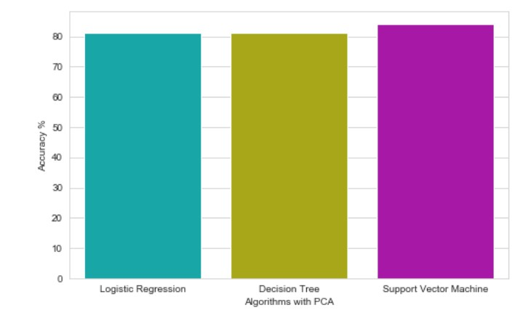
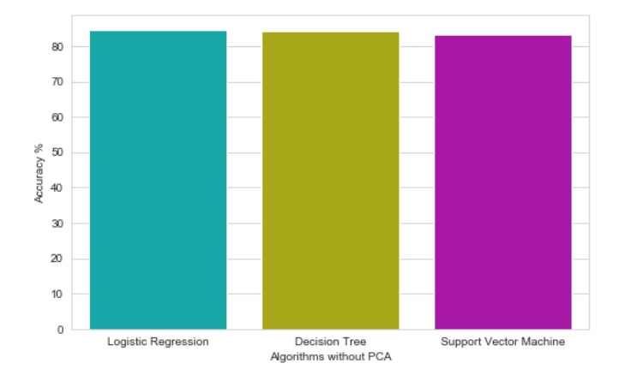
Results

Slide 11
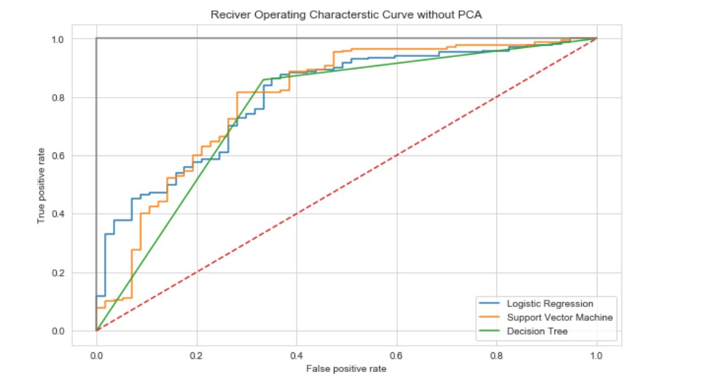
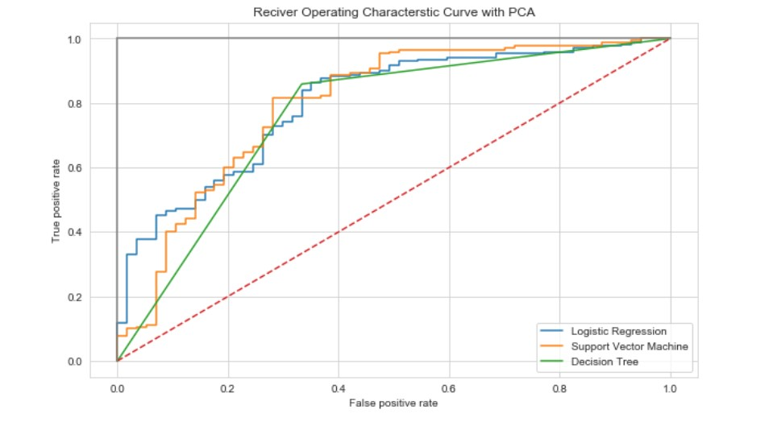

Slide 12
Results Analysis
 | Dataset-1 | Dataset-2
Logistic Regression | Without PCA 25.64 With PCA 25.64 | Without PCA 84.58 With PCA 81.05
Decision Tree | without PCA 74.35 With PCA 74.35 | Without PCA 84.14 With PCA 81.05
Support vector Machine | without PCA 74.35 With PCA 74.35 | Without PCA 83.25 With PCA 84.14 | Stratified k-folding (k=10) 86.63 for dataset-1 88.06 for dataset-2

Slide 13
Conclusion & Significance
The early detection of PD is essential to a better understanding of the disease causes, initiate therapeutic interventions, and enable developing appropriate treatments
These robust results suggest that a machine learning approach can indeed be implemented to significantly improve diagnosis methods of Parkinson’s disease. Given the necessity of early diagnosis for effective treatment, my machine learning models provide a very promising alternative to the current, rather ineffective method of diagnosis.
Current methods of early diagnosis are only 53% accurate, while our machine learning model produces 86% accuracy. This increase is critical because an accurate, early diagnosis is needed to effectively treat the disease.
Typically, by the time the disease is diagnosed, 60% of nigrostriatal neurons have degenerated, and 80% of striatal dopamine have been depleted.

Slide 14
With an earlier diagnosis, much of this degradation could have been slowed or treated.
Our results are very significant because Parkinson’s affects over 10 million people worldwide who could benefit greatly from an early, accurate diagnosis.
Not only is my machine learning approach more accurate in terms of diagnostic accuracy, it is also more scalable, less expensive, and therefore more accessible to people who might not have access to established medical facilities and professionals.
The diagnosis is also much simpler, requiring only a 10-15 second voice recording and producing an immediate diagnosis.

Slide 15
Future research
Given more time and resources, we would investigate the following:
1.Use larger datasets in conjunction with the University of Oxford dataset.
2.Tune and improve our models even further to achieve even better results.
3.Investigate different structures and types of neural networks.
4.Construct a novel algorithm specifically suited for the prediction of Parkinson’s.
5.Generalize our findings and algorithms for all types of dementia disorders, such as Alzheimer’s

Slide 16


