Slide 1
An Improved Random Forest Model for the Prediction of Dam Displacement
Batch : 7
Guide : Sri . N. Hanumantha Rao
T. Sai Mukhesh (Y18CS166)
Y. Sandeep Reddy (Y18CS180)
T. Ashish (Y18CS162)

Slide 2
Abstract
Dam behavior prediction is a classic problem in the monitoring of dam structure. To obtain accurate results, different researchers have established various models.
However, the models of predecessors rarely studied the nonlinear characteristics of dam displacement data and the abnormal values of monitoring data. It means that abnormal values will contaminate data set, and consequently reduce the accuracy of model predictions.
In this novel technique, an improved Random Forest (RF) model was proposed for analyzing dam displacement prediction and was coupled with a sliding time window strategy. The proposed model is developed by the following steps.
First, for the purpose of alleviating the time-lag effect of impact factor phenomenon, a sliding time window strategy was introduced into the RF model to improve the time sensitivity.

Slide 3
Second, aiming to determine the hyperparameters, Grid Search (GS) was introduced into RF model to improve the global optimization ability.
This development takes masonry arch dam126. as example, and adopts the horizontal displacement recorded by Global Navigation Satellite Systems (GNSS) as the research object.
The accuracy and validity of the proposed model are verified and evaluated based on the evaluation criteria. This technique provide better prediction based on short-term monitoring data.
It also has strong robustness on the abnormal data series, has simpler structures and less parameters, and requires less time for model training, so it can be a potential tool for actual monitoring tasks.

Slide 4
INTRODUCTION
As of now there are more than 58,000 dams distributed in 96 countries
The Hydropower is considered to be the best choice for green energy
However, with the development of hydropower, long-term maintenance of dams should be considered. Today, dam damage, or failures are caused by various reasons, increase in external load because of abnormal weather, and poor durability because of the aging of existing dams.
Structural failure is not a sudden process hence monitoring and early warning model based on the observed data, and to identify abnormal behaviors as early as possible so as to eliminate or minimize adverse impact.

Slide 5
Dataset
Date | Water level | Temperature | Air | Pore pressure | Flood
9-Aug-98 | 16504 | 0.41 | 4.62 | 18.59 | 0.1
######## | 18532 | 1.38 | 5.19 | 22.05 | 0.4
######## | 17194 | 1.98 | 4.81 | 25.18 | 0.6
######## | 17194 | 2.58 | 4.81 | 28.08 | 0.7
######## | 16351 | 2.94 | 4.57 | 29.41 | 0.8
######## | 15712 | 0.18 | 4.4 | 24.2 | 0.1
######## | 16425 | 0.57 | 4.6 | 26.07 | 0.2
9-Aug-99 | 16259 | 0.44 | 4.55 | 20.24 | 0.1
######## | 16973 | 0.97 | 4.75 | 22.03 | 0.3
######## | 16973 | 1.51 | 4.75 | 24.52 | 0.4
######## | 19650 | 2.8 | 5.5 | 28.13 | 0.8
######## | 17187 | 3.39 | 4.81 | 30.59 | 1
######## | 15228 | 3.44 | 4.26 | 32.56 | 1
######## | 16544 | 0.42 | 4.63 | 10.22 | 0.1
######## | 16544 | 0.83 | 4.63 | 14.21 | 0.2
######## | 17496 | 1.52 | 4.9 | 18.21 | 0.4
######## | 25535 | 4.45 | 7.14 | 24.51 | 1.3
######## | 25282 | 7.31 | 7.07 | 30.56 | 2.1
19-Jul-03 | 16625 | 0.44 | 4.65 | 21.22 | 0.1
20-Jul-03 | 16449 | 0.83 | 4.6 | 24.39 | 0.2
21-Jul-03 | 21100 | 2.52 | 5.9 | 28.41 | 0.7
22-Jul-03 | 17955 | 3.33 | 5.02 | 30.96 | 1
23-Jul-03 | 15950 | 3.58 | 4.46 | 32.35 | 1
30-Jul-03 | 16962 | 4.12 | 4.75 | 24.1 | 1.2
31-Jul-03 | 24146 | 6.66 | 6.76 | 27.09 | 1.9

Slide 6
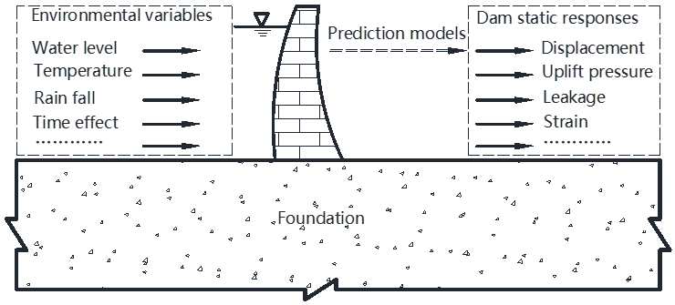
Dam Architecture

Slide 7
Traditional model
Traditional statistical models mainly use the hydrostatic-seasonal-time (HST) model, (h; s; t) [29], which can be divided into three parts:
the hydrostatic component (the influence of reservoir water), (h);
d(h) = Σαh(t)
the seasonal component (associated predominantly with temperature), (s);
d(s) = Σ(b1sin(2πit/365) + b2cos(2πit/365))
the irreversible component (the dissipation of hear of hydration, creep, alkali-aggregate reaction, and so on), (t);
d(t) = c0 ln(t) + c1 t
The HST model can be written as follows:
d(h, s, t) = d(h) + d(s) + d(t) + e

Slide 8
Multi-Layer Perceptron
Multi-layer perception is fully connected dense layers, which transform any input dimension to the desired dimension.
A multi-layer perception is a neural network that has multiple layers.
To create a neural network we combine neurons together so that the outputs of some neurons are inputs of other neurons.
It has one input layer and for each input, there is one neuron(or node), it has one output layer with a single node for each output and it can have any number of hidden layers and each hidden layer can have any number of nodes.

Slide 9
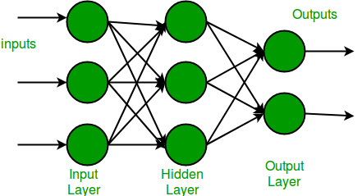
MLP Architecture
Notes:
A schematic diagram of a Multi-Layer Perceptron (MLP)

Slide 10
Every node in the multi-layer perception uses a sigmoid activation function.
The sigmoid activation function takes real values as input and converts them to numbers between 0 and 1 using the sigmoid formula.
F(x) = 1/(1+exp(-x))
This allows for probability-based predictions or classification of items into multiple labels

Slide 11
Disadvantages
MLP with hidden layers have a non-convex loss function where there exists more than one local minimum. Therefore different random weight initializations can lead to different validation accuracy.
MLP requires tuning a number of hyperparameters such as the number of hidden neurons, layers, and iterations and is a sensitive feature to scaling.

Slide 12
Random Forest
An ensemble classifier using many decision trees.
It can be used for Classification or Regression.
One of the most important features of the Random Forest Algorithm is that it can handle the data set containing continuous and categorical variables for regression and classification respectively.
It performs better results for classification problems.
Accuracy in results is relatively high when compared.

Slide 13
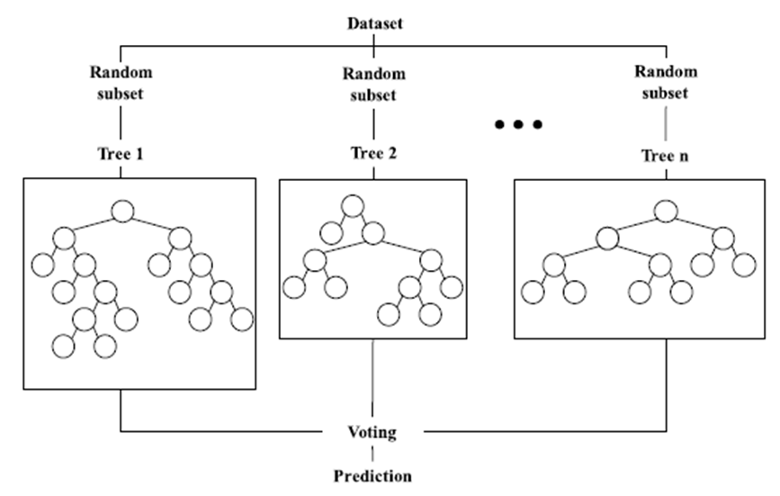
Random Forest Architecture

Slide 14
Disadvantages
A forest is less interpretable than a single decision tree. Single trees may be visualized as a sequence of decisions.
A trained forest may require significant memory for storage, due to the need for retaining the information from several hundred individual trees.
Although random forests can be an improvement on single decision trees, more sophisticated techniques are available. Prediction accuracy on complex problems is usually inferior to gradient-boosted trees.

Slide 15
LSTM
LSTM is a special kind of recurrent neural network capable of handling long-term dependencies.
LSTM mans Long Short Term Memory which is a type of recurrent neural network.
Long Short-Term Memory Network is an sequential network, that allows information to persist.
A recurrent neural network is used for persistent memory. It is capable of handling the vanishing gradient problem faced by RNN.

Slide 16
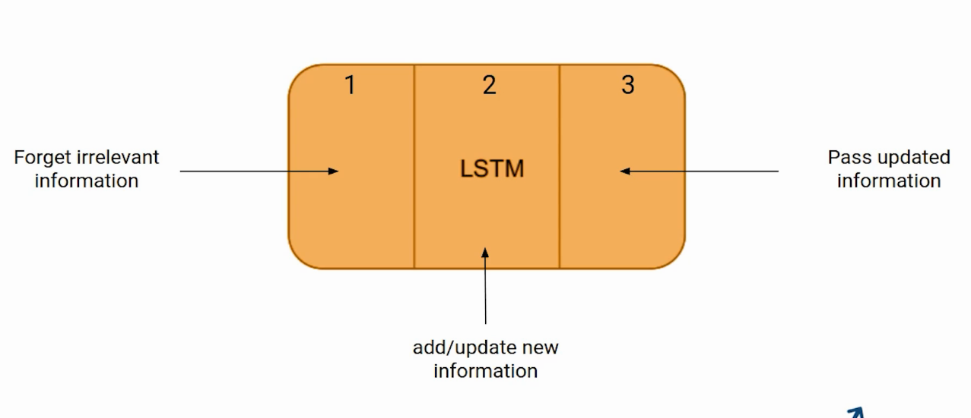
LSTM Architecture:
Three parts of an LSTM cell are known as gates. The first part is called Forget gate, the second part is known as the Input gate and the last one is the Output gate.

Slide 17
Disadvantages of LSTM:
LSTMs take longer time to train.
LSTMs require more memory to train.
LSTMs are easy to overfit.
Dropout is much harder to implement in LSTMs.
LSTMs are sensitive to different random weight initializations.

Slide 18
CNN:
A Convolutional Neural Network (CNN) is a Deep Learning algorithm which can take in an input , assign importance (learnable weights and biases) to various aspects/objects in the data and be able to differentiate one from the other.
The role of the ConvNet is to reduce the images into a form which is easier to process, without losing features which are critical for getting a good prediction.

Slide 19
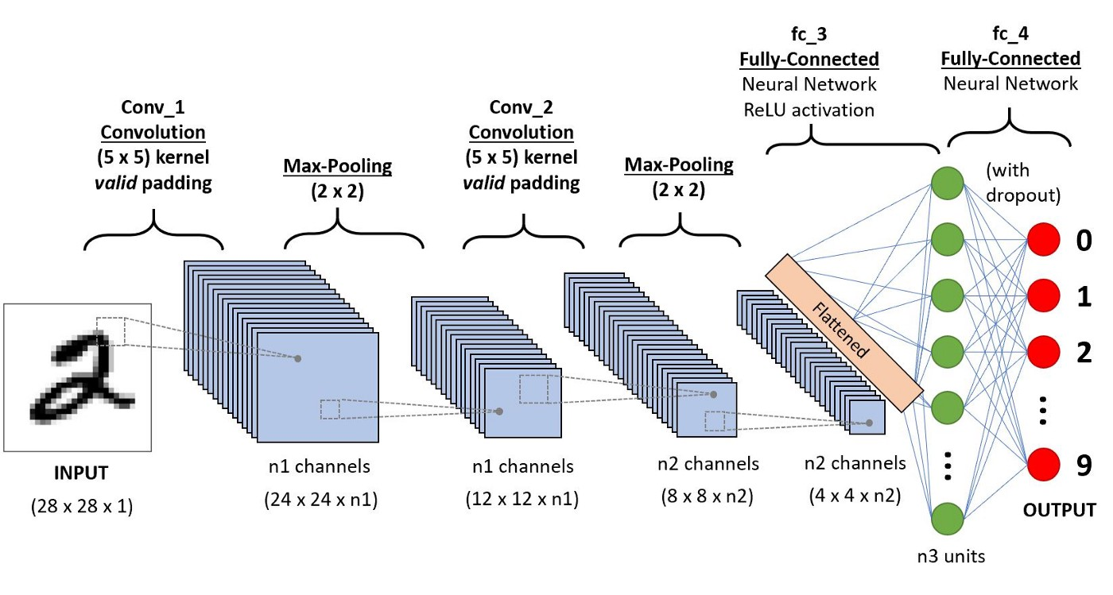
CNN Architecture:

Slide 20
Disadvantages of CNN:
CNN are slower and also requires many parameters.
Lots of training data is required.
CNN cannot handle orientations i.e., if a image is trained at some angle and if the image is rotated by some angle then CNN has some issues with it.

Slide 21
Proposed Model
To predict dam displacement many machine learning algorithm models was developed but their performance is not accurate as they not consider any time series or sliding window data (combination of old and new data based on data or times).
To overcome from this problem author of this paper has introduced Improved Random Forest algorithm which consists of two modules:
Sliding Window Technique
Grid Search

Slide 22
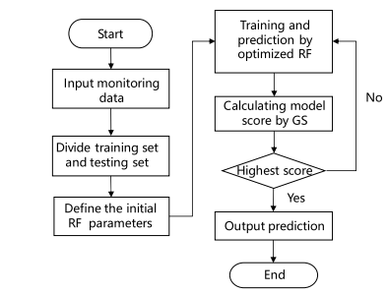
Improved Random Forest

Slide 23
Steps in our proposed model
According to the length of the sliding time window, this study obtains the time sub-sequence basic block data set of the arch dam displacement monitoring data.
Divide the data set into a training set and a testing set, and the data are standardized to facilitate model training and speed up model testing
Define the initial Random Forest model
Input the testing set into the optimized model and the predicted value of the arch dam displacement is obtained, which is the average value of each regression tree
Use the Grid Search method to calculate the score of the model on the testing set.
Compare the model performance of the RF, MLP, CNN, LSTM and the optimized RF.

Slide 24
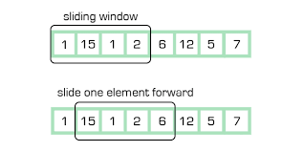
Sliding Window Strategy
As its name suggests, this technique involves taking a subset of data from a given array or string, expanding or shrinking that subset to satisfy certain conditions, hence the sliding effect.
Sliding window technique is useful for solving problems in array or string, especially it is considered as a technique that could reduce the time complexity from O(n²) to O(n).
This module will add old and new data to training model and the main purpose of alleviating the time-lag effect of impact factor phenomenon, a sliding time window strategy was introduced into the RF model to improve the time sensitivity

Slide 25
Grid Search
This algorithm will take optimized parameters such as feature selection, Estimator and cross validation values with Random Forest algorithm to train model multiple times and then select model with best score and due to this optimization technique we will get accurate model.
The main advantage of introducing Grid Search into RF model to improve the global optimization ability by searching hyperparameter space.
Hyperparameters are parameters whose values control the learning process and determine the values of model parameters that a learning algorithm ends up learning.

Slide 26
Advantages
Proposed Model has delivered a better accuracy than the existing models.
Our model works well with data with some abnormalities.
This model observed to have better performance in long term predictions.

Slide 27
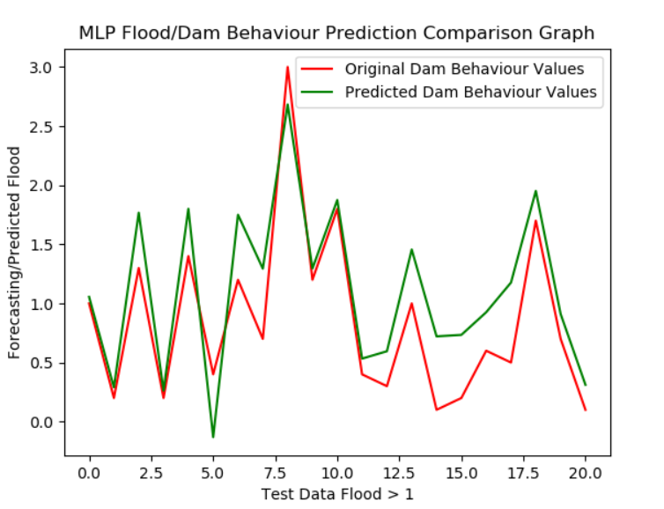
Results
MLP

Slide 28
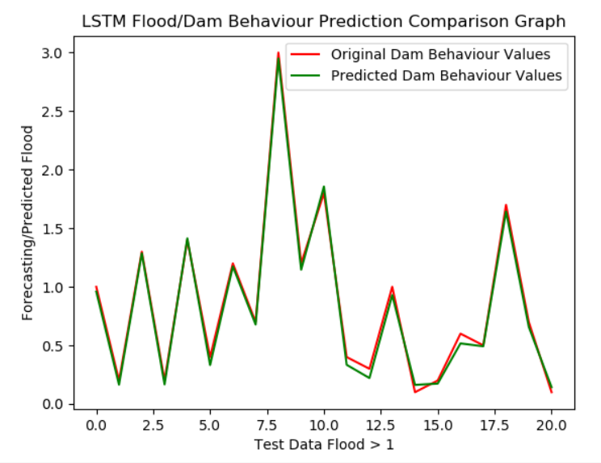
LSTM

Slide 29
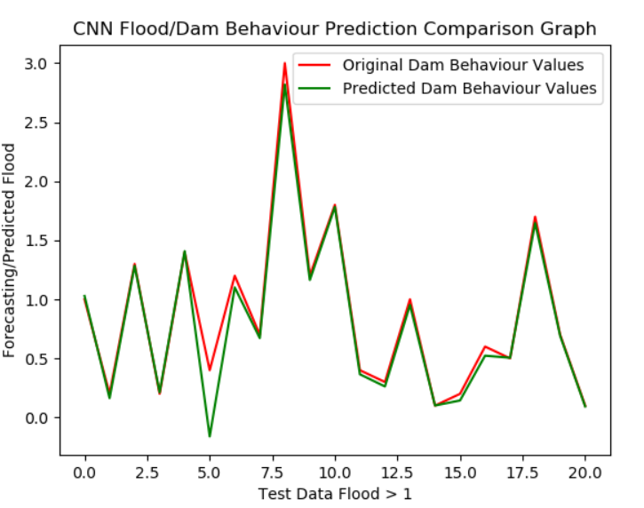
CNN

Slide 30
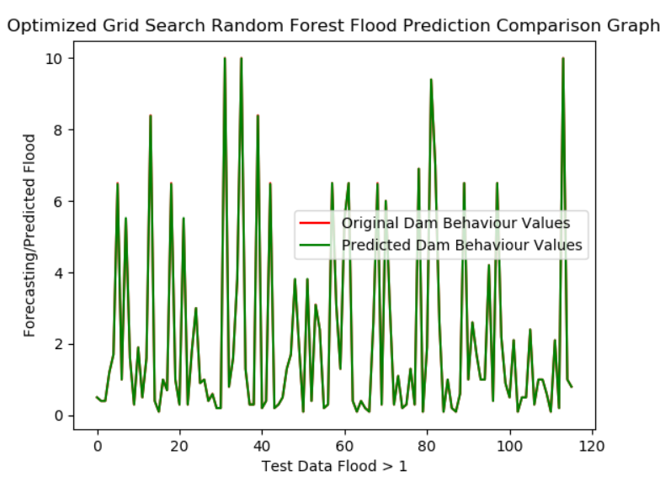
Improved Random Forest

Slide 31
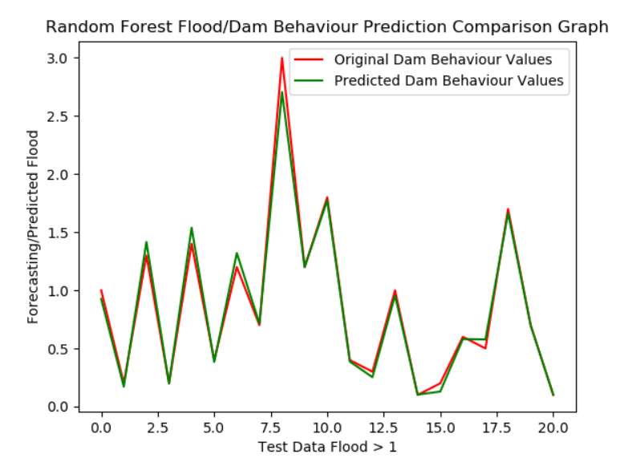
Random Forest

Slide 32
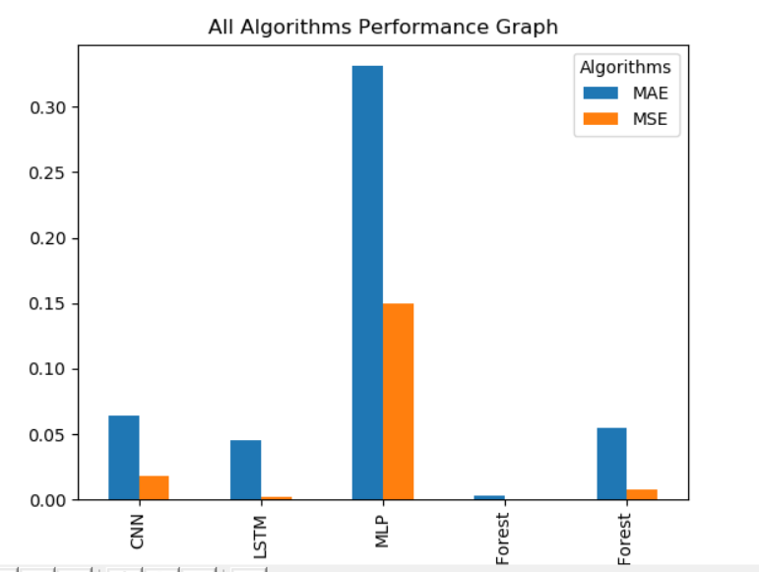
MAE and MSE

Slide 33


