Slide 1
DMP_MI
An Effective Diabetes Mellitus Classification Algorithm on Imbalanced Data With Missing Values
Guided By:
Ch Ratna Babu
By
Madhavi.V Y18CS171
Sajida Begum.SK Y18CS158
Swetha.M L19CS193

Slide 2
CONTENTS
Abstract
Existing Systems
Drawbacks of Existing System
Proposed System
Frame Work of DMP_AI Algorithm
Data Set
Algorithms used
Conclusion

Slide 3
ABSTRACT
As a widely known chronic disease, diabetes mellitus is called a silent killer. It makes the body produce less insulin and causes increased blood sugar, which leads to many complications and affects the normal functioning of various organs, such as eyes, kidneys, and nerves. Although diabetes has attracted high attention in research, due to the existence of missing values and class imbalance in the data, the overall performance of diabetes classification using machine learning is relatively low. This paper focuses on how to achieve a good performance for diabetes classification. Usually, there are missing values and class imbalance problems in medical data, which has a big influence on the classification accuracy. An effective Prediction algorithm for Diabetes Mellitus classification on Imbalanced data with Missing values (DMP_MI) is proposed.

Slide 4
EXISITING SYSTEM
Various techniques have been applied for diabetes diagnosis and classification by using,
Artificial neural network (ANN) and artificial immune system (AIS)-76.0% accuracy
Linear discriminant analysis (LDA) with support vector machine (SVM)-77.6% accuracy
Class-wise k Nearest Neighbor (CkNN) method-78.2% accuracy
A hybrid classification model of multilayer perceptron-80% accuracy
K-Nearest Neighbor (KNN), Naïve Bayes (NB), Iterative Dichotomiser 3 (ID3), Classification and Regression Tree (CART).
A Gaussian process based classification technique with three kernels of linear, polynomial and radial basis-82%
Karegowda have achieved the best accuracy of 84.7%, through using a hybrid model, which integrated genetic algorithm (GA) and back propagation network (BPN)

Slide 5
DRAWBACKS
The following conclusions can be drawn from the above literatures
The prediction accuracy of diabetes diagnosis remains as a challenging problem.
Missing value in medical data is a common phenomenon.
Class imbalance plays a vital role in the classification process, and the accuracy rate alone cannot sufficiently represent classification performance

Slide 6
PROPOSED SYSTEM
To address the above challenges, This propose a prediction algorithm taking into account the problems of missing data and class imbalance.
First, the Naïve Bayes method is used to compensate for missing values.
Then, the Adaptive synthetic sampling method (ADASYN) is adopted to oversample the dataset, increasing the number of minor class so as to achieve a balance of classes.
Finally, a machine learning algorithm Random Forest (RF) is adopted as the classifier, RF draws on the advantage of ensemble learning, namely, several decision trees are integrated to form a new strong predictor.
The DMP_MI algorithm described here has achieved 87.10% classification accuracy on real diabetes dataset, which outperforms many other algorithm.

Slide 7
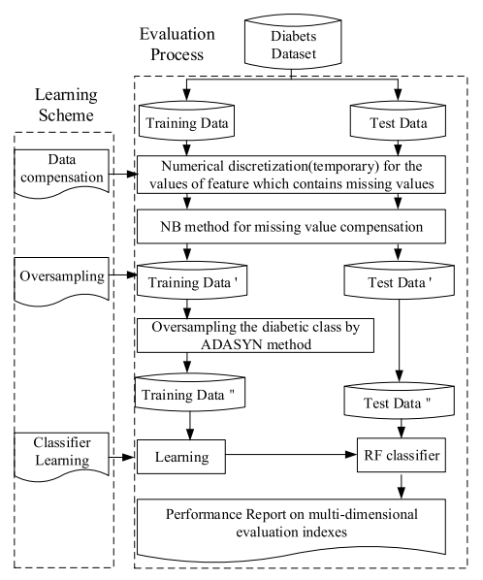
FRAMEWORK OF DMP_MI ALOGORITHM

Slide 8
DATA SET
Experiments are performed using the Pima Indians Diabetes Database (PIDD) taken from UCI Repository.
Like most medical data, there are missing values and distribution imbalance.
The PIDD dataset contains 768 samples, where there are only 392 samples without missing values. Also, diabetic and non-diabetic samples are 268 and 500 respectively, which presents class imbalance.
It comprises 8 numeric-valued features and a class label, where
the value `0' for a class means negative for diabetes
the value `1' means positive for diabetes.

Slide 9
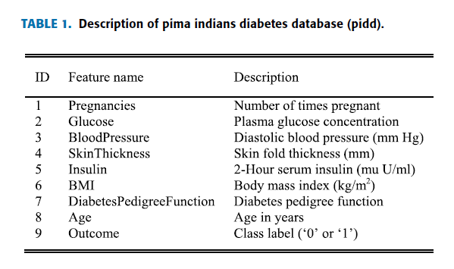
DATA BASE DESIGN
We had created a database named as “ new rent”.
This database mainly consist of 4 tables:
1.admin
2.room_rental_registrations
3.room_rental_registrations_apartments
4.users

Slide 10
ALGORITHMS USED IN PROJECT
DMP_MI ALGORITHM
RANDOM FOREST
DECISION TREE CLASSIFICATION
SUPPORT VECTOR MACHINE
K NEAREST NEIGHBORS
LOGISTIC REGRESSION

Slide 11
DMP_AI ALGORITHM
The steps of DMP_MI algorithm are given below:
As NB is a classification method, to predict the missing values of a continuous-valued feature, numerical discretization should be done first. However, the discretized data is only used for the step of missing value compensation, it is original data without numerical discretization that is used when making the final diabetes classification.

Slide 12
The feature being compensated is viewed as the output label, the remaining features are used as the input. The dataset is divided into test set and training set according to whether the output label is missing or not. If there is an output label, the data will be divided into the training dataset, or, it will be divided into the test dataset. The missing value is compensated according to Naïve Bayes method. This is repeated until all features are compensated.
According to the ADASYN method, the classes of diabetes only contains diabetic and non-diabetic. ADASYN method is used to oversample the minor class, namely the diabetic class. Then, the numbers of diabetic and non-diabetic samples are consistent with each other, and the purpose of balancing the class data is achieved.
The classification procedure follows the steps to construct n CART trees and form a random forest. The final classification result will be given by the joint voting of multiple trees.

Slide 13
ADYSYN
The ADASYN method is an adaptive data generation method, which can generate samples adaptively to reduce the class imbalance of a dataset.
Input for the Algorithm:
Training Dataset: Dᵣ with m samples with {xᵢ, yᵢ}, i= 1 to m, where xᵢ is
an n-dimensional vector in feature space and yᵢ is the corresponding
class.
Let mᵣ and mₓ be the number of minority and majority class
samples respectively, such that mᵣ ⪯ mₓ and mᵣ + mₓ = m

Slide 14
Calculate the Degree of Imbalance, d = mᵣ / mₓ
If d < dₓ ( where dₓ is the preset threshold for maximum tolerated imbalance) then:
Calculate the number of synthetic samples to be generated from the minority class: G = (mₓ — mᵣ) × β, β is the balance level of the synthetic samples generated. β = 1 means there is a total balance between two classes.
For each xᵢ ∈ minority samples, find the k-nearest neighbors based on Euclidean distance and calculate the ratio rᵢ, rᵢ = Δᵢ / K
Normalize rₓ ← rᵢ / ∑ rᵢ, such that rₓ is now a density distribution.

Slide 15
Calculation of synthetic sample generated for each minority datapoint gᵢ = rₓ × G, where G is the total number of synthetic data examples that need to be generated for the minority class as defined in a forementioned Equation.
For each minority class data example xᵢ, generate gᵢ synthetic data examples according to the following steps:
Do the Loop from 1 to gᵢ:
Randomly choose one minority data example, xᵤ, from the K nearest neighbors for data xᵢ.
Generate the synthetic data example: sᵢ = xᵢ + (xᵤ − xᵢ) × λ where (xᵤ− xᵢ) is the difference vector in n-dimensional spaces, and λ is a random number: λ ∈ [0, 1].

Slide 16
RANDOM FOREST
Calculation of synthetic sample generated for each minority datapoint gᵢ = rₓ × G, where G is the total number of synthetic data examples that need to be generated for the minority class as defined in a forementioned Equation.
For each minority class data example xᵢ, generate gᵢ synthetic data examples according to the following steps:
Do the Loop from 1 to gᵢ:
Randomly choose one minority data example, xᵤ, from the K nearest neighbors for data xᵢ.
Generate the synthetic data example: sᵢ = xᵢ + (xᵤ − xᵢ) × λ where (xᵤ− xᵢ) is the difference vector in n-dimensional spaces, and λ is a random number: λ ∈ [0, 1].

Slide 17
DECISION TREE
Decision tree is the most powerful and popular tool for classification and prediction. A Decision tree is a flowchart like tree structure, where each internal node denotes a test on an attribute, each branch represents an outcome of the test, and each leaf node (terminal node) holds a class label.
Decision trees classify instances by sorting them down the tree from the root to some leaf node, which provides the classification of the instance. An instance is classified by starting at the root node of the tree, testing the attribute specified by this node, then moving down the tree branch corresponding to the value of the attribute .This process is then repeated for the sub tree rooted at the new node.

Slide 18
LOGISTIC REGRESSION
It is a classification not a regression algorithm.
It is used to estimate discrete values based on given set of independent variable(s).
it predicts the probability of occurrence of an event by fitting data to a logit function. Hence, it is also known as logistic regression.

Slide 19
KNN
It can be used for both classification and regression problems.
However, it is more widely used in classification problems in the industry.
K nearest neighbours is a simple algorithm that stores all available cases and classifies new cases by a majority vote of its k neighbours.
The case being assigned to the class is most common amongst its K nearest neighbours measured by a distance function.

Slide 20
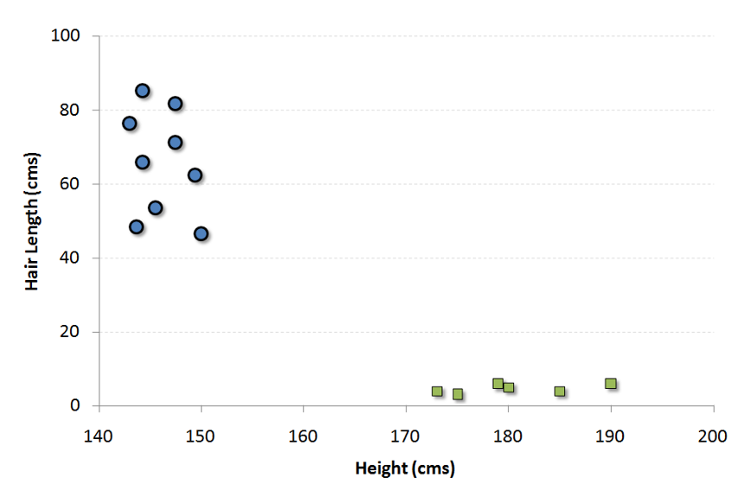
SUPPORT VECTOR MACHINE
It is a classification method.
In this algorithm, we plot each data item as a point in n-dimensional space (where n is number of features you have) with the value of each feature being the value of a particular coordinate.
For example

Slide 21
CONCLUSION
We have proposed a diabetes mellitus classification algorithm targeting the challenging characteristics of missing values and class imbalance problems seen in the diabetes dataset.
The algorithm has addressed both the data preprocessing and classification phases. High quality dataset was obtained by compensating missing values with decreased class imbalance.
In the comparison experiment results, the proposed DMP_MI algorithm has outperformed other algorithms on accuracy and other classifier performance indicators, and has shown great potential for diabetes prediction
In future, we hope to use the DMP_MI algorithm for the automatic analysis of diabetes with precise severity degree. There are also plans to extend and improve the algorithm to predict and diagnose other type of diseases

Slide 22


