Slide 1
Performance Evaluation of Machine Learning Methods for Credit Card Fraud Detection
Hari Krishna Vinjam (Y18CS176)
Venkata Nagasaidatha Pavan Vamsi Vulavala (Y18CS177)
Lakshmi Adinadh Somepalli (Y18CS159)
Guide: Dr. B. Varaprasad Rao Sir

Slide 2
Abstract
The advance in technologies such as e-commerce and financial technology (FinTech) applications have sparked an increase in the number of online card transactions that occur on a daily basis.
As a result, there has been a spike in credit card fraud that affects card issuing companies, merchants, and banks. It is therefore essential to develop mechanisms that ensure the security and integrity of credit card transactions.In this project, we implement a machine learning (ML) based framework for credit card fraud detection using a real world datasets that were generated from European credit cardholders.

Slide 3
This framework was evaluated using the following ML methods: Random Forest (RF), Gradient Boosting, Decision Tree (DT), and Extra Tree (ET).
Random Undersampling method is used to treat class imbalance problem.
The models were evaluated using the accuracy, the recall, the precision.

Slide 4
Introduction
Credit card Fraud occurs when an unauthorized or undesirable use of a credit card is made by a criminal .
This happens when the credit card authentication details are stolen using different types of fraudulent techniques such as intercepting an e-commerce transaction or cloning an existing card.

Slide 5
Introduction
In this project, we implement machine learning (ML) algorithms for credit card fraud detection that are evaluated on a real world dataset which was generated from European cardholders in September 2013.
In this project we measure the performance of machine learning models with and without balancing the dataset.

Slide 6
Dataset
The dataset used in this research was generated from European cardholders in September 2013.
This dataset is synthetic.
Further, the dataset has 1999999 card transactions in total.
There are 16 features in the dataset. Some of the the features within the dataset are numerical and some are categorical.

Slide 7
Features in dataset
User, Card, Year, Month, Time, Day, Amount, Use Chip, Merchant Name, Merchant City, Merchant State, MCC, Zip, Errors, Is Fraud are the features in the dataset.
Of these Use Chip, Merchant Name, Merchant City, Merchant State, MCC, Zip, Errors are categorical variables.
User, Card, Year, Month, Time, Day, Amount and are numerical variables.
Is Fraud is the target variable.

Slide 8
Features in dataset
The class (label) is represented by the last column whereby the value of 0 represents a legitimate transaction and the value of 1 is a fraudulent activity.

Slide 9
METHODS
Decision Tree
Random Forest
Gradient Boosting
Extra tree

Slide 10
1.Random Forest
Random Forest is a robust machine learning algorithm that can be used for a variety of tasks including regression and classification.
It is an ensemble method, meaning that a random forest model is made up of a large number of small decision trees, called estimators, which each produce their own predictions.
The random forest model combines the predictions of the estimators to produce a more accurate prediction.

Slide 11

Diagram

Slide 12
2.Extreme Gradient Boosting(XGBoost)
Gradient boosting refers to a class of ensemble machine learning algorithms that can be used for classification or regression predictive modeling problems.
Ensembles are constructed from decision tree models.
Trees are added one at a time to the ensemble and fit to correct the prediction errors made by prior models.
This is a type of ensemble machine learning model referred to as boosting.

Slide 13
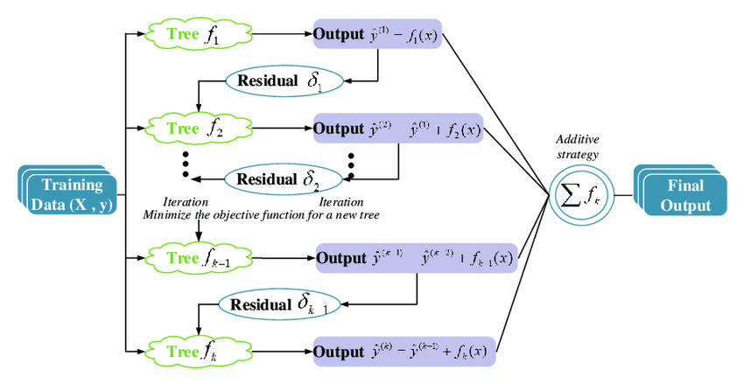
Diagram

Slide 14
3.decision tree
A decision tree is a flowchart-like structure in which each internal node represents a "test" on an attribute (e.g. whether a coin flip comes up heads or tails)
Each branch represents the outcome of the test, and each leaf node represents a class label (decision taken after computing all attributes).

Slide 15
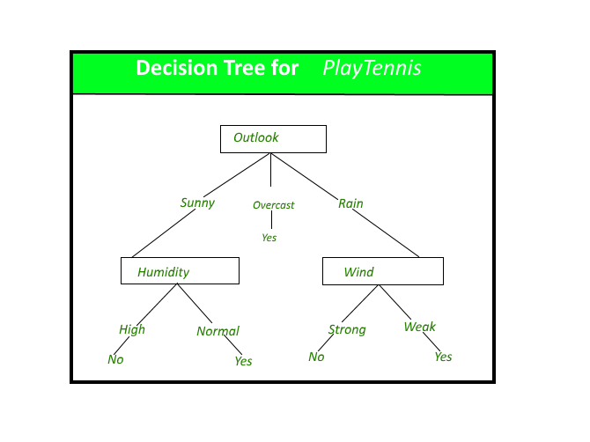
Diagram

Slide 16
4.Extra tree
Extra Trees is an ensemble machine learning algorithm that combines the predictions from many decision trees.
It is related to the widely used random forest algorithm. It can often achieve as-good or better performance than the random forest algorithm,although it uses a simpler algorithm to construct the decision trees used as members of the ensemble.

Slide 17
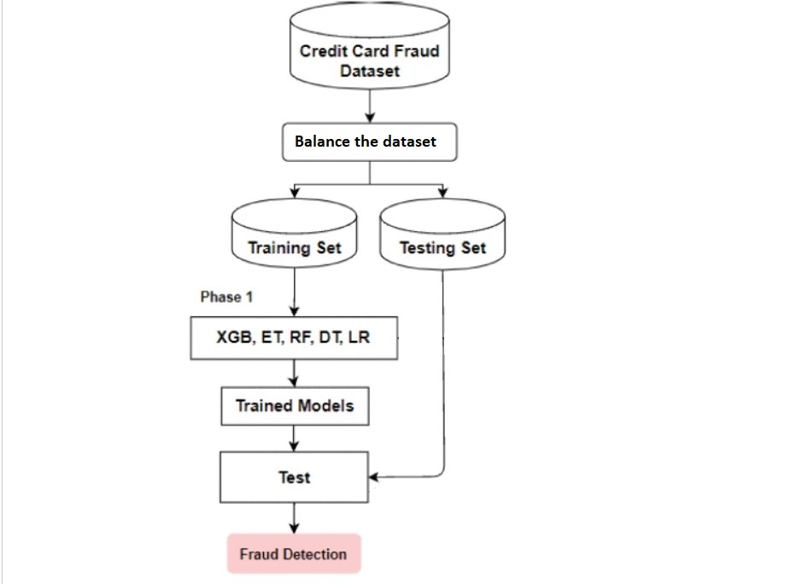
SYSTEM DESIGN

Slide 18
EXPERIMENTAL SETUP
The classification experiments will be conducted on Google Colab or Jupyter Notebook.
The ML models were implemented using the Scikit-Learn ML framework.

Slide 19
PERFORMANCE METRICS
The credit card fraud dataset that is used in this research contains traces of legitimate and fraudulent transactions that are labeled as 0s and 1s .
Therefore, we have framed this ML task as a binary classification task. Such problems are evaluated using performance metrics that includes: the accuracy (AC ), the recall (RC ), and the precision (PR ).
False positive (FP): correct transactions that are incorrectly labeled as fraudulent

Slide 20
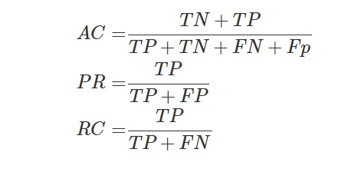
PERFORMANCE METRICS
False Negative (FN): fraudulent transactions that are incorrectly classified as legitimate transactions.
True positive (TP): fraudulent activities that are accurately flagged fraudulent.
True Negative (TN): genuine transactions that are positively classified as genuine.

Slide 21
Results without balancing the dataset
Model | Accuracy | Precision | Recall
Decision tree | 99 | 59 | 63
Random Forest | 99 | 97 | 37
Gradient Boosting | 99 | 76 | 8
Extra Tree | 99 | 93 | 33
Results after balancing the dataset
Model | Accuracy | Precision | Recall
Decision tree | 89 | 90 | 89
Random Forest | 92 | 96 | 88
Gradient Boosting | 88 | 93 | 83
Extra Tree | 89 | 89 | 87

Slide 22
CONCLUSION
This project implemented several ML algorithms for credit card fraud detection using the European credit card fraud dataset that was generated in September 2013. The ML methods proposed in this work included the DT, RF, ET, XGB.
Random Undersampling is used to treat the class imbalance problem.
Before balancing the dataset all models performed poorly on precision and recall.
After balancing the dataset there is a significant improvement in performance of the models

Slide 23

THANK YOU

