Slide 1

What is Linux?
Linux Overview
Linux Distros
Windows vs Linux vs Unix

Slide 2






Introduction
Linux is a Unix-like, open source and community-developed operating system (OS) for computers, servers, mainframes, mobile devices and embedded devices. It is supported on almost every major computer platform, including x86, ARM and SPARC, making it one of the most widely supported operating systems.
Linux Distros
S.NO | Linux | Windows
1. | Linux is an open source operating system. | While windows is proprietary
2. | Linux is free of cost. | Need to purchase
3. | It’s file name case-sensitive. | Not case-sensitive
4. | In linux, monolithic kernel is used. | While in this, micro kernel is used.
5. | There are 3 types of user account – (1) Regular , (2) Root , (3) Service account | There are 3 types of user account – (1) Administrator , (2) Standard , (3) Guest
6. | Root user is the super user and has all administrative privileges. | Administrator user has all administrative privileges of computers.

Slide 3
Features Of Linux
Multiuser Capacity.
Multitasking.
Security.
GUI.
File System.
Open Source.
Kernel - Shell.

Slide 4
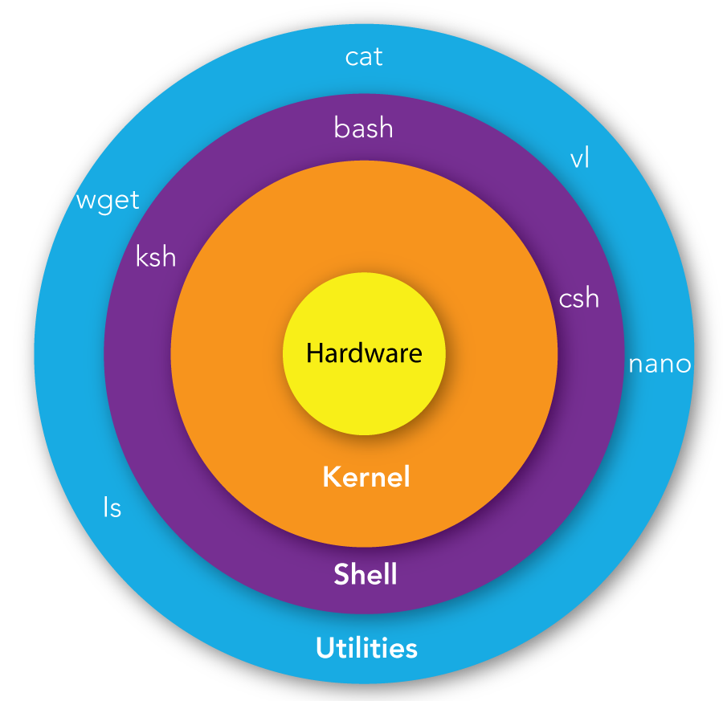
Linux Kernel And Shell Model

Slide 5
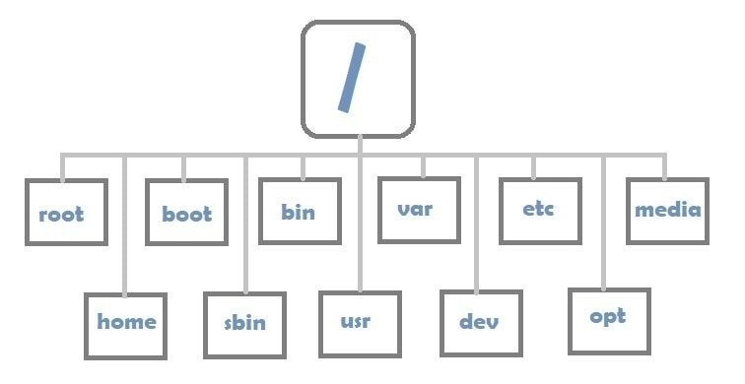
File System
What is s File System
Windows vs Linux File System
Linux File System Model

Slide 6
Installing Linux Subsystem in Windows.
Basic Linux Commands
ls pwd man
exit sudo ps/kill
date echo hostname
wget tar ping
whoami whois ifconfig
Command history with arrow keys

Slide 7
File Permissions:
To check the file permissions use command $ls –l
-rw-r--r-- 1 root root 46 Apr 14 16:37 example.txt
User Permissions:
--- --- ---
rwx rwx rwx -> Read, Write and Execute
user group other all
How to change file permissions using chmod
How to change group membership using chmod
Change permissions with regular mode and octal notations
How to change ownership of the file with chown

Slide 8
Managing Files and Directories
cd mkdir rm
cp mv cat
chmod chown touch
grep diff rm –r
sort curl id
tree df -H
Root User Commands
useradd/del/mod passwd systemctl
fdisk apt-get shutdown

Slide 9
nano and vi editors
- Install nano with package
To execute nano
$nano filename
To save the file ctrl+o
To close the app ctrl+x
To open a file to retain it’s formatting, add option –w
Basic nano text editor commands:
CTRL + A Lets you jump to the beginning of the line.
CTRL + E Lets you to jump to the end of the line.
CTRL + Y Scrolls page down.
CTRL + V Scrolls page up.
CTRL + G A Help window will pop out and show you all the available commands.
CTRL + O To save the file. Nano will ask you to edit or verify the desired file name.
CTRL + W Search for a specified phrase in your text. Press ALT + W to search for the same phrase again.
CTRL + K It cuts the entire selected line to the cut buffer (similar to clipboard).
CTRL + U To paste the text from the cut buffer into the selected line.
CTRL + J Justifies the current paragraph.
CTRL + C Shows the current cursor position in the text (line/column/character).
CTRL + R Opens a file and inserts it at the current cursor position.
CTRL + X To exit Nano text editor. It prompts a save request if you made any changes to the file.
CTRL + \ Replaces string or a regular expression.
CTRL + T Invokes the spell checker, if available.
CTRL + _ Lets you go to the specified line and column number.
ALT + A To select text. You can combine this command with CTRL + K to cut a specific part of the text to the cut buffer.

Slide 10
vi editor commands - vi editor comes along with shell
Moving the cursor by one character:
h – move the cursor left
l – move the cursor right
k – move the cursor up
j – move the cursor down
Moving the curser by word:
b – move to the start of a word
e – move to the end of a word
Moving curser by line:
0 (zero) – jump to the beginning of the line
$ – jump to the end of the line
:# – move to a specified line number
Moving by screen:
Ctrl + b – move back one full screen
Ctrl + f – move forward one full screen
Editing and Copying:
s – delete a character (and move into insert mode)
dw – delete to end of the word
db – delete to beginning of the word
u – undo
Ctrl + r – redo
yy – copy (yank) entire line
dd – cut (delete) entire line
p – paste after the cursor
v – select text using character mode
V – select lines using line mode
aw – select a word
y – yank (copy) the marked text
d – delete (cut) the marked text
p – paste the text after the cursor
Saving and Exiting
:w – save the file
:wq – save and close the file
:q! – quit without saving changes
^: set nu – sets the numbers

Slide 11
Package Management
Super User Mode – root user
$apt-get command
Installing packages in Linux
Ex: Apache, net-tools, ssh-geygen, tree etc.

Slide 12
Virtualization
Installing and configuring Virtual Box and deploying Linux
Deploying a Linux EC2 Machine on AWS.
SSH key based Authentication.
SSH Tools: Putty and MobaXterm

Slide 13

End of the Course
Thank you

