Slide 1
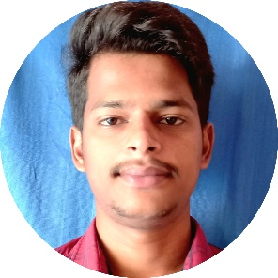
Kalyan Puramsetti
Highlights
Almost 2yrs(Sep 2021 – Present) of IT experience specialized in core java, Spring boot and microservices.
Worked for US based health insurance client that provides health and insurance benefits to the citizens
Worked for the development of above health insurance intranet web application.
4 months(Mar 2021 – July 2021) of internship at cognizant trained in Core java, J2EE, Spring Boot and Microservices, AWS(EC2, S3, RDS).
Developed an E-commerce web application as a mini-project.
Education
Experience
B.Tech - Electronics and Communication Engineering(2017-2021).
Developed almost four APIs(Login management, Data collection, Reports generation, Eligibility Determination(ED)) in our application.
Maintained one central MySQL RDS database that stored data for all APIs.
Swagger and Postman are used for the REST APIs testing.
Used SonarQube for the code review which detects bugs, vulnerabilities etc.
For the source code management used Gerrit-code-review and GitHub.
Used Jenkins tool to get code from github, to build using maven and to run in tomcat server.
Deployed and run APIs using AWS EC2 linux instance through MobaXterm.
Follow the Agile methodology for the project management.
Participated in regular meetings, code reviews, and submitted progress on time.
In internship developed PurchaseManagement Microservices which handles order request and cart details, Use MySQL cloud RDS database for storing of order and cart details.
For every order or cancellation request stored one kafka message in separate table.
Deployed using AWS EC2 instance and S3 bucket and made publicly accessible.
For source code management used Github.
Technical Skills
Languages: Core Java(Java 8), J2EE, AWS(EC2, S3, RDS), Linux.
Framework: Spring boot and Microservices, REST APIs.
Databases: MySQL
Tools: STS IDE, MySql workbench, Postman, MobaXterm, Putty, Jira, Swagger, Jenkins, SonarQube, GitHub, Gerrit, Apache kafka.
Contact Details
Ph no: +916305628286
Email: puramsettikalyan99@gmail.com
1

