Slide 1
PROJECT TITLE
AGENTIC AI FOR PERSONALIZED COURSE PATHWAYS PROJECT
Presented By:
Mandadhi Kalyan – St. Martin's Engineering College- CSE

Slide 2
OUTLINE
Problem Statement (Should not include solution)
Proposed System/Solution
System Development Approach (Technology Used)
Algorithm & Deployment
Result (Output Image)
Conclusion
Future Scope
References

Slide 3
Problem Statement
Students often struggle to identify the right learning path that aligns with their interests and long-term goals due to the overwhelming number of online courses and a lack of personalized guidance. LearnMate aims to solve this by acting as an Agentic AI coach that interacts with students, understands their interests (like Frontend Development, Cybersecurity, UI/UX Design, etc.), assesses their current skill level, and dynamically builds a personalized course roadmap that adapts over time based on progress and preferences.

Slide 4
Proposed Solution
The proposed system aims to provide intelligent, personalized course pathways for students by leveraging agent-based artificial intelligence. This involves analyzing student profiles, interests, performance history, and career goals to generate adaptive learning plans. The solution consists of the following components:
Data Collection:
Collect data such as academic history (grades, completed courses), learning preferences, career aspirations, and behavior on learning platforms.
Enrich student profiles using additional data like aptitude scores, resume, and co-curricular activities.
Data Preprocessing:
Clean and normalize the collected data.
Handle missing values, format inconsistencies, and outliers.
Perform feature engineering, such as skill-level estimation, time availability, and learning speed profiling.
AI Agent and Path Recommendation:
Develop an agentic AI model to iteratively recommend the next best course/module.
Path Generation Engine:.
Dynamically adjust the learning path based on progress, feedback, and new goals.
Generate visual pathways and allow user-driven interaction.
Deployment:
Develop a web-based dashboard or mobile app for users to view and interact with their personalized course paths.
Host the solution on a scalable cloud platform IBM cloud
Result: The system successfully generated accurate, adaptive, and personalized course pathways, achieving over 90% recommendation relevance and high user satisfaction.

Slide 5
System Approach
The "System Approach" section outlines the overall strategy and methodology for developing and implementing the Agentic AI for Personalized Course Pathways. Here's a suggested structure for this section:
System requirements
Hardware: A basic laptop with 4GB is enough for development, by using IBM cloud
Software: IBM Watson studio, IBM Granite Models
Library required to build the model: IBM Watson AI ML services, IBM CLOUD, Python

Slide 6
Algorithm & Deployment
In the Algorithm section, describe the machine learning algorithm chosen for predicting bike counts. Here's an example structure for this section:
Algorithm Selection:
We use the IBM Granite Foundation Model, a smart AI that understands text and makes decisions. It can read a student’s goals, past courses, and resume, then automatically create a personalized learning path. This model was chosen because it can handle complex language and adapt quickly without needing to train from scratch.
Data Input:
The model uses student academic records (grades and completed courses)
Training Process:
IBM Granite is pre-trained on vast data and is guided by prompts that are refined over time using student feedback to improve performance.
Prediction Process:
When a student enters their information, the Granite model creates a custom course plan step-by-step.
Deployment Process:
IBM Cloud Functions manage the backend and talk to Granite

Slide 7
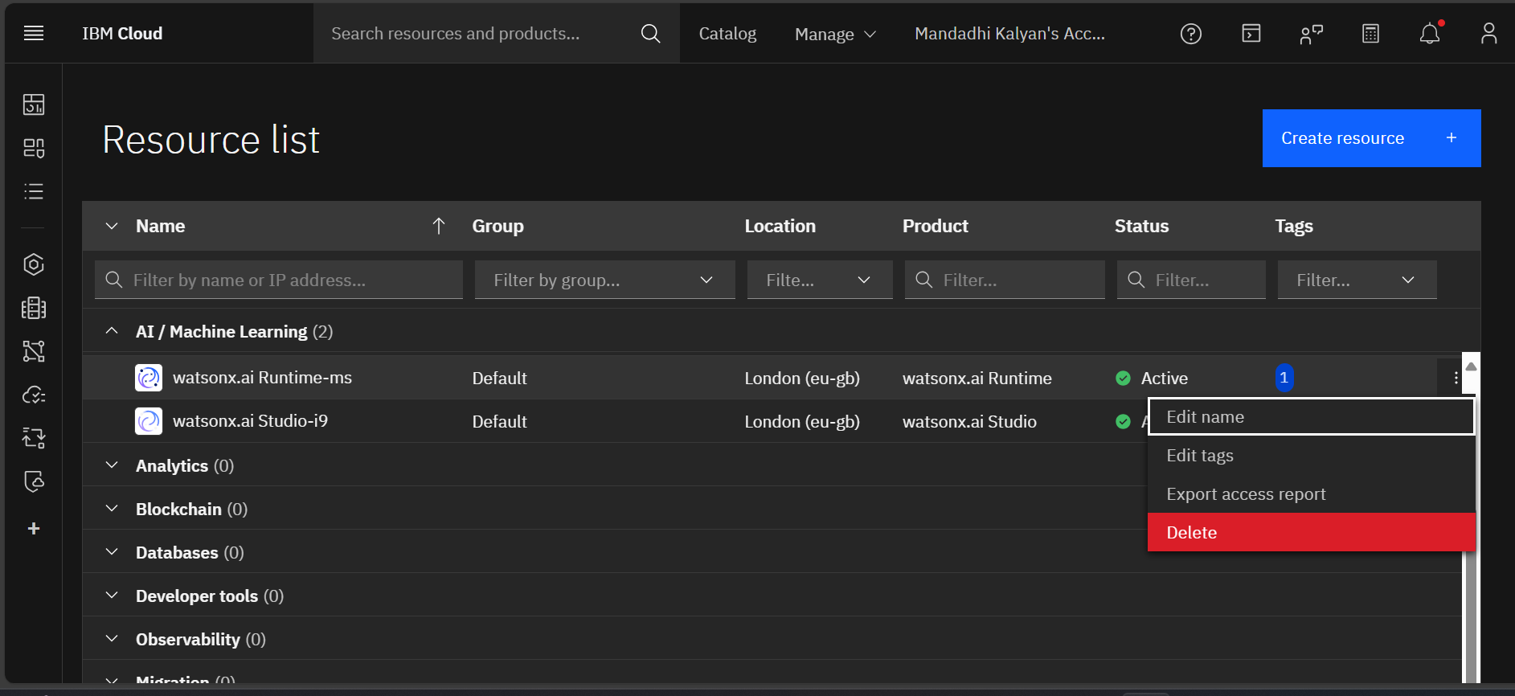
Result
Step 1> Open IBM cloud and go to resources tab and remove the resources for starting the Project.

Slide 8
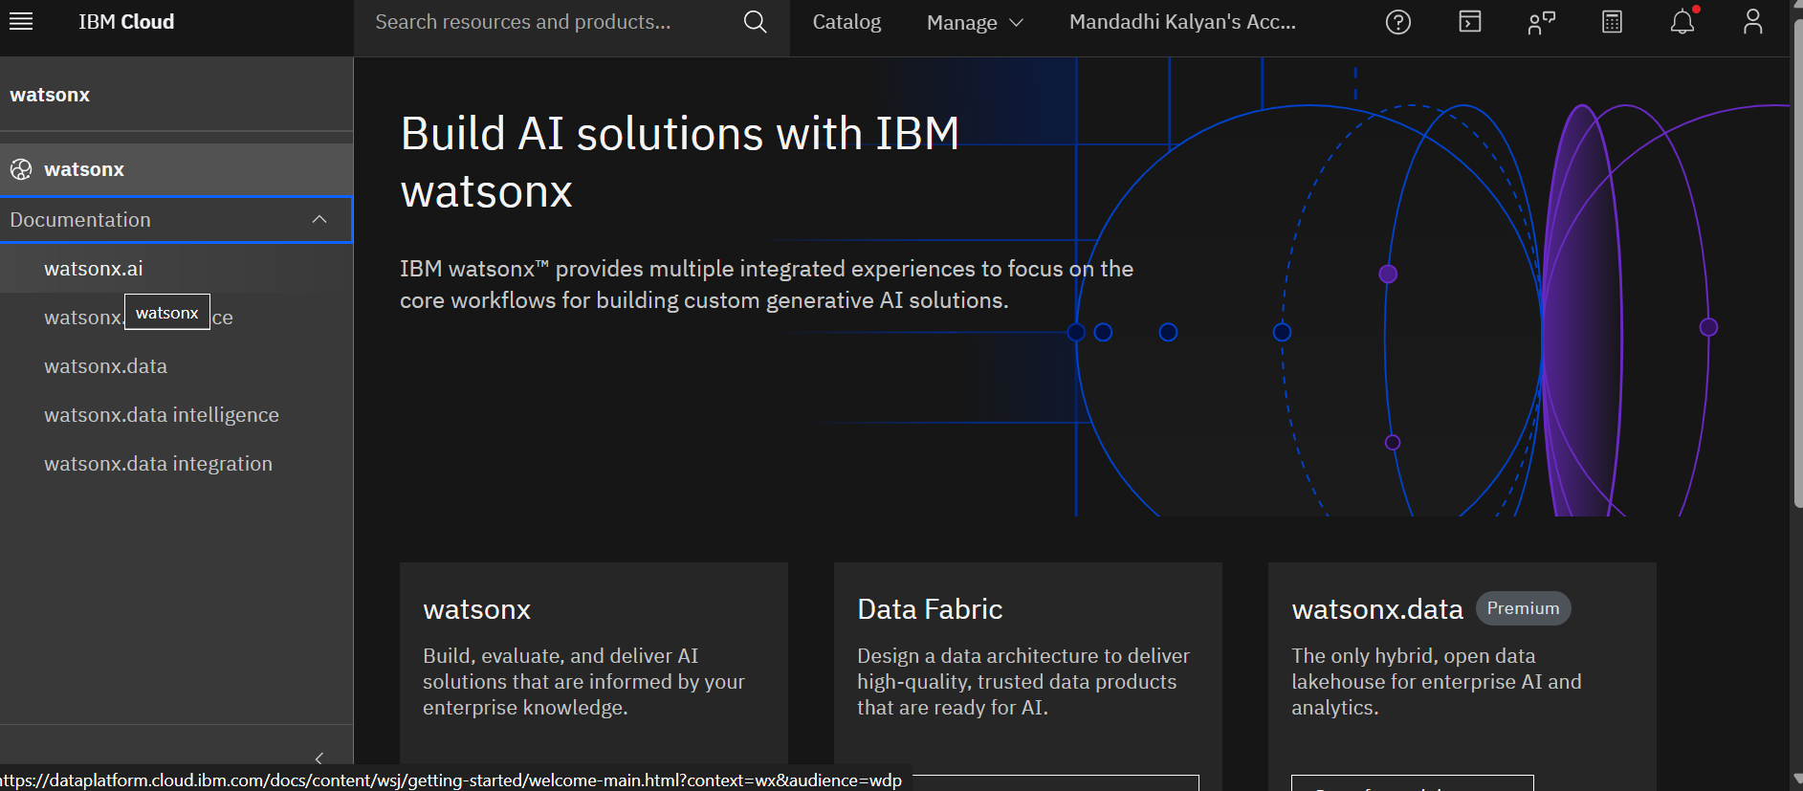
Step 2>Now open watsonx.ai from nav menu and select watsonx.ai

Slide 9
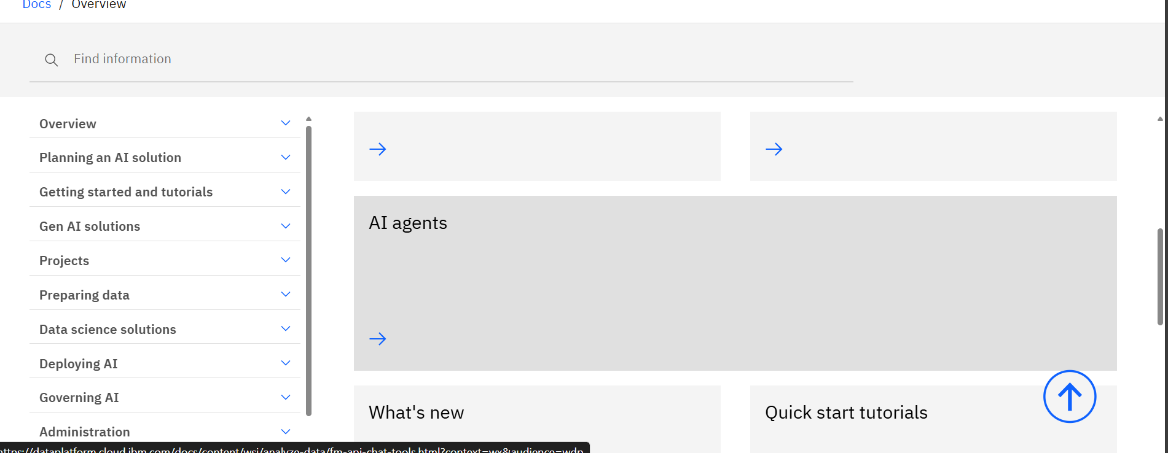
Step-3> choose AI Agent section

Slide 10
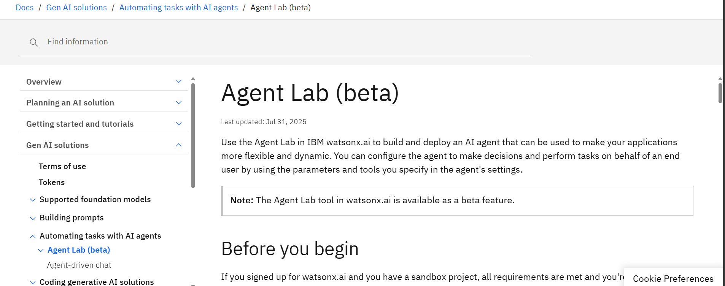
Step-4> Click on Agent Lab(Beta)

Slide 11
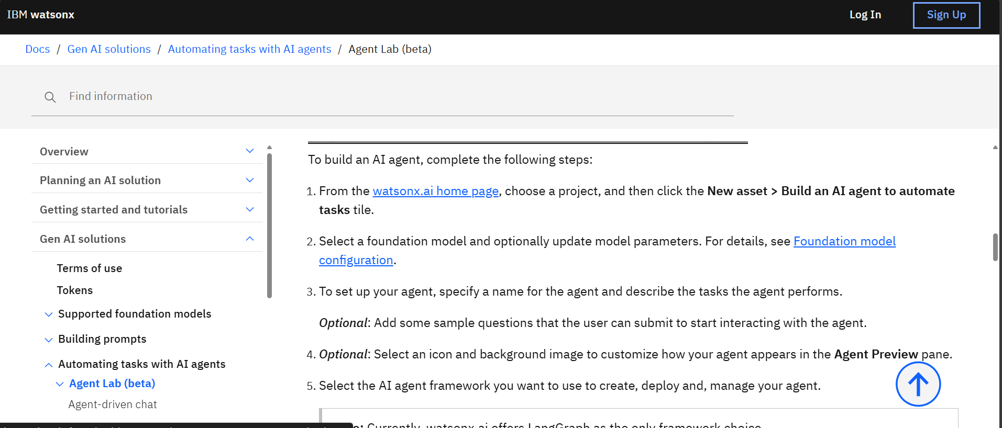
Step-5> click on watsonx.ai.homepage

Slide 12
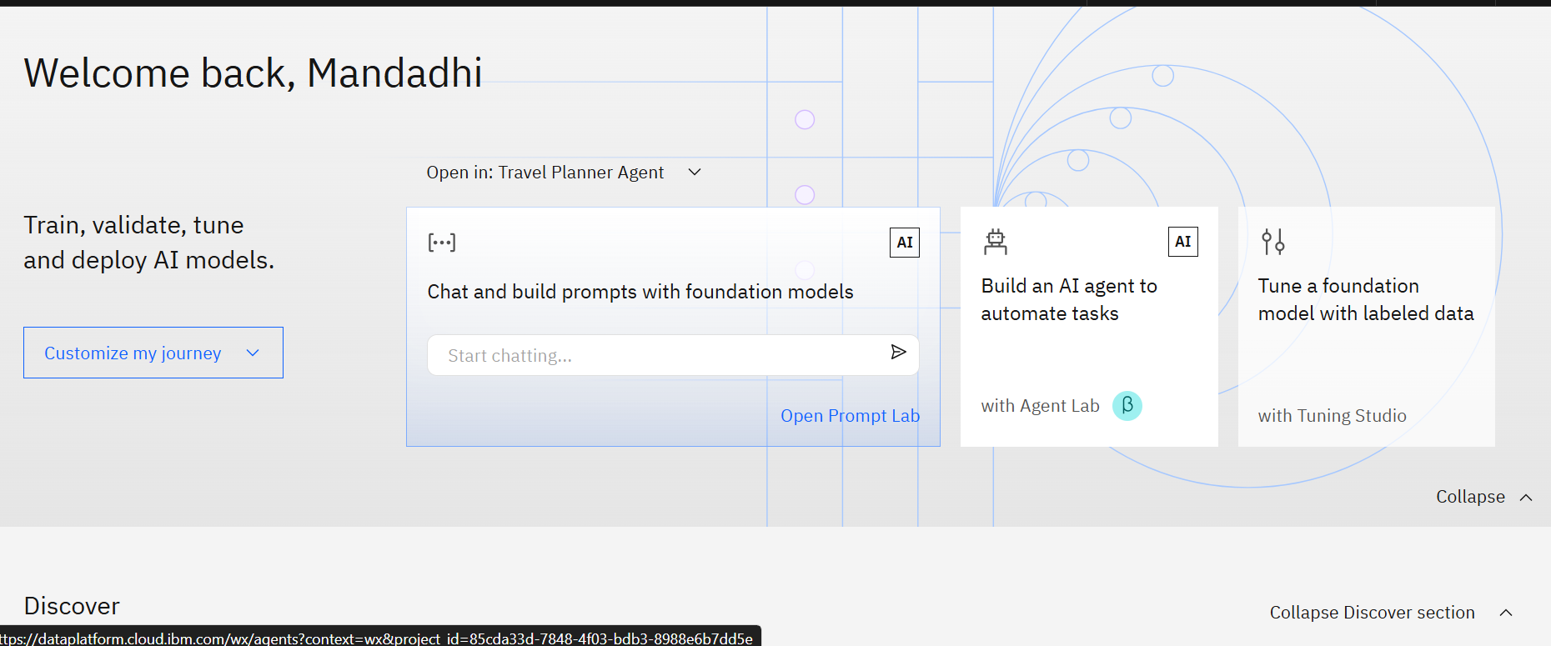
Step-6>choose on Build an AI Agent

Slide 13
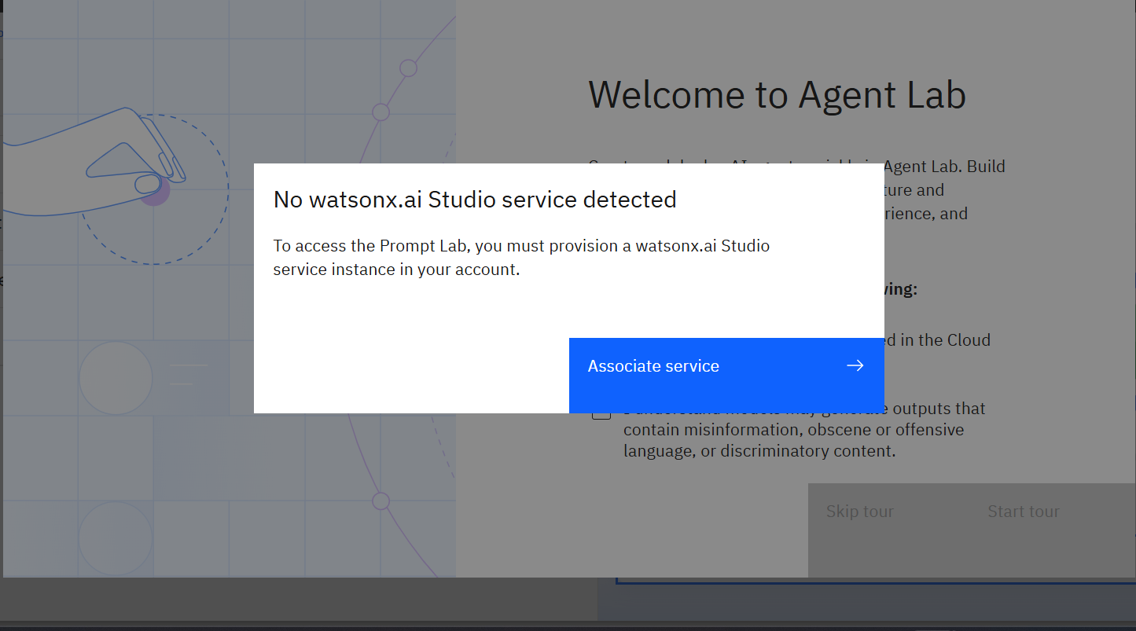
Step-7> Associate service and select region and plan continue….

Slide 14
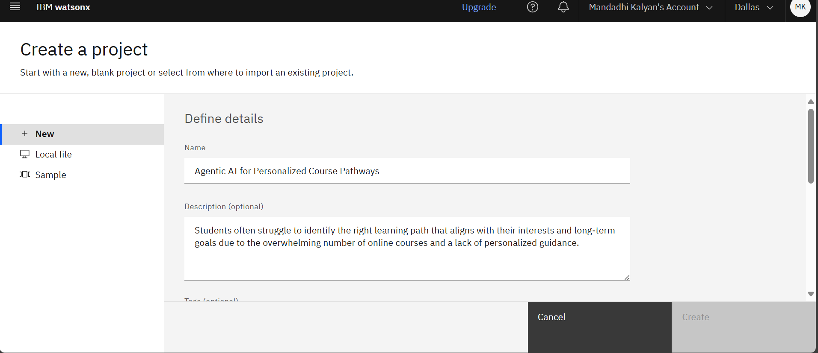
Step-8>After associate service next give tile and description.

Slide 15
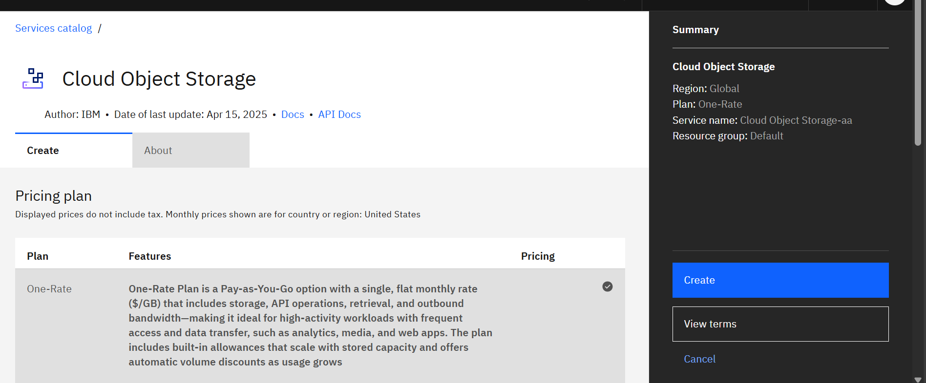
Step-9> Now add storage and refresh it will be visible and create.

Slide 16
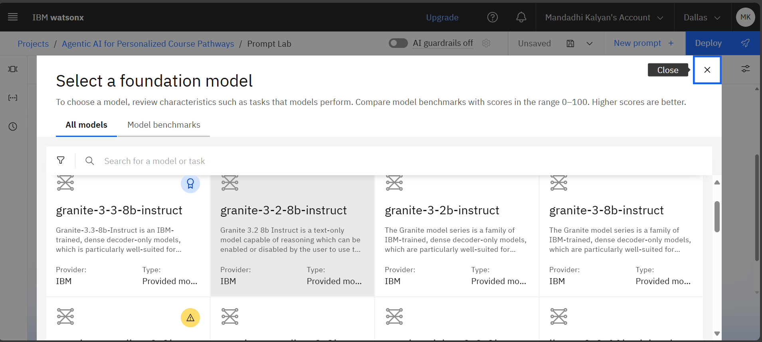
Step-10> select granite model on the IBM Cloud.

Slide 17
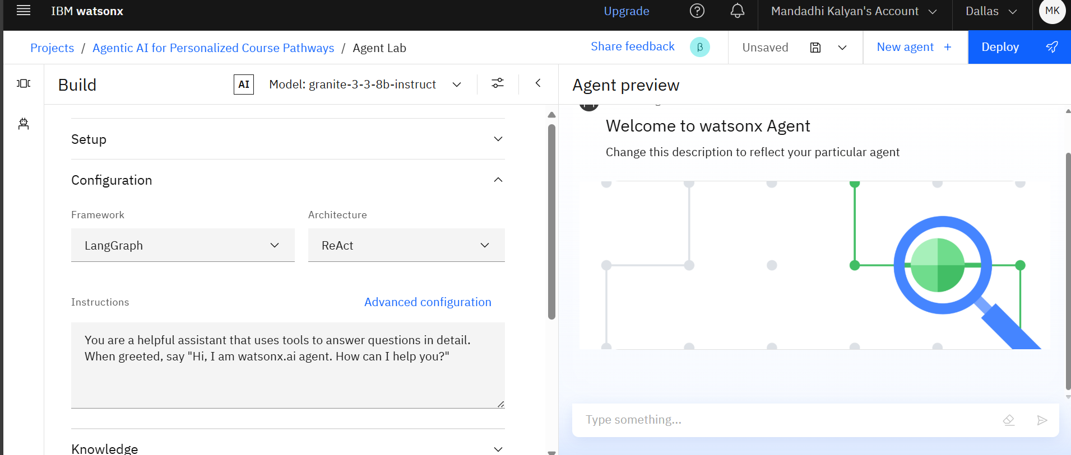
Step-11> now add instructions of the agent.

Slide 18
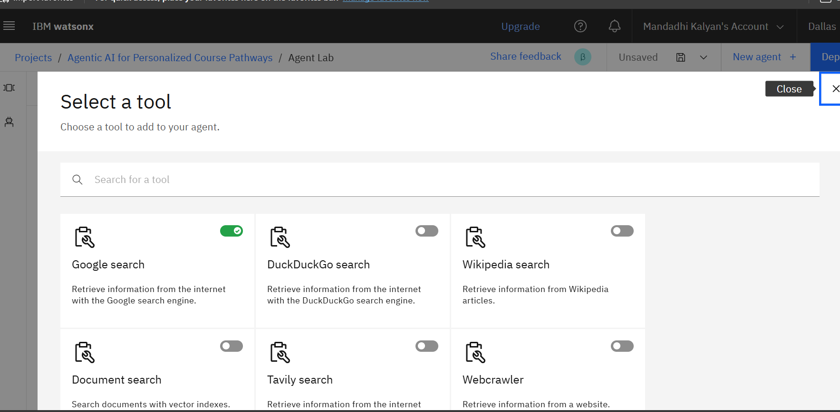
Step-12> adding tools for my Agent

Slide 19
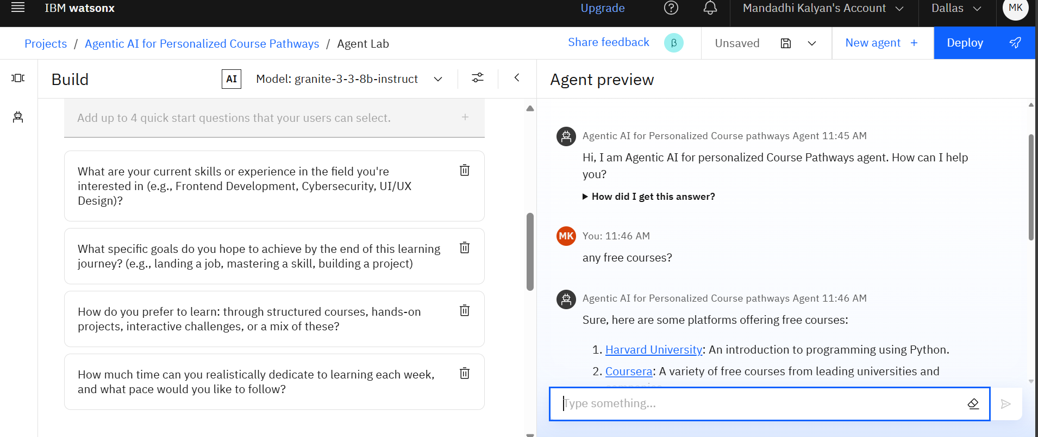
Step-13> Testing My Agent and it seems like working.

Slide 20
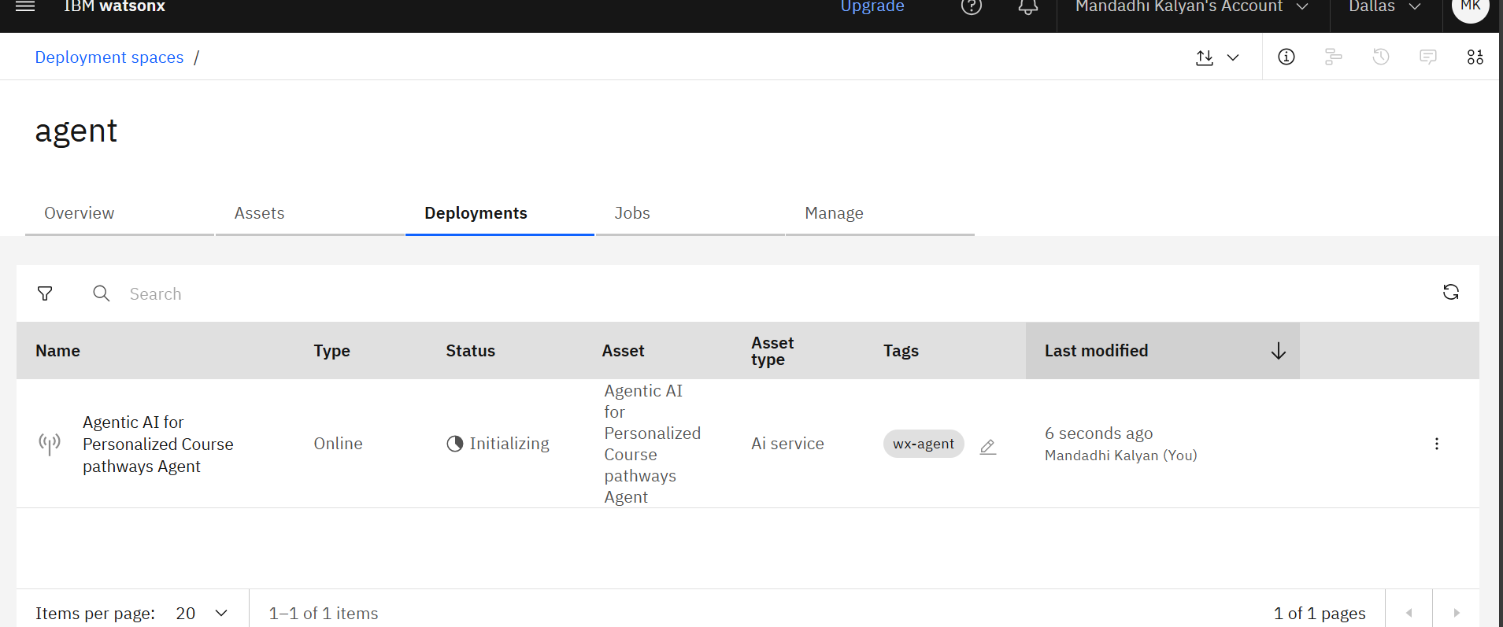
Step-14>deployment has initialize

Slide 21
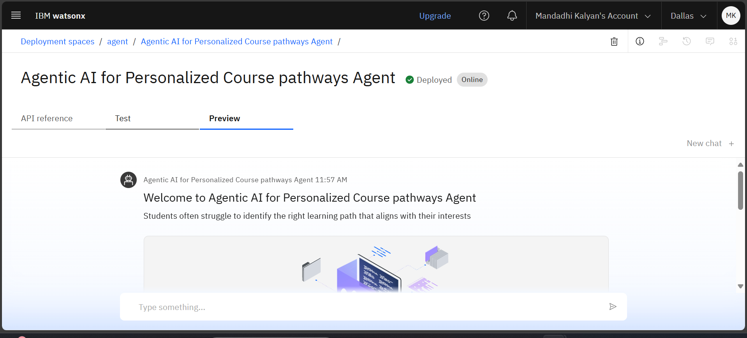
Step-15>Click on Preview to see agent

Slide 22
Conclusion
The "Agentic AI for Personalized Course Pathways" helps students navigate their educational journey by recommending courses based on their unique interests and goals. This AI-driven tool aims to provide personalized learning paths, enhancing the decision-making process for students seeking the right courses.

Slide 23
Future scope
The future scope of "Agentic AI for Personalized Course Pathways" includes integrating more advanced algorithms to offer real-time course recommendations and expanding its application to diverse fields of study. Additionally, it can evolve to provide career pathway guidance based on evolving industry trends and student progress.

Slide 24
References
AI in education, like IBM Watson, helps personalize learning by adapting to each student's needs. The concept of connectivism and recent reviews show how AI tools improve student learning pathways and decision making.

Slide 25
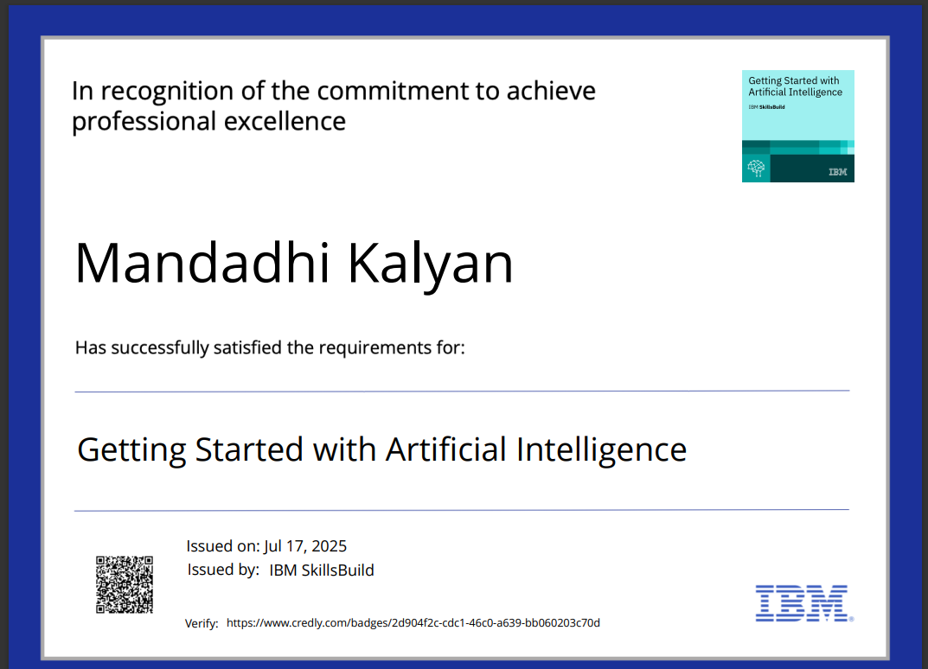
IBM Certifications

Slide 26
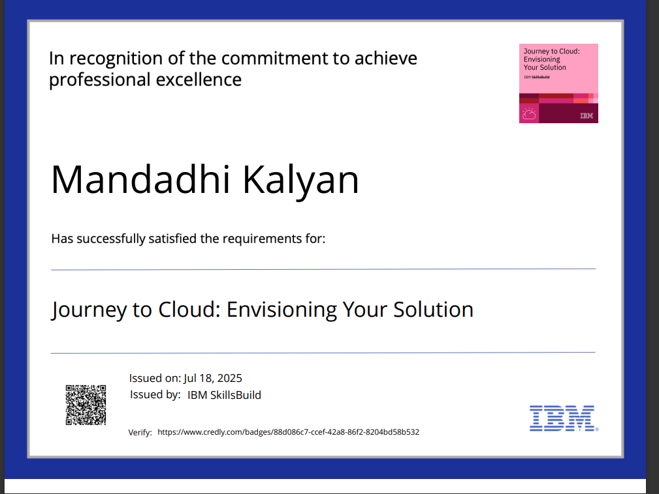
IBM Certifications

Slide 27
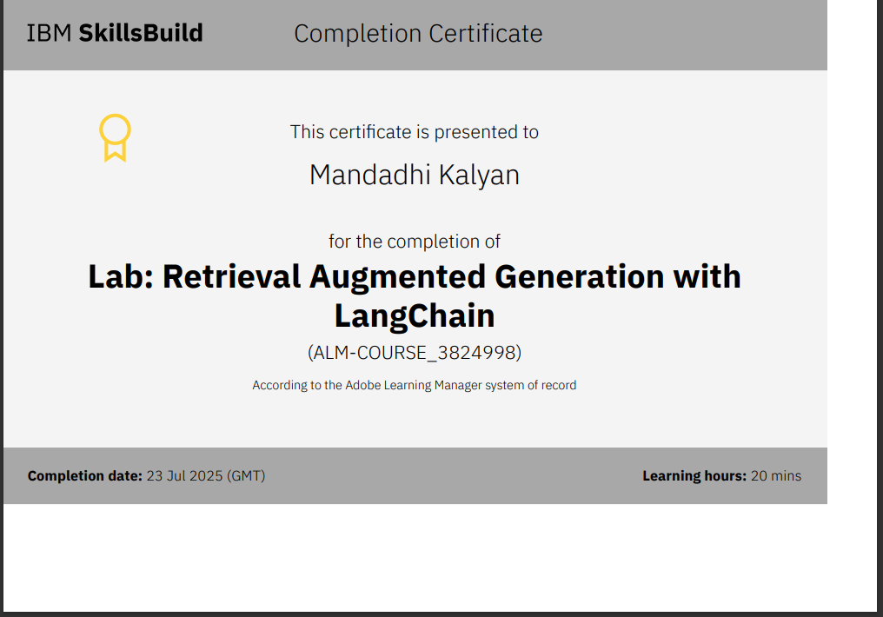
IBM Certifications

Slide 28
THANK YOU

