Slide 1

Anomaly Detect : Security Analysis for Anomaly Detection with Machine Learning
Project Guide
R. Veeramohan rao.
Asst.Professor, CSE Department.
Batch- C7
P.Kalyan Venkatesh -Y17ACS528
T.Jyothsna sai -Y17ACS549
SK.Salma -Y17ACS545
T.Kushvanth -Y15ACS546

Slide 2
Table of Contents
1. Abstract
2. Introduction
3. Problem Statement
4. Existing Work
5. Proposed Work
6. Advantages
7. Development Platform
8. Implementation
9. References

Slide 3
1 Abstract
Security breaches causing anomalous activities due to malicious, vulnerable, or misconfigured analytic applications are considered the top security risks to big “sensitive” data.
The risk is further expanded from the coupling of data analytics with the Cloud. Towards maintaining secure and trustworthy applications, effective anomaly detection and prediction become crucial tasks to be offered by Cloud providers.

Slide 4
2.Introduction
Anomaly detection has been extensively studied in diverse research domains ranging from distributed systems, computer networks, social networks, surveillance systems, among others.
It has been widely applied for various purposes not only confined for security, but also extended for system performance failure and reliability.
Log-based Anomaly Detection: It simply revolves around the task of uncovering anomalies that do not conform with the normal/expected patterns within log dataset.

Slide 5
Paper
M. A. Elsayed and M. Zulkernine, "PredictDeep: Security Analytics as a Service for Anomaly Detection and Prediction," in IEEE Access, vol. 8, pp. 45184-45197, 2020, doi: 10.1109/ACCESS.2020.2977325.
Description of the Protocol
PredictDeep, a novel framework for anomaly detection in big data systems. The PredictDeep framework is offered as an advanced security analytics service from a trusted party to the consumers.
PredictDeep leverages the advantages of streaming data analytics combined with graph analytics and machine learning techniques to mine log data collected from monitoring systems looking for hidden anomalous and suspicious activities.

Slide 6
3.Problem Statement
Security breaches causing anomalous activities due to malicious, vulnerable, or misconfigured analytic applications are considered the top security risks to big “sensitive” data.
This paper presents a novel security analytics framework for anomaly detection.

Slide 7
4. Existing Work
Security breaches causing anomalous activities due to malicious, vulnerable, or mis configured analytic applications are considered the top security risks to big “sensitive” data.
Furthermore, the unique features of Cloud analytic applications, which run on distributed large scale heterogeneous computing environments, render traditional rule-based and statistics-based solutions ineffective.

Slide 8
5.Proposed Work
Our solution aims to detect known as well as unknown patterns of security anomalies indicating security violations using machine learning algorithms.
The proposed framework leverages log data collected from monitoring systems and using machine learning techniques to add intelligence for detecting known and unknown patterns of security anomalies.
The input given is log dataset and the output is to detect whether an application or system is safe or not.

Slide 9
6.Advantages
Statistics and ML based approaches mainly assume that the observed data points are independent and uniformly distributed within the dataset
ML-based analysis approaches consider the interrelated correlation between the data points which facilitate deeper and wider coverage for detecting anomalous patterns.
Nowadays, big data analytics and machine learning are gaining increasing momentum in the security field. As the risk of cyber-attacks grows ,security analytics grow in importance and potential even more.

Slide 10
7.Development Platform
Hardware:
Ram: 4gb min
Hard Disk: 500gb min
Graphic Processing unit if required.
Software:
OS: Windows 10
Programming Language: Python
Domain: Cybersecurity.

Slide 11
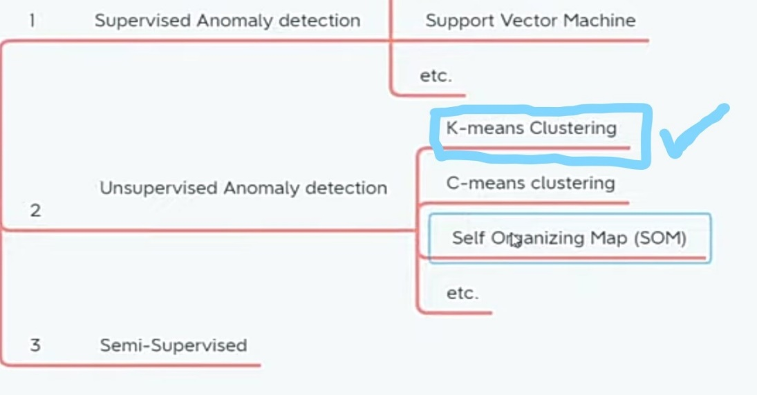
8.Implementation
Collect and store log dataset
Preprocess the dataset
Algorithm:
K-means clustering algorithm

Slide 12
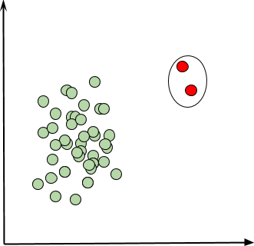
K-means clustering algorithm:
1. Specify the number k of clusters to assign
2. Randomly initialize k centroids.
3. Repeat:
4. Expectation: Assign each point to its closest centroid.
5. Maximization: Compute the new centroid(mean) of each cluster.
6.until The centroid positions do not change.

Slide 13
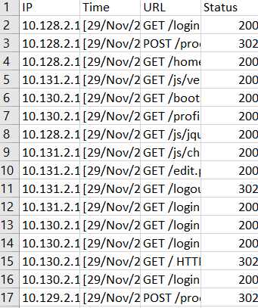
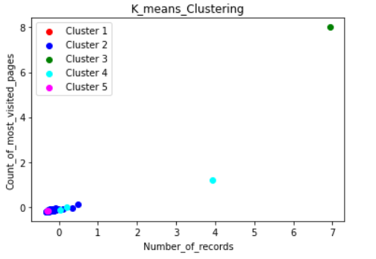
INPUT:
OUTPUT:

Slide 14
9.References
Check Point Software Technology. 2019 Cyber Security Report. Accessed: 2019. [Online]. Available: https://pages.checkpoint.com/cybersecurity-report-2019.html
Big Data Security and Privacy Handbook: 100 Best Practices in Big Data Security and Privacy, Cloud Security Alliance, Seattle, WA, USA, 2016.
J. Zhu, S. He, J. Liu, P. He, Q. Xie, Z. Zheng, and M. R. Lyu, ‘‘Tools and benchmarks for automated log parsing,’’ in Proc. IEEE/ACM 41st Int. Conf. Softw. Eng., Softw. Eng. Pract. (ICSE-SEIP), May 2019, pp. 121–130.
M. Du and F. Li, ‘‘Spell: Streaming parsing of system event logs,’’ in Proc. IEEE 16th Int. Conf. Data Mining (ICDM), Dec. 2016, pp. 859–864.
Taha and A. S. Hadi, ‘‘Anomaly detection methods for categorical data: A review,’’ ACM Comput. Surv., vol. 52, no. 2, pp. 1–35, May 2019.
R. Angles, ‘‘The property graph database model,’’ in Proc. AMW, CEUR Workshop, 2018, p. 2100.
M. A. Elsayed, M. Zulkernine: PredictDeep: Security Analytics as a Service for Anomaly Detection and Prediction,IEEE 2020

