Slide 1
CYBER SECURITY

Slide 2
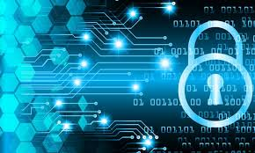
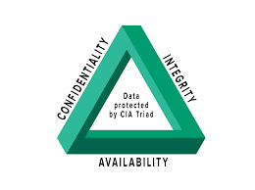
Cyber Security-Introduction
Cyber security or IT security are a set of techniques which protects our computers,networks,programs and data from unauthorized access or attacks.
CIA traid,is a model designed to form their security policies.
C-Confidentiality
I-Integrity
A-Availability

Slide 3
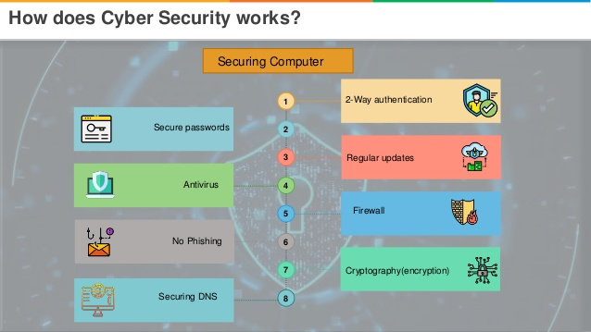
Keyterms:
Exploitable
:
Make use or an advantage.
Malicious
:
Intending to do harm
Vulnerability
:
Weakness in design,implementation.
Threat
:
Likely to cause damage or danger.It is possible danger that may exploit vulnerability.
Attack
:
An assault on system security that derives from an intelligent threat.

Slide 4
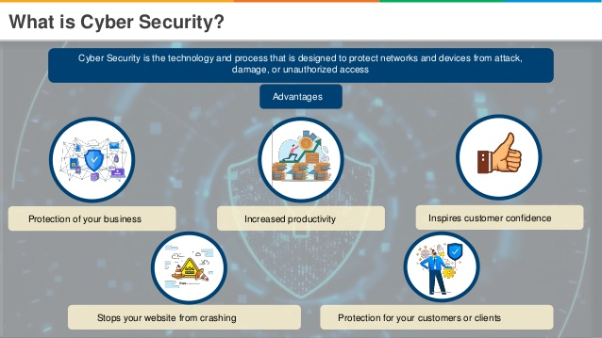
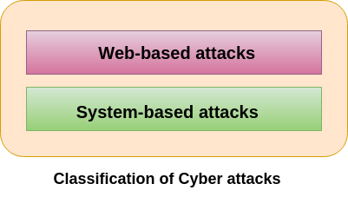
Types of cyber attacks:
Web based attacks:
Injection attacks,DNS spoofing,Session hijacking,Phishing,Brute force,Denial of service,Dictonary attacks,URL Interpretation,File inclusion attacks,Man in the middle attacks.
System based attacks:
Virus,Worm,Trojan house,Backdoors,bots.

Slide 5
CLOUD COMPUTING

Slide 6
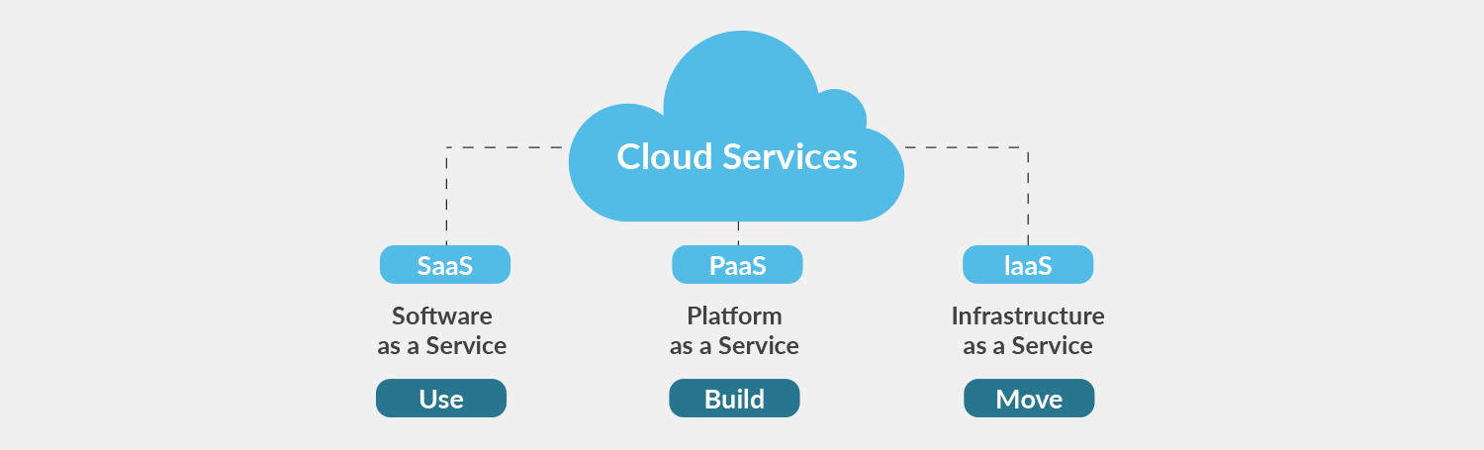
Cloud computing
Cloud computing is: ‌storing data/applications on remote servers
Processing data/applications from servers
Accessing data/applications via internet.
It contains 2 models:
Service model: it contains 3 types
1.iaas
2.paas
3.saas

Slide 7
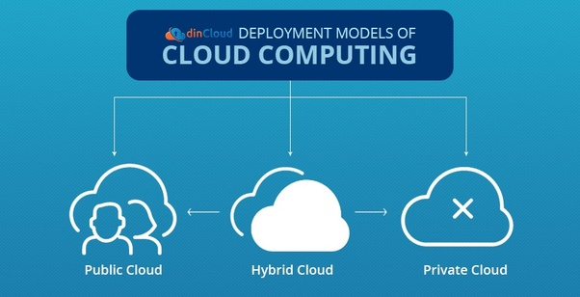
Cloud computing
‌Deployment models: there are 3 types of models
1.public cloud 2.private cloud 3.hybrid cloud
Applications of cloud computing:
1.data storage
2.business
3.social networking
4.education etc

Slide 8
MACHINE LEARNING

Slide 9
MACHINE LEARNING

Slide 10
WHAT IS MACHINE LEARNING
Machine learning is an application of artificial intelligence (AI) that provides systems the ability to automatically learn and improve from experience without being explicitly programmed.

Slide 11
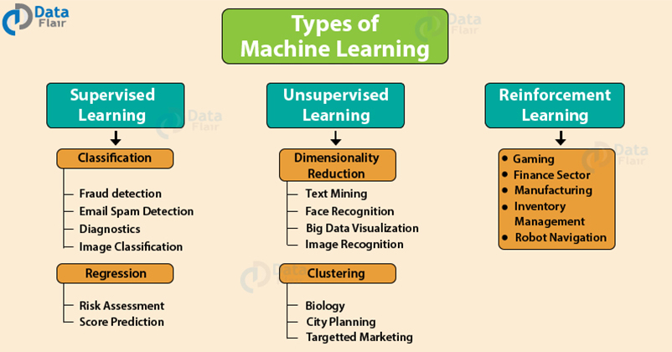

Slide 12
ML for cyber security
With machine learning, cyber security systems can analyze patterns and learn from them to help prevent similar attacks and respond to changing behavior.
Mostly simple Regression is used for performing predictions of cyber security

Slide 13
BIG DATA

Slide 14
Big Data is also data but with a huge size. Big Data is a term used to describe a collection of data that is huge in volume and yet growing exponentially with time. In short such data is so large and complex that none of the traditional data management tools are able to store it orprocess it efficiently.
What is big data

Slide 15
Types Of Big Data
Structured Data:Any data that can be stored, accessed and processed in the form of fixed format is termed as a 'structured' data.
Unstructured Data:Any data with unknown form or the structure is classified as unstructured data. In addition to the size being huge, un-structured data poses multiple challenges in terms of its processing for deriving value out of it.

Slide 16
Semi-structured:Semi-structured data can contain both the forms of data. We can see semi-structured data as a structured in form but it is actually not defined

Slide 17
Benefits of Big Data Processing
Businesses can utilize outside intelligence while taking decisions.
Improved customer service.
Early identification of risk to the product/services, if any.
Better operational efficiency.

