Slide 1



Resume Extractor
Powered By HatchBird Solutions

Slide 2
Description
Resume Extractor is a web application to process the Resumes who are looking for their respective jobs. Here we get the resumes from the corresponding admin Email and extract the resume file to get the all details about the candidate. After that we can assign the processed resume to their relevant job positions. We can assign the job order and resume to user for process them.
Powered By HatchBird Solutions

Slide 3
Modules
Resume Reader Jar
Login/Logout
Mail Room
  Keep In View
  Upload Resume
Resume Processor
Job Orders
Resume Folder
Advance Resume Search
Admin Management
  User Management
  Assign Email URN
  Assign User URN
  Company Management
Powered By HatchBird Solutions

Slide 4
Resume Processor Application
Resume Reader Jars
.
.
.
.
Resume Extractor
Manual Resume Upload
Email-1
Mail Room
Email-2
Database
Process Candidate Resume
Email-3
Resume Advanced Search
Job Orders
Admin Management
Email-n
Assign Job Orders, Resumes to Users
Powered By HatchBird Solutions

Slide 5

Resume Reader Jar
The Resume Reader is an Executable Jar, Which access the given Email Account’s Inbox and reads the all Incoming Emails.
It get an Incoming Emails, which are to be file attached. It ignores the non-attachement Emails.
It gets the information like sender Email Id, Email Sent date, Email Subject and Email Attachment.
After it gets the attachment, it opens the file and Extract the Candidate Information like Name, DOB, Gender, Age, Degree, Salary Information, Experience & etc.., and save these information to Database.
Powered By HatchBird Solutions

Slide 6
Resume Reader Jar
Database
Email Account
Inbox
Email ID
Password
Read Attachment Emails Only
Extract Attachments (Resumes)
Powered By HatchBird Solutions

Slide 7
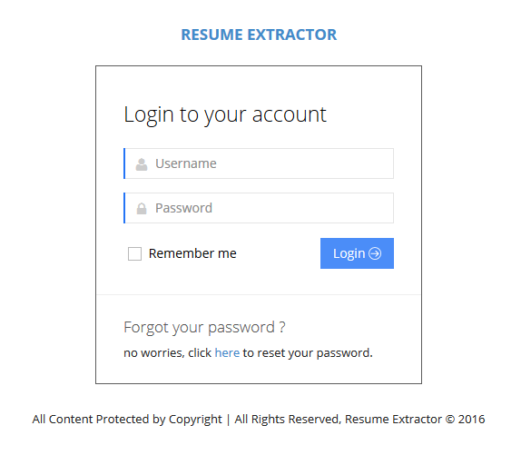
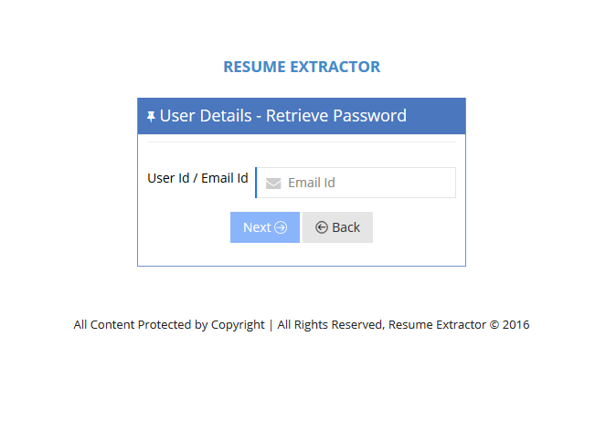
Login/Logout
We Providing the Secure login with user password encryption.
Providing the Forget Password.
While logout we clear the temporary files from cache for the corresponding user for saving the server space.
Powered By HatchBird Solutions

Slide 8
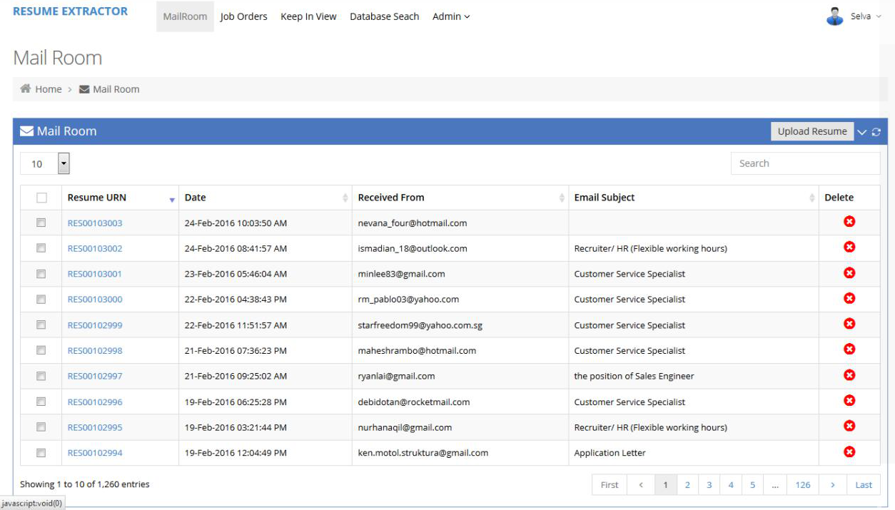
Mail Room
Admin can view the all Incoming Attachment Email in Mail Room.
Here Admin can Upload the Resume as Manually also.
Here each Resume have the unique “Resume URN(Unique Resume Number)”
Here Admin can View, Delete and Move the Resumes to “Keep In View ” or “Archive”
Admin can click the Resume URN to view the Resume Candidate Information.
Powered By HatchBird Solutions

Slide 9
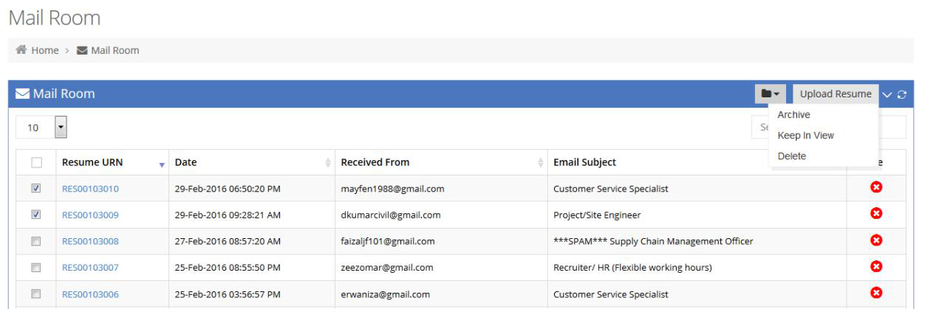
Mail Room – Keep In View/Archive
Admin can select a single or multiple Resume to move to “Keep In View” or “Archive”
“Keep In View” means, these Resumes are processed later, until these are keep in view.
“Archive” means, these Resumes are processed immediately.
And also can “Delete” the selected Resumes.
Powered By HatchBird Solutions

Slide 10
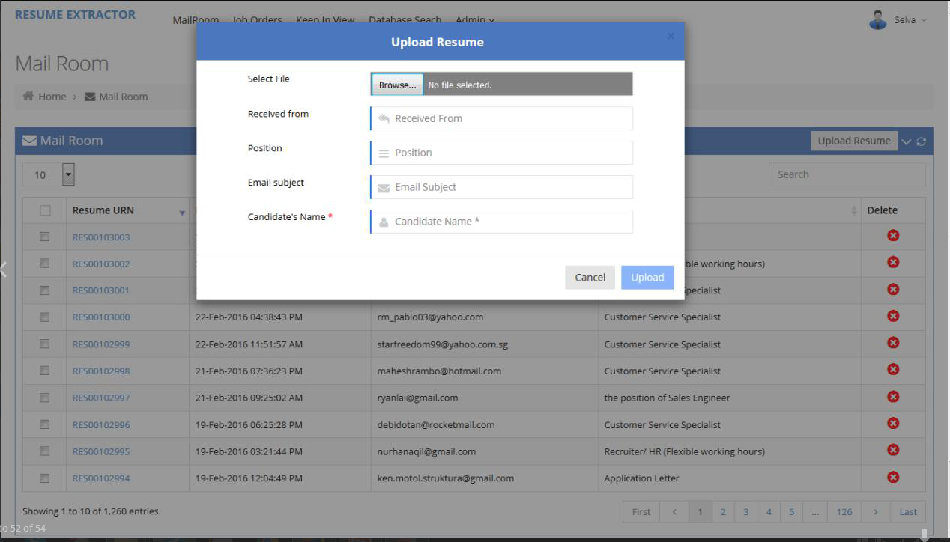
Mail Room – Upload Resume
Admin can Upload the Resume Manually.
While uploading Resume admin can provide the information like Candidate Email, Name & etc..,
Powered By HatchBird Solutions

Slide 11
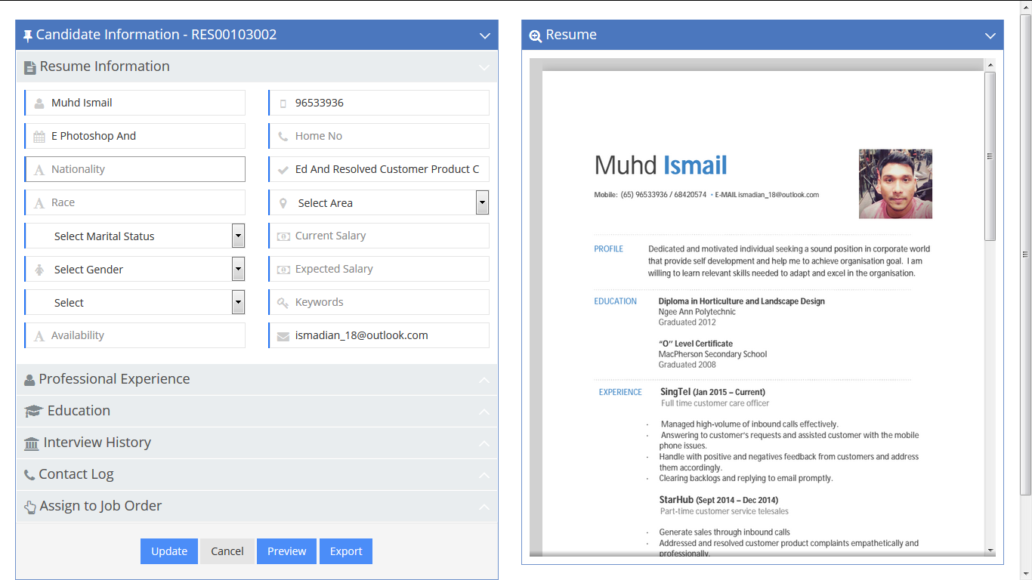
Resume Processor
The Resume Processor is nothing but, View the Candidate Resume Information.
  Candidate Basic Information
  Candidate Contact Information
  Candidate Professional Experience
  Candidate Education
  Candidate Interview History
  Candidate Contact Logs
  Assign Job Orders to the Candidate
  View the Resume
Powered By HatchBird Solutions

Slide 12
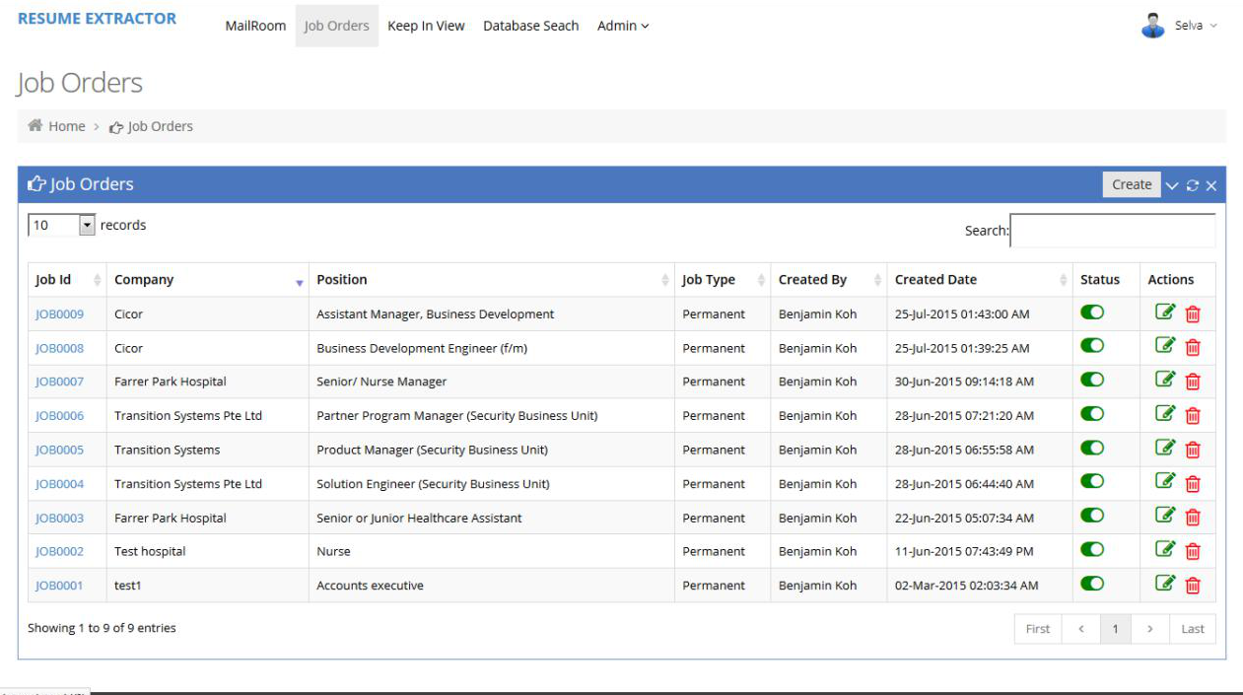
Job Orders
Job Orders have the Unique Job Id.
Admin can Create, Update and Delete the Job Orders and Assign it to other Employees.
Powered By HatchBird Solutions

Slide 13
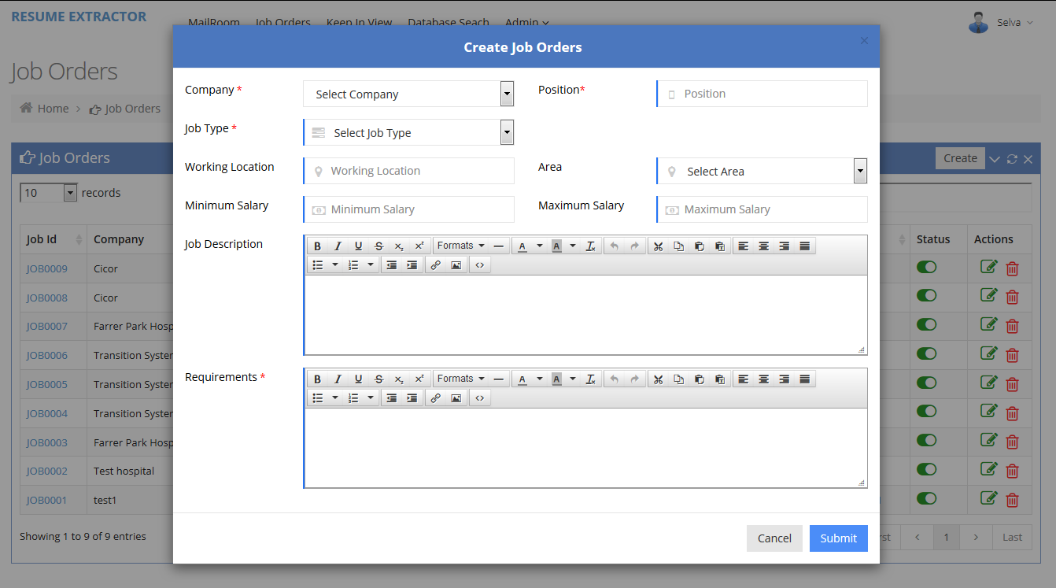
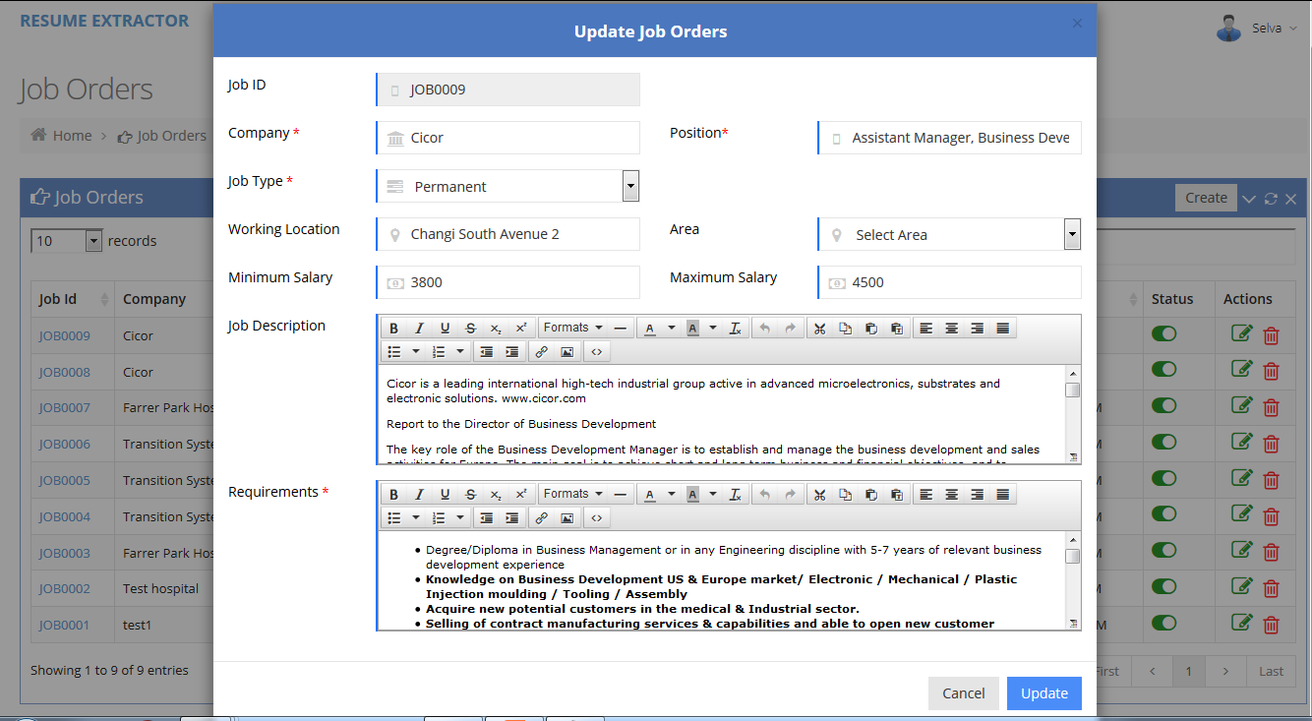
Job Order - Create and Update
Powered By HatchBird Solutions

Slide 14
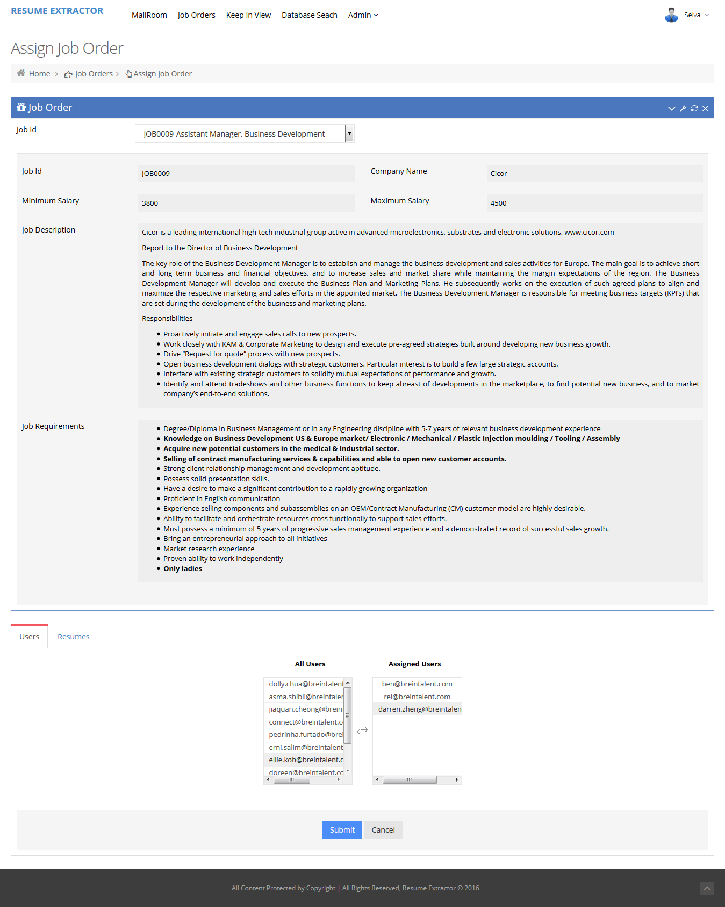
Job Order - Assign Job Order
Powered By HatchBird Solutions

Slide 15
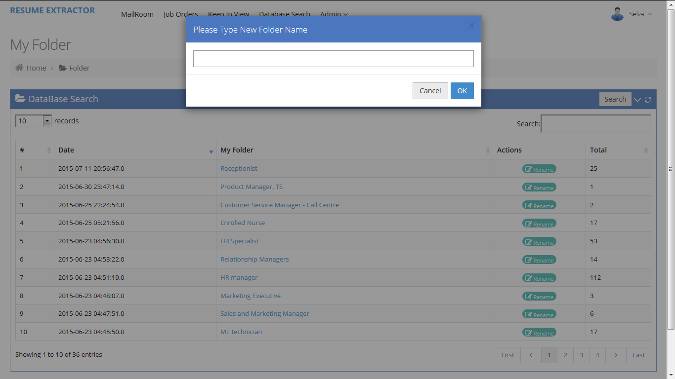
Resume Folder
Admin can Create the Folder to hold the Resumes.
Admin can Assigns any Resumes to any Folder
Powered By HatchBird Solutions

Slide 16
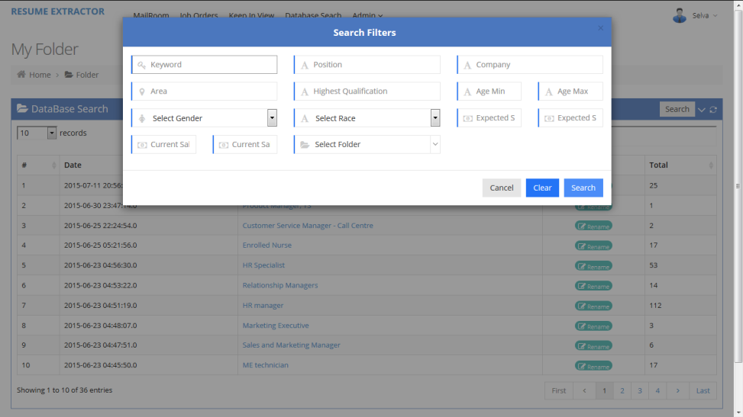
Advance Resume Search
Admin can Search and Filters the Resumes by,
  Keyword
  Positions
  Company
  Area and Highest Qualifications
  Gender and Race
  Expected Salary Minimum & Maximum
  Current Salary Minimum & Maximum
  Resume Folder
Powered By HatchBird Solutions

Slide 17
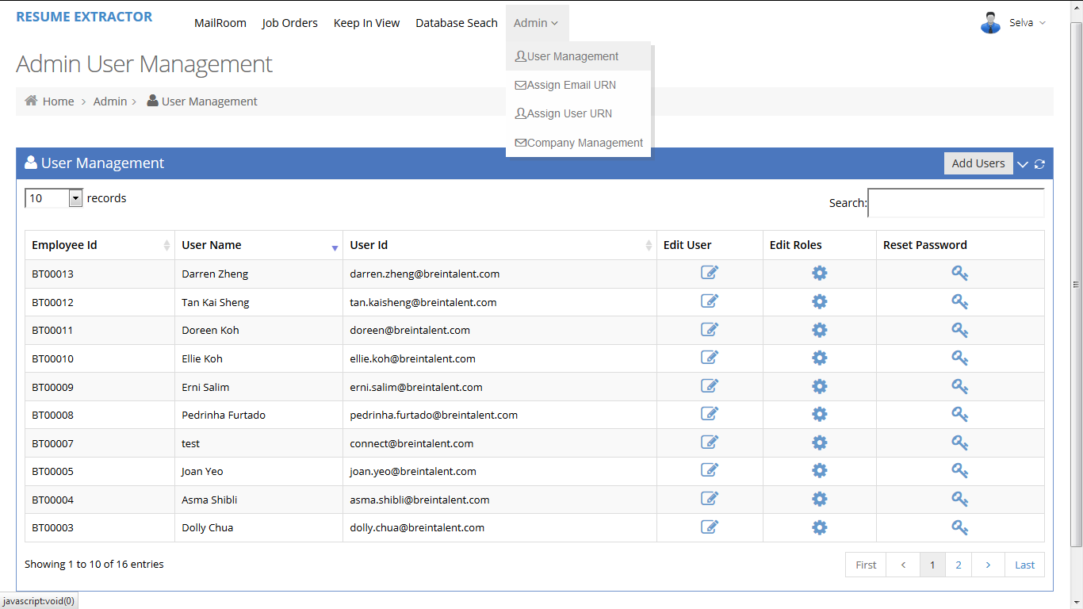
Admin Management
In Admin Management, Admin can do below rights,
  User Management
  Assign Resume Reader Jar Email
  Company Management
Powered By HatchBird Solutions

Slide 18
User Management
Admin can Create, Update & Delete the Users
Admin can Edit the User Roles as Admin or Manager or Executive
Admin can Reset the any user password.
Powered By HatchBird Solutions

Slide 19
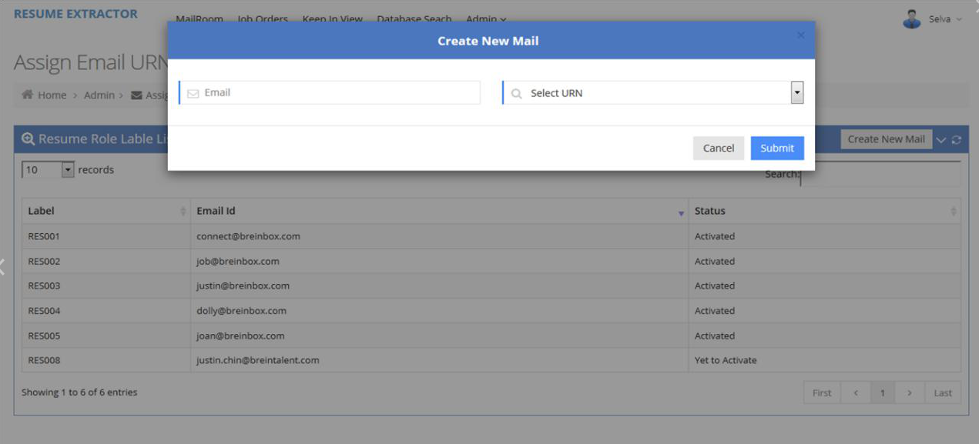
Assign Mail Reader Email to Resume URN
Admin can Create Mail Reader Emails and assign the mail with unique Resume URN.
Admin can Activate & Deactivate the Emails in mail reader.
Powered By HatchBird Solutions

Slide 20
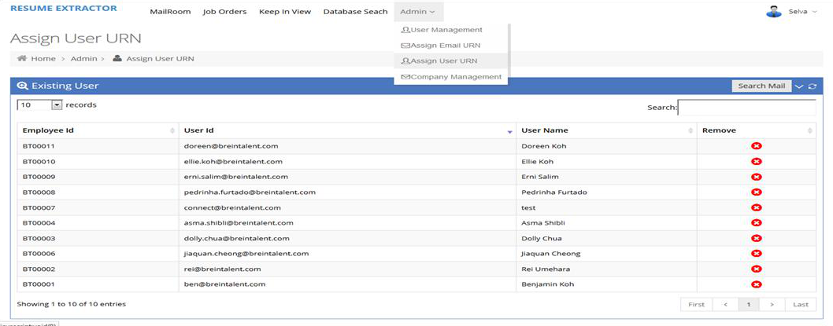
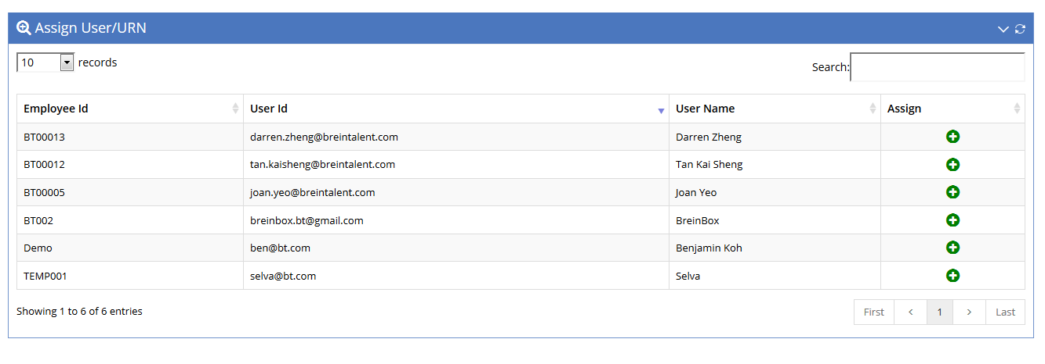
Assign Mail Reader Email to User
Admin can Assign & Remove any User to the mail Reader Jar Email
Powered By HatchBird Solutions

Slide 21
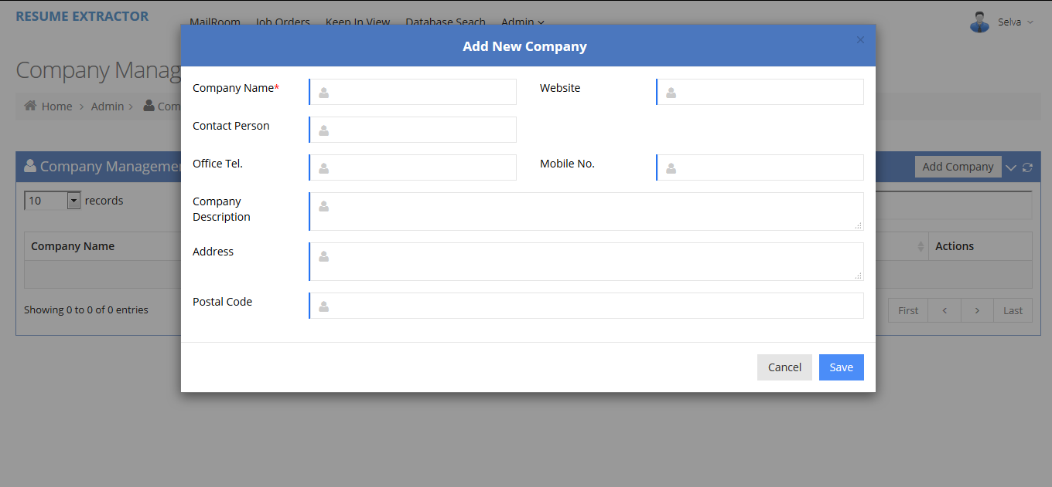
Company Management
Admin can Create, Update & Delete the Company.
Each company have the unique Company Id.
These Companies are used to create a job orders.
Powered By HatchBird Solutions

Slide 22
Thank You
Powered By HatchBird Solutions

