Slide 1




ESelfGuru
Justice Basheer Ahmed Sayeed College for Women (Autonomous)
Powered By HatchBird Solutions

Slide 2
Description
ESelfGuru is an Online Educational Tutorial Website for College Students. In Admin Side, they can Register Student, Create an Exam, Upload the Multiple Choice Questions, Monitoring the Students Activities and Conduct an Online Exam.
In Student Side, they can attend the Online Exams periodically and analysis their status and ranking by themself.
Powered By HatchBird Solutions

Slide 3
Modules
Login/Logout
Role Module
Dashboard
User Module
Create Online Multiple Choice Assessment(MCA) Exams
Upload Multiple Choice Assessment(MCA) Questions
View Exam Result
Student Modules
  Dashboard
  Exam Module
Powered By HatchBird Solutions

Slide 4

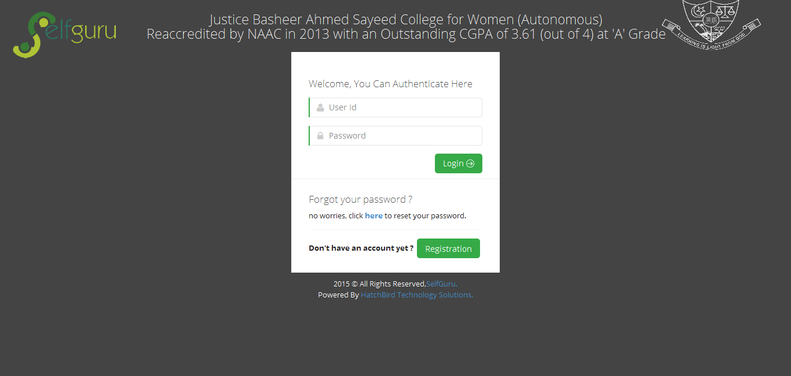
Login/Logout
We Providing the Secure login with user password encryption.
Providing the Forget Password.
While logout we clear the temporary files from cache for the corresponding user for saving the server space.
Powered By HatchBird Solutions

Slide 5
Role Module
In ESelfGuru We are using below User Roles
Admin Roles
  Super Admin
  Admin
  Instructor
Student
Powered By HatchBird Solutions

Slide 6
Role Module
 | Add Admin | Update Admin | Delete Admin | Add Instructor | Update Instructor | Delete Instructor | Add Student | Update Student | Delete Student | View Result
Super Admin | Yes | Yes | Yes | Yes | Yes | Yes | Yes | Yes | Yes | Yes
Admin | No | No | No | Yes | Yes | Yes | Yes | Yes | Yes | Yes
Instructor | No | No | No | No | No | No | Yes | Yes | Yes | Yes
Student | No | No | No | No | No | No | No | No | No | No
For creating MCA Exams and Upload MCA Questions can be done by SuperAdmin, Admin & Instructor, not by Student.
We can able to flexible to modify any roles and its rights.
Powered By HatchBird Solutions

Slide 7
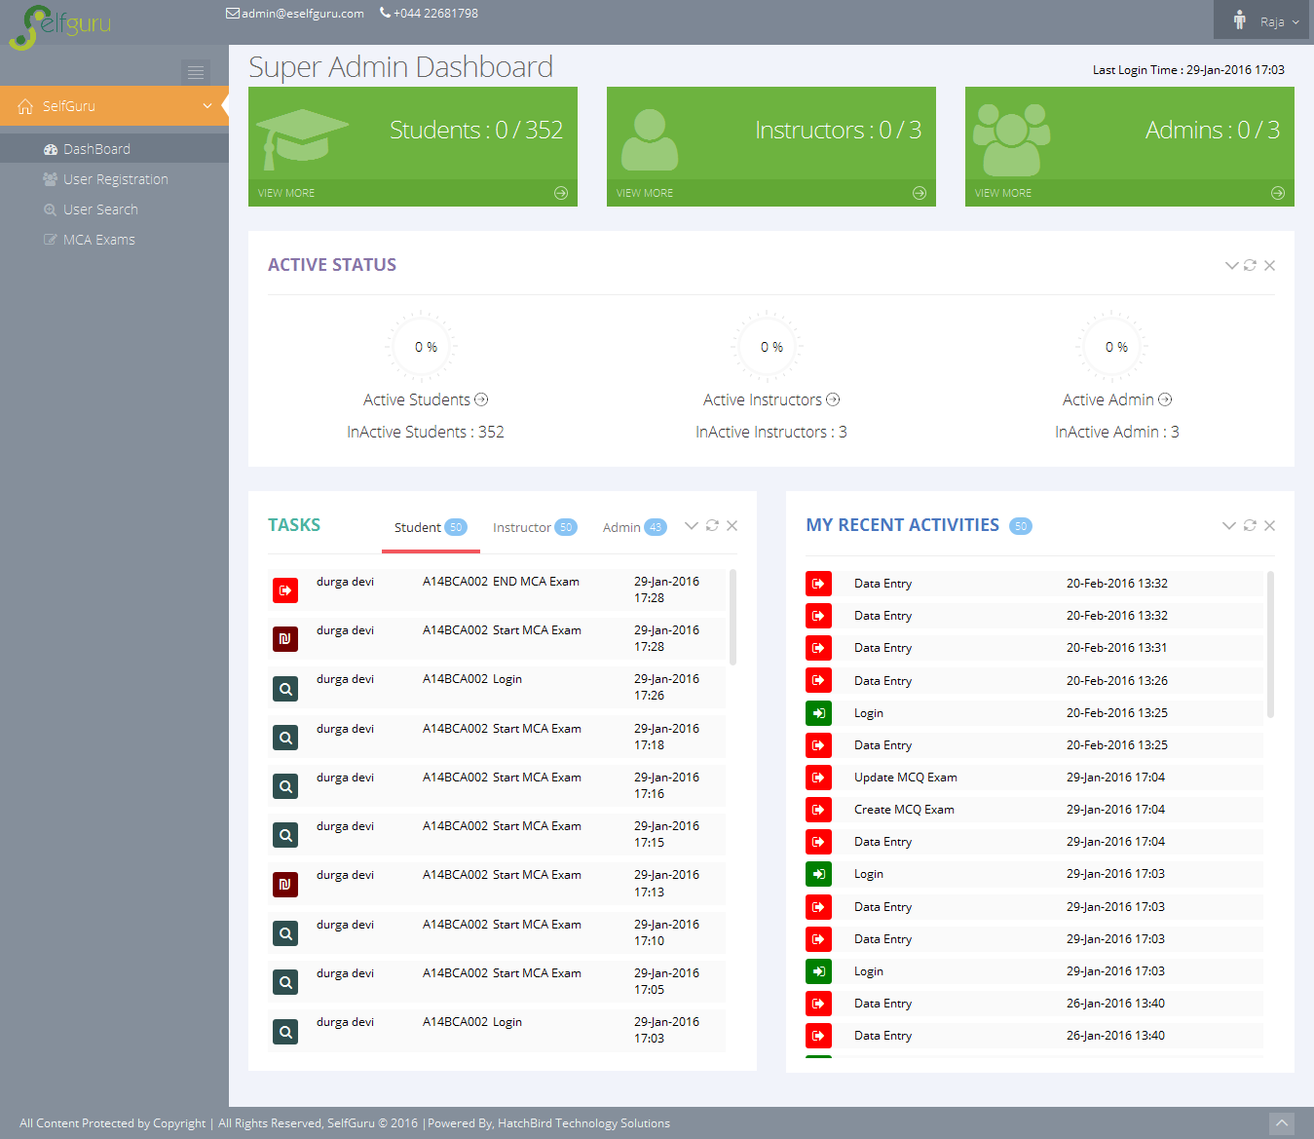
Dashboard
Dashboard in Admin View : we can monitor the currently login users on this system.
Monitoring the child role users activities.
Monitoring our own activities.
Powered By HatchBird Solutions

Slide 8
User Module
Admin Role User can Register/Update their Child Role Users.
Admin Role User can Delete and Reset their Child Role Users Password.
Here the Student Registration is free for this college students only.
We are checking the user is already exist or not, the user information(Email Id, Mobile No) is already exist or not and the Serial Key is already exist or not while User Registration from server side.
Here we can Print the User’s List and Export the User’s list as pdf or MS-Excel.
Powered By HatchBird Solutions

Slide 9
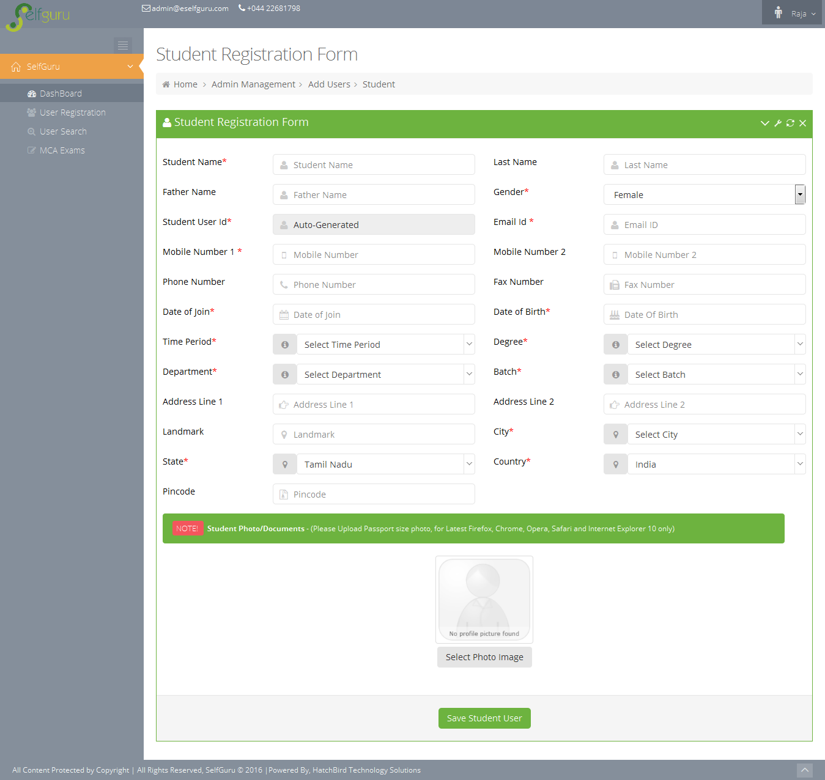
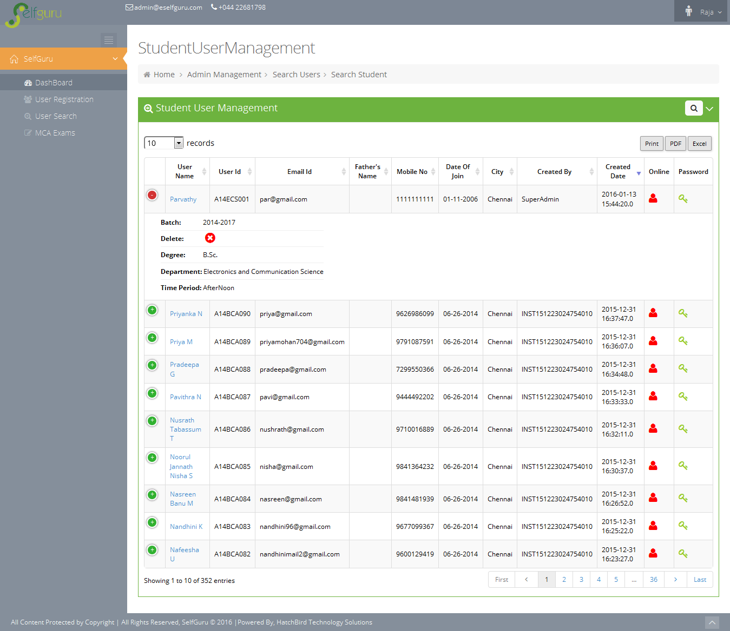
User Module
Powered By HatchBird Solutions

Slide 10
Create Online MCA Exam
Here Admin Role User can Multiple Choice Assessment(MCA) Online Exam
Admin can Create, Enable/Disable, Publish, Postpone the online exam.
Admin creates the exam based on Time Period(Forenoon, Afternoon), Subjects & Chapters, Degree & Department and Batch in 2 ways,
  Online Exam
  Offline Exam
Student can View only the Online Exam not the Offline Exam.
An Offline Exam is mostly used for upload the questions for the corresponding Time Period(Forenoon, Afternoon), Subjects & Chapters, Degree & Department and Batch.
Here we assign the 100 Questions per exam with some conditions depends on the Students Batch.
Powered By HatchBird Solutions

Slide 11
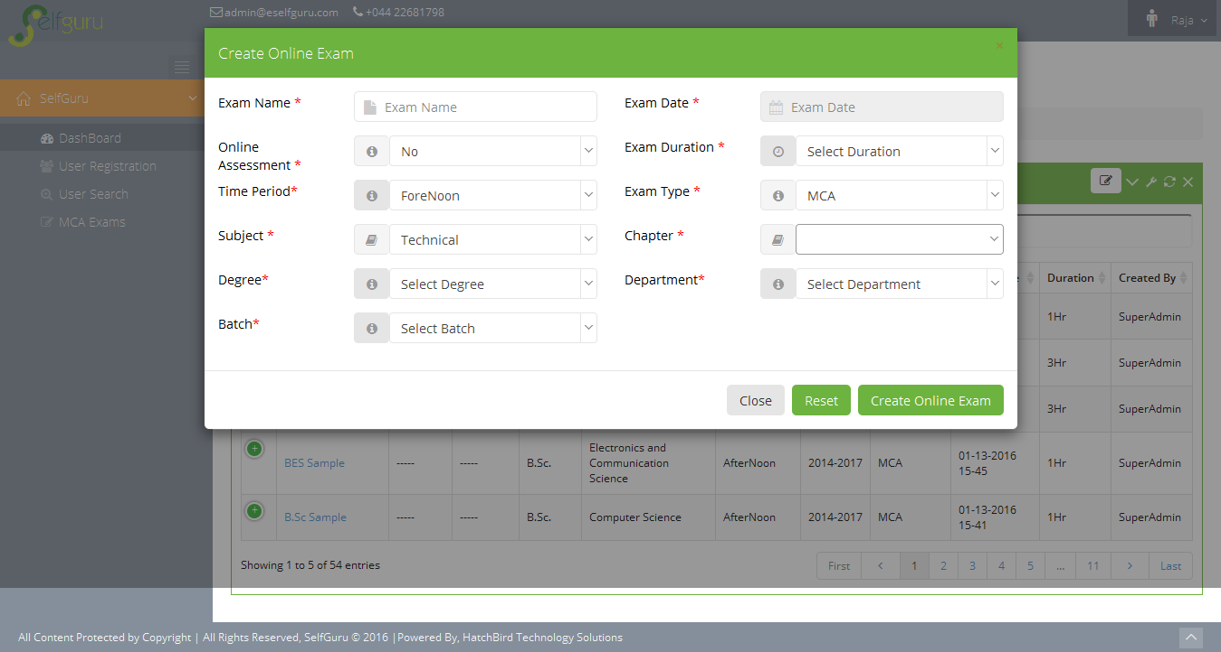
Create Online MCA Exam
For 1st Year Students, the MCA Questions comes under below scenario
  Aptitude
    General Aptitude – 20 Questions
    Verbal – 20 Questions
    Non-Verbal – 20 Questions
    Logical – 20 Questions
    Reasoning – 20 Questions
For 2nd & 3rd Year Students, the MCA Questions comes under below scenario
  Aptitude
    General Aptitude – 10 Questions
    Verbal – 10 Questions
    Non-Verbal – 10 Questions
    Logical – 10 Questions
    Reasoning – 10 Questions
  Technical
    Corresponding Department Core Subject – 50 Questions
Powered By HatchBird Solutions

Slide 12
Create Online MCA Exam
Subjects & Chapters are
  Aptitude
    General Aptitude
    Verbal
    Non-Verbal
    Logical
    Reasoning
  Technical
    Corresponding Department Core Subject.
For 1st Year Students
  General Aptitude - 20 Questions
  Verbal – 20 Questions
  Non-Verbal – 20 Questions
  Logical – 20 Questions
  Reasoning - 20 Questions
For 2nd & 3rd Year Stude
Powered By HatchBird Solutions

Slide 13
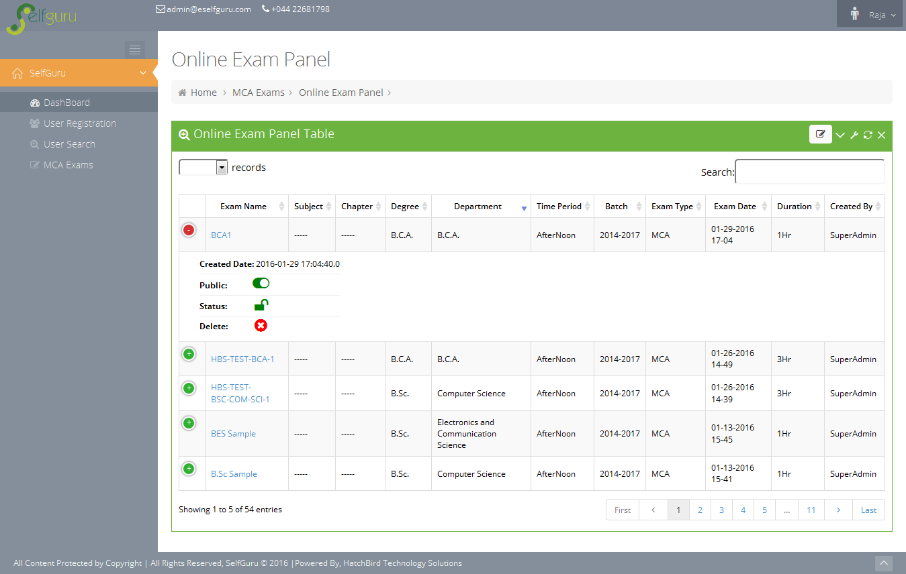
Create Online MCA Exam
Powered By HatchBird Solutions

Slide 14
Upload MCA Questions
Admin can Upload & Delete the MCA questions for the corresponding online exam with respect to the Time Period(Forenoon, Afternoon), Subjects & Chapters, Degree & Department and Batch .
The MCA Question contains Question, 4 Optional Answers & Explanation are uploaded via Text or Image.
Here we can upload the MCA Question in 2 ways
  Manual Upload
  MCA Question Upload Using Snipping
Admin mentions the Mark per Question and Correct Answer of the Corresponding Questions.
Admin can upload any number of MCA Questions for the online exam.
Powered By HatchBird Solutions

Slide 15
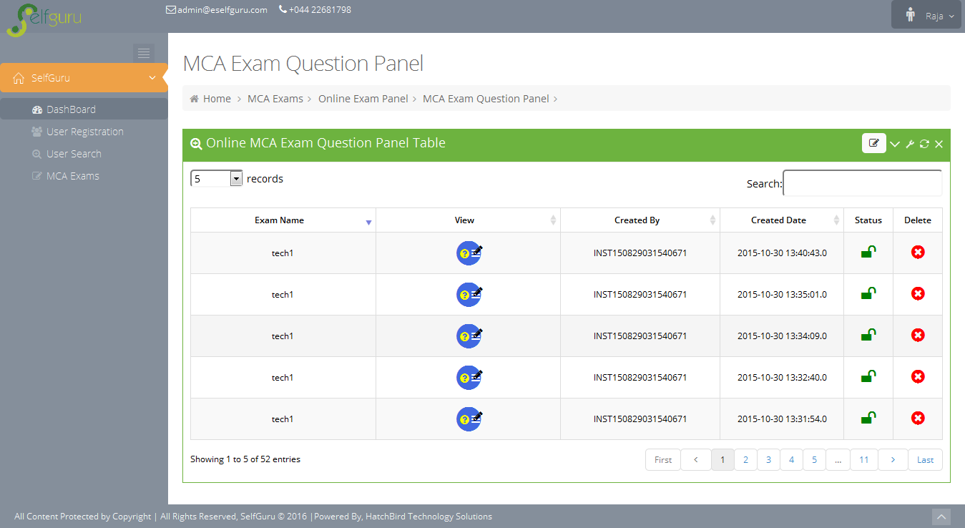
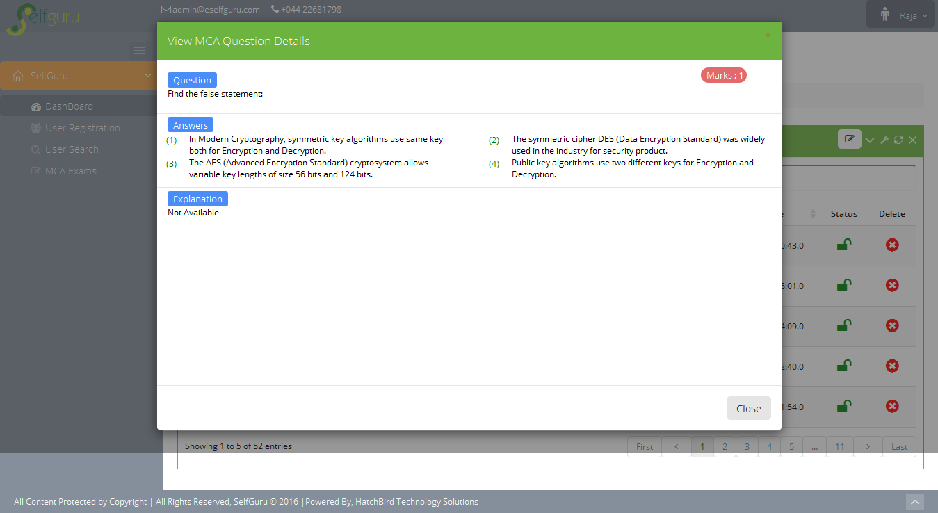
Upload MCA Questions
Uploaded MCA Questions
View the Selected MCA Questions
Powered By HatchBird Solutions

Slide 16
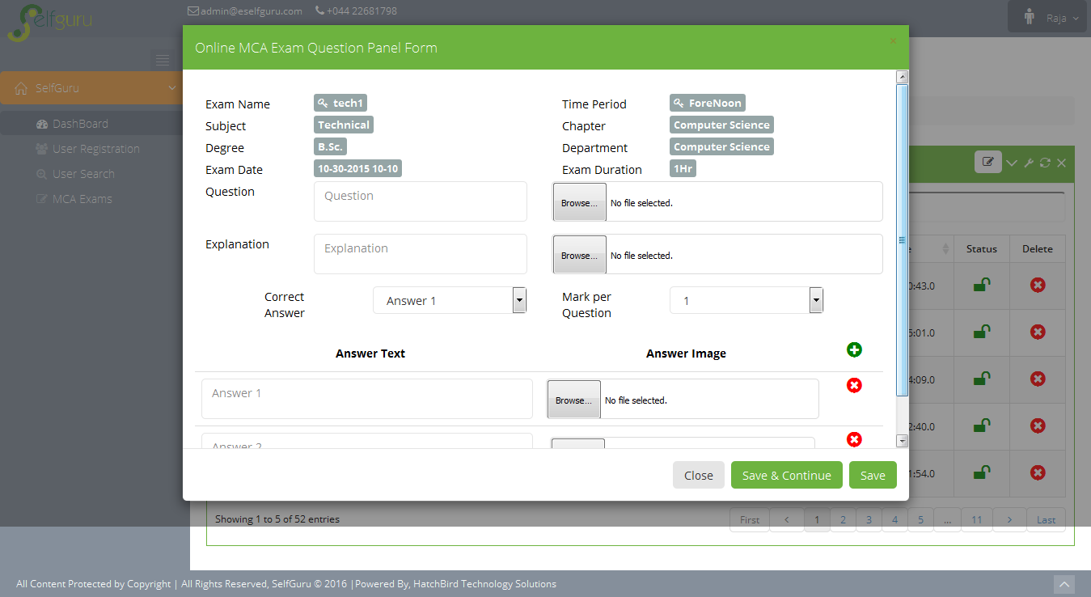
MCA Questions Manual Upload
Admin can Upload the MCA questions by text or image by manual upload
Admin can View & Delete the created MCA questions.
This type of upload can be done except Google Chrome browsers.
Powered By HatchBird Solutions

Slide 17
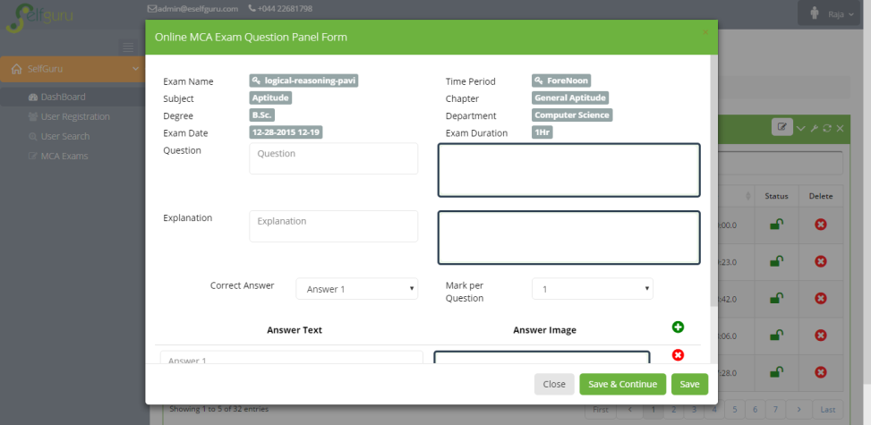
Upload MCA Questions By Snipping
This type of snipping method is working only on Google chrome only.
First Admin should open the “Snipping Tool”
Then Select the Questions from any file or web site and then paste it to the corresponding give area.
Finally we click the “Save” button, the MCA question will be saved to Database.
Powered By HatchBird Solutions

Slide 18
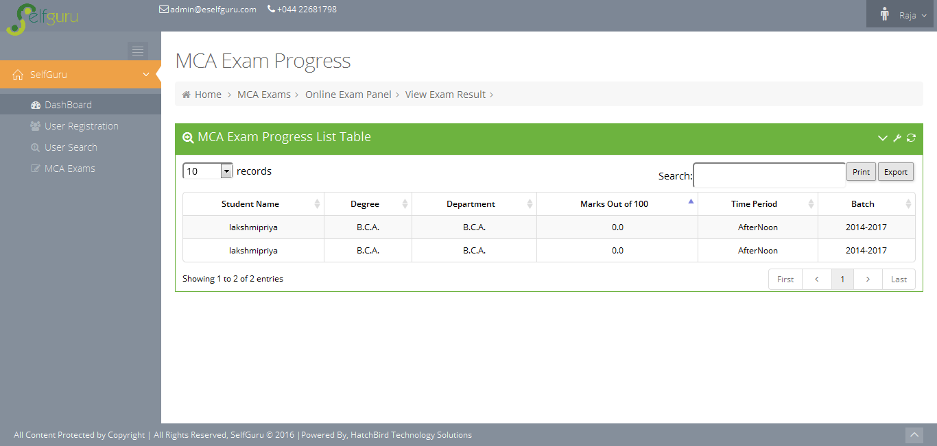
View Student Result
Admin can view the Student’s Exam Result for the selected Corresponding Exam
Admin can Print the Exam Result.
Admin can Export the Exam Result as PDF or MS-Excel
Powered By HatchBird Solutions

Slide 19
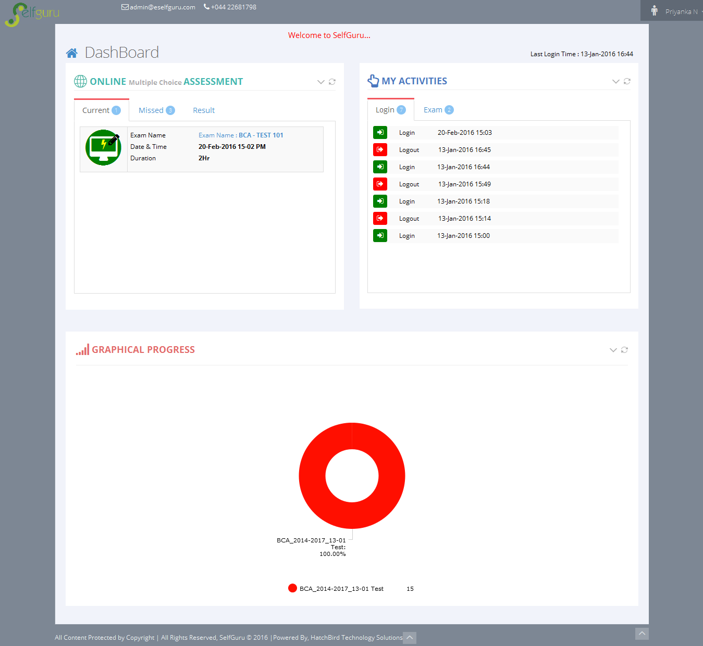
Dashboard
Dashboard Shows List Online MCA Exams as Currently available exams and Missed Exams.
List of Results of previously attended exams.
List of Student Activities of Login and Exams.
Shows Student’s Progress in Graphical Representation.
Powered By HatchBird Solutions

Slide 20
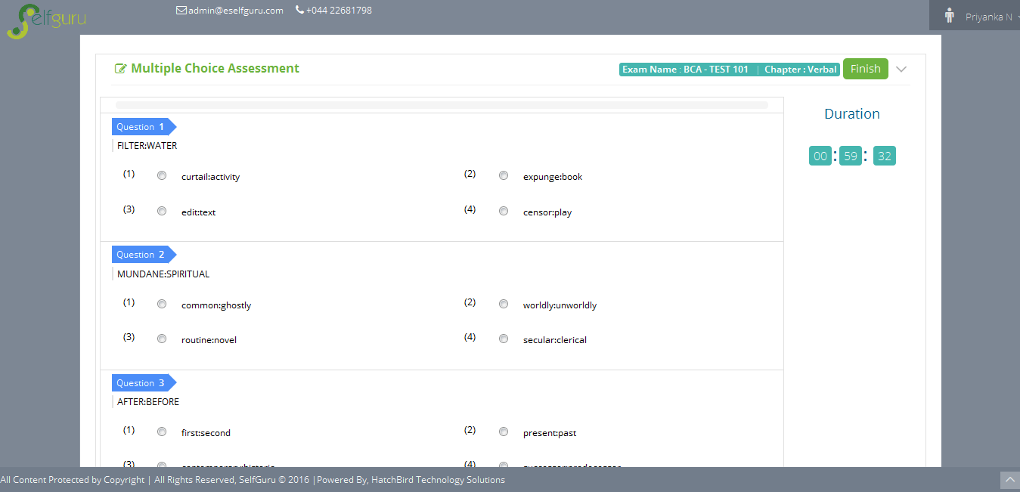
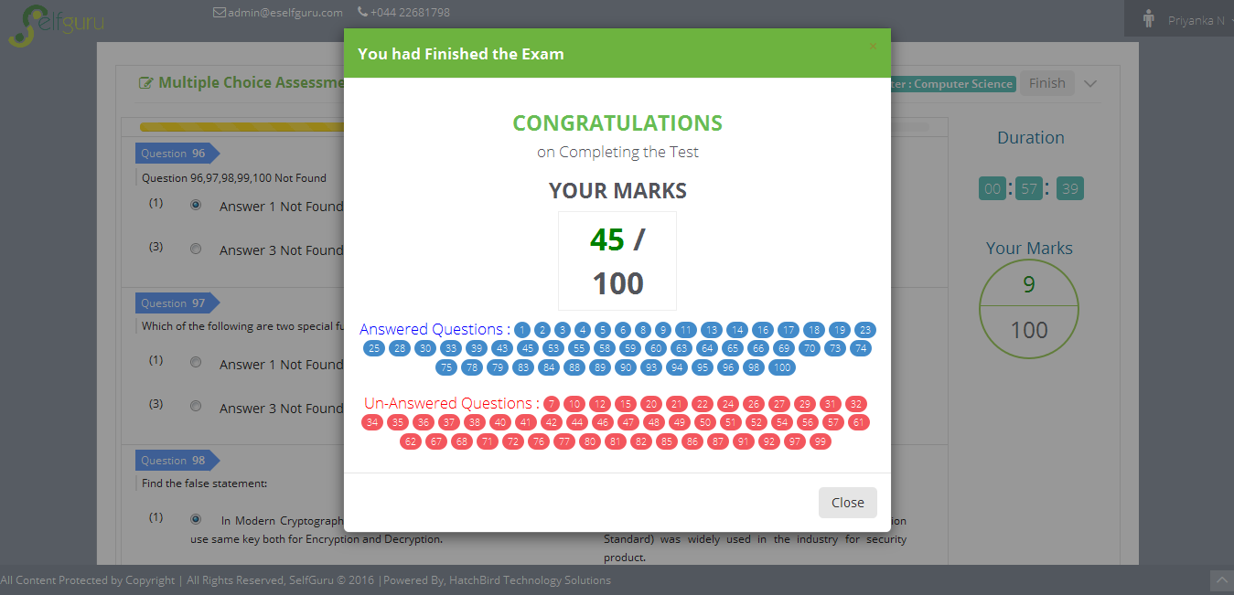
Exam Module
This exam is created by Admin.
This exam can be attended at only one time.
Here it takes the number of questions as randomly depends on the Time Period(Forenoon, Afternoon), Subjects & Chapters, Degree & Department and Batch.
It shows the Timer – Admin the sets the time per question. It automatically calculate the actual exam duration( time per question * number of questions).
If the Time is up, it automatically stop the exam.
If student finish the exam before the exam duration, they can click the “Finish” button to complete the exam.
After finish the exam it calculate the marks for the exam by automatically.
Powered By HatchBird Solutions

Slide 21
Thank You
Powered By HatchBird Solutions

