Slide 1
ROAD DATA PROCESSOR
Prepared By Tamil Selvan

Slide 2
DATA PROCESSOR TECHNOLOGY
Java 8 – JRE Update 1.8.262
Apache KAFKA (Topics)
Spring OAuth
Spring Security
Spring Boot Micro Services / On Premises

Slide 3
Incoming Data Channels
Email
Incoming
Data
Multi Tenant
V7-Reader
Data DB
Web Upload
Web Site
MESSAGE TOPIC
SMS
EXTRACT TOPIC
WhatsApp

Slide 4
V7-EXTRACTOR
EXTRACT TOPIC
D
A
T
A
E
X
T
R
A
C
T
O
R
Excel - Normal
P1
Excel
Excel File Reader
Excel - Expedite
P2
Handler
PDF - Normal
KAFKA Consumers
P3
PDF
PDF File Reader
PDF - Expedite
P4
Handler
Word - Normal
KAFKA Consumers
P5
Word
Word File Reader
Word - Expedite
Handler
P6
--------------------
--------------------
--------------------
--------------------
--------------------
--------------------
---------
---------
HTML- Normal
KAFKA Consumers
P14
Handler
HTML
HTML File Reader
HTML- Expedite
P14
Handler

Slide 5
DATA EXTRACTOR
Data Executor
Custom Data Provider
Input Template 1
Enumerated Data Provider
Word/Excel/PDF..
Input Template 1
Input Template 2
Input Template 3
Input Template 4
--------------
--------------
--------------
--------------
--------------
--------------
--------------
--------------
--------------
Input Template n
Data Input Template Parser Engine
Custom Data Provider
Input Template 2
Custom Data Provider
Input Template 3
CoreBase
Table
CoreData
Table
Data DB
--------------------
--------------------
--------------------
--------------------
Custom Data Provider
Input Template n

Slide 6
INCOMING DATA – TABLE DATA
DATA ATTACHMENT – TABLE DATA

Slide 7

COREBASE – TABLE DATA
COREBASE PRODUCER– TABLE DATA
INCOMING DATA – DATA ATTACHMENT - COREBASE
Incoming Data
Core Base
Data Attachment
Incoming Id
Data URN

Slide 8
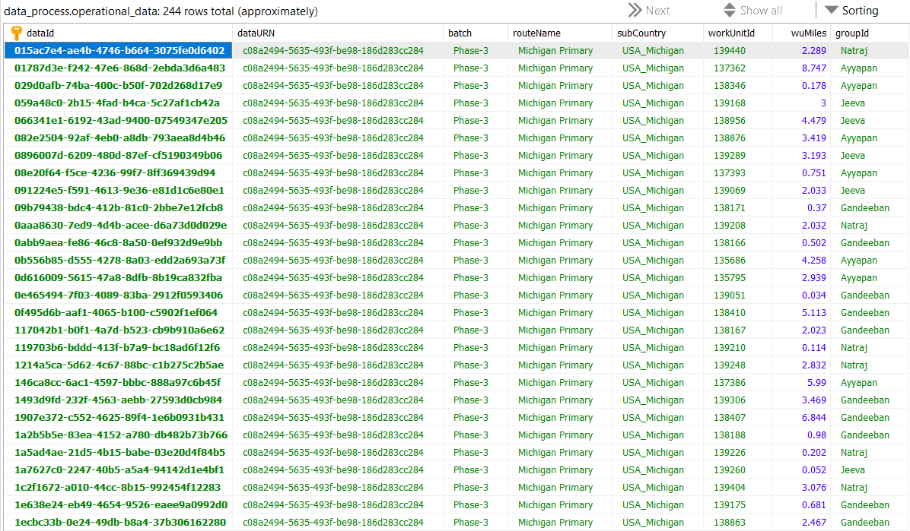
COREDATA – TABLE DATA

Slide 9
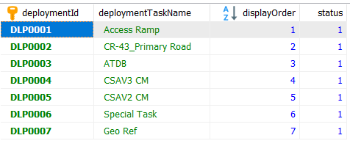
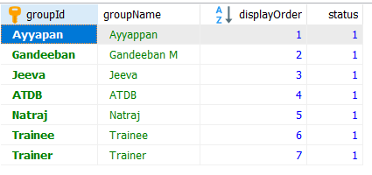
RESOURCE DEPLOYMENT– TABLE DATA
RESOURCE GROUP – TABLE DATA

Slide 10
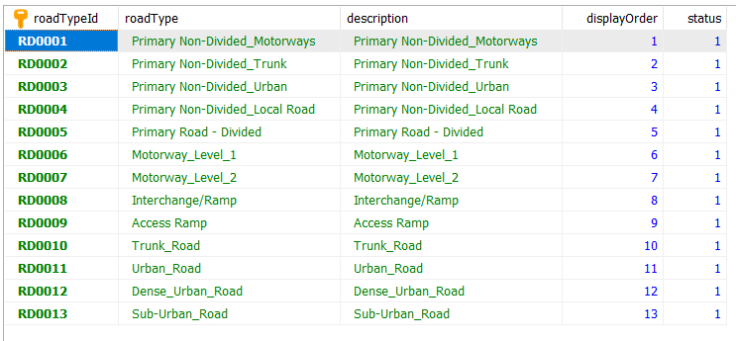

ROAD TYPE – TABLE DATA
TASK TEAM – TABLE DATA

Slide 11
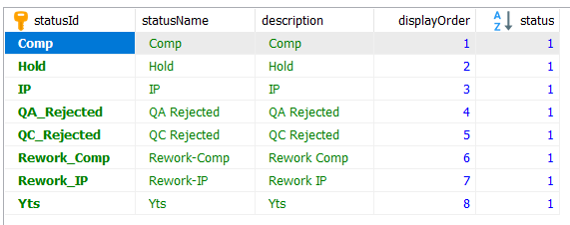
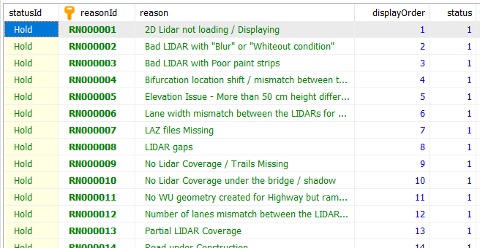
STATUS – TABLE DATA
STATUS REASON – TABLE DATA

Slide 12
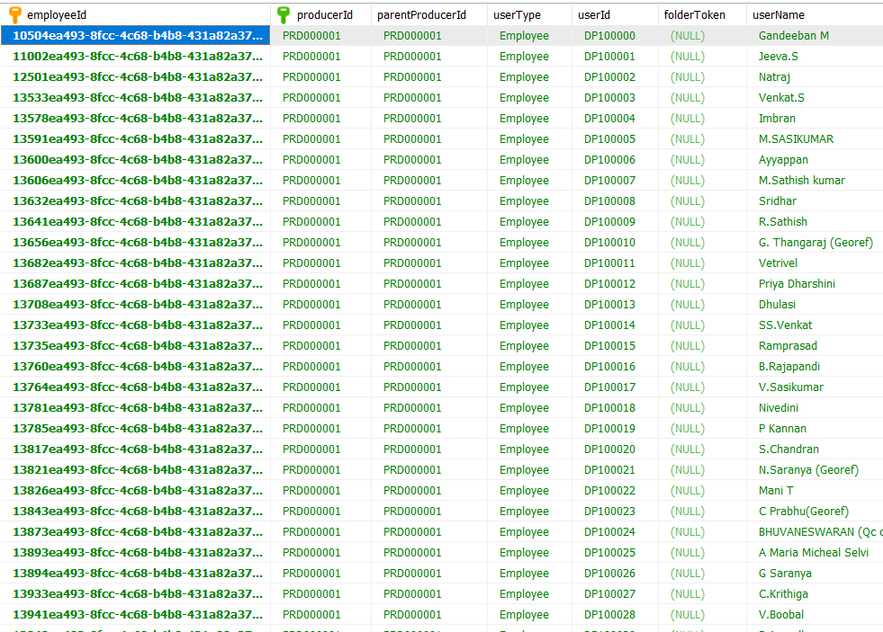
USER – TABLE DATA

Slide 13
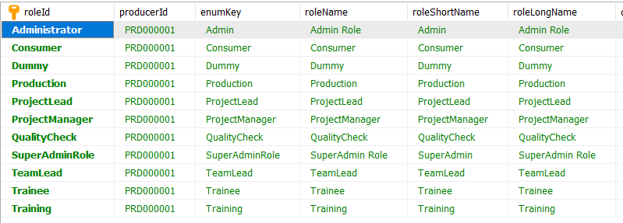
ROLES – TABLE DATA

Slide 14
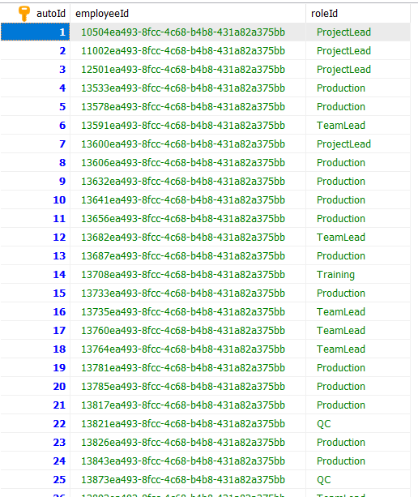
USER - ROLES – TABLE DATA

