Slide 1
Introduction and What is Machine Learning?
Segment 1

Slide 2
Welcome!
Introduction to this video
Who am I?
What’s my background?
Where do I work?
How do I use Python
Why am I making this tutorial?

Slide 3
About this video
Who is this video for?
What will you learn?

Slide 4
About this Video
What will you learn today?
Outline:
What is machine learning?
Introduction to scikit-learn
Set up the environment
Data preprocessing

Slide 5
About this video
Outline continued:
Supervised learning
Random forests
Linear regression
Unsupervised learning
Clustering
Principal component analysis
Model evaluation
Conclusion

Slide 6
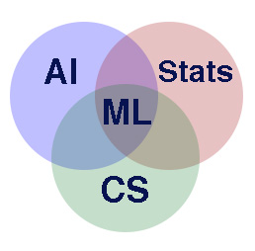
What is machine learning?
Application of algorithms that learn from examples
Representation and generalization
Notes:
-intersection of…and computer engineering
-create a model that will take in data and learn from it

Slide 7
Why should we care?
Useful in every day life
Email spam, handwriting analysis, stock market analysis, Netflix
Especially useful in data analysis
Feature extraction, linear regression, classification, clustering
Notes:
Which features are useful, predict values on both categorical and continuous data, and figure out if any patterns exist at all

Slide 8
Machine Learning Vocab
Instance/observation/data point
Feature
Class
Categorical
Nominal
Ordinal
Continuous
Notes:
-Class: representation of the relationship between the instances and their features. Could be a label, a regression line, or a cluster.
-cat: discrete/finite. Spam/not spam. Nominal like red blue green, or ordinal, meaning hierarchy, like s-m-l

Slide 9
Machine learning
Supervised learning
Classification and regression
Unsupervised learning
Clustering and dimensionality reduction

Slide 10
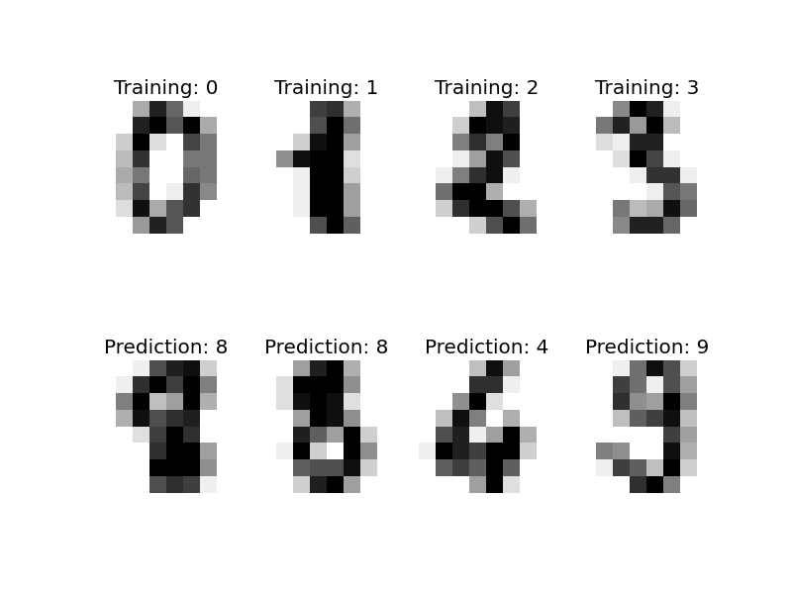
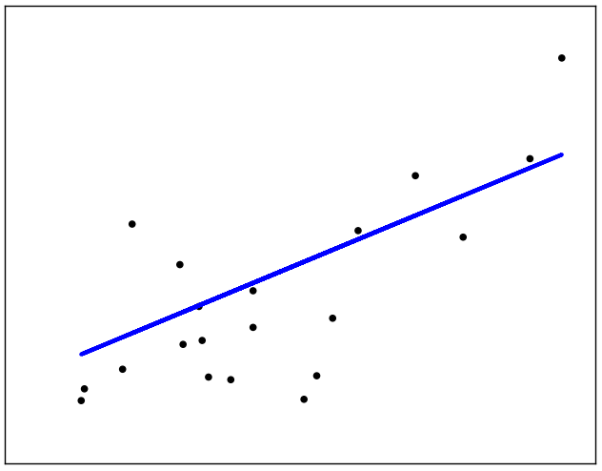
Supervised learning
Labeled data
You know what you’re looking for
Classification: predict categorical labels
Regression: predict continuous target variables
Notes:
-estimator learns link bet the instances and their classes
-going to focus on classification

Slide 11
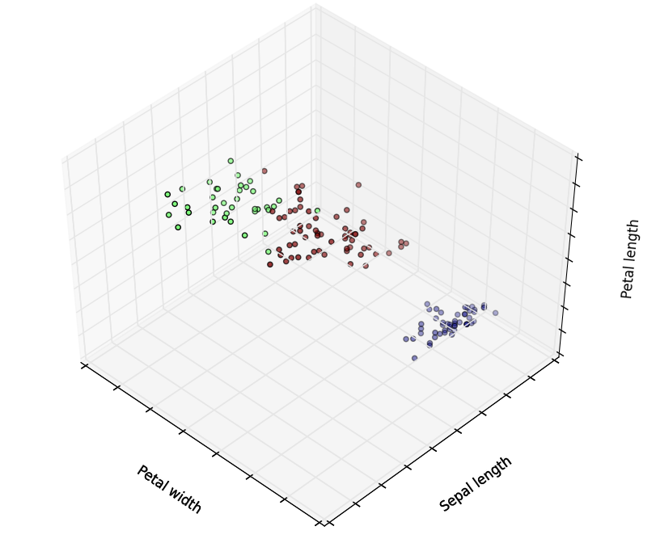
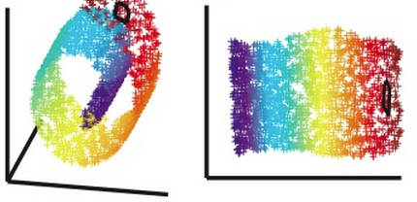
Unsupervised learning
Unlabeled data
You might have no idea what you’re looking for
Clustering: splitting observations into groups
Dimensionality reduction: flatten data to fewer dimensions
Notes:
-pull out rel
-features == dimensions
-focus on clustering

Slide 12
Machine Learning
Supervised
Unsupervised
Semi-supervised
Reinforcement learning
Neural networks
…and many more!
Notes:
-NN: rep of CNS: rep networks as systems of…
-let’s get into sup

