Slide 1
K-means Clustering
Segment 9

Slide 2
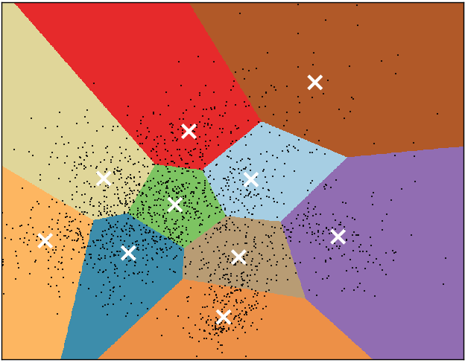
K-means clustering
Formally: a method of vector quantization
Partition space into Voronoi cells
Separate samples into k groups of equal variance
Uses the Euclidean distance metric
Notes:
-k is the number of cluster centers
-VQ or the process of mapping a large set of input values to a smaller set, in this case k
-Vor-oh-noy, the name for the regions that k-means clustering creates
-works by dividing up a set of points, where each group is represented by its centroid point, which, in k-means clustering, are the k initial clusters you choose
-separate…
-and thus works to minimize within-cluster sum of squares

Slide 3
K-means clustering
Iterative refinement
Three basic steps
Step 1: Choose k
Iterate over:
Step 2: Assignment
Step 3: Update
Repeats until convergence has been reached
Notes:
-assignment: observations are assigned to the clusters they’re most similar to
-update: cluster center is recalculated to the mean of the new cluster based on the assignment, so the cluster center is going to move
-repeats until points no longer move around

Slide 4
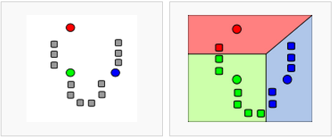
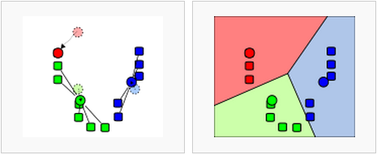
K-means clustering
Assignment
Update
Notes:
-assigned to clusters: top right
-bottom left: new cluster center is calculated
-observations are reassigned
-and so on

Slide 5
K-means clustering
Advantages
Scales well
Efficient
Will always converge
Disadvantages
Choosing the wrong k
Convergence to local minimum
Notes:
-local minimum: locally, the minimum value, but may not be globally minimum, so may not be the minimum value in the dataset

Slide 6
K-means clustering
When to use
Normally distributed data
Large number of samples
Distance can be measured in a linear fashion
Notes:
-non-normally distributed can skew
-data that can’t be separated linearly may require another method (perhaps some kernel tricks)
-let me say a few words about scikit-learn

Slide 7
K-means in scikit-learn
Efficient and fast
You: pick n clusters, kmeans: finds n initial centroids
Run clustering jobs in parallel

Slide 8
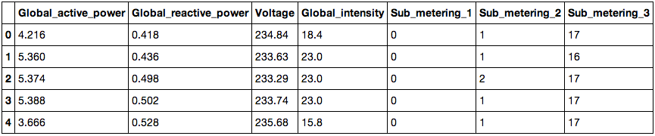
Dataset
University of California Machine Learning Repository
Individual household power consumption
Notes:
Global active power: household global minute-averaged active power (in kilowatts) || global reactive power: household global minute-averaged reactive power kwts
Voltage: minute-averaged voltage in volts || global intensity: household global minute-averaged current intensity (in amperes)
Sub-metering: 1 kitchen, 2 laundry room, 3 water-heater/air conditioner

Slide 9
K-means parameters
n_clusters
max_iter
n_init
init
precompute_distances
tol
n_jobs
random_state
Notes:
N_clusters: 8 | max_iter: maximum number of iterations through algorithm in a single run. Defaults to 300. |
N_jobs: parallel (haven’t done much but would be cool) | init: choosing cluster centers
I’m going to talk about n_clusters and init

Slide 10
n_clusters: choosing k
Graphing the variance
Information criterion
Cross-validation
Notes:
-so, as you may have guessed, choosing k is the most important part of k-means clustering, bc if you do it wrong, your results won’t mean much
-graph the variance: graph the percentage of variance explained against different values of k. at some point, values of k will stop significantly explaining variance.
-information criterion: goodness of fit of an estimated statistical model
-cross-val: much like cross val to test how accurate your model is, you can use cross-val to test different values of k

Slide 11
n_clusters: choosing k
Graphing the variance
from scipy.spatial.distance import cdist, pdist
cdist: distance computation between sets of observations
pdist: pairwise distances between observations in the same set
Notes:
Unfortunately, there is no built-in function for this.
We can use scipy and numpy to figure it out. Not going to walk you through every single line, but I’ll describe what’s going on. It’s on my github

Slide 12
Comparing results: silhouette score
Silhouette coefficient
No ground truth
Mean distance between an observation and all other points in its cluster
Mean distance between an observation and all other points in the next nearest cluster
Silhouette score in scikit-learn
Mean of silhouette coefficient for all of the observations
Closer to 1, the better the fit
Large dataset == long time
Notes:
-We can do that by comparing their silhouette scores.
-no ground truth: we don’t have anything to compare it to
-SC: used when ground truth labels for the clusters aren’t known, like we have in our data here.

Slide 13
What does this tell us?
Patterns exist
Groups of similar observations exist
Sometimes, the defaults work
We need more exploration!

