Slide 1
Linear Regression
Segment 7

Slide 2
What is linear regression?
Relationship between continuous variables
Dependent variable y against explanatory variable(s) x
Minimize residual sum of squares

Slide 3
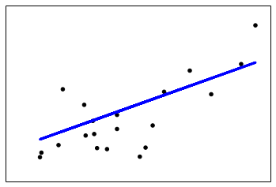
Linear regression

Slide 4
Ridge regression
Works to minimize a penalized version of the least squares cost function using regularization
Penalize larger prediction deviation

Slide 5
Ridge regression
Parameters
alpha
solver

Slide 6
Lasso regression
Estimates sparse coefficients
Minimize a penalized version of the least squares cost function

Slide 7
Lasso regression
Parameters
alpha
normalize

