Slide 1
K-means Clustering
Segment 9

Slide 2
K-means clustering
Formally: a method of vector quantization
Partition space into Voronoi cells
Separate samples into k groups of equal variance
Notes:
-k is the number of cluster centers
-VQ or the process of mapping a large set of input values to a smaller set, in this case k
-Vor-oh-noy, the name for the regions that k-means clustering creates
-works by dividing up a set of points, where each group is represented by its centroid point, which, in k-means clustering, are the k initial clusters you choose
-separate…
-and thus works to minimize within-cluster sum of squares

Slide 3
K-means clustering
Iterative refinement
Step 1: Choose k
Iterate over:
Step 2: Assignment
Step 3: Update
Notes:
-assignment: observations are assigned to the clusters they’re most similar to
-update: cluster center is recalculated to the mean of the new cluster based on the assignment, so the cluster center is going to move
-repeats until points no longer move around

Slide 4
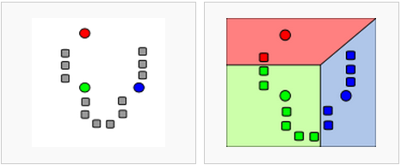
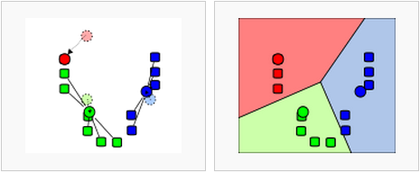
K-means clustering
Assignment
Update
Notes:
-assigned to clusters: top right
-bottom left: new cluster center is calculated
-observations are reassigned
-and so on

Slide 5
K-means clustering
Advantages
Scales well
Efficient
Will always converge
When to use
Normally distributed data
Large number of samples
Notes:
-non-normally distributed can skew
-data that can’t be separated linearly may require another method (perhaps some kernel tricks)
-let me say a few words about scikit-learn

Slide 6
Choosing k
Graphing the variance
Information criterion
Cross-validation
Notes:
-so, as you may have guessed, choosing k is the most important part of k-means clustering, bc if you do it wrong, your results won’t mean much
-graph the variance: graph the percentage of variance explained against different values of k. at some point, values of k will stop significantly explaining variance.
-information criterion: goodness of fit of an estimated statistical model
-cross-val: much like cross val to test how accurate your model is, you can use cross-val to test different values of k

Slide 7
k-means parameters
n_clusters
max_iter
n_init
Notes:
N_clusters: 8 | max_iter: maximum number of iterations through algorithm in a single run. Defaults to 300. |
N_jobs: parallel (haven’t done much but would be cool) | init: choosing cluster centers
I’m going to talk about n_clusters and init

Slide 8
Comparing results: silhouette score
Silhouette coefficient
No ground truth
Silhouette score in scikit-learn
Mean of silhouette coefficient for all of the observations
Closer to 1, the better the fit
Notes:
-We can do that by comparing their silhouette scores.
-no ground truth: we don’t have anything to compare it to
-SC: used when ground truth labels for the clusters aren’t known, like we have in our data here.

