Slide 1
Feature Extraction and Price Prediction
Mobile Phones Market Analysis

Slide 2
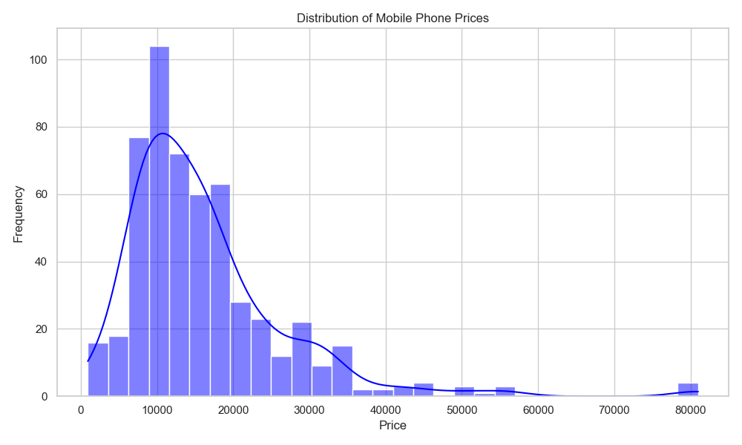
Target Variable: Price Distribution
• The price distribution is right-skewed.
• Most phones fall into the budget or mid-tier categories.
• A long tail exists for premium/flagship devices.
• This indicates a broad market with distinct pricing tiers.

Slide 3
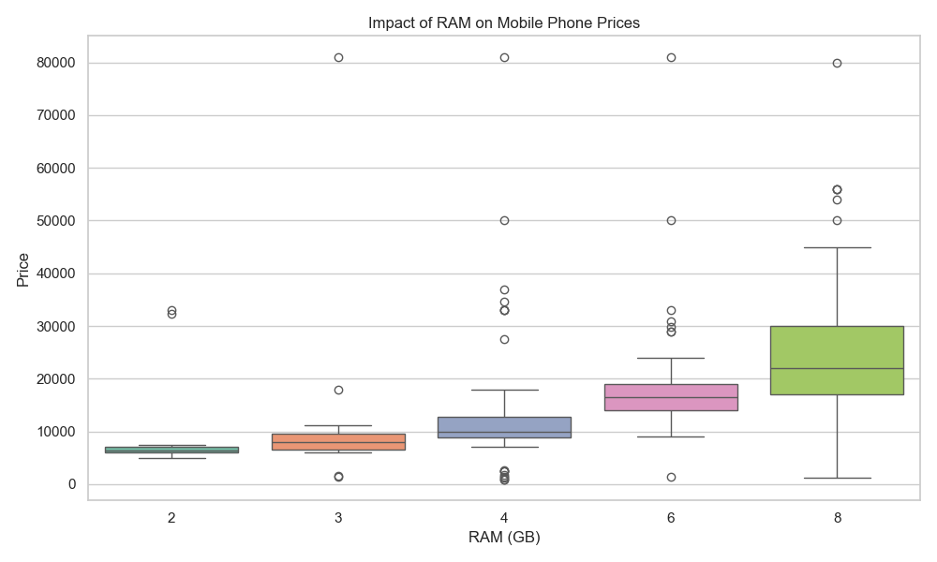
Key Price Driver: RAM Capacity
• RAM has a very strong, step-function relationship with Price.
• Each incremental tier of RAM forces a distinct jump in median price.
• High RAM is a primary premium pricing anchor.

Slide 4
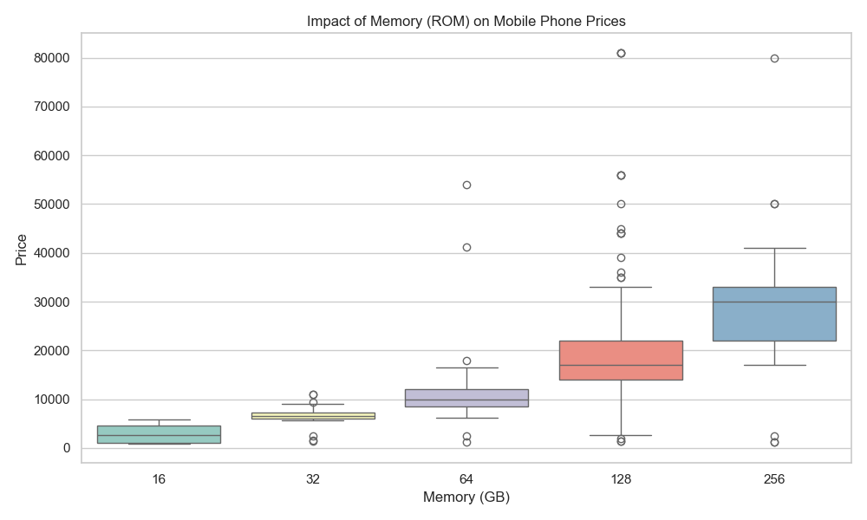
Key Price Driver: Storage Memory (ROM)
• Storage capacity operates similarly to RAM.
• It provides a clear, actionable way to justify price increases.
• Base models start low, while higher storage variants command significant premiums.

Slide 5
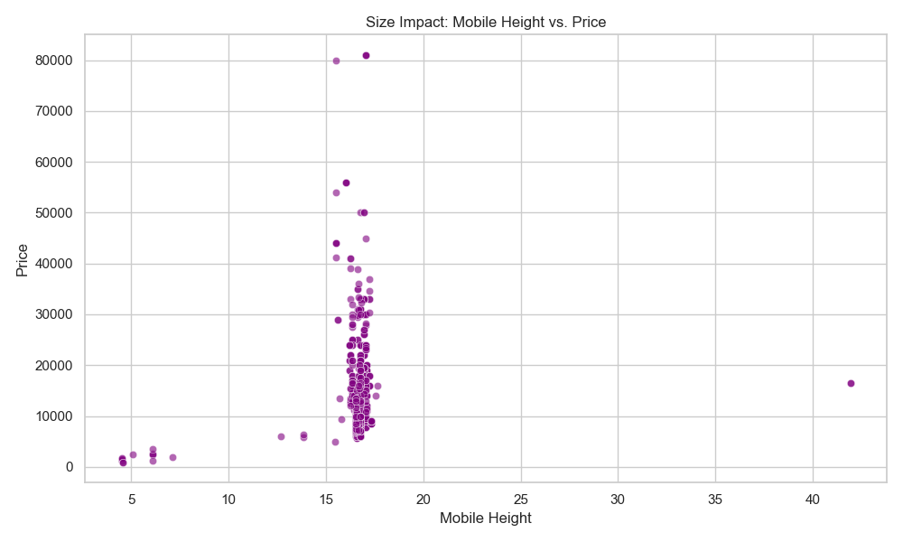
Size Impact: Mobile Height vs. Price
• Physical size (Mobile Height) shows near zero correlation with price.
• Most devices cluster around a standard size regardless of cost.
• Size is NOT a reliable differentiator for premium pricing.

Slide 6
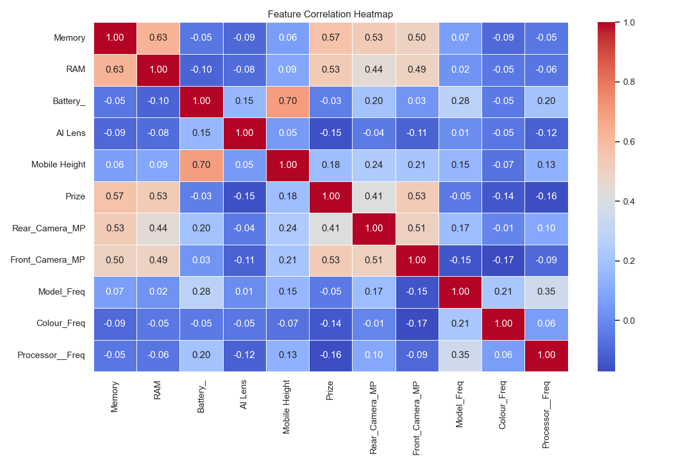
Feature Correlation Analysis
• RAM (0.83) and Memory (0.75) are the strongest linear predictors.
• Rear Camera MP (0.64) is also highly significant.
• Battery capacity and physical dimensions show extremely weak correlations.

Slide 7
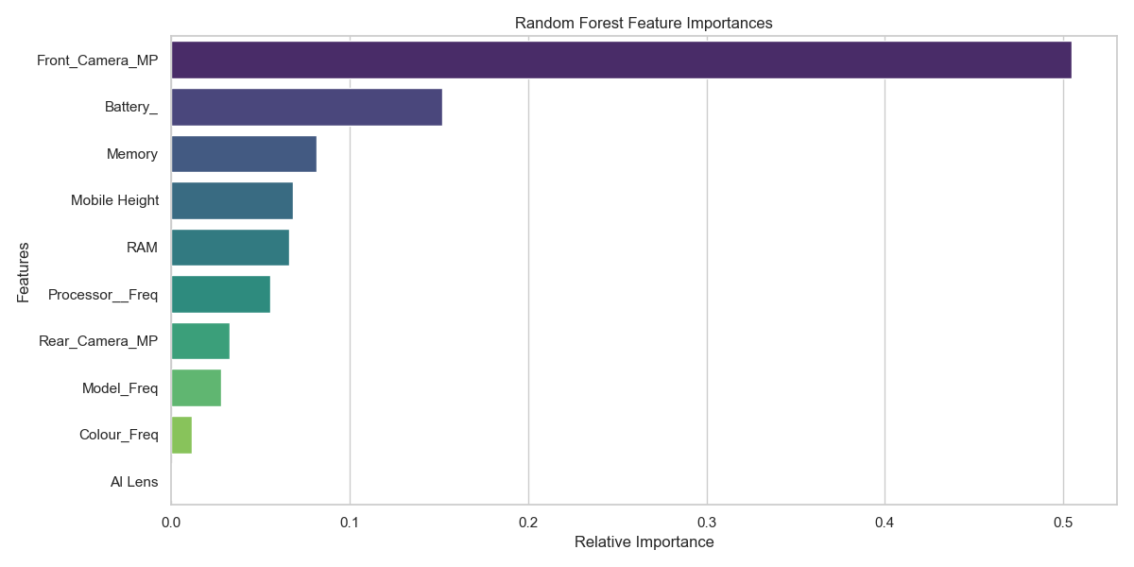
Ultimate Feature Importance (Random Forest)
• Random Forest extracted Gini importances confirming our EDA.
• Compute (Memory/RAM) are the undisputed top drivers.
• Rear Camera quality provides the next best justification for price bumps.
• Battery and screen size offer diminishing returns.

