Slide 1
Real Estate Exploratory Data Analysis
Comprehensive Analysis of Housing Prices
1460 Properties Analyzed

Slide 2
Executive Summary
Dataset: 1460 properties with 90 features
Price Range: $34,900 - $755,000
Median Price: $163,000
Average Price: $180,921
Key Features Created: 9 engineered features
Analysis Includes: Distributions, Correlations, Trends, Clusters

Slide 3
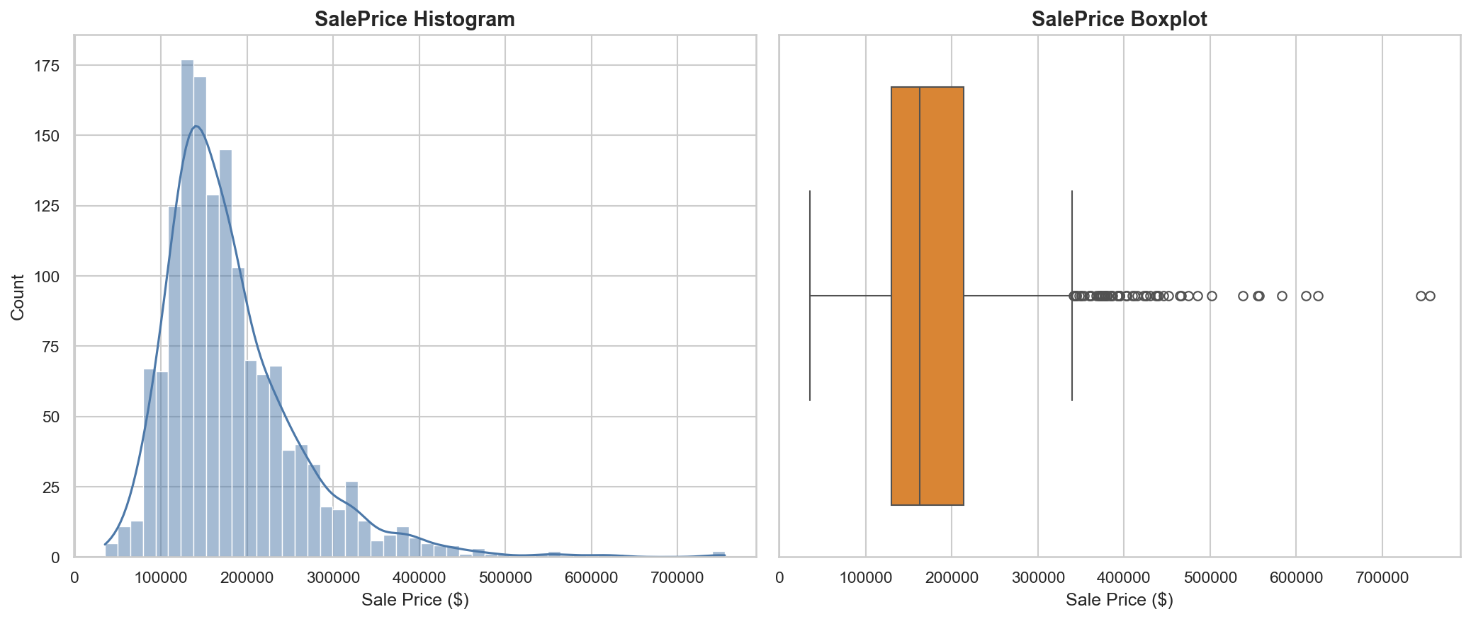
SalePrice Distribution
Distribution shows central tendency, spread, skewness, and outliers in house prices.

Slide 4
SalePrice Statistics
Mean: $180,921.20
Median: $163,000.00
Standard Deviation: $79,442.50
Minimum: $34,900
Maximum: $755,000
25th Percentile: $129,975
75th Percentile: $214,000

Slide 5
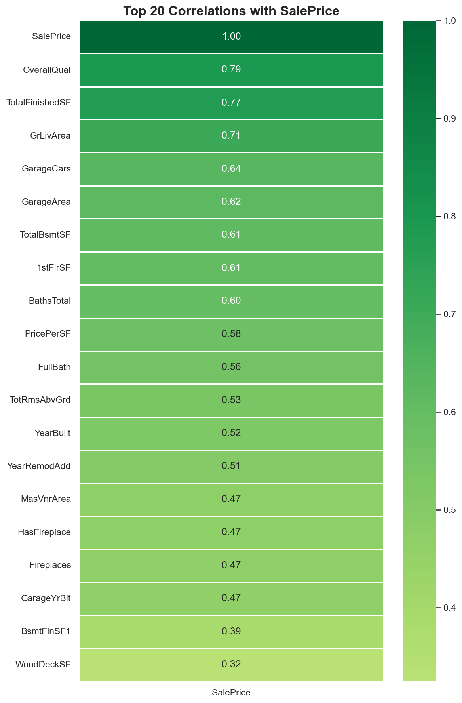
Feature Correlations
Top features ranked by correlation with SalePrice. Green indicates positive correlation, red negative.

Slide 6
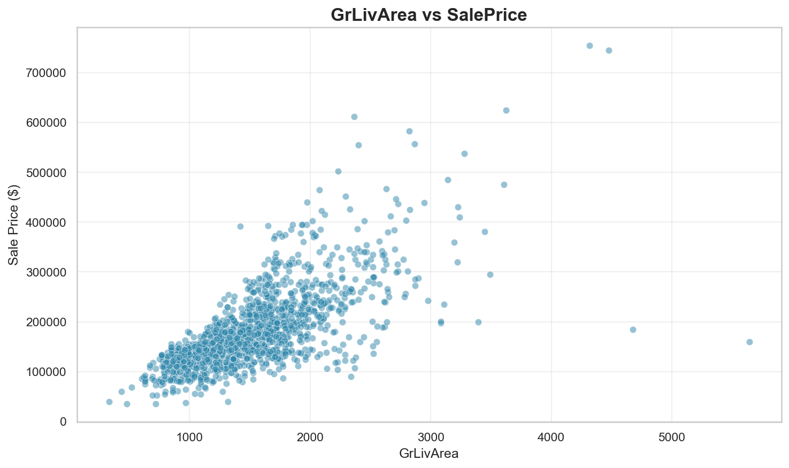
GrLivArea Impact on Price
Relationship between GrLivArea and sale price. Look for linear trends and outliers.

Slide 7
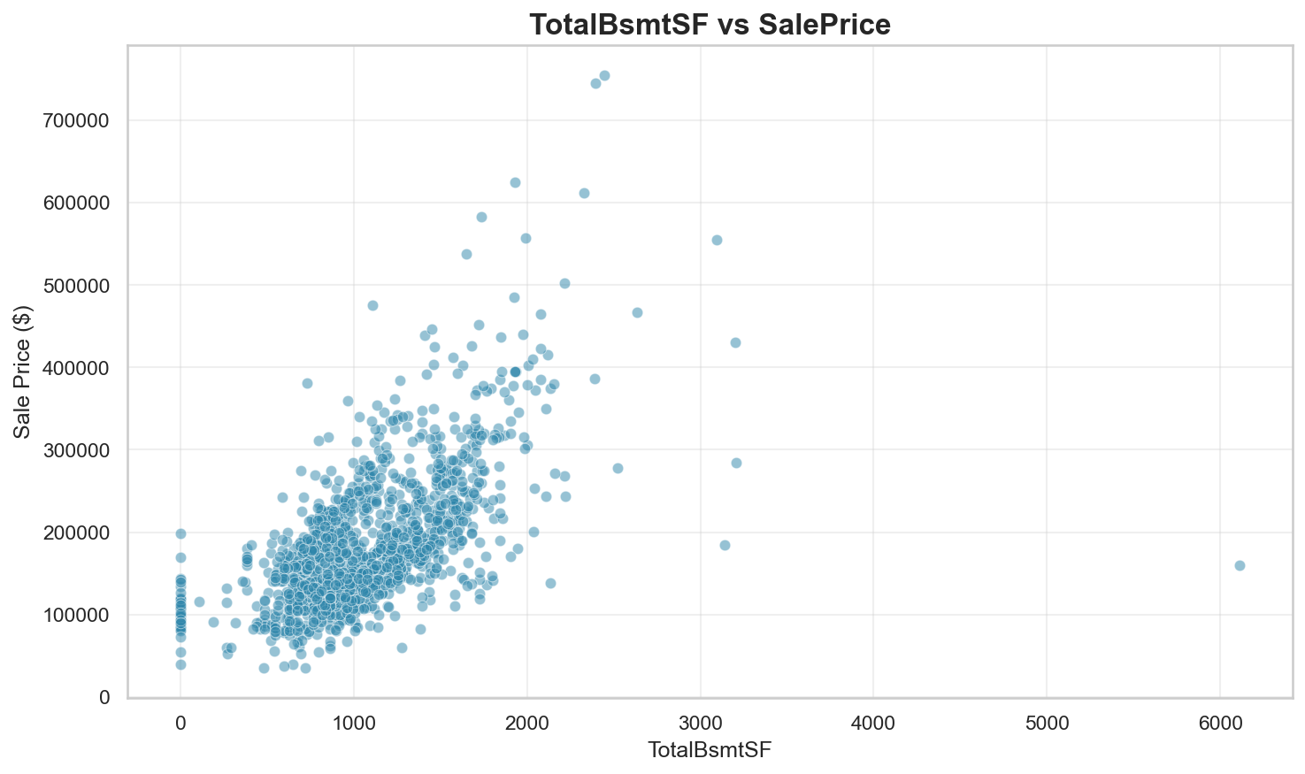
TotalBsmtSF Impact on Price
Relationship between TotalBsmtSF and sale price. Look for linear trends and outliers.

Slide 8
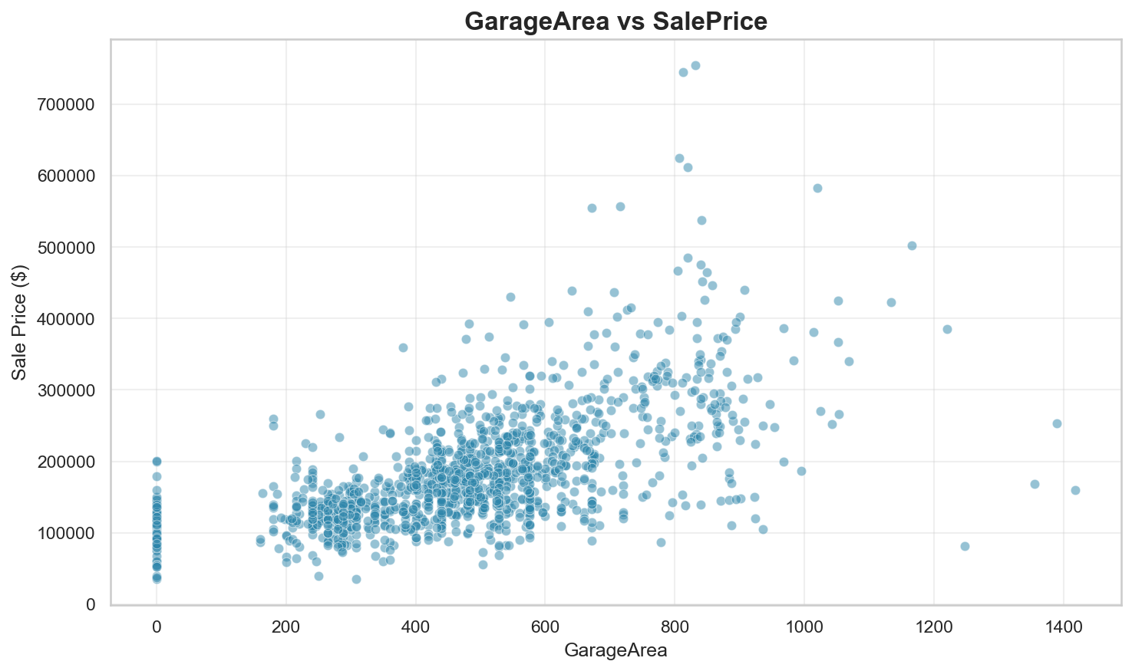
GarageArea Impact on Price
Relationship between GarageArea and sale price. Look for linear trends and outliers.

Slide 9
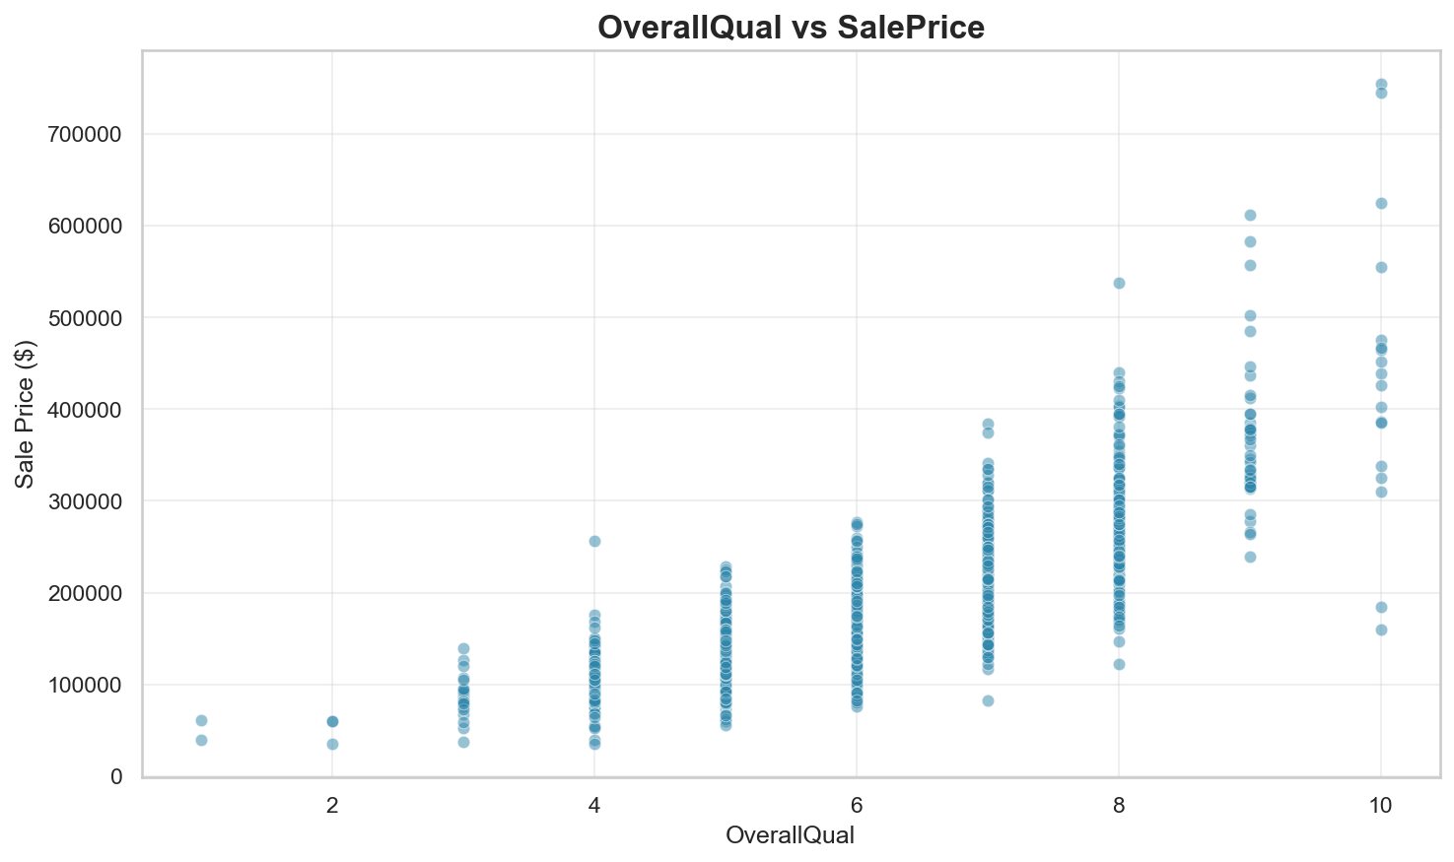
OverallQual Impact on Price
Relationship between OverallQual and sale price. Look for linear trends and outliers.

Slide 10
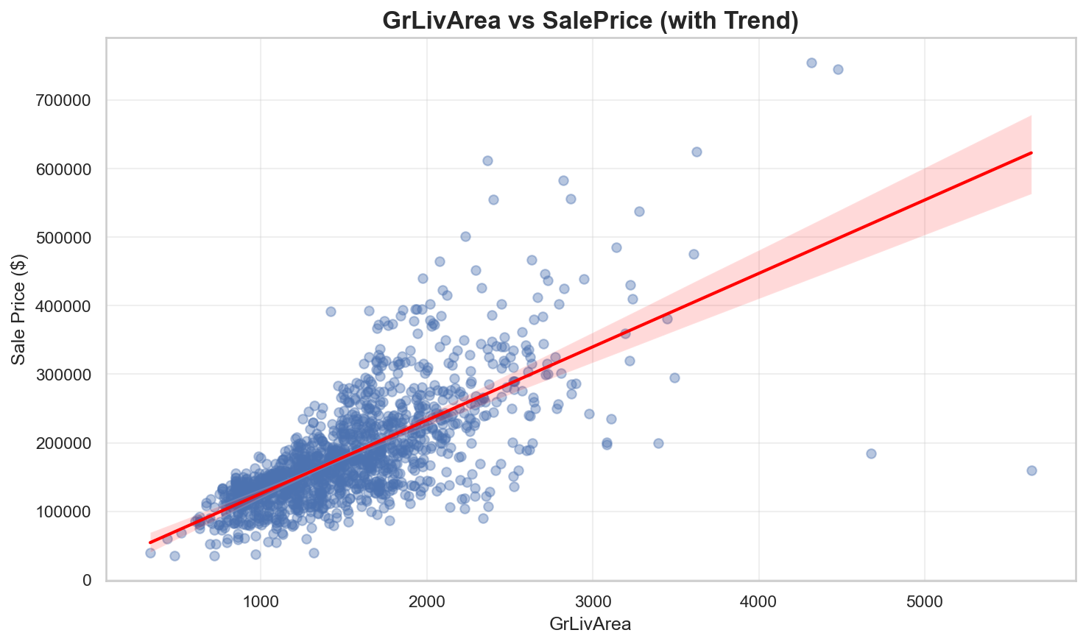
GrLivArea Price Trend
Trend line shows the marginal effect of GrLivArea on house price.

Slide 11
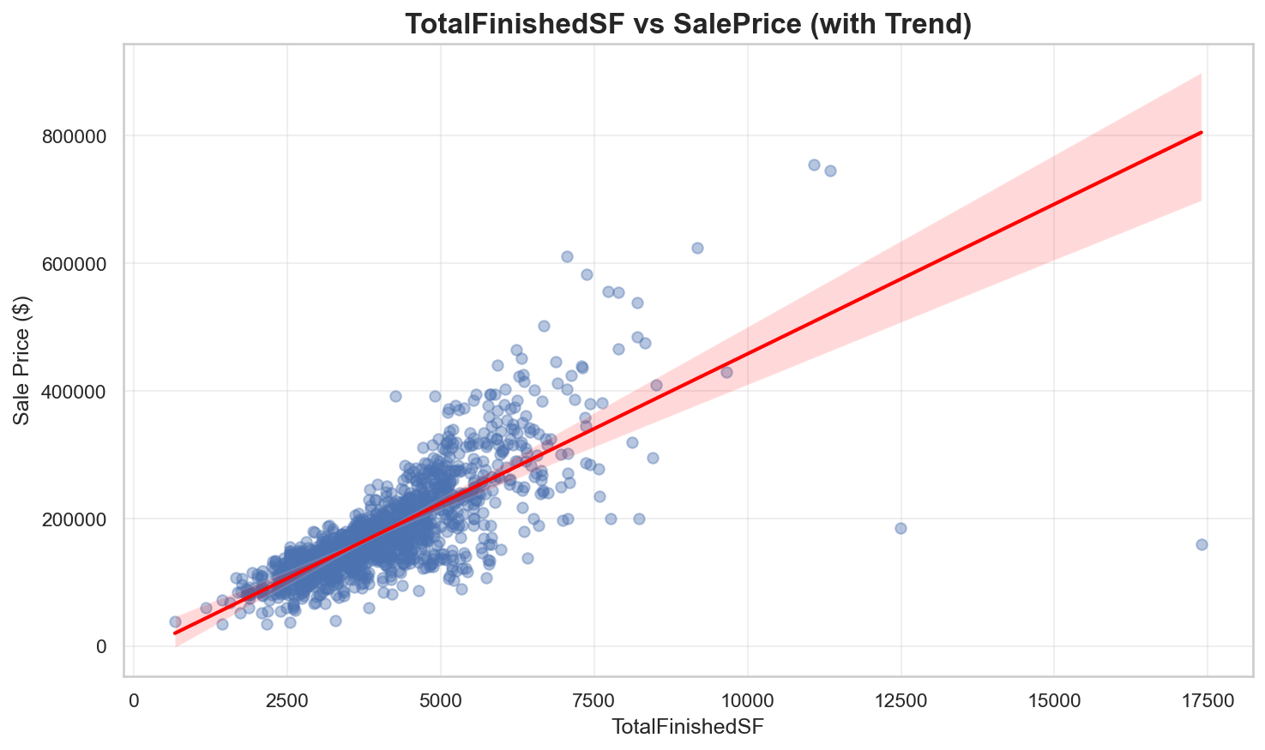
TotalFinishedSF Price Trend
Trend line shows the marginal effect of TotalFinishedSF on house price.

Slide 12
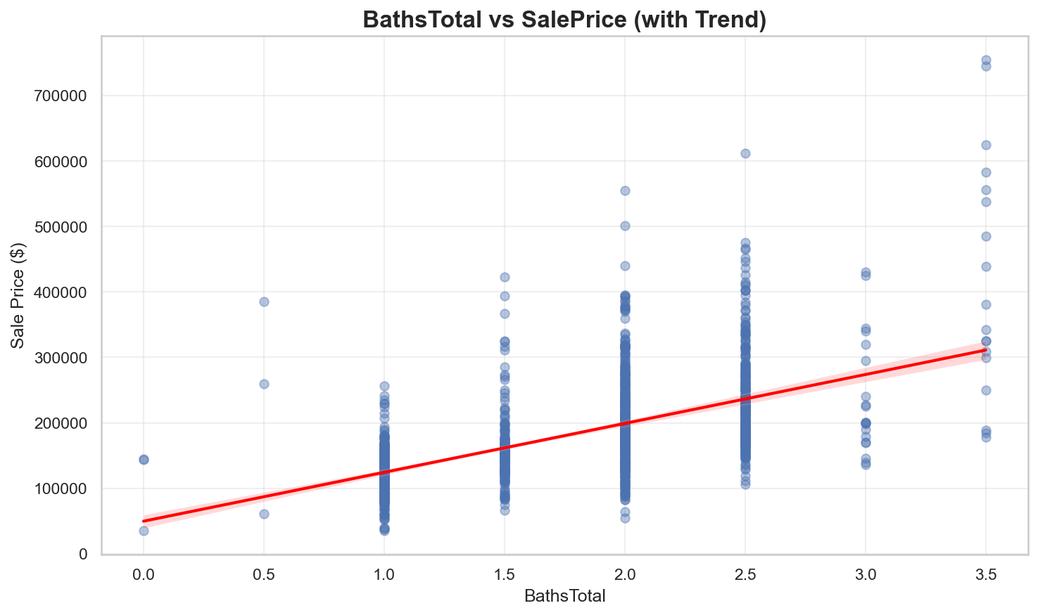
BathsTotal Price Trend
Trend line shows the marginal effect of BathsTotal on house price.

Slide 13
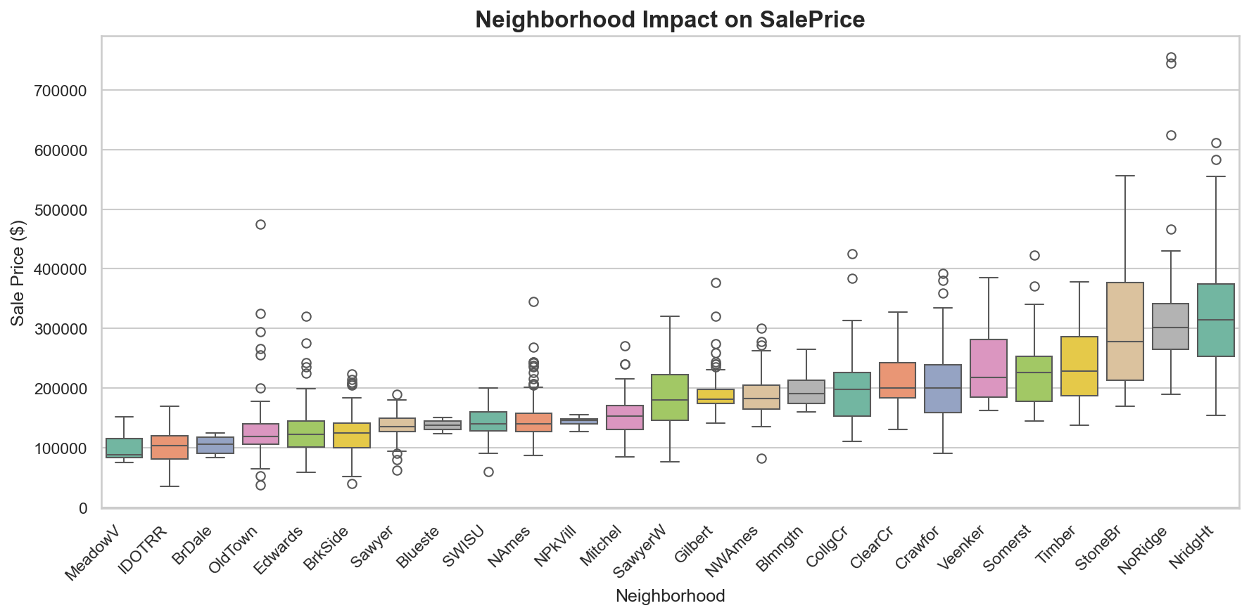
Neighborhood Analysis
Price variation across different Neighborhood categories, sorted by median price.

Slide 14
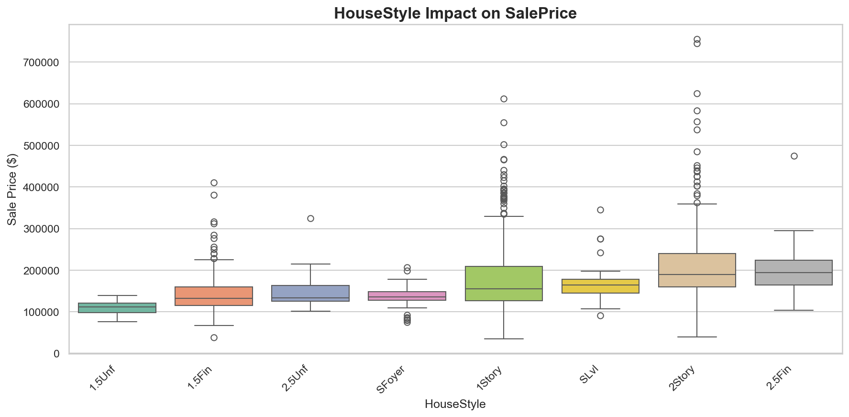
HouseStyle Analysis
Price variation across different HouseStyle categories, sorted by median price.

Slide 15
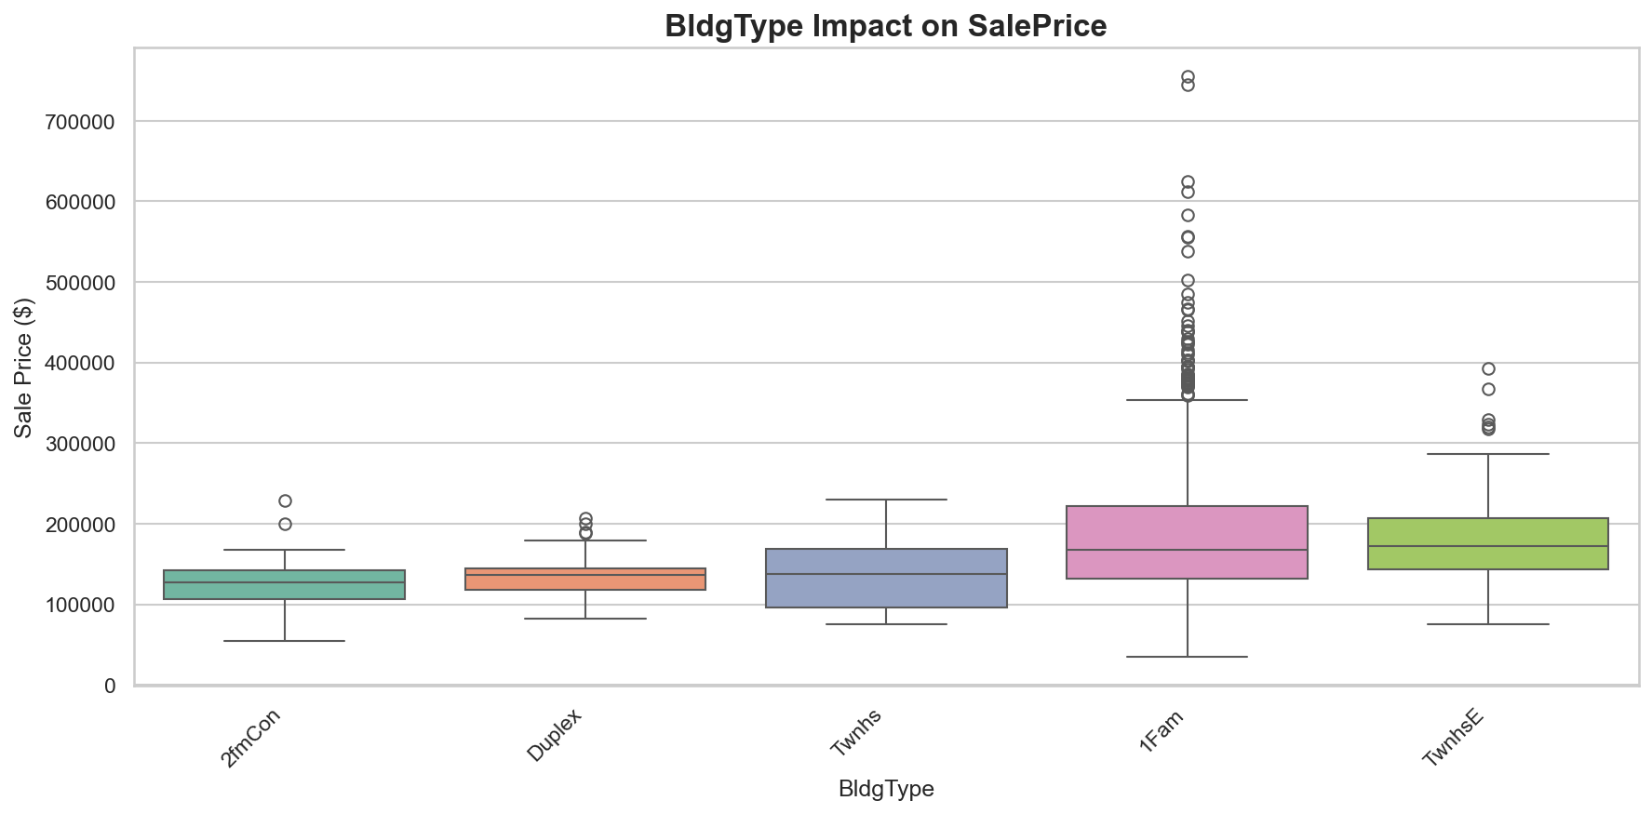
BldgType Analysis
Price variation across different BldgType categories, sorted by median price.

Slide 16
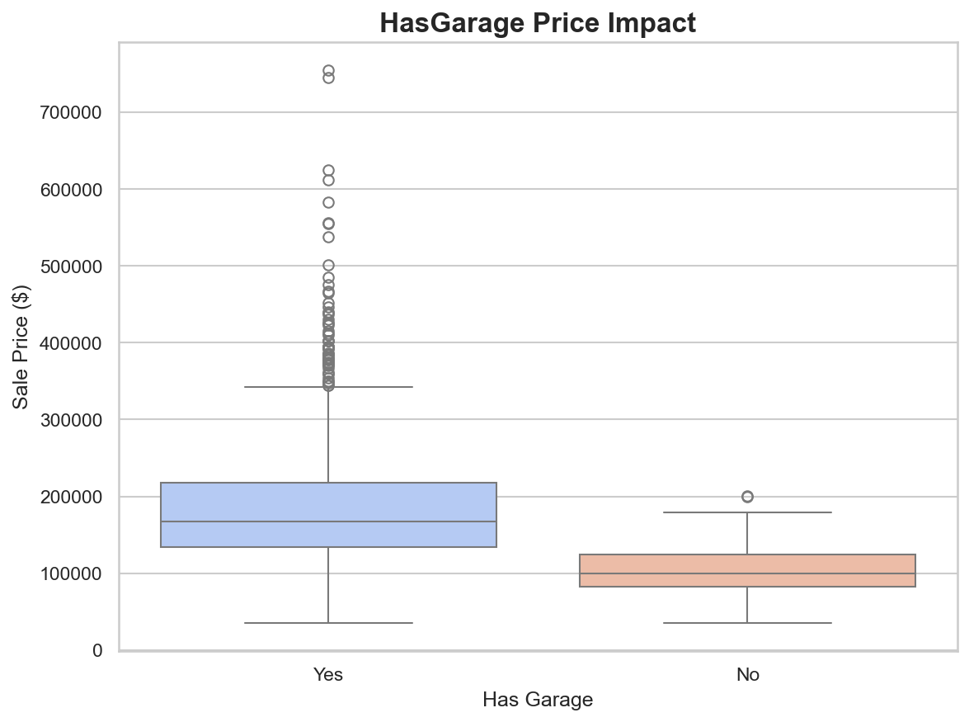
HasGarage Value Analysis
Median price difference: $67,500 (67.5% premium). Shows value added by this amenity.

Slide 17
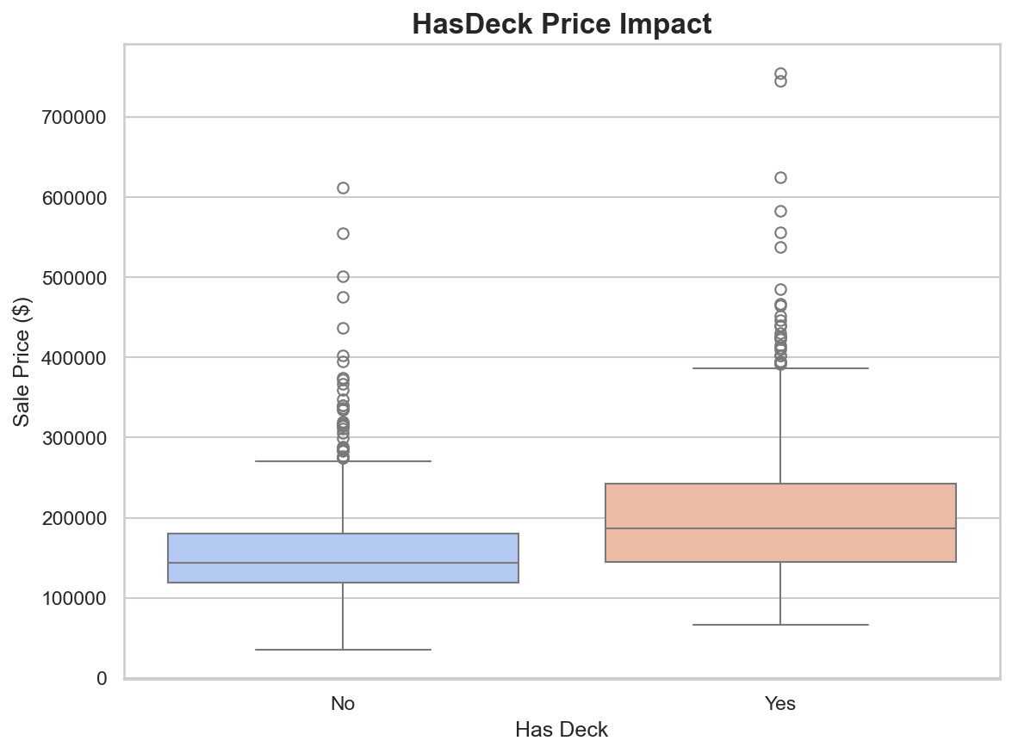
HasDeck Value Analysis
Median price difference: $42,848 (29.7% premium). Shows value added by this amenity.

Slide 18
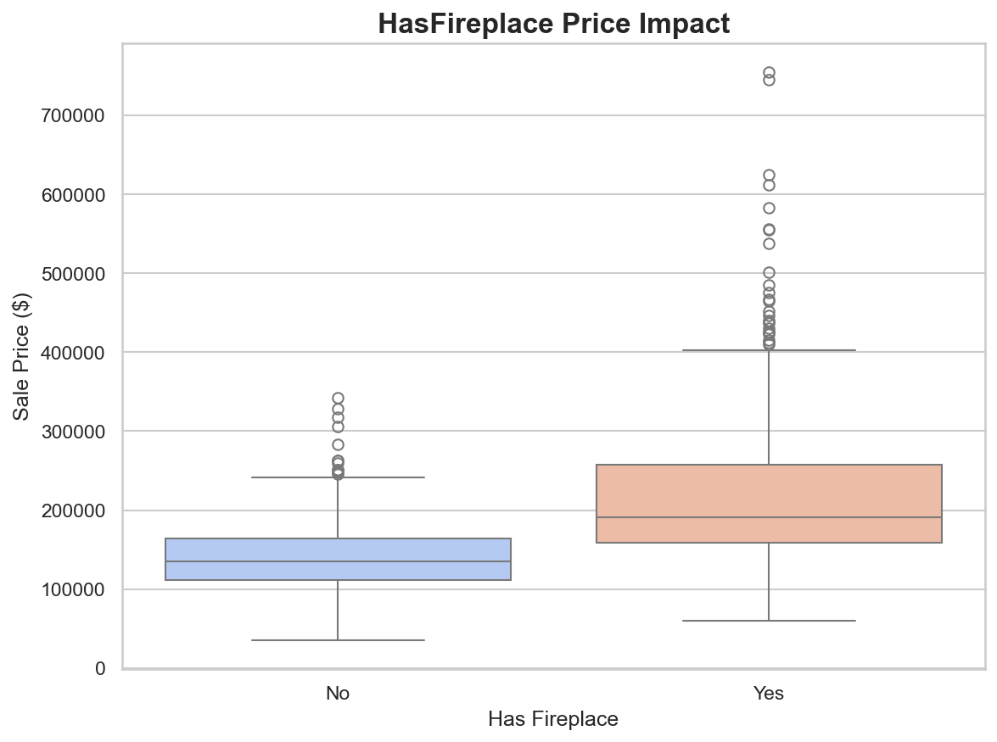
HasFireplace Value Analysis
Median price difference: $56,000 (41.5% premium). Shows value added by this amenity.

Slide 19
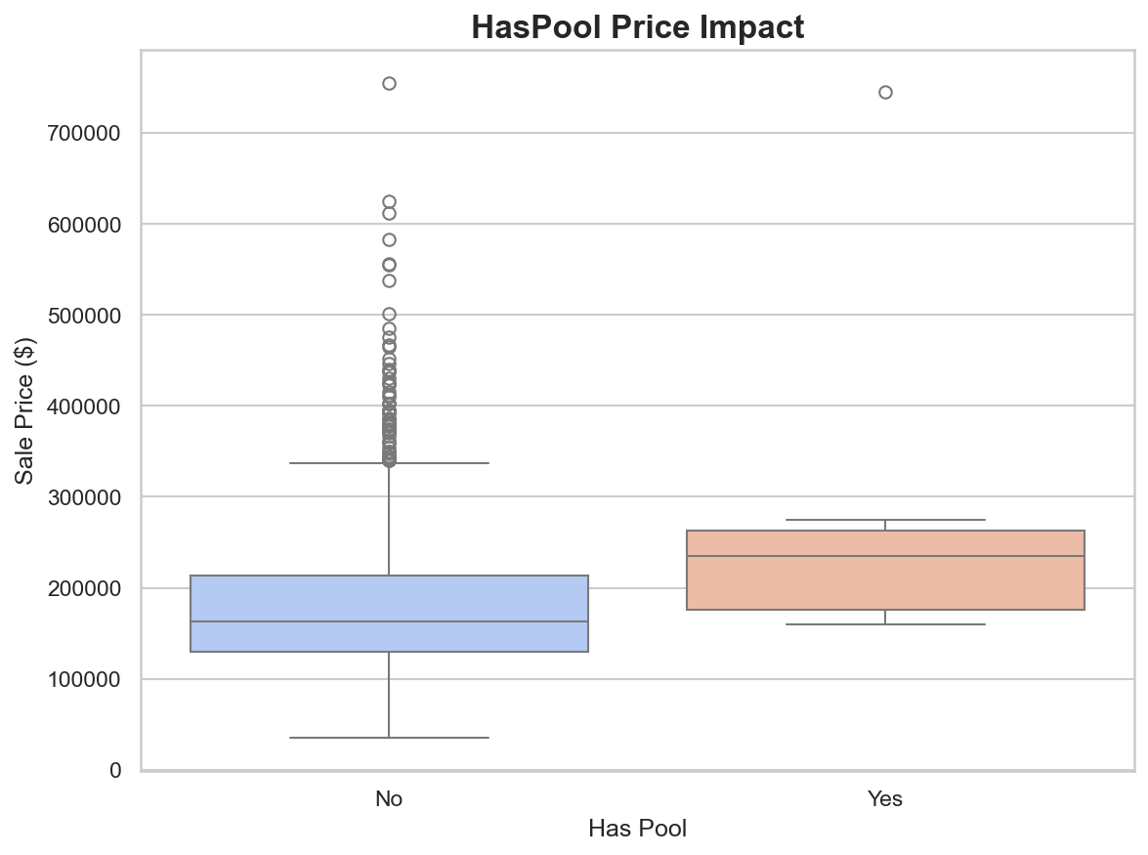
HasPool Value Analysis
Median price difference: $72,100 (44.3% premium). Shows value added by this amenity.

Slide 20
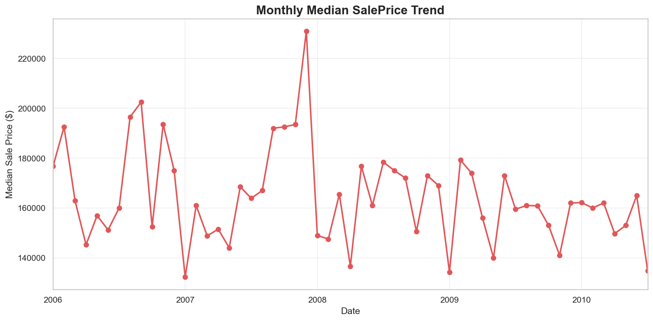
Monthly Price Trends
Median sale price over time showing seasonal patterns and market momentum.

Slide 21
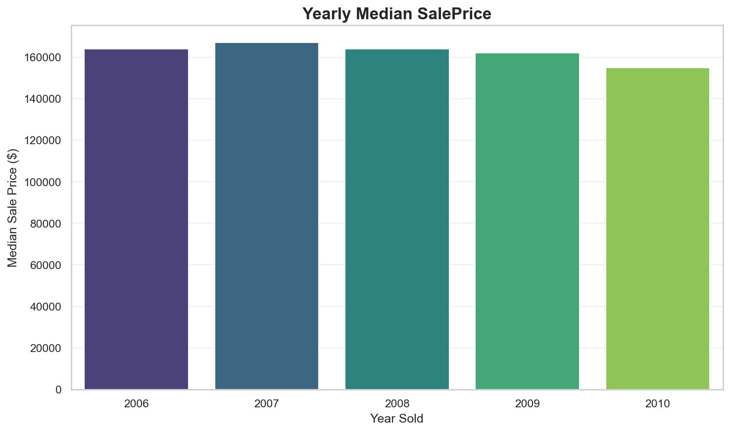
Yearly Price Trends
Year-over-year median price changes showing market appreciation or depreciation.

Slide 22
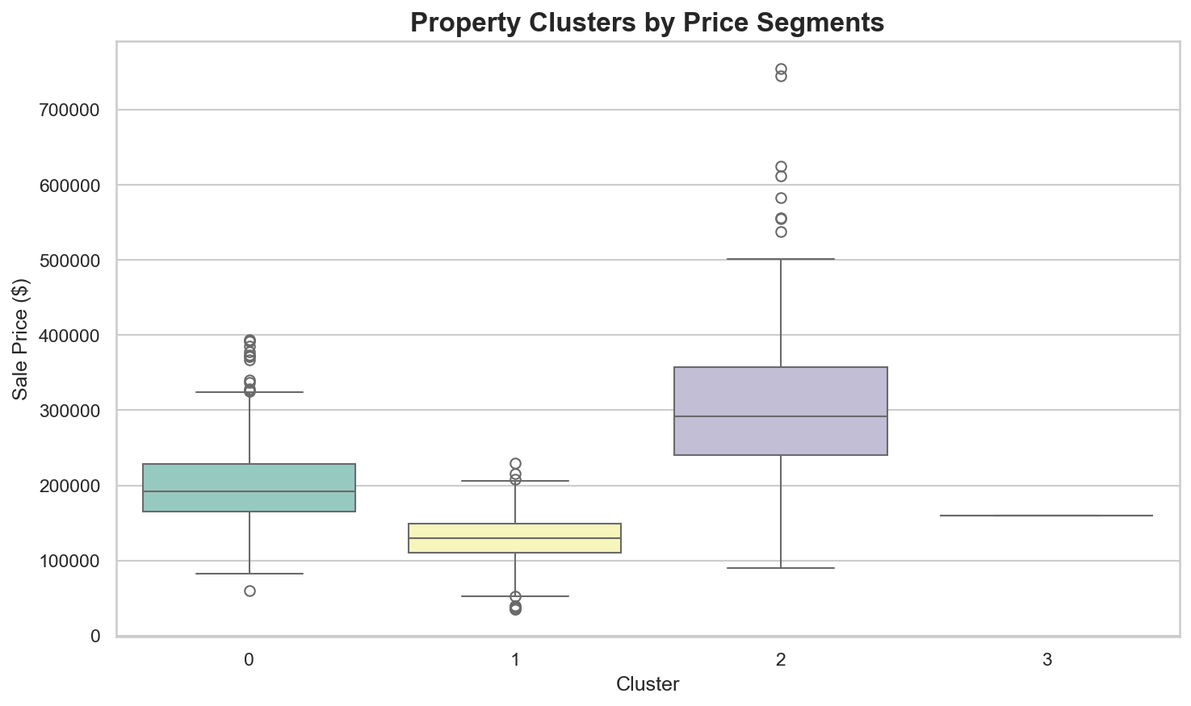
Market Segmentation
Properties grouped into 4 clusters based on GrLivArea, BathsTotal, GarageCars, TotalBsmtSF. Reveals distinct price segments.

Slide 23
Key Insights
Strong correlations: Overall Quality, Living Area, and Total Basement SF drive prices
Location matters: Neighborhood has significant impact on property values
Size premium: Larger homes and more bathrooms command higher prices
Amenities add value: Garage, fireplace, and deck increase median prices
Market timing: Seasonal and yearly trends affect sale prices
Distinct segments: Properties cluster into clear price and feature groups

Slide 24
Recommendations
Focus on quality improvements: Overall quality has highest correlation with price
Maximize living space: GrLivArea strongly predicts higher sale prices
Location strategy: Target high-value neighborhoods for investments
Add value amenities: Consider garage, basement finishing, and fireplaces
Market timing: Be aware of seasonal patterns when listing properties
Segment marketing: Tailor strategies to different property clusters

