Slide 1

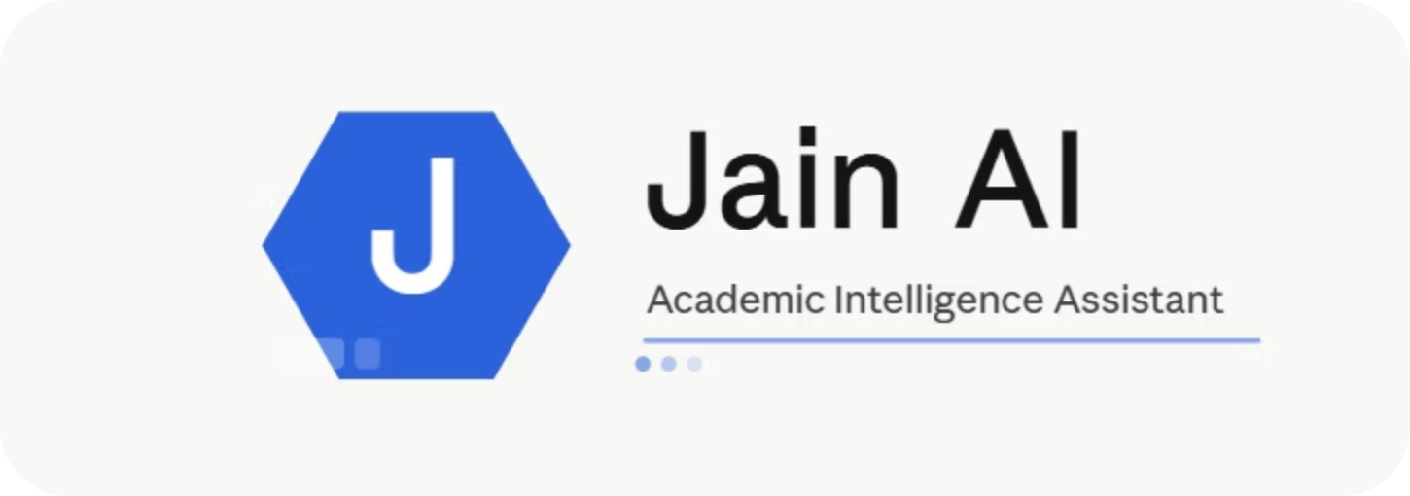
Jain AI
AI that actually knows.
Document-Grounded Academic Assistant
ACADEMIC ASSISTANT

Slide 2

The Problem: Information Overload
📄 Scattered Documents
⏳ Time-Consuming Searches
University information is buried across dozens of PDFs, making it nearly impossible to find what you need quickly.
Manual searching through unstructured documents wastes valuable student and staff time every day.
🤖 Unreliable Chatbots
Generic AI assistants hallucinate and provide inaccurate answers that cannot be trusted for academic decisions.

Slide 3

Our Solution: JainAI
Jain AI reads your institution’s documents first, then delivers precise, trustworthy answers to student questions.
Solution
Objective
Jain AI is an intelligent academic assistant that helps students and staff find accurate information quickly by grounding every response in official institutional documents.
Deliver faster access to reliable answers, reduce manual searching, and improve confidence in academic decisions.
Ask in plain language
Get grounded answers
Natural language queries, no technical skills needed.
Every response is backed by real institutional documents.
Save time, reduce errors
Find accurate information in seconds, not minutes.

Slide 4
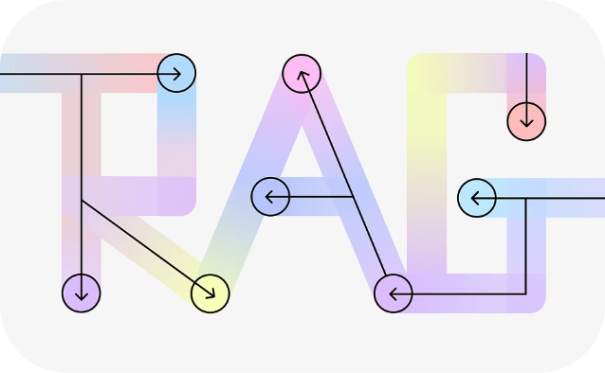
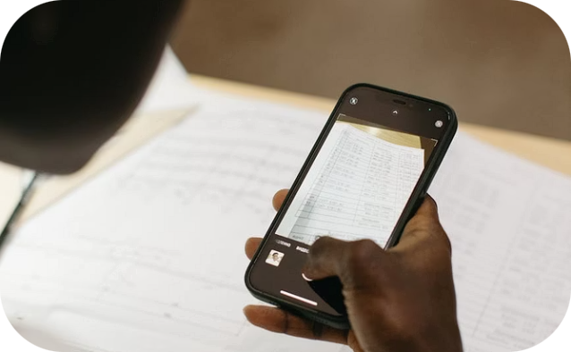

Core Features at a Glance
RAG + LLM Chatbot
OCR Capability
Zero Hallucination
Retrieves relevant document passages and generates accurate, context-aware responses using large language models.
Extracts text from scanned PDFs and image-based documents, enabling real-world document handling at scale.
Every answer is grounded in verified source documents — no guessing, no fabrication, fully traceable.

Slide 5
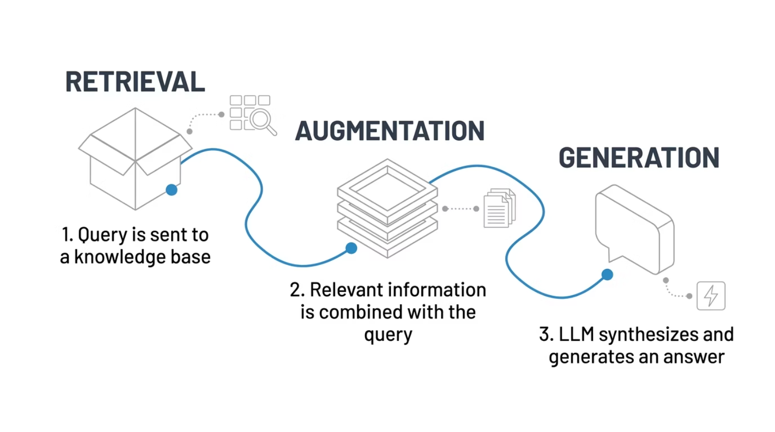

FEATURE 1
RAG + LLM Chatbot
RAG pulls useful information from documents
LLMs turn that context into clear answers
Improves accuracy with grounded sources
Reduces hallucinations and guesswork
🔍 Retrieval
🧠 Augmented
💬 Generation
Finds relevant information from documents.
Adds retrieved data as context.
LLM generates the final answer.

Slide 6
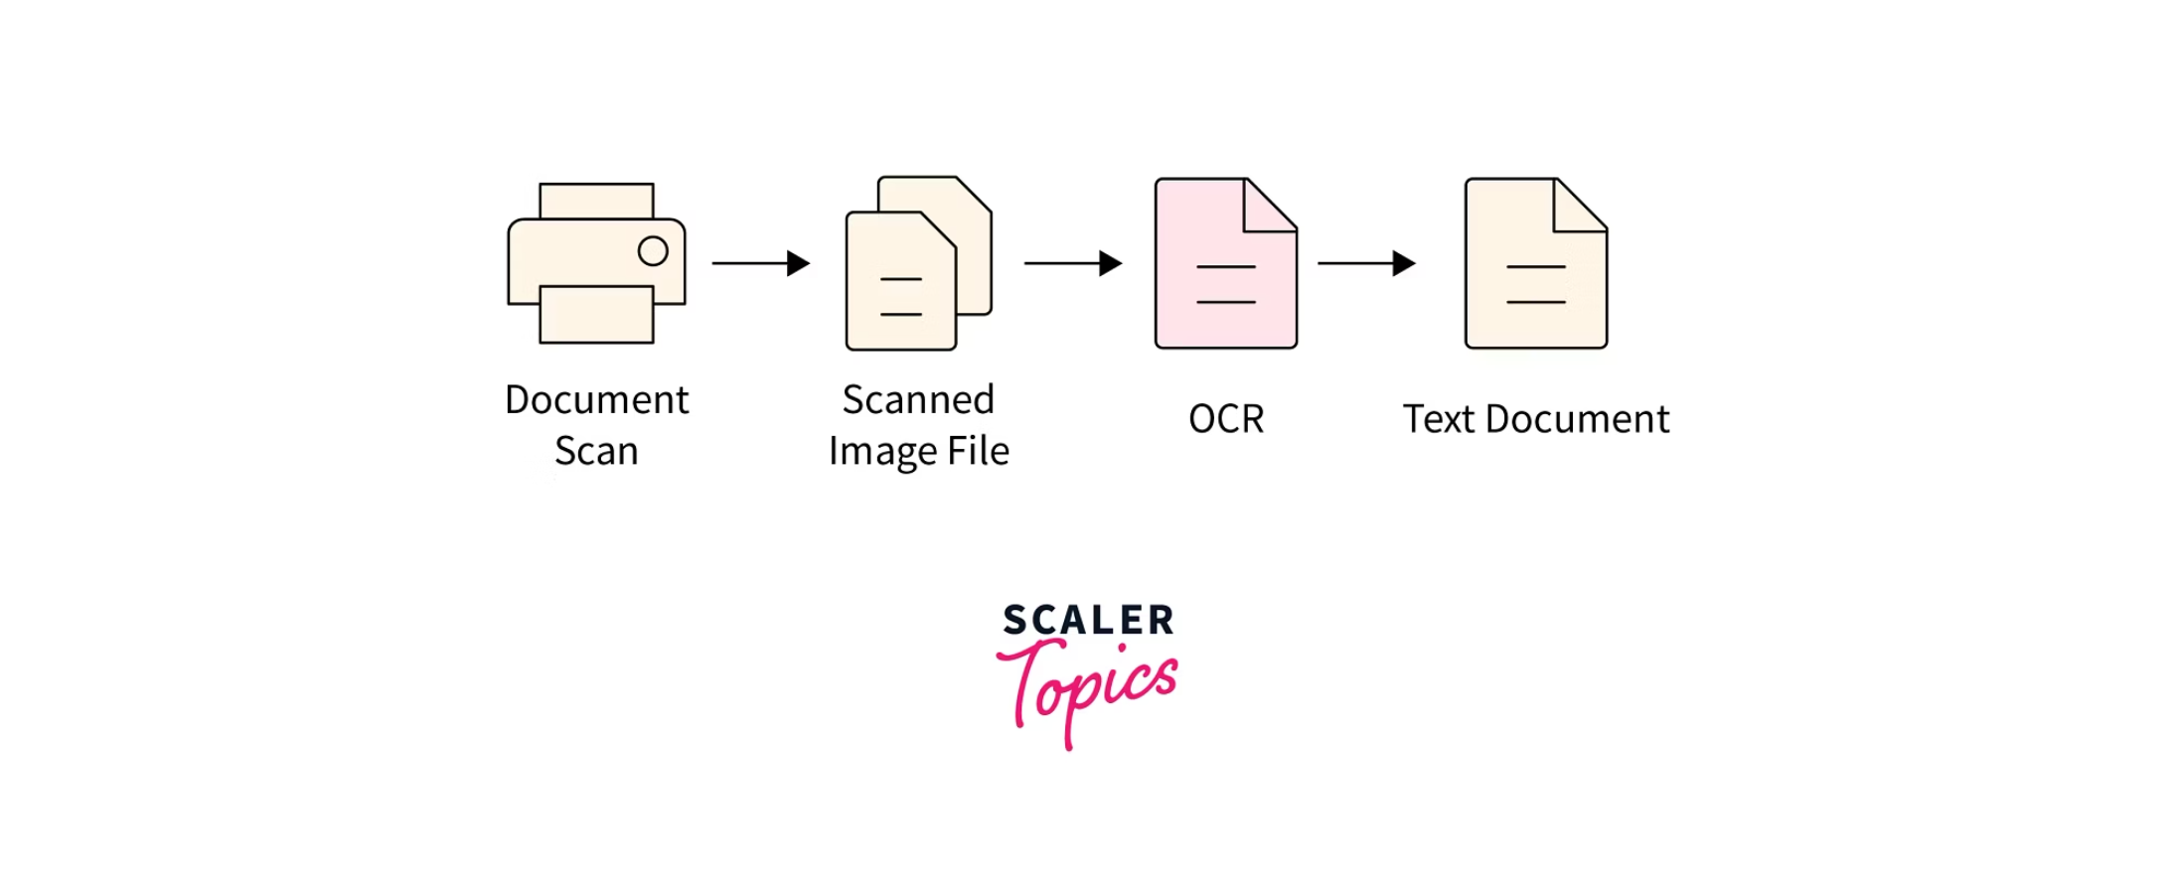
FEATURE 2
OCR Capability
Not all university documents are machine-readable. Jain AI's OCR engine extracts text from scanned PDFs, handwritten forms, and image-based documents — making every file searchable and queryable.
Scanned PDFs
Image Documents
Real-World Ready
Full text extraction from image-based PDFs.
Supports PNG, JPG, and other image formats.
Handles messy, real institutional document formats.

Slide 7

FEATURE 3
Accurate, Verifiable Responses
Jain AI eliminates the biggest risk of generative AI: hallucination. Every answer is tied directly to source documents, giving students and staff confidence in the information they receive.
0
100%
Hallucinations
Source-Backed
Document-grounded retrieval eliminates fabricated answers.
Every response is traceable to an original document.

Slide 8
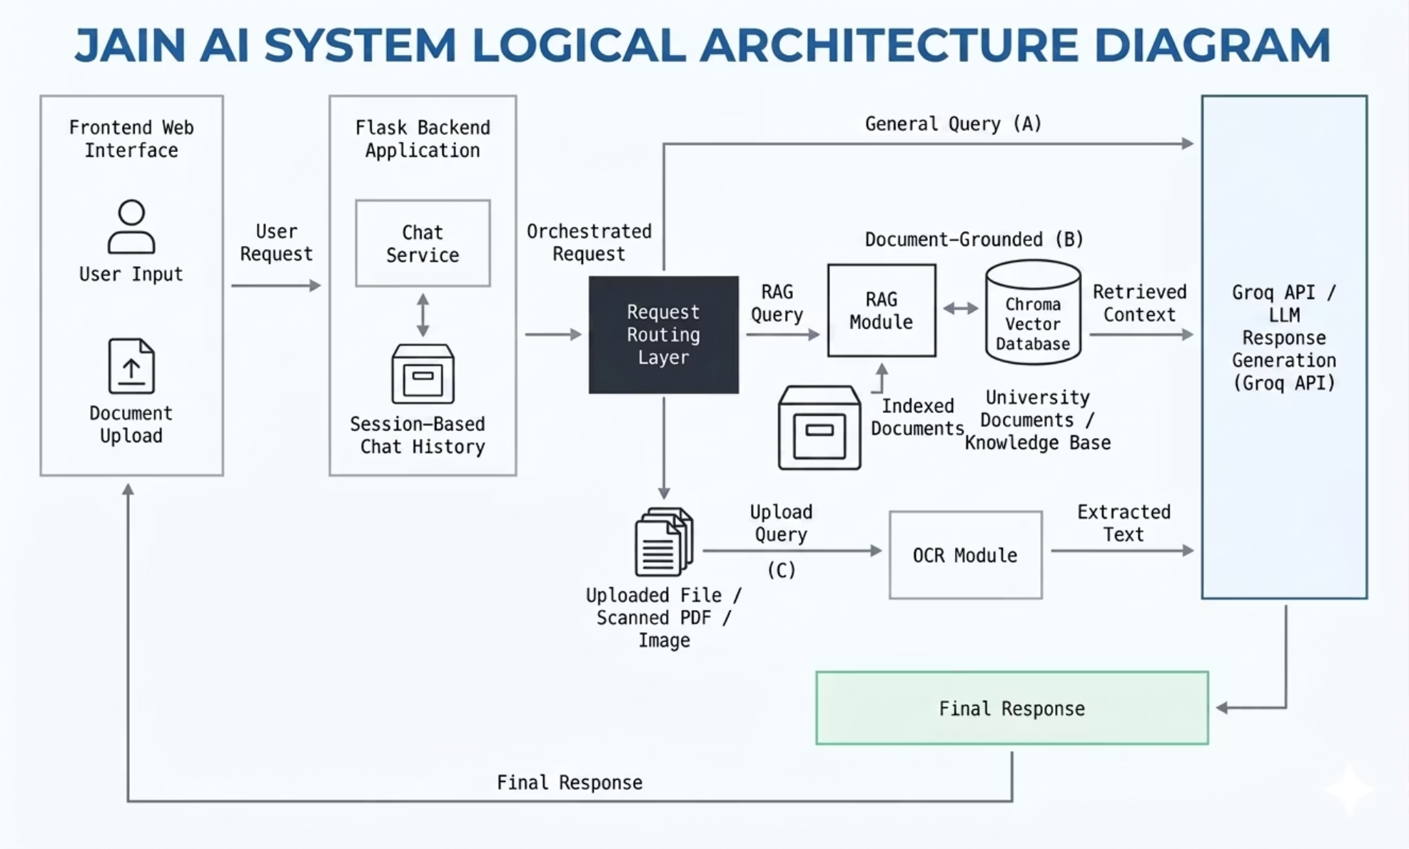
JainAi Architecture
The system routes queries, retrieves relevant data, and generates accurate responses.
Routing Layer: Processes and classifies user queries using Flask backend
RAG Pipeline: Retrieves relevant information from the vector database
OCR Module: Extracts text from uploaded PDFs and images
LLM (Groq API): Generates accurate, context-based responses
Routing → Retrieval → Generation

Slide 9
Technical Stack
Jain AI is built on a modern, open-source stack designed for speed, scalability, and accuracy.
Python
Flask
Core backend language for all AI and data processing logic.
Lightweight web framework powering the REST API layer.
Groq API
Chroma DB
Ultra-fast LLM inference for real-time response generation.
Lightweight vector database for semantic document retrieval.
Hugging Face
HTML / CSS
Pre-trained embedding models for semantic text representation.
Clean, responsive frontend for the chat interface.
rag
ocr
Retrieves relevant document context to generate accurate, data-driven responses.
Extracts readable text from scanned PDFs and images for processing.

Slide 10


Conclusion:
Jain AI helps students get accurate answers faster, save time on research, and avoid the risks of hallucinations.
1
Accurate Answers
Grounded in trusted documents so students can rely on every response.
2
Saves Time
Find the right information quickly and spend more time learning.
3
No Hallucinations
Responses stay focused, clear, and aligned with the source material.
4
Why It Matters
Give every student a smarter, more confident way to learn and succeed.

Slide 11


Thank You
For your time and attention. We look forward to transforming academic information access with Jain AI.
JAIN AI

