Slide 1
Corporación Favorita Grocery Sales Forecasting
Kalyan Bhattacharjee

Slide 2














A little about me
Scientist with business and engineering acumen focusing on integrating machine learning and real time analytics into data driven modern systems
Expertise:
3 years of experience in data driven operations research and AI (PhD)
1 year of commercial experience in production level machine learning, AI and data driven analytics
Learning:

Slide 3
Overview
Challenge
Dataset
Details
EDA
Solutions
Suggestions

Slide 4
Challenge
Grocery stores are always at high risks of either running out or overstocked in the absence of a proper forecasting model.
Forecasting model needs to be accurate and generalized enough to accommodate business needs as well as customer satisfaction.
Corporación Favorita is one of the largest Ecuadorian based supermarket chain and the problem scope is within their sales division.
The idea is to propose an accurate forecasting model to predict the sales in future timeframes.

Slide 5
Dataset
The training dataset contains (January 2013- 15th August 2017):
Sales by date, store, item and flag related to whether item on promotion or not.
The test dataset only covers 16th August, 2017 to 31st August, 2017.
Some additional data are provided:
Stores information such as location and type
Items metadata such as class and whether they are perishable or not.
Count of sales transactions for the training data.
Daily oil price because of strong economic dependency of Ecuador on oil.
List of holidays

Slide 6
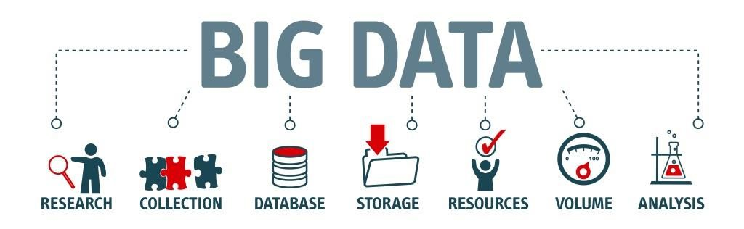
Details (1 of 2)
Training data contains 12549704 records.
54 stores and promotion feature contains NAs.
Unit sales is the target feature: negative values indicate item return.
Some test items are not included in the training data
The importance of public sector pay days (on the 15th and the end of the month) as well as the impact of a major earthquake on April 16 2016.

Slide 7
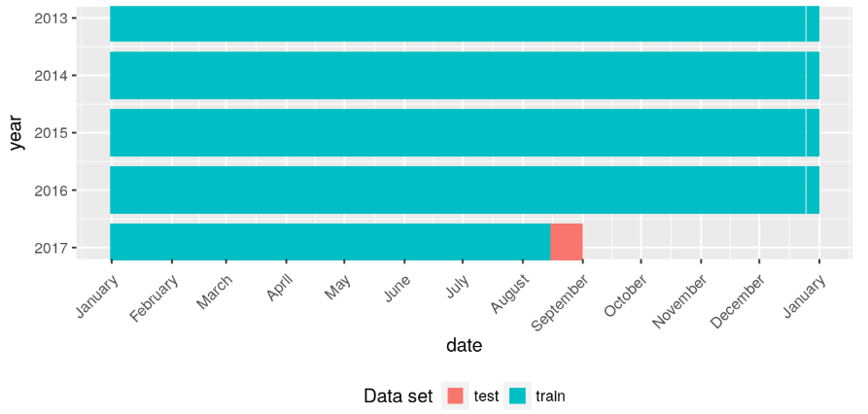
Details (2 of 2)

Slide 8
Difficulties
Huge data size.
Lots of categorical features such as item, store, promotion flag, city, state, type of item, family of item, class of item, cluster of store, holiday’s type, name, locale description, transferred flag etc.
Very few features to start with for forecasting.
Noisy observation in relation to temporal aspect.

Slide 9
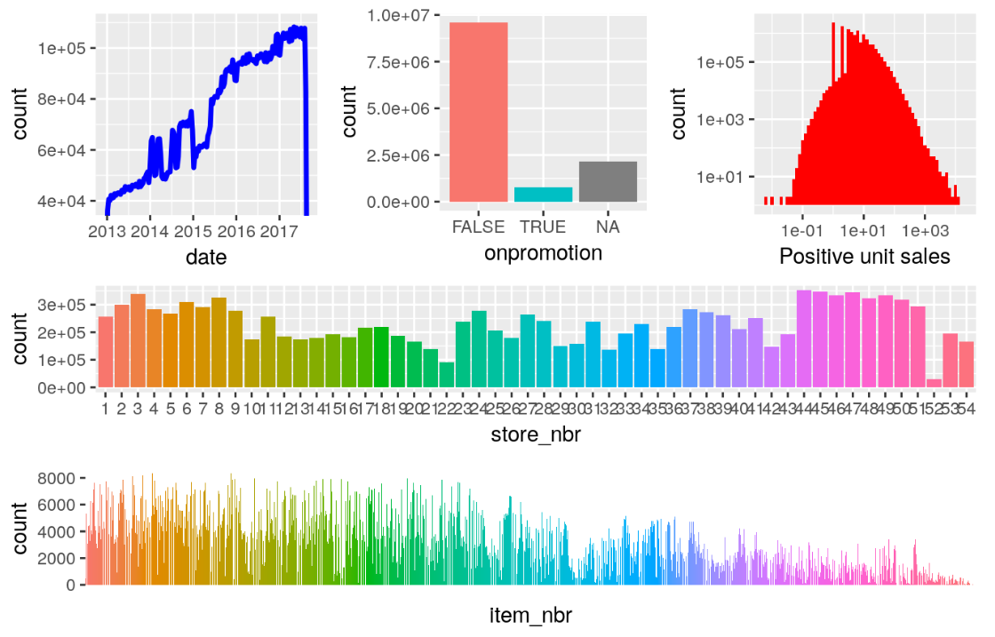
EDA
Training Data
(double-logarithmic axes on the unit sales plot)

Slide 10
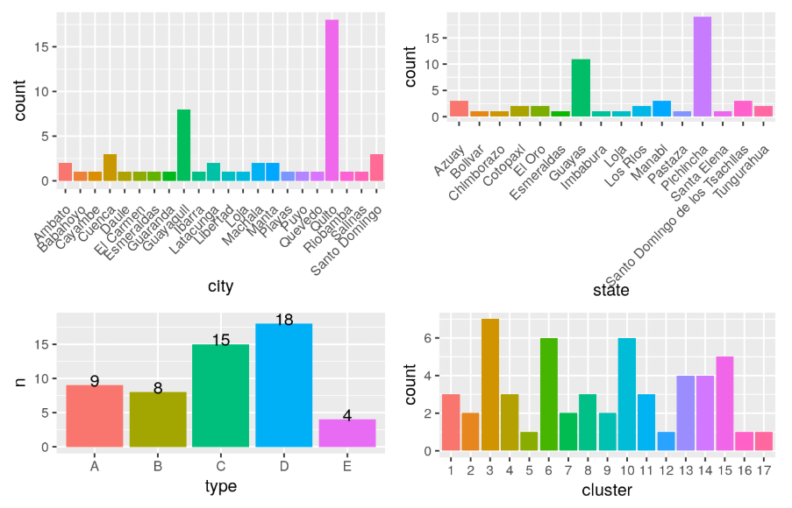
EDA
Stores

Slide 11
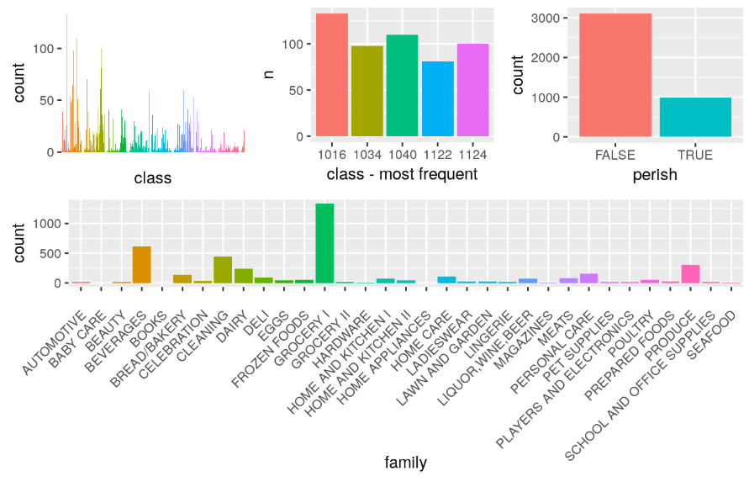
EDA
Items

Slide 12
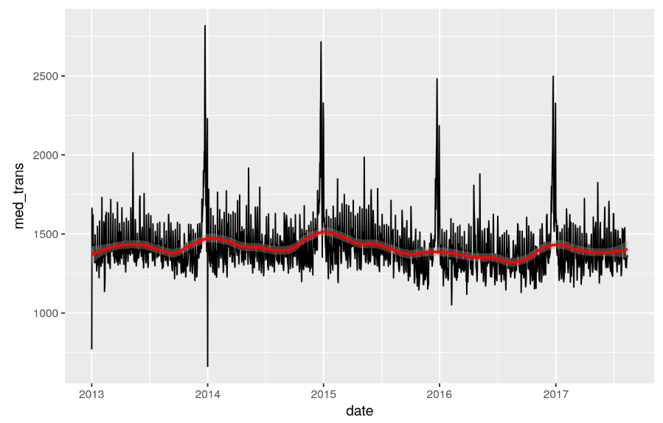
EDA
Transaction

Slide 13
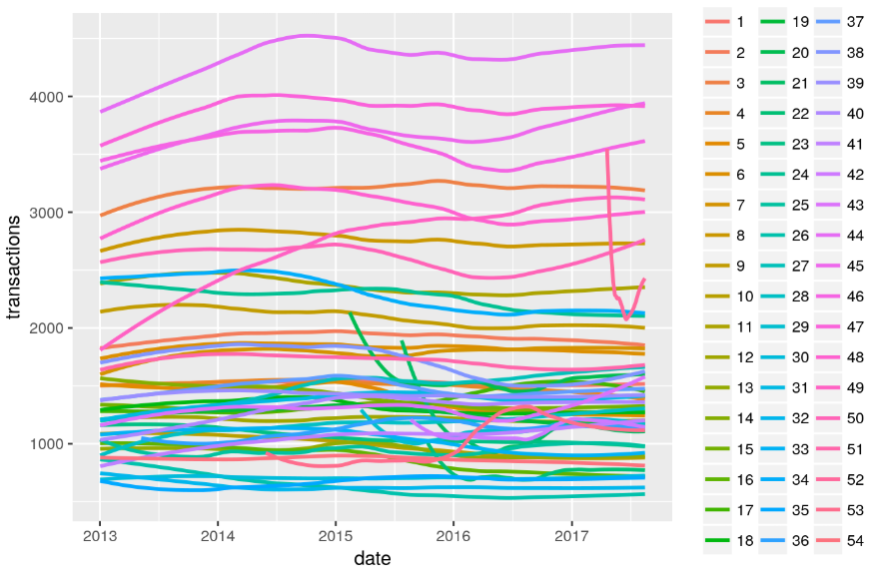
EDA
Store transactions

Slide 14
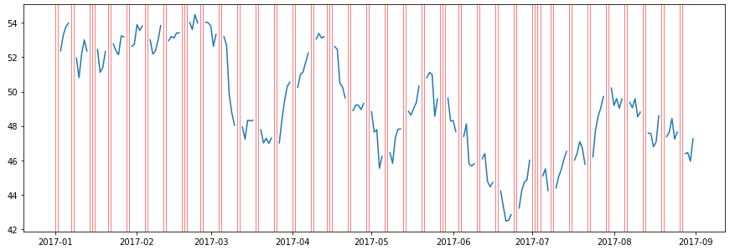
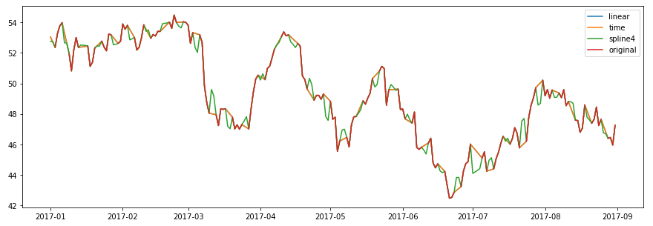
EDA
Oil price

Slide 15
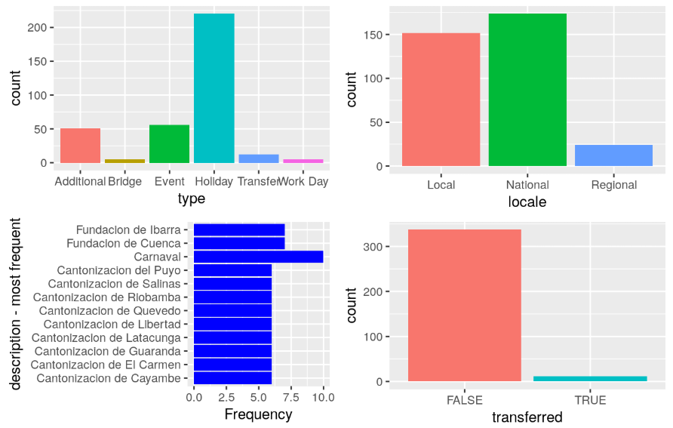
EDA
Holidays

Slide 16
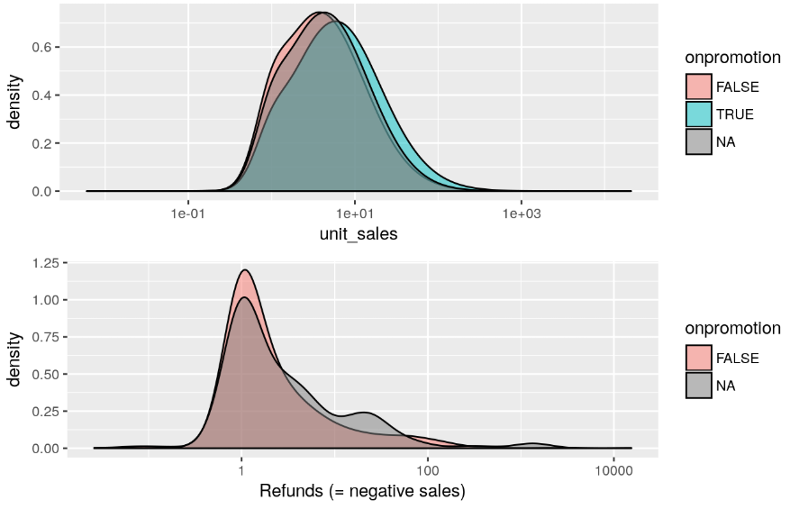
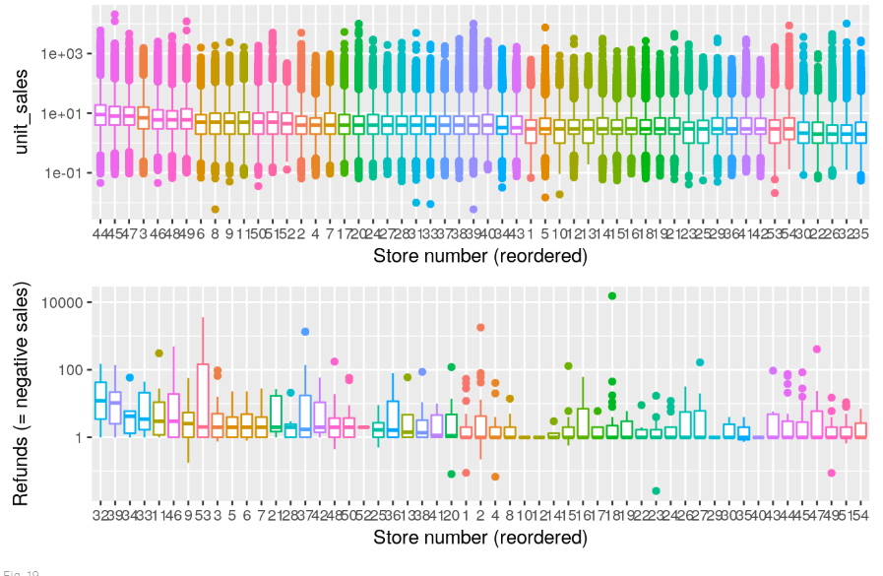
Sales and refunds

Slide 17
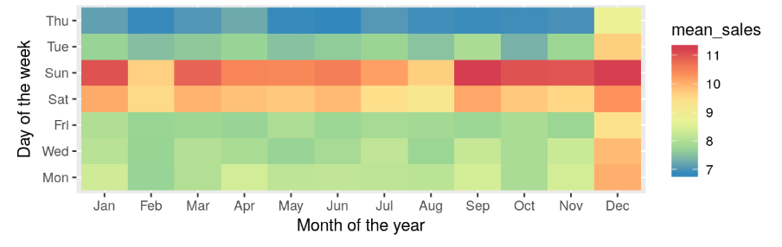
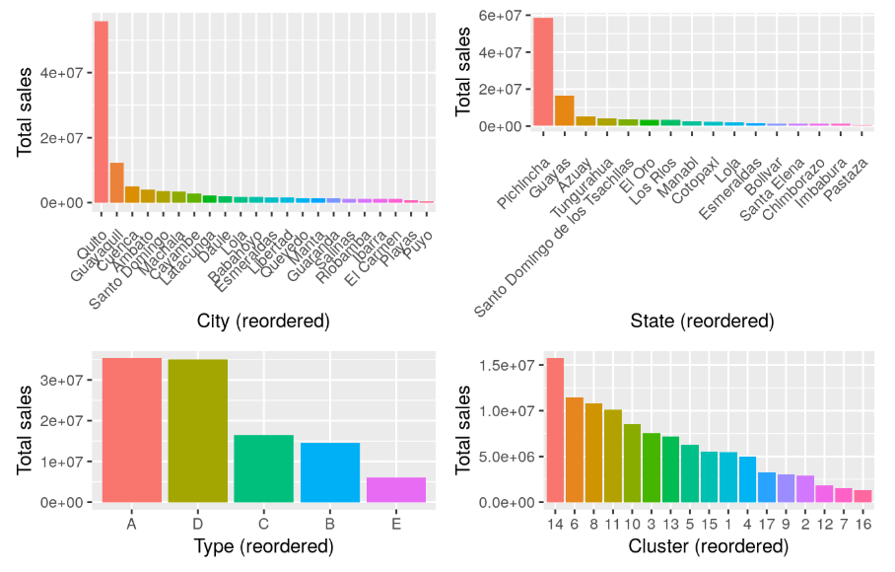
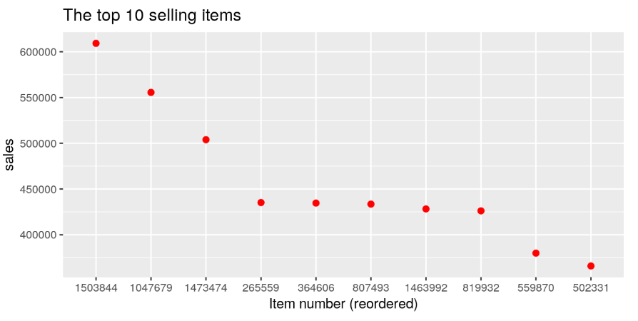
Sales

Slide 18
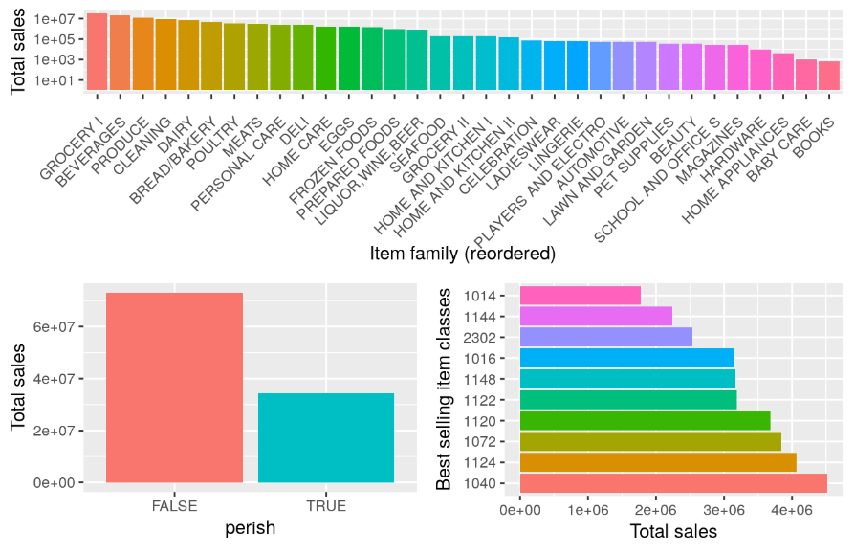
Items

Slide 19
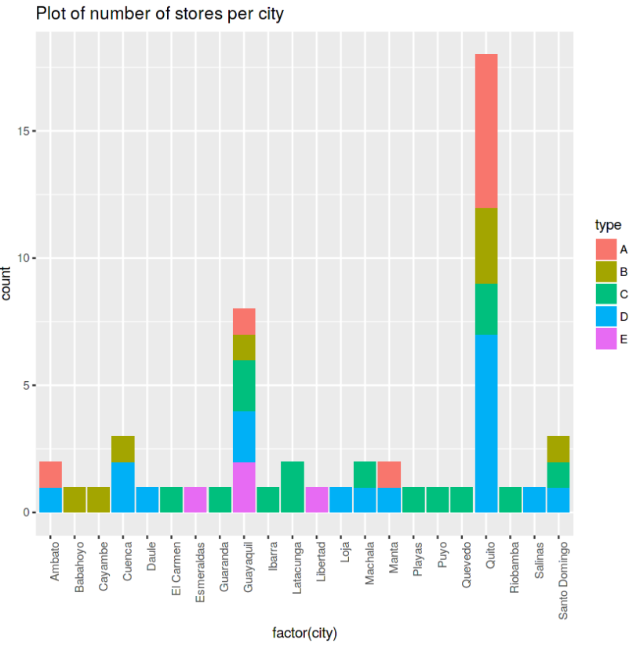
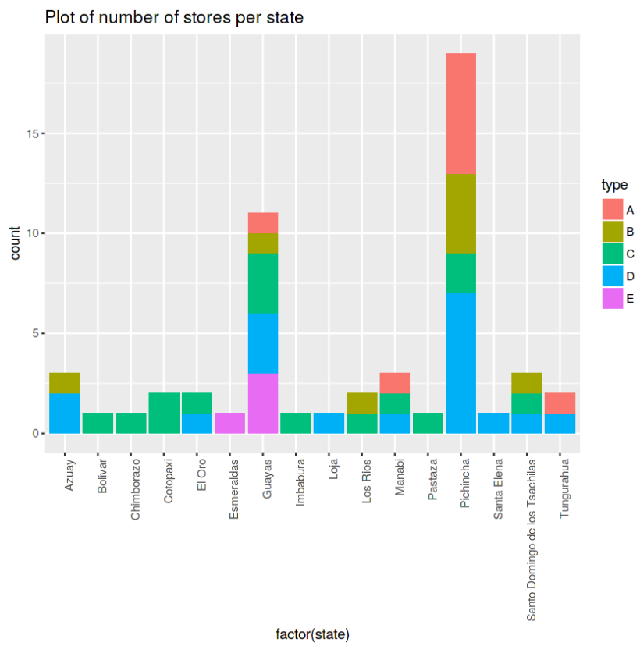
Stores per city & state

Slide 20
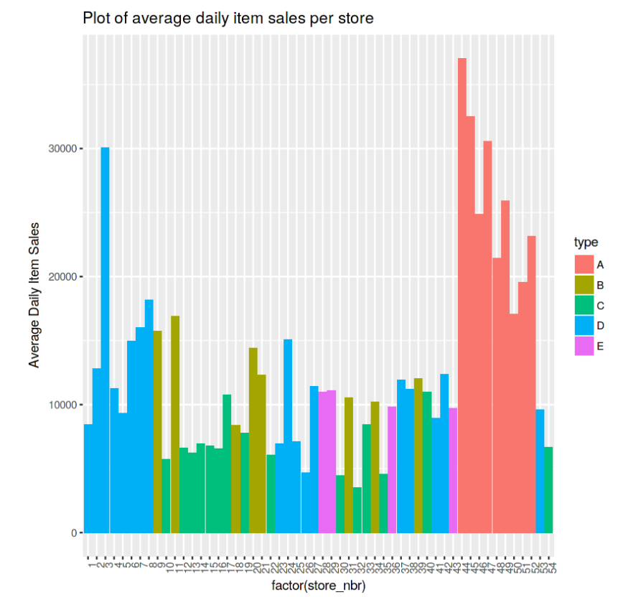
Avg daily item sales

Slide 21
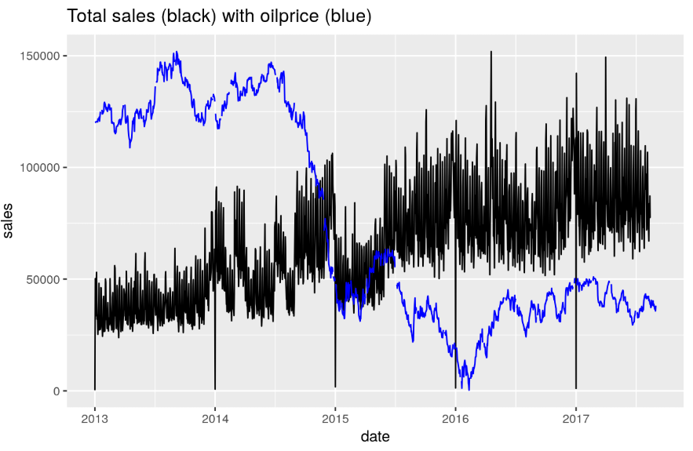
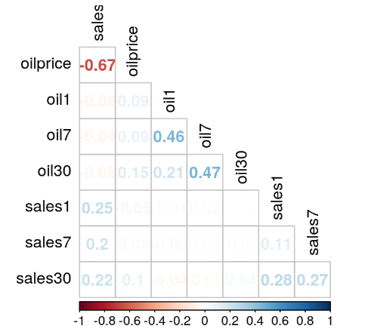
Oil price

Slide 22
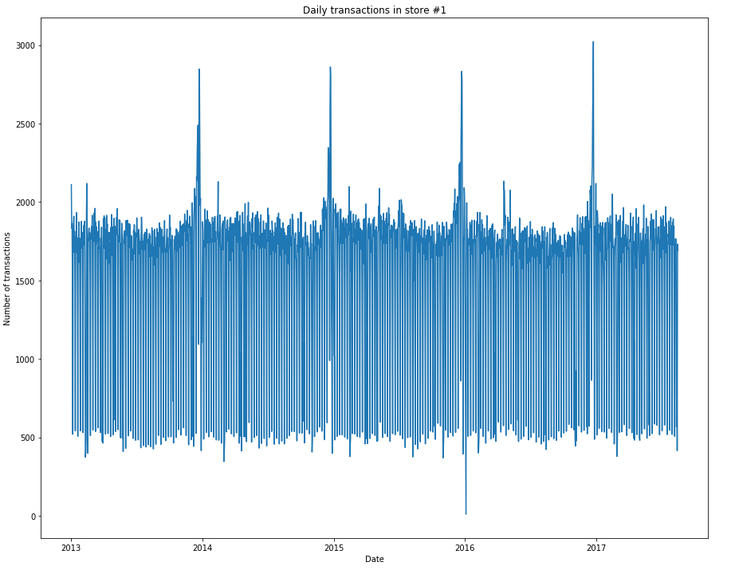
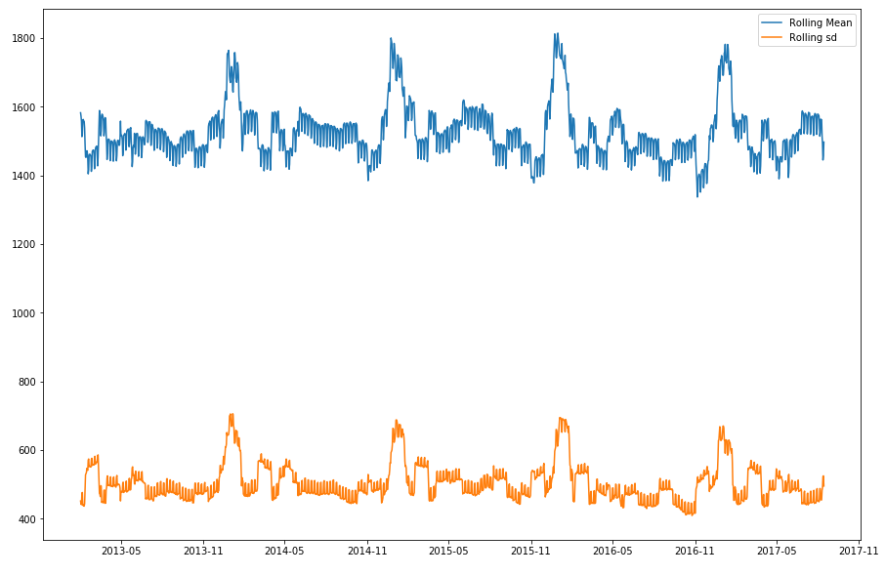
Single store in Quito

Slide 23
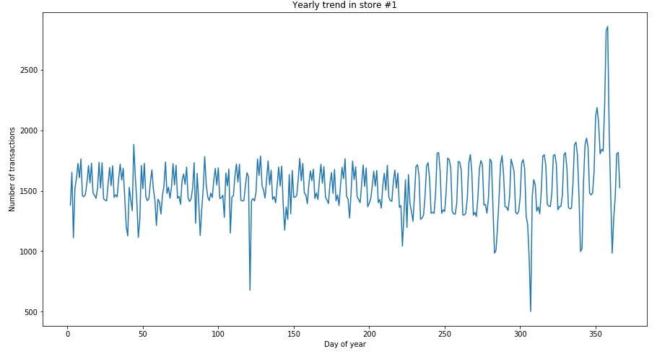
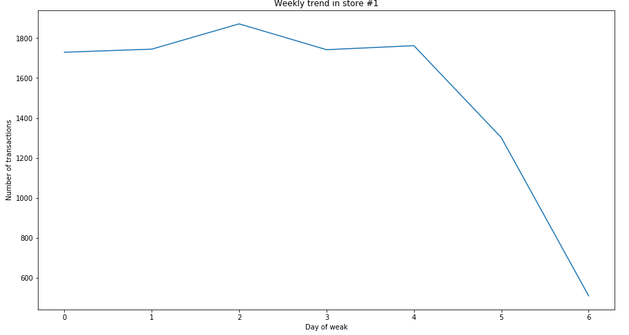
Single store in Quito

Slide 24
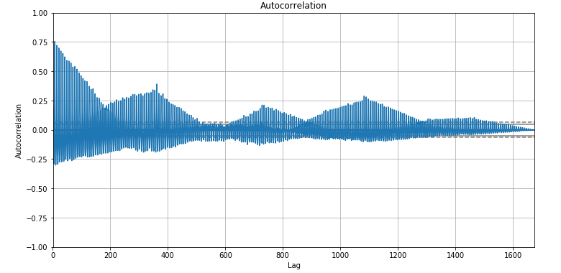
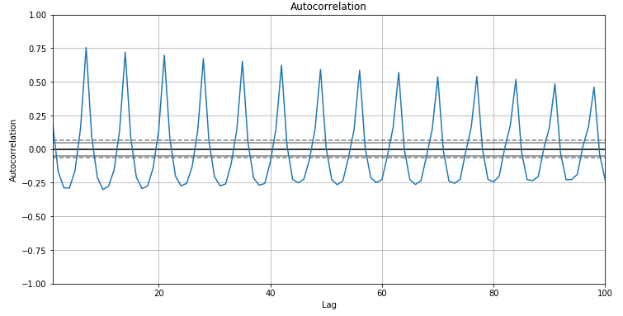
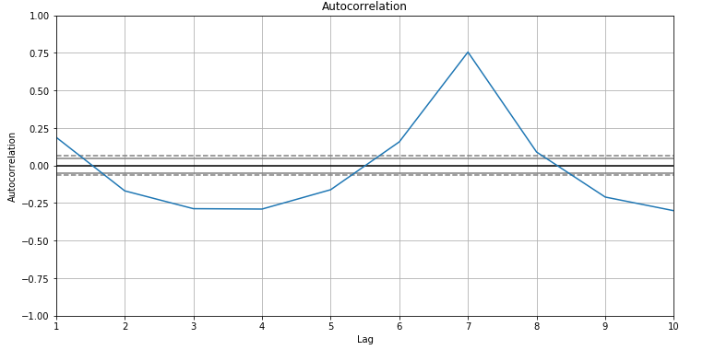
Single store in Quito
Autocorrelation

Slide 25
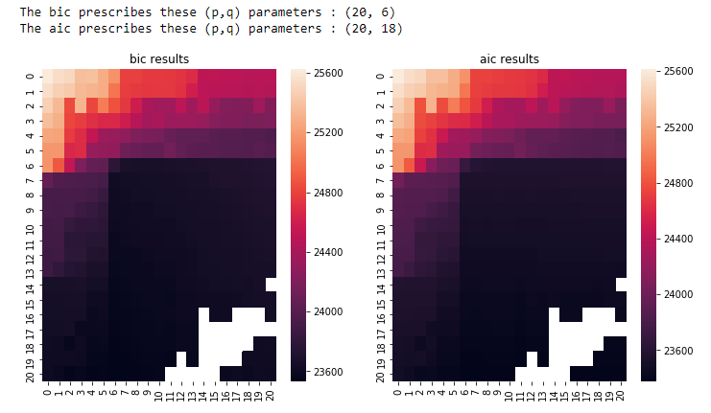
Single store in Quito
Coefficients

Slide 26
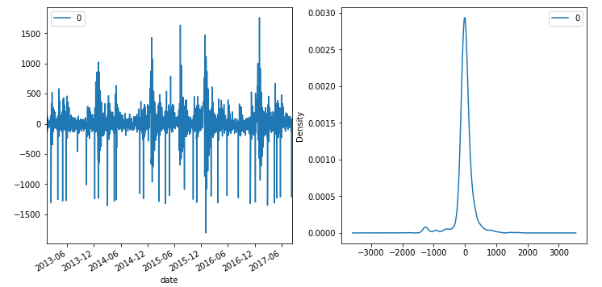
Single store in Quito
ARIMA residuals

Slide 27
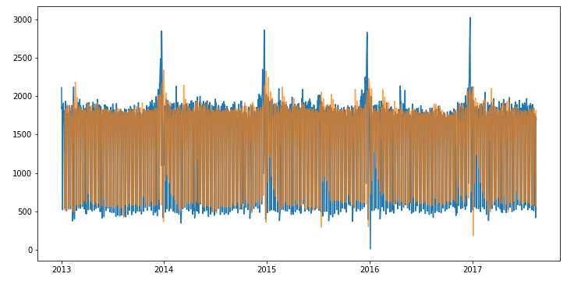
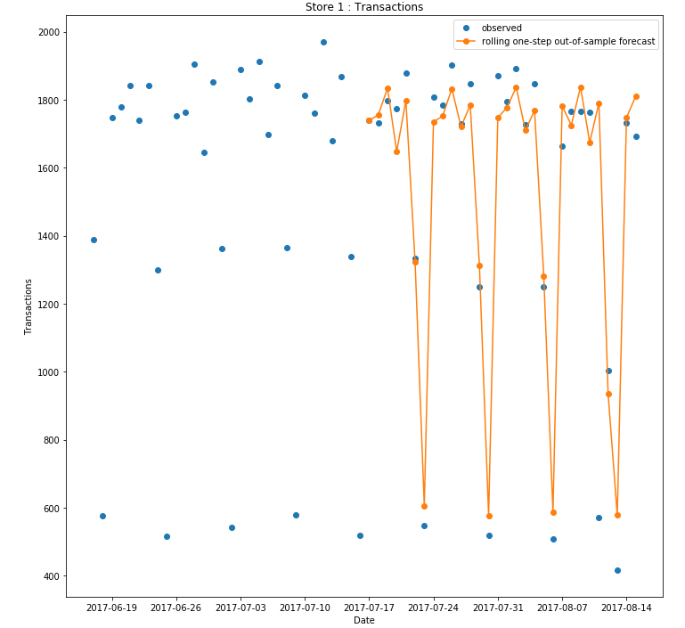
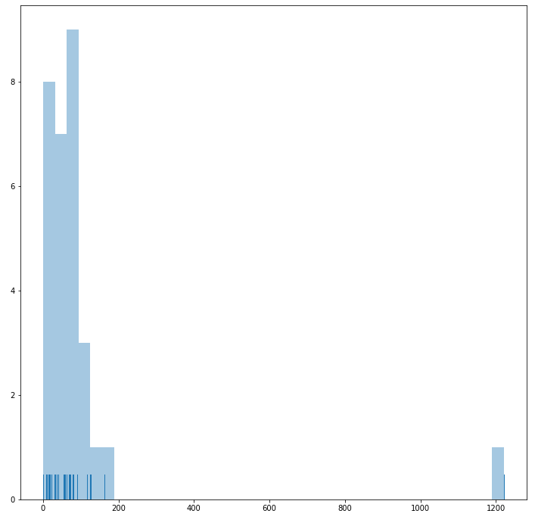
Single store in Quito
ARIMA fitting

Slide 28
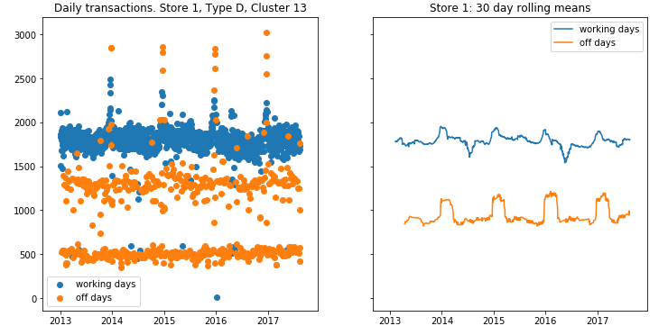
Transactions by day

Slide 29
Transactions by day

Slide 30
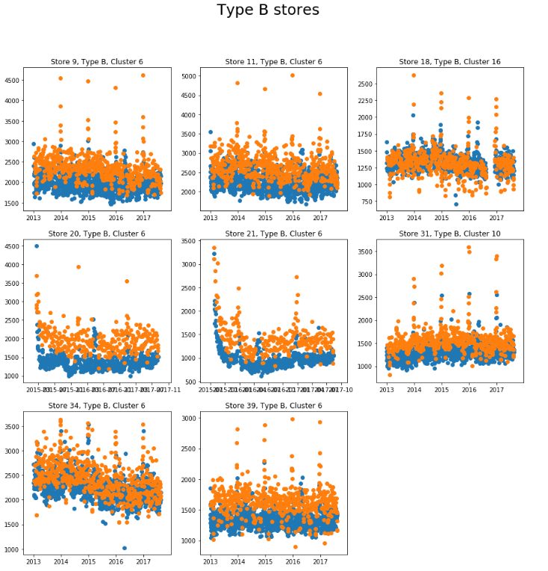
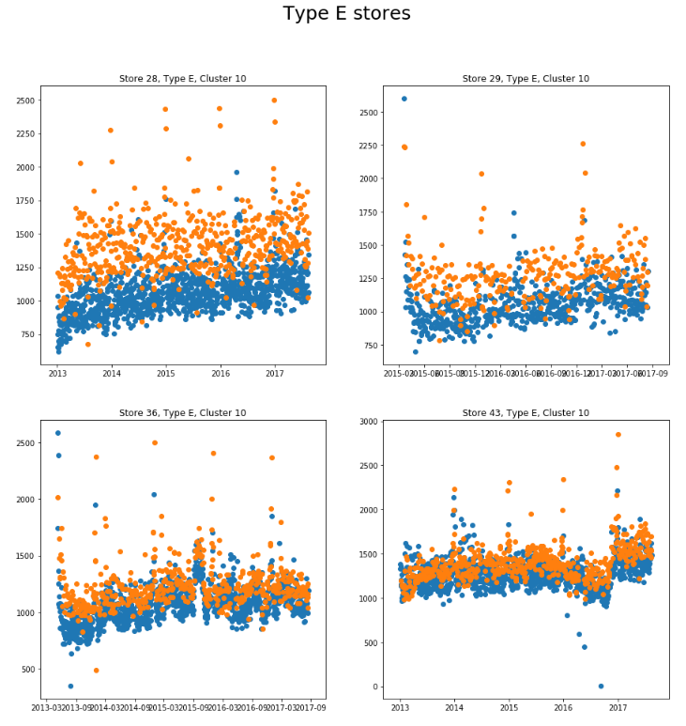
Transactions by type

Slide 31
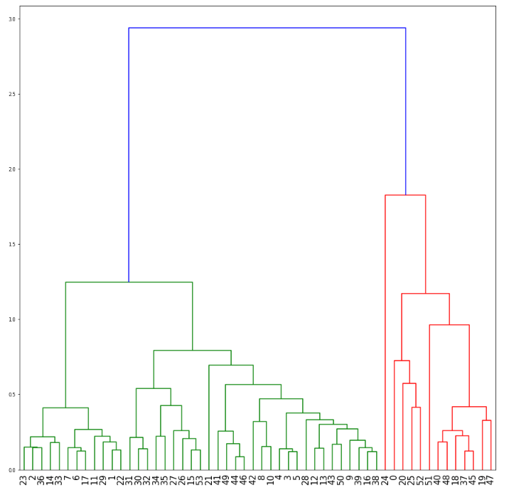
Clustering
Hierachical clustering based on the AgglomerativeClustering algorithm on mean and std of normalized transaction volume per day of the week per store
Not clear demarcation

Slide 32
Solutions

Slide 33
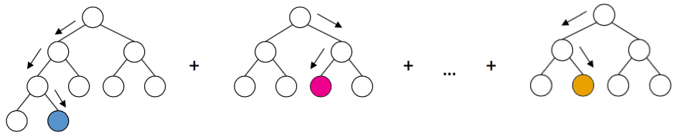
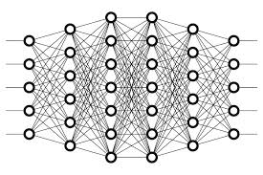
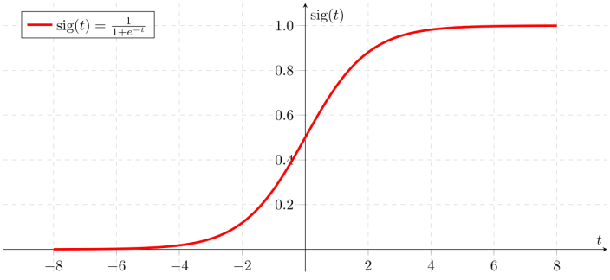
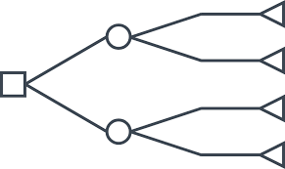
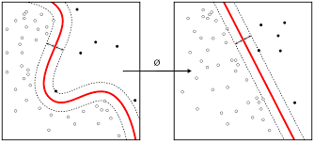
Model variety

Slide 34
Which one (s) ?
Depends on the data, the requirement (false positive vs false negative)
Generalization capability.
Not overfitting neither underfiting.
Or ensemble learning can also be used.

Slide 35
Model used
Input
FC
ReLU
FC
ReLU
ReLU
FC
FC
Sigmoid
Loss
Backprop

Slide 36
Training details
128 as batch size
Learning rate 0.01
SGD with nesterov momentum as optimizer
Code in PyTorch (https://github.com/kalyanb29/Customer)

Slide 37
Evaluation criteria / Metric
NWRSLE: 0.507 using LightGBM
NWRSLE: 0.507 using Keras

Slide 38
Alternative directions ?
RNNs can be used since history with time is given.
Try maximizing/minimizing other metric suited for the problem.
Try reducing redundant features.
Optimize for hyperparameters using Gridsearch.
What should work ? Everything. Eventually. In most cases.
Should work.

Slide 39
What’s next ?
Reuse top layers of model for transfer learning in other problem areas. May work well across data sets.
Better models with more data.
Apply different model architectures as they become better understood.
Deploy. Does your model scale to millions of customers?

Slide 40



