Slide 1
Corporación Favorita Grocery Sales Forecasting
Kalyan Bhattacharjee

Slide 2














A little about me
Scientist with business and engineering acumen focusing on integrating machine learning and real time analytics into data driven modern systems
Expertise:
3 years of experience in data driven operations research and AI (PhD)
1 year of commercial experience in production level machine learning, AI and data driven analytics
Learning:

Slide 3
Overview
Challenge
Dataset
Details
EDA
Solutions
Suggestions

Slide 4
Challenge
Grocery stores are always at high risks of either running out or overstocked in the absence of a proper forecasting model.
Forecasting model needs to be accurate and generalized enough to accommodate business needs as well as customer satisfaction.
Corporación Favorita is one of the largest Ecuadorian based supermarket chain and the problem scope is within their sales division.
The idea is to propose an accurate forecasting model to predict the sales in future timeframes.

Slide 5
Dataset
The training dataset contains (January 2013- 15th August 2017):
Sales by date, store, item and flag related to whether item on promotion or not.
The test dataset only covers 16th August, 2017 to 31st August, 2017.
Some additional data are provided:
Stores information such as location and type
Items metadata such as class and whether they are perishable or not.
Count of sales transactions for the training data.
Daily oil price because of strong economic dependency of Ecuador on oil.
List of holidays

Slide 6
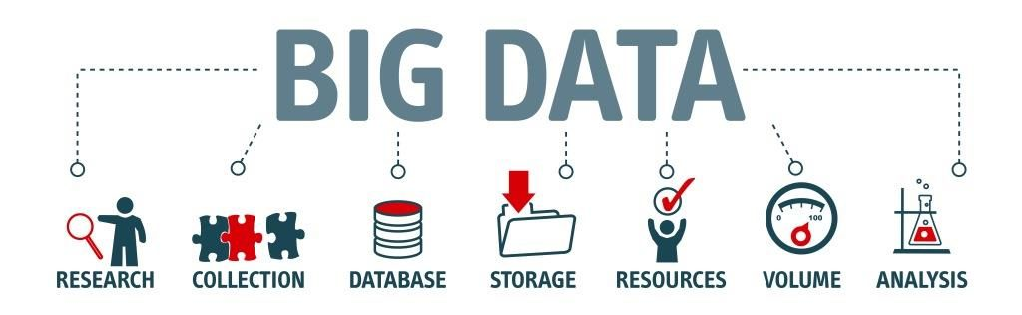
Details
Training data contains 12549704 records.
54 stores and promotion feature contains NAs.
Unit sales is the target feature: negative values indicate item return.
Some test items are not included in the training data
The importance of public sector pay days (on the 15th and the end of the month) as well as the impact of a major earthquake on April 16 2016.

Slide 7
Difficulties
Huge data size.
Lots of categorical features such as item, store, promotion flag, city, state, type of item, family of item, class of item, cluster of store, holiday’s type, name, locale description, transferred flag etc.
Very few features to start with for forecasting.
Noisy observation in relation to temporal aspect.

Slide 8
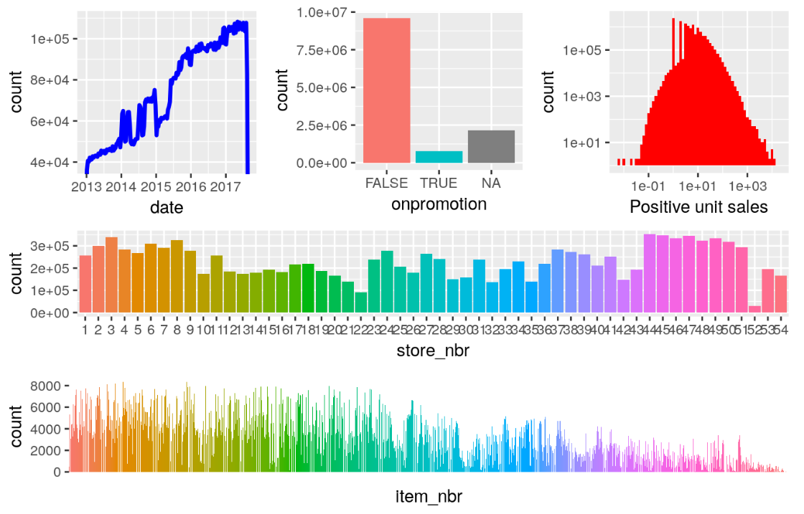
EDA
Training Data

Slide 9
EDA
Training Data
(double-logarithmic axes on the unit sales plot)

Slide 10
EDA
Training Data

Slide 11
Feature engineering (1 of 2)
category, company and brand are important part of transaction data but they are noisy.
Negative features are important given the problem context.
Some features are not useful in the algorithmic context such as shopper_id, offer_id, company.
To avoid some categorical features, new set of features are created such as probability of a product and category being repeatedly bought by customer (30, 60, 90 days before the offer date)

Slide 12
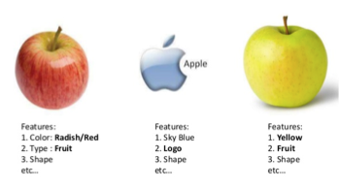
Feature engineering (2 of 2)
Some more additional features could be product and category popularity depending on the number of times customers buy, average count of buying different products in the same category, market share in categories, products and dept, mean and median price of product that a customer buy, what is the most common product/category quantity customer buy, for each customer what is the dominated product market share etc.
Negative features are also important given the problem context such as all the probabilities of not buying a particular product/category etc.
Based on the dates seasonal features can also be incorporated.

Slide 13
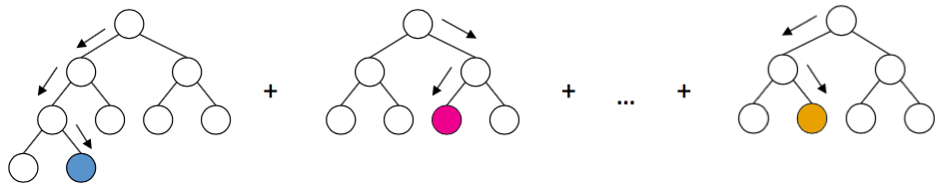
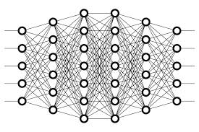
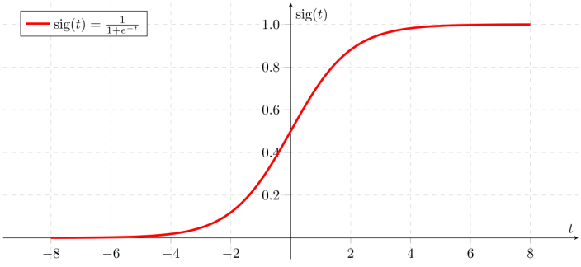
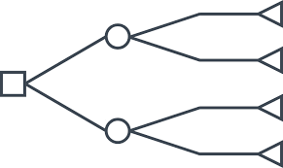
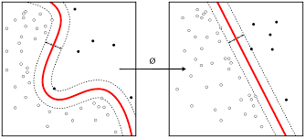
Model variety

Slide 14
Which one (s) ?
Depends on the data, the requirement (false positive vs false negative)
Generalization capability.
Not overfitting neither underfiting.
Or ensemble learning can also be used.

Slide 15
Model used
Input
FC
ReLU
FC
ReLU
ReLU
FC
FC
Sigmoid
Loss
Backprop

Slide 16
Training details
128 as batch size
Learning rate 0.01
SGD with nesterov momentum as optimizer
Code in PyTorch (https://github.com/kalyanb29/Customer)

Slide 17
Evaluation criteria / Metric
Accuracy: 0.749
Precision: 0.599
Recall: 0.204
F1 score: 0.304
AUC_ROC: 0.577

Slide 18
Alternative directions ?
RNNs can be used since history with time is given.
Try maximizing/minimizing other metric suited for the problem.
Try reducing redundant features.
Optimize for hyperparameters using Gridsearch.
What should work ? Everything. Eventually. In most cases.
Should work.

Slide 19
What’s next ?
Reuse top layers of model for transfer learning in other problem areas. May work well across data sets.
Better models with more data.
Apply different model architectures as they become better understood.
Deploy. Does your model scale to millions of customers?

Slide 20



