Slide 1
Predicting Valuable Customers
Kalyan Bhattacharjee
Research Engineer

Slide 2














A little about me
Scientist with business and engineering acumen focusing on integrating machine learning and real time analytics into data driven modern systems
Expertise:
3 years of experience in data driven operations research and AI (PhD)
1 year of commercial experience in production level machine learning, AI and data driven analytics
Learning:

Slide 3
Overview
Challenge
Dataset
Details
Difficulties
Features
Solutions
Suggestions

Slide 4
Challenge
Brands often offer discounts to attract new customers.
Valuable customers are those who returns after initial incented purchase.
With enough history, this problem tries to predict which customers are most likely to repeat purchase.

Slide 5
Dataset
The training dataset contains (before 01/05/2013):
Transaction history for about a year prior to offering incentive
Incentive offered and behavioural response of each
Information about the offers
The test dataset only contains the offers after 01/05/2013.
The challenge is to predict probable returning customer (classification problem).
Evaluation criterion is area under ROC (Receiver Operating Characteristic) curve.

Slide 6
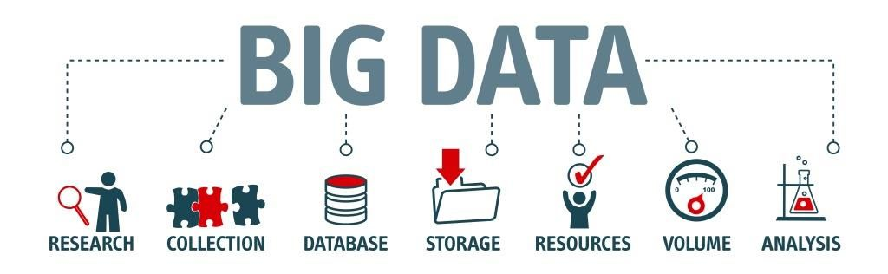
Details (1 of 3)
Raw dataset is of about 22 GB size.
349,655,789 rows of transaction data.
311,541 customers (160,057 in training and 151,484 in test).
37 offer types.
Training dataset contains 43455 (27.15%) loyal customers (class imbalance).

Slide 7
Details (2 of 3)
Transaction data
0 | shopper_id
1 | chain
2 | department
3 | category
4 | company
5 | brand
6 | date_of_purchase
7 | product_size
8 | product_measure
9 | purchase_quantity
10 | purchase_amount
Training data: list of features with known outcome
Test data: same list except field 4 and 5 are removed
List of characteristic for an incentive
0 | offer (index)
1 | category
2 | quantity
3 | company
4 | offervalue
5 | brand
0 | shopper_id
1 | chain
2 | offer (index)
3 | market
4 | repeat_trips
5 | repeater
6 | date_of_offer

Slide 8
Details (3 of 3)
history
id - A unique id representing a customer
chain - An integer representing a store chain
offer - An id representing a certain offer
market - An id representing a geographical region
repeattrips - The number of times the customer made a repeat purchase
repeater - A boolean, equal to repeattrips > 0
offerdate - The date a customer received the offer
transactions
id - see above
chain - see above
dept - An aggregate grouping of the Category (e.g. water)
category - The product category (e.g. sparkling water)
company - An id of the company that sells the item
brand - An id of the brand to which the item belongs
date - The date of purchase
productsize - The amount of the product purchase (e.g. 16 oz of water)
productmeasure - The units of the product purchase (e.g. ounces)
purchasequantity - The number of units purchased
purchaseamount - The dollar amount of the purchase
offers
offer - see above
category - see above
quantity - The number of units one must purchase to get the discount
company - see above
offervalue - The dollar value of the offer
brand - see above

Slide 9
Difficulties
Huge data size.
Lots of categorical data such as shopper_id, category, offer, company etc.
Very few features to start with to distinguish shoppers.
Class imbalance

Slide 10

Data cleaning
Data size can be reduced to 1.66 GB just by filtering out the records in transaction which do not contain any of the companies, brands or chains.

Slide 11
Feature engineering (1 of 2)
category, company and brand are important part of transaction data but they are noisy.
Negative features are important given the problem context.
Some features are not useful in the algorithmic context such as shopper_id, offer_id, company.
To avoid some categorical features, new set of features are created such as probability of a product and category being repeatedly bought by customer (30, 60, 90 days before the offer date)

Slide 12
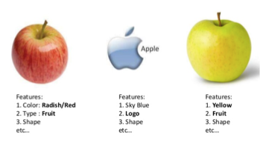
Feature engineering (2 of 2)
Some more additional features could be product and category popularity depending on the number of times customers buy, average count of buying different products in the same category, market share in categories, products and dept, mean and median price of product that a customer buy, what is the most common product/category quantity customer buy, for each customer what is the dominated product market share etc.
Negative features are also important given the problem context such as all the probabilities of not buying a particular product/category etc.
Based on the dates seasonal features can also be incorporated.

Slide 13
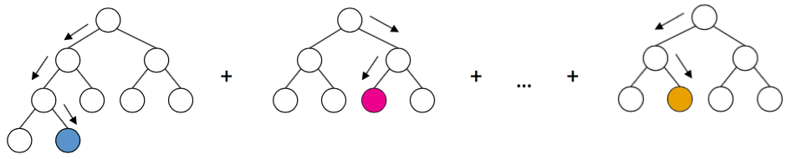
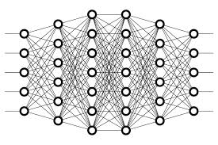
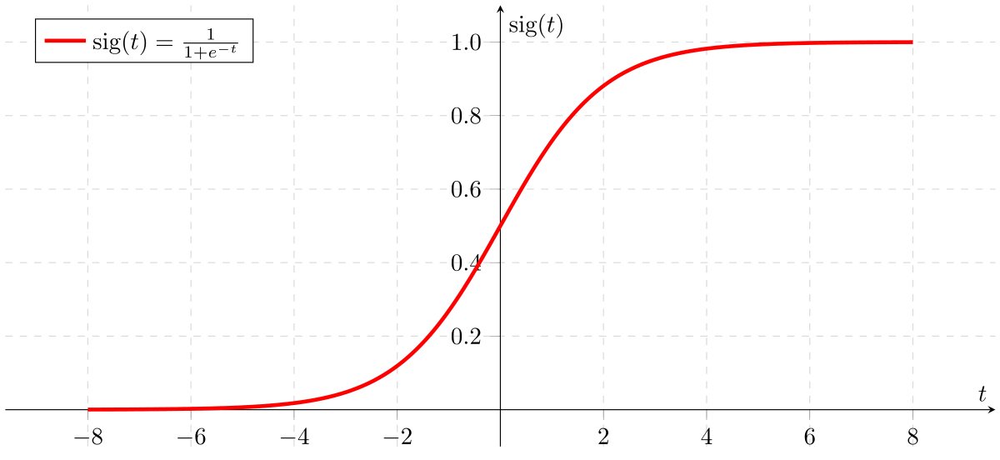
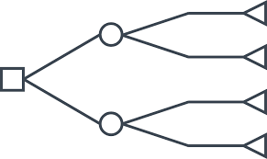
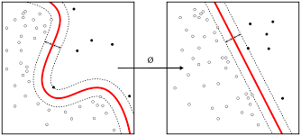
Model variety

Slide 14
Which one (s) ?
Depends on the data, the requirement (false positive vs false negative)
Generalization capability.
Not overfitting neither underfiting.
Or ensemble learning can also be used.

Slide 15
Model used
Input
FC
ReLU
FC
ReLU
ReLU
FC
FC
Sigmoid
Loss
Backprop

Slide 16
Training details
128 as batch size
Learning rate 0.01
SGD with nesterov momentum as optimizer
Code in PyTorch (https://github.com/kalyanb29/Customer)

Slide 17
Evaluation criteria / Metric
Accuracy: 0.749
Precision: 0.599
Recall: 0.204
F1 score: 0.304
AUC_ROC: 0.577

Slide 18
Alternative directions ?
RNNs can be used since history with time is given.
Try maximizing/minimizing other metric suited for the problem.
Try reducing redundant features.
Optimize for hyperparameters using Gridsearch.
What should work ? Everything. Eventually. In most cases.
Should work.

Slide 19
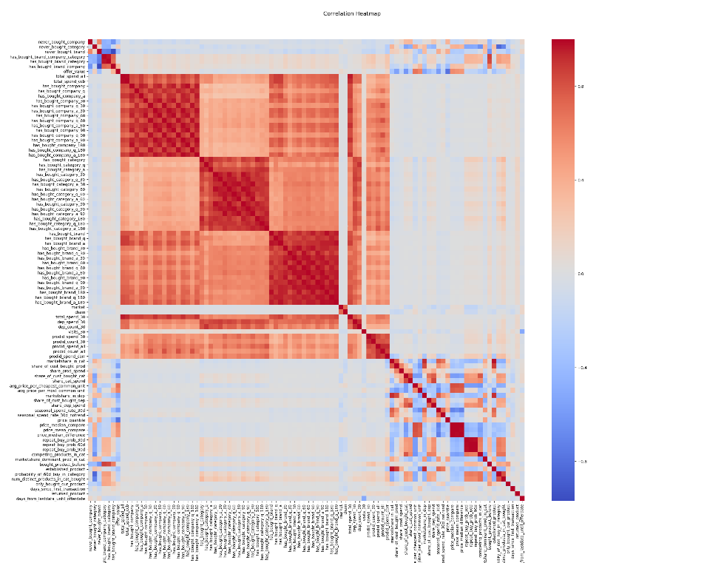
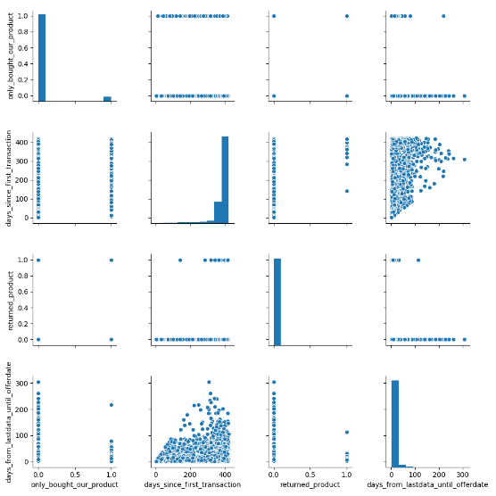
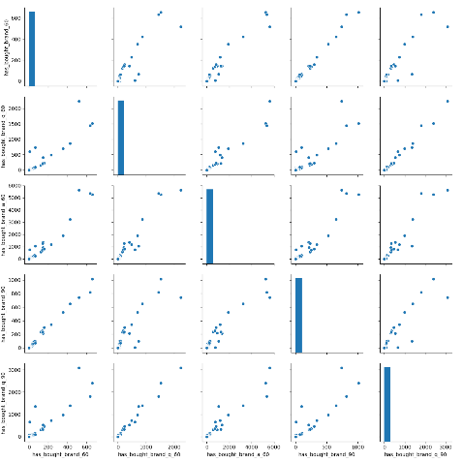
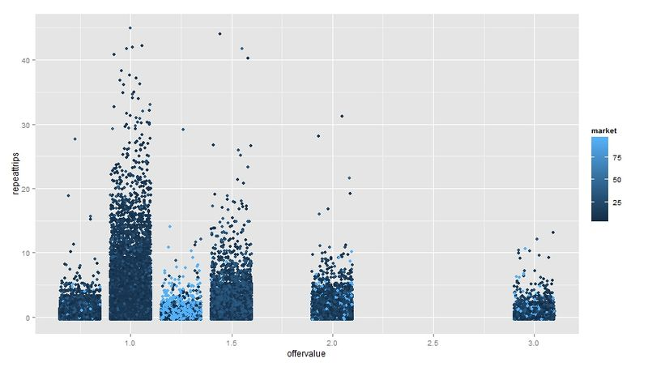
Feature

Slide 20
What’s next ?
Reuse top layers of model for transfer learning in other problem areas. May work well across data sets.
Better models with more data.
Apply different model architectures as they become better understood.
Deploy. Does your model scale to millions of customers?

Slide 21



