Slide 1
IOCTL DRIVER

Slide 2
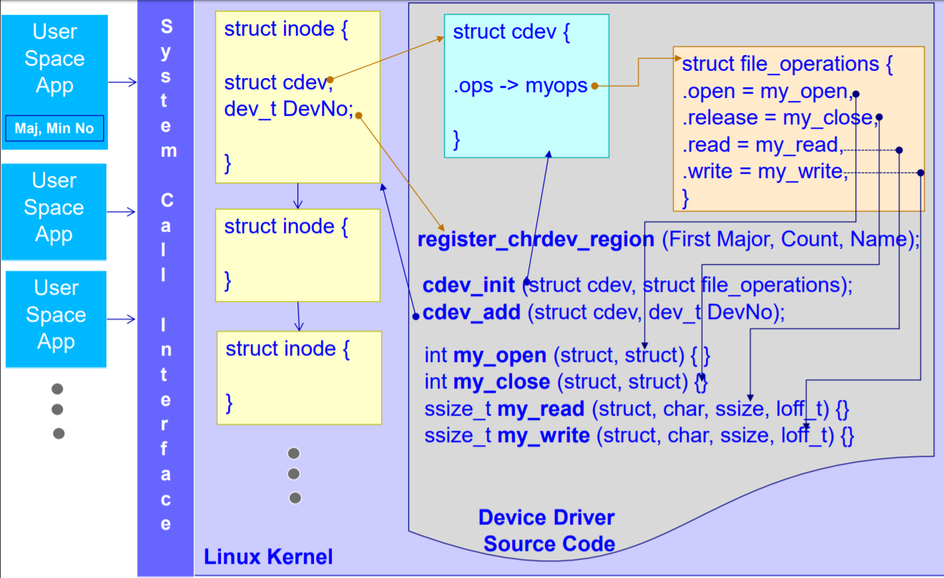
Overview of Character driver

Slide 3
IOCTL Driver
IOCTL is referred to as Input and Output Control, which is used to talking to device drivers.
It is used for special operation in device file IOCTL. The special operation are vendor /device specific .
The ioctl will allow 256 operations/functionality in single IOCTL.

Slide 4
Steps involved in IOCTL
We need to identify target device and find our total no of special operation need to support .
We need to create one request command, the command should be unique across all drivers
We need to implement IOCTl function in drivers source and implement Switch case to handle request .

Slide 5
IOCTL call in User space
Header file:
User Space: <sys/ioctl.h>
long ioctl ( "file descriptor","ioctl command","Arguments");
<file descriptor>: This the open file on which the ioctl command needs to be executed, which would generally be device files.
<ioctl command>: ioctl command which is implemented to achieve the desired functionality
<arguments>: The arguments need to be passed to the ioctl command.

Slide 6
Create IOCTL Commands
Before writing the code for ioctl, you need to choose the numbers that correspond to commands. The ioctl command numbers should be unique across the system in order to prevent errors caused by issuing the right command to the wrong device.
The approved way to define ioctl command numbers uses four bitfields, which have the following meanings.
Type or magic number (type) : The Magic Number is a unique number or character that will differentiate our set of ioctl calls from the other ioctl calls. some times the major number for the device is used here.
Sequence number or Command Number which is eight bits wide. This means we can have up to 256 ioctl commands (nr) : Command Number is used to differentiate the commands from one another.
Direction, whether we are reading or writing
Size it is the size of user data or argument type involved
To arrive at unique numbers easily we use the following macros
_IO(type, nr)
_IOR(type, nr, dataitem)
_IOW(type, nr, dataitem)
_IOWR(type, nr, dataitem)

Slide 7
IOCTL call in the driver
Header file in Kernel : linux/ioctl.h
int ioctl(struct inode *inode, struct file *file, unsigned int cmd, unsigned long arg)
Where
<inode> : is the inode number of the file being worked on. <file> : is the file pointer to the file that was passed by the application. <cmd> : is the ioctl command that was called from the userspace. <arg> : are the arguments passed from the userspace

Slide 8

Call flow of IOCTL call
All file operation (fops)are execute in process context
Ioctl fun now end up single thread call , this will not allow multi app / it is not a concurrent function., it is by default single thread function.
If we register IOCTl call in fops with “.unlocked_ioctl = ts_ioctl,” then it will work as concurrent function/without kernel lock.

Slide 9
THANK YOU

