Slide 1


SRM VALLIAMMAI ENGINEERING COLLEGE
AN AUTONOMOUS INSTITUTION
Approved by AICTE | Affiliated to Anna University | Accredited by NBA
‘A’ Grade Accreditation by NAAC | ISO 9001:2015 CERTIFIED
DEPARTMENT OF INFORMATION TECHNOLOGY
ACADEMIC YEAR 2022-2023(ODD SEMESTER)
SOLDIER HEALTH MONITORING AND TRACKING SYSTEM USING IoT
TEAM MEMBERS:
BALAJI G - 142219205010
BALASUBRAMANIAN KALYAN - 142219205012
ELA BARATH - 142219205019
GOKUL ARAVIND V - 142219205022
UNDER THE GUIDANCE OF:
Dr. S. RAVIKUMAR B.E, M.E, Ph.D Assistant Professor (Sel.G)
Department of IT
Base Paper: “Novel Wearable Device for Health Monitoring and Tracking of soldiers Based on LoRa Module”, Institute of Electrical and Electronics Engineers, Yashash Jain; Bhupesh Soni; Ayush Goyal; Chetna Sharma, 2021.

Slide 2
OUTLINE OF THE PRESENTATION
INTRODUCTION
CHALLENGES
ARCHITECTURE DIAGRAM
OBJECTIVE
TECHNICAL BACKGROUND
MODULES AND RESULT ANALYSIS

Slide 3

INTRODUCTION
Border surveillance is the most important task in the field of national defense and security. To maintain peace and to ensure safety of a country’s people, the borders need to be kept under 24/7 monitoring.
Especially, under current circumstances, when activities like terrorist infiltrations and illegal movement of both living as well as non-living beings have become common, it becomes of utmost importance to strictly protect the border areas against such activities.
To curb such happenings on the border areas, the least that can be done is to provide constant monitoring. In current scenario, this monitoring takes place manually by the border security forces which are responsible for continuously keeping an eye on the borders.
It takes a lot of manpower and assets as the borders are stretched across hundreds of miles and have extreme terrain as well as climatic conditions. Hence, the need of the hour is to design an automated border surveillance system which can perform the surveillance task without requiring any human assistance.

Slide 4
OBJECTIVE
Nowadays, the security system of the nation depending upon the enemy’s war and so the security of the soldiers is considered as an important role in it. Concerning the safety of the soldiers, there are numerous tools to observe the health condition of the soldiers.
The proposed system uses GPS to track the direction of the soldier in the form of latitude and longitude values. So that direction can be found easily. The proposed system can be mounted on the soldier’s body to track their health status and current location using GPS.
These information will be transmitted to the control room through IoT. The proposed system comprise of tiny wearable physiological equipment’s, sensors, transmission modules.
Hence, with the use of the proposed equipment, it is possible to implement a low cost mechanism to protect the valuable human life on the battlefield.

Slide 5
OBJECTIVE
Designing of this system using GPS and GSM gives a wireless system for tracking the location of the soldier and observing the heart beat rate and body temperature of the soldier
An essential requirement of this situation is a controller which automatically detects trespasser in the border and report nearby board security control unit.
It can employ for suspicious bomb detection & demolition, threat detection
It can also be used for tactical communication, fast-deployed relay stations.

Slide 6
CHALLENGES
The framework for making a robot for surveillance purpose is existing.
It only has limited range surveillance.
Database is not stored.
Controlling the robot needs specialized computer.
To overcome:
Wireless technology is one of the most integral technologies in the electronics field. This technology is used to serve our project as a supreme part of surveillance act.
Automatic monitoring can also be done
Can be accessed with laptops or mobile.
It overcomes the problem of limited range surveillance by using the concept of IOT.

Slide 7

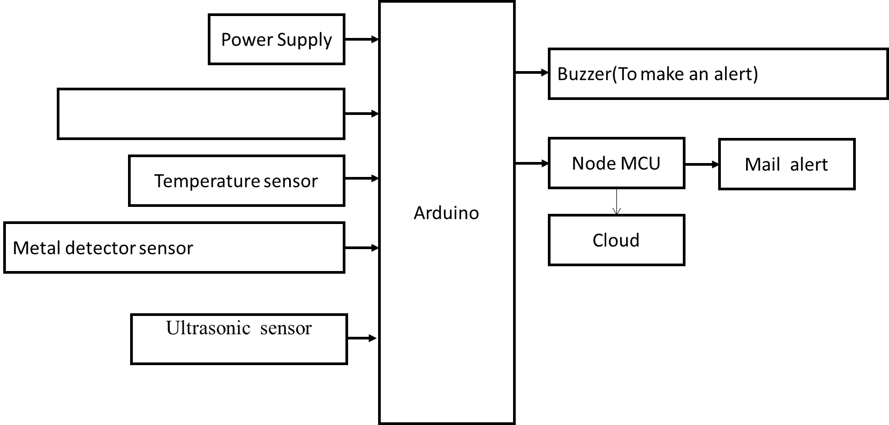
ARCHITECTURE DIAGRAM
PIR Sensor

Slide 8
TECHNICAL BACKGROUND
This reports an IoT based system for the health monitoring and tracking of the soldiers. Arduino board is used which is a low cost solution for the possessing purpose.
Biomedical sensors provides heartbeat, body temperature, and environmental parameters of every soldier to control room. This technology can be helpful to provide the accurate location of missing soldier in critical condition and overcome the drawback of soldiers missing in action.
The addressing system is also helpful to improve the communication between soldier to soldier in emergency situation and provide proper navigation to control room.
Thus we can conclude that this system will act as a lifeguard to the army personnel of all over the globe. In future, a portable handheld sensor device with more sensing options may be developed to aid the soldiers.
This project utilize a PIR sensor for human detection, a metal detector to detect the presence of explosives and a wireless camera for monitoring the scenario continuously at the remote station.

Slide 9

MODULES
Software Sensor SW1, SW2, RV2, RV3 Connection modules
Cloud Storage Module
Software Implementation Module
Arduino to NodeMCU Module
IoT Source code Module
Hardware Implementation

Slide 10
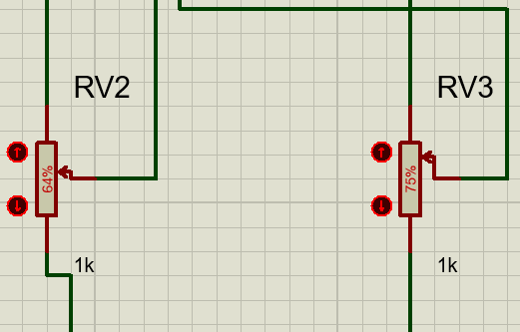
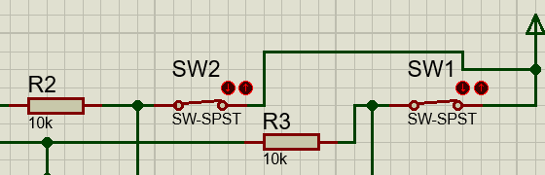
MODULE - 1
Connecting all the sensors to the hardware simulation software and having a switch in between connections. Every sensor has a resistor connected with it to alternate the current flow and manage it.
SW1, SW2, RV2, RV3 are the sensors connected.

Slide 11
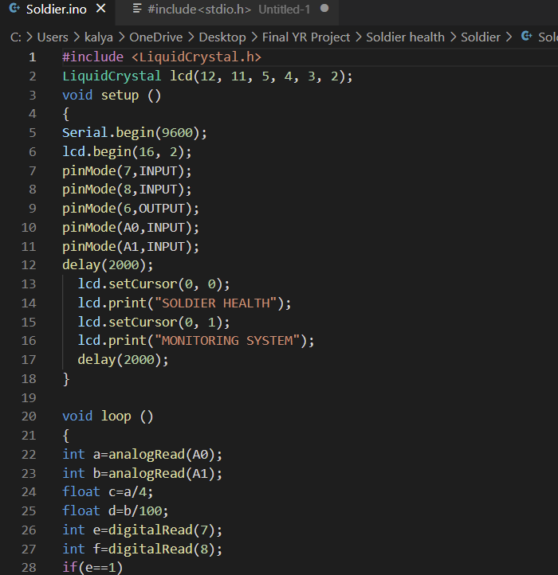
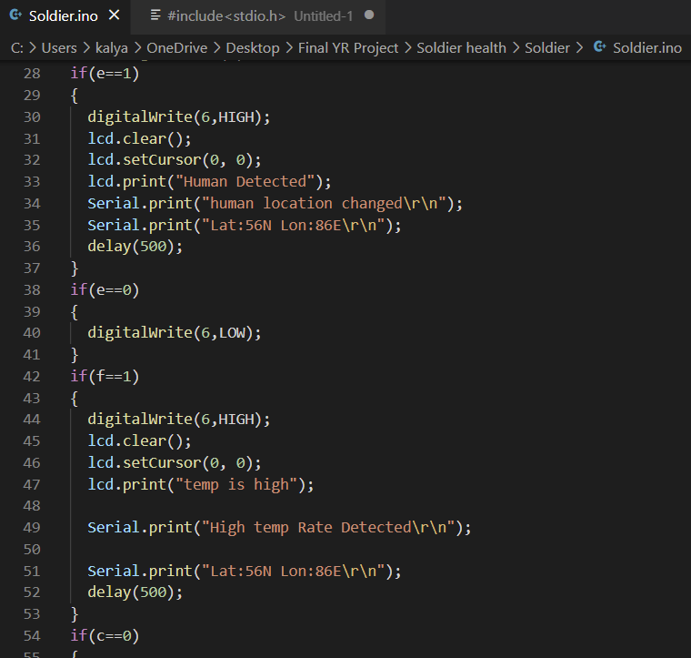
MODULE - 2
Base Source code of the Soldier Health Monitoring System completed. Complex things of the project is yet to be completed so there could be improvements and minute changes in the code in future.

Slide 12
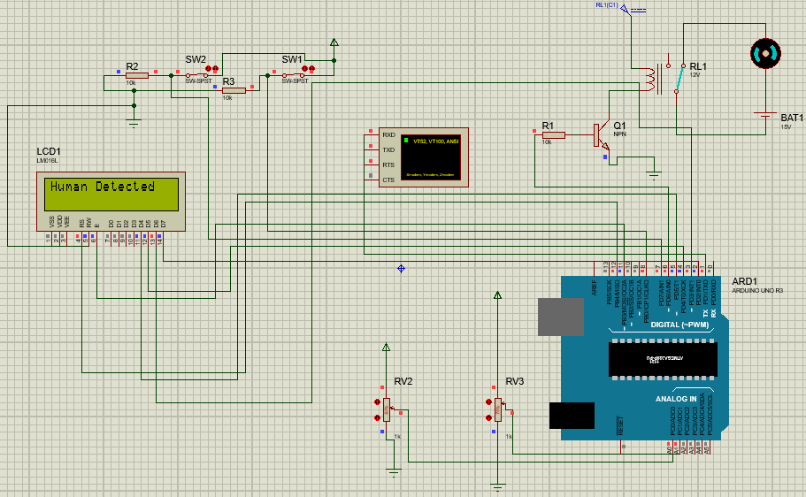
RESULT ANALYSIS & MODULE - 3
Software Implementation of the project and demo/simulation of the project has been completed successfully.
This implementation shows and generalizes the basic work flow of the process.

Slide 13
REFERENCE PAPERS
Novel Wearable Device for Health Monitoring and Tracking of Soldiers Based on LoRa Module – Yashash Jain, Bhupesh Soni, Ayush Goyal, Chetna Sharma, 2020, IEEE, CICT.
IoT-based Health Monitoring via LoRaWAN – Afef Mdhaffar, Tarak Chaari, Kaouthar Larbi, Mohammed Jmaiel, Bernd Freisleben, 2017, IEEE, ICST.
Design and Implementation of a Smart Soldier Uniform – Antoine Abi Zeid Daou, Christian Haddad, Roy Abi Zeid Daou, 2021, IEEE, IMCET.
Soldier Safety using GPS and GSM Modem – J. Swetha Priyanka, Aditi Deshpande, G. Raja Mourya, Anil Kumar, 2017, IEEE, ICIRCA.
Implementation of Soldier Tracking and Health Monitoring System, Laxman Thakre, Nayan Patil, Prashant Kapse, Piyush Potbhare, 2022, IEEE, ICETET.
Implementation of Soldier Tracking and Health Monitoring System, Laxman Thakre, Nayan Patil, Prashant Kapse, Piyush Potbhare, 2022, IEEE, ICETET.

Slide 14
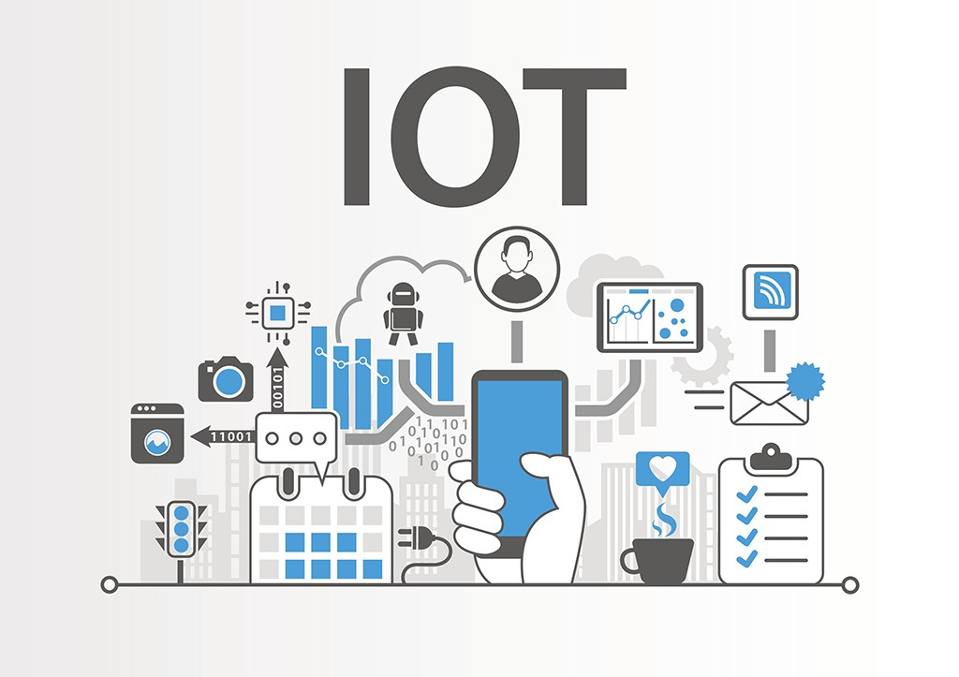
THANK YOU

