Slide 1

Zomato Restaurant
Expansion Analysis
Kalyan Bandaru 27-05-2025

Slide 2
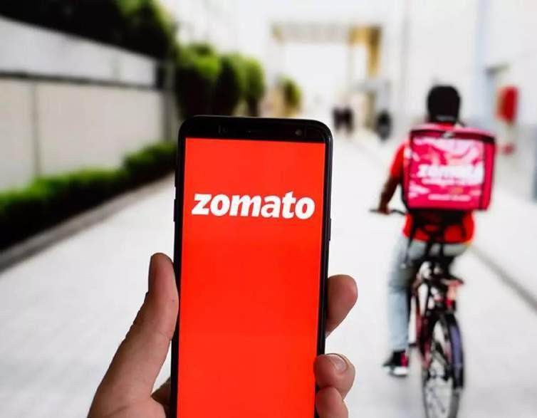
Analysis Objective
Identifying the new countries where Zomato can open new restaurants and expand its business.
Analyzed restaurants ratings and the price range for deeper insights for better decision making .
Analyzed and calculated the expenditure so that we can control our expenditure in the newer restaurants.
Analyzed the cuisines we should go for in the restaurants.

Slide 3

About Zomato
Zomato is an Indian multinational restaurant aggregator and food delivery company. It was founded by Deepinder Goyal and Pankaj Chaddah in 2008.
Zomato charges a 20-25% commission from the particular restaurant for each order placed. In some
regions, the commission rate may vary from 5-7%.

Slide 4
Data summary
Restaurant ID: Unique identifier for each restaurant.
Restaurant Name: The name of the restaurant.
Country Code: Country code of the location
where the restaurant is situated.
City: The city where the restaurant is located.
Address: The specific address of the restaurant.
Locality: The locality or neighborhood where the restaurant is situated.
Locality Verbose: Detailed information about the locality.
Longitude: The geographical longitude coordinate of the restaurant.
Latitude: The geographical latitude coordinate of the restaurant.
Cuisines: The type of cuisine offered by the restaurant.
Currency: The currency used for transactions in the restaurant.
Has Table booking: Indicates whether the restaurant has a table booking option (Yes/No).
Has Online delivery: Indicates whether the
restaurant offers online delivery (Yes/No).
Is delivering now: Indicates whether the restaurant is currently delivering (Yes/No).
Switch to order menu: Indicates whether users can switch to the order menu (Yes/No).
Price range: A numeric value indicating the price
range category of the restaurant.
Votes: The number of votes or ratings/(feedback) received by the restaurant.
Average Cost for two: The average cost for two people dining at the restaurant.
Rating: The overall rating of the restaurant is based on user reviews.
Datekey opening: The date when the restaurant was opened.

Slide 5



Analytical approach and tools
Data Cleaning: Utilized function like Clean, remove duplicates to ensure data accuracy.
Data Enrichment: Enhanced the dataset with additional variables using VLOOKUP, Concatenate, IF & AND operators, Find & REPLACE to cross reference external data source.
Descriptive Analysis: Employed pivot tables to for summarizing key metrics and analyzing the expansion for Zomato across different countries and states.
Visualization: Created dynamic charts and dashboards for data representation and enabling interactive data exploration.

Slide 6











Country wise Count of Restaurants
10000
8652
1000
433
100
60
60
60
80
24
21
40
22
34
20
20
20
10
4
1
From the chart we can analyze that in India there are more numbers of restaurants i.e. 8652 we can say that almost 90% of the market is being occupied by India so the competition is very high there.
In the countries like Canada , Indonesia, Philippines, Qatar, Singapore, and Sri Lanka the market saturation is very low so I’ll suggest to open up for the newer restaurant in these countries as by opening the restaurants we can develop a great market share for the restaurants .

Slide 7
Total count of restaurants
opened per year
Year wise Count of Restaurants
1120
1100
1098
1102
1080
1080
1086
1060
1060
1051
1040
1020
1022
1024
1027
1000
980
2010
2011
2012
2013
2014
2015
2016
2017
2018
We can analyze the trend and predict in the next year how many restaurants will open probably.
As from 2015 we see a steady growth over the years so we can say the trend will continue.

Slide 8

Country wise average number of voters
1000
772
407
431
494
429
243
164
315
146
205
111
103
137
100
32
20
10
1
Australia
Brazil
Canada
India
Indonesia
New Zealand
Philippines
Qatar
Singapore
South Africa
Sri Lanka
Turkey
United Arab Emirates
United Kingdom
United States of America
Indonesia has the highest voters with 772 votes followed by UAE and USA with 494 and 429 votes respectively .
Brazil has the least number of voters with 20 votes.
Here we can observe that even the countries having highest number of restaurants the number of voters can less or vice versa.
For example, India has the highest number of restaurants 8652 but it only have 137 votes.

Slide 9


Country Name | Number of Restaurants
Australia | 24
Brazil | 60
Canada | 4
India | 8652
Indonesia | 21
New Zealand | 40
Philippines | 22
Qatar | 20
Singapore | 20
South Africa | 60
Sri Lanka | 20
Turkey | 34
United Arab Emirates | 60
United Kingdom | 80
United States of America | 433
Grand Total | 9550
As we can see in the chart that Canada, Indonesia, Philippines, Qatar, Singapore, and Sri Lanka has least restaurants as compared to other countries so we can open new restaurants here .
Less number of restaurants means we can develop a great market here.
We should then look for the cities within these countries where we should focus.

Slide 10
Country & Cities for opening
new restaurants
These are the particular cities where we can focus for restaurant expansion as the market here is not developed yet .
Less market means less competition that means we can easily develop a market with an average expenditure.

Slide 11
Country vs Average Rating
5.00
4.50
4.00
3.50
3.00
2.50
2.00
1.50
1.00
0.50
0.00
4.30
4.47
4.06
3.87
3.58
3.58
Canada
Indonesia
Philippines
Qatar
Singapore
Sri Lanka
Philippines has the highest rating of 4.47 followed by Indonesia with a rating of
4.30.
Canada and Singapore has least rating with 3.58 rating.
The ratings are quite good for these countries so as per the data it can be a good decision if we go for restaurant expansion in these countries.

Slide 12
Count of Restaurants
Price Range Count of Restaurants
586
1 | 4443
2 | 3113
3 | 1408
4 | 586
Grand Total | 9550
1408
1
4443
2
3
4
3113
In this chart we see the price range distribution in the range of 1 to 4.
We see that 42% of restaurant falls under the price range of 1
whereas only 7% of the restaurants falls under the price range of 4.

Slide 13
Count of restaurants having online delivery
Count of restaurants having table booking
1158
2451
No Yes
No
Yes
7099
8392
Here we can see the two charts which shows the count of the restaurants offering for table booking and online delivery.
We can see that 26% of the restaurants provides online delivery rest 76% do not offer any online
delivery service.
While in the chart 2 we see that only 12% of the restaurants offers for table booking rest 88% do not offer any table booking.
So if in our new restaurants we go for online delivery and table booking then it can be a good strategy .

Slide 14


Suggested Countries
Suggested Countries vs Average cost for two (INR)
Average of Average cost for two (INR)
665.00
Canada Indonesia Philippines Qatar Singapore Sri Lanka
2201.10
1434.07
2442.36
6553.64
10136.21
665.00
2201.10
1434.07
Canada
Indonesia
10136.21
2442.36
Philippines
Qatar Singapore Sri Lanka
6553.64
Grand Total 4109.80
The average cost for two Singapore is high with the value Rs.10136.21/- and Sri Lanka stands at least with value Rs.665/-.
This gives us proper control over the expenditure on the food.

Slide 15
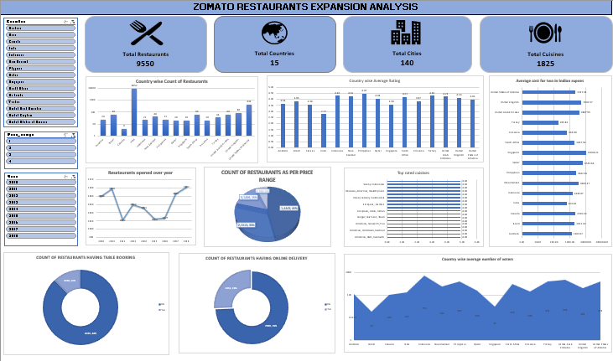

Slide 16
Dashboard insights
The dashboard provides comprehensive insights of restaurants across various countries, cities, and price ranges. On the left, three slicers Country, Price Range, and Year allows to filter data accordingly.
Key visualizations include:
Column Charts (2): Displays the number of restaurants by country, average rating of countries.
Bar Charts (2): Shows the average cost for two (in INR) across countries, top rated cuisines.
Pie Chart: Illustrates the distribution of restaurants by price range, highlighting an inverse relationship—lower price ranges have higher restaurant counts.
Donut Charts (2): Represent the number of restaurants offering online booking and table reservations.
Line Chart: Shows the yearly trend of new restaurant openings.
Bar Chart: Displays the average number of voters per country.
These insights are more useful and gives clear understanding in making informed decisions for strategic restaurant expansion.

Slide 17

Conclusion
Analyzed the data and identified countries where newer restaurants can be opened.
Identified the states and the cities where we can open the restaurant within the suggested country on the basis of the average cost , ratings , no. of restaurants already opened there , price range etc.
All these cities has the highest average cost for two and less market saturation that means less competition.

Slide 18

Reference
Raw data is provided by
Newton School team.
Used MS Excel, MS Word, MS PowerPoint to complete this project.

