Slide 1
Explaining Emotions: A Study of XAI in Sentiment Analysis on the IMDB Dataset
Team:
Dogiparthi Aasrith -21BAI1702
Yarraguntla Kalyan Chakravarthy -21BAI17593
Shobith Paripalli -21BAI1722
Nikhil Phaneendra -21BAI1345

Slide 2
Problem Statement
Sentiment analysis, the process of identifying emotional tone from text, faces significant challenges despite advancements in AI. Text, especially from large datasets like IMDB movie reviews, often contains nuanced language, sarcasm, idioms, and cultural references that can obscure the true sentiment, making it difficult for AI models to consistently and accurately interpret emotions. Additionally, many of today’s AI models function as "black boxes," where the decision-making process is unclear, leading to skepticism and mistrust among users—particularly when the systems deal with sensitive human emotions. To address these challenges, Explainable AI (XAI) techniques have emerged, aiming to make AI models more transparent and understandable to both technical and non-technical users. However, integrating XAI into sentiment analysis models requires a delicate balance to ensure that explainability enhances, rather than compromises, the accuracy of predictions. The goal is to develop approaches that not only maintain or improve sentiment analysis accuracy but also provide clear and actionable insights into how predictions are made.

Slide 3
Abstract
In natural language processing, sentiment analysis gives important insights into how feel, especially in big datasets like IMDB movie reviews. However, these analyses often struggle because the predictive models they use can be really confusing. They operate like "black boxes". This study aims to fix that by using Explainable AI (XAI) techniques specifically SHAP (SHapley Additive exPlanations) and LIME (Local Interpretable Model-agnostic Explanations) to make sentiment classification transparent and clearer.
We are going to apply these XAI methods to deep learning frameworks that use Convolutional Neural Networks (CNNs) and Long Short-Term Memory (LSTM) networks. Our goal is to keep the high accuracy in guessing sentiments while also showing how the model makes its decisions.
Early results show that by adding explainability, users trust the model's outputs more and understand them better, without losing any performance. This study highlights how XAI can help make AI-driven sentiment analysis easier to grasp and more reliable - this opens doors for better-informed and clearer data-driven choices in media analysis and even more areas.

Slide 4
Literature review
The paper provides a comprehensive survey of the current state of sentiment analysis, emphasizing the dominance of deep learning models such as Convolutional Neural Networks (CNNs) and Recurrent Neural Networks (RNNs) in achieving state-of-the-art performance. However, it highlights a critical challenge associated with these models: their "black-box" nature, which leads to significant issues in interpretability and the ability to understand and justify their decision-making processes. To address these challenges, the paper explores the field of eXplainable Artificial Intelligence (XAI), which aims to make AI models more interpretable. The survey discusses various approaches and definitions of explainability, particularly in the context of sentiment analysis, and examines the ongoing debate between model performance and interpretability. Additionally, the paper identifies the need for further research into explainable models for multilingual sentiment analysis, suggesting that future efforts could focus on leveraging Graph Neural Networks to develop dependency-based rules for different languages.
This paper has significant advances in the field of explainable artificial intelligence (XAI) within supervised learning. It highlights key works that have explored the ethical and trust-related challenges posed by the opacity of deep learning models, particularly in sensitive applications like healthcare and finance. The survey discusses the emergence of various interpretability methods aimed at making AI systems more transparent and accountable. It also examines previous surveys and reviews, emphasizing the growing importance of XAI in ensuring the reliability and fairness of machine learning models. Additionally, the paper addresses the broader implications of these developments for artificial general intelligence (AGI) and ethical AI.

Slide 5
The literature survey in this paper reviews various approaches to automatic sarcasm detection, including rule-based, statistical, machine learning, and deep learning techniques. It highlights the challenges of detecting sarcasm, especially in single sentences, and the importance of contextual information in improving accuracy. The survey discusses the evolution of sarcasm detection methods from focusing on isolated utterances to incorporating broader contextual cues like social-graph, temporal context, and user profiles. It also examines recent advancements in multimodal sarcasm detection, integrating text with images and other media. The need for more sophisticated methods to capture contextual incongruity in dialogues and conversational threads is emphasized, pointing to ongoing challenges and future research directions.
The literature survey in this paper explores the rapidly evolving field of Explainable Artificial Intelligence (XAI), addressing the critical need for transparency in AI systems. It reviews key contributions and approaches to XAI, including efforts by academia, industry, and government organizations like DARPA, highlighting the importance of fairness, accountability, and transparency in algorithmic decision-making. The survey discusses the growing body of research focused on creating explainable models without compromising performance, emphasizing the interdisciplinary nature of XAI. It also identifies gaps in formalism and the limited study of the human role in existing approaches, suggesting areas for future research and development.

Slide 6
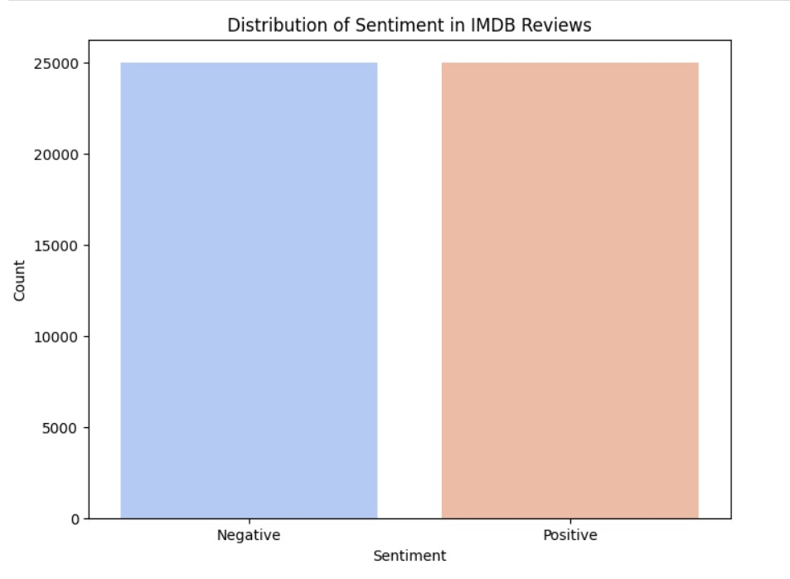
Dataset description
This project uses the IMDB dataset. It's widely recognized in the machine learning world. It has lots of movie reviews from viewers. Each review is already marked as positive or negative. So, it creates a clear yes-or-no challenge. With its huge variety of natural language text, you'll find many different ways to write—from chill to really formal. This makes it perfect for testing out advanced sentiment analysis techniques.

Slide 7
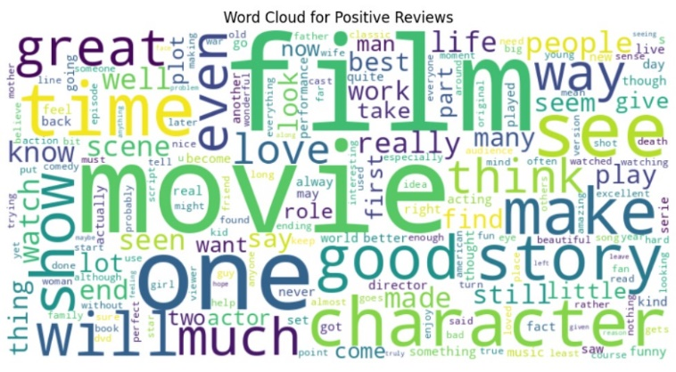
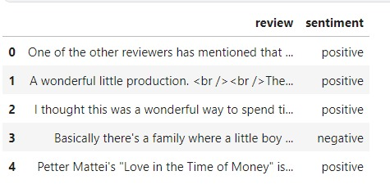
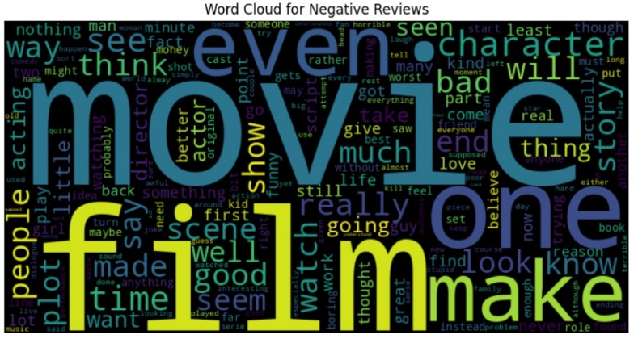
Dataset Visualization

Slide 8
Methodology
Building the Sentiment Analysis Model (Bidirectional LSTM)
Step 1.1: Data Preparation for Training
Split the dataset into training and test sets (usually an 80/20 or 70/30 split).
Convert the text reviews into a numerical format using techniques like Word Embeddings, Tokenization (to work with sequential models).
Step 1.2: Bidirectional LSTM Model Design
Define the architecture of a Bidirectional LSTM (BiLSTM) model to capture both forward and backward relationships in the text.
Embedding Layer: For mapping the words to their corresponding embeddings.
Bidirectional LSTM Layer: The BiLSTM will process the input sequence in both forward and reverse directions, giving more context for each word.
Dense Layers: Use dense (fully connected) layers to make the final sentiment classification.
Activation Function: Softmax for multi-class classification (positive, neutral, negative).
Dropout: Add dropout layers for regularization to avoid overfitting.

Slide 9
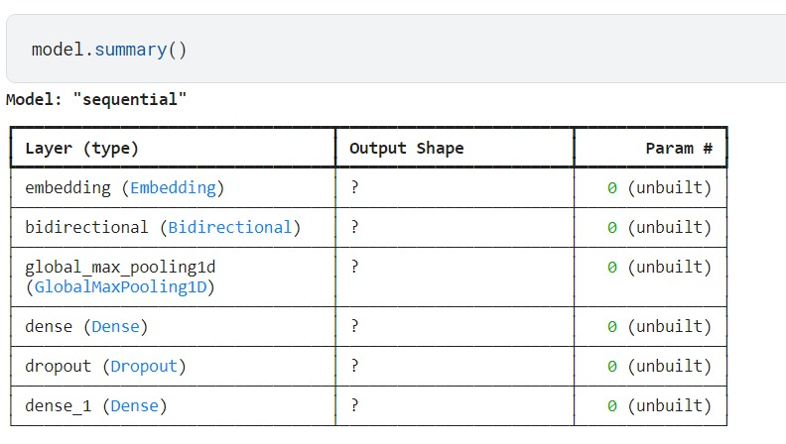
Step 1.3: Model Training
Train the BiLSTM model using the training dataset.
Use loss functions like categorical cross-entropy and optimizers such as Adam.
Step 1.4: Model Testing
After training, evaluate the model using the test set to measure accuracy, precision, recall, F1-score, and other relevant metrics.
Save the trained model for predictions and further use in explainability studies.

Slide 10
Integrating Explainable AI (XAI) Tools
Implement LIME (Local Interpretable Model-agnostic Explanations)
Use LIME to explain individual sentiment predictions by perturbing the input data and observing how the BiLSTM model responds.
LIME generates explanations that show which parts of the review (words or phrases) influenced the model’s decision.
Implement SHAP (SHapley Additive exPlanations)
Use SHAP to provide global and local explanations. SHAP assigns each feature (i.e., word in a review) an importance value based on its contribution to the sentiment prediction.
SHAP visualizations can help understand the overall behavior of the BiLSTM model (global explanations) and why it made specific predictions (local explanations).

Slide 11
Evaluating Model and Explainability
Step 2.1: Explainability Analysis
Analyze each review using the XAI tools (LIME and SHAP) to explain why the BiLSTM model predicted a specific sentiment.
Use visual tools to highlight key words or phrases that had the most influence on the sentiment prediction.
Step 2.2: Compare Accuracy and Explainability
Evaluate the model’s performance metrics (accuracy, precision, recall, etc.) and how well the explanations generated by LIME and SHAP align with human intuition.
Consider whether the explainability provided by the XAI tools is consistent with the review content and if it helps in understanding how the BiLSTM model operates.
Step 2.3: Model Performance Metrics
Collect evaluation metrics from the BiLSTM model (accuracy, precision, recall, F1-score) and analyze how the model interprets different reviews.
Present these metrics alongside the LIME and SHAP-generated explanations to assess how transparent the model

Slide 12
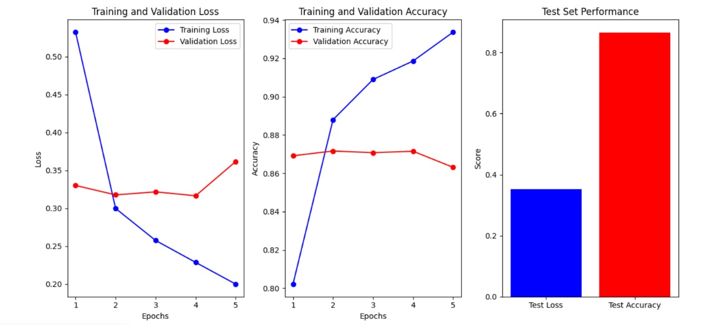
Result

Slide 13
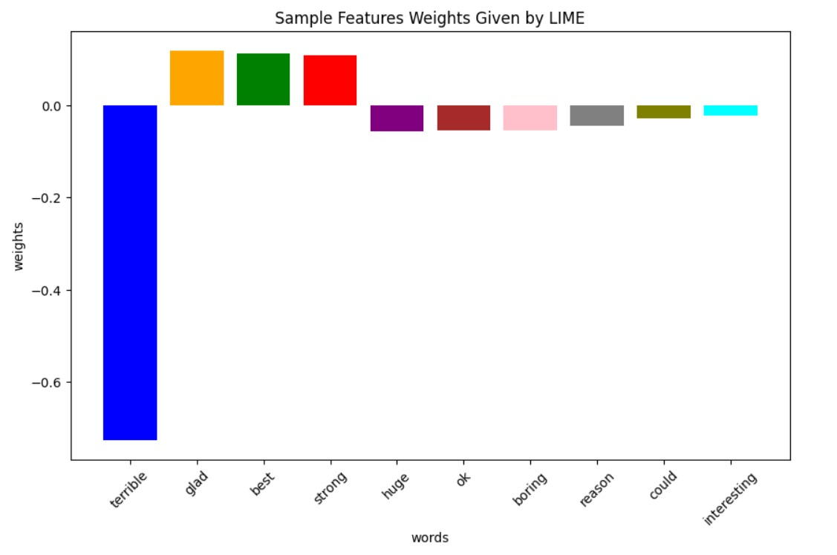
The results depicted in the above charts indicate that the model is learning effectively on the training data, as shown by the significant decrease in training loss and the consistent increase in training accuracy, reaching almost 94% by the final epoch.
The validation loss remains relatively flat and starts to increase after the third epoch, while the validation accuracy plateaus around 87-88%, showing little improvement.
The test set results, with a lower test loss and high-test accuracy above 85%, indicate that the model performs well on the unseen test data.

Slide 14
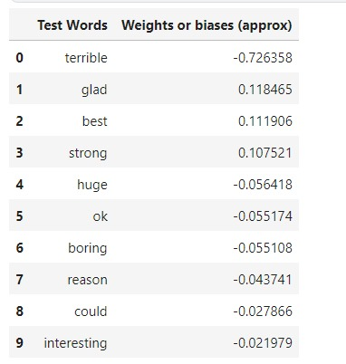
As for the model, as shown in figure, we get explanation features. The word terrible is mostly related in a negative context and hence is having a negative sentiment.
Similarly, best is mostly in those sentences which depict the positive sentiment. By the Table below, we can interpret our data and understand the biases in the dataset. Our model is not just a black box now, and the customers know the insides of the system through just one graph. Thus, we achieve the explanations along with the insights from the data.

Slide 15
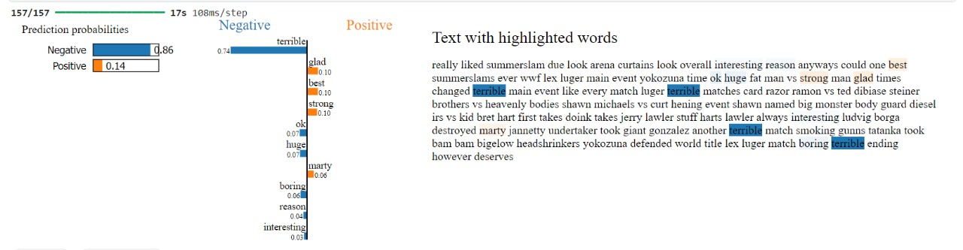
The image depicts the analysis of a text using a sentiment classification model. The prediction probabilities indicate an 86% likelihood that the text is negative and a 14% chance that it is positive. Key words contributing to the negative sentiment, such as "terrible" (with the highest negative contribution), "boring," and "reason," are highlighted. Positive words like "glad," "best," and "strong" contribute to a much smaller portion of the sentiment analysis. In the highlighted text, the negative tone is reinforced by the repeated use of the word "terrible" in describing events, matches, and the overall experience, along with terms like "boring" and "fat man." Positive words like "glad" and "interesting" seem to have little impact on altering the overall negative sentiment. The text reflects a critical perspective of certain aspects of the event being described, with emphasis on disappointment regarding specific matches and performers.

Slide 16
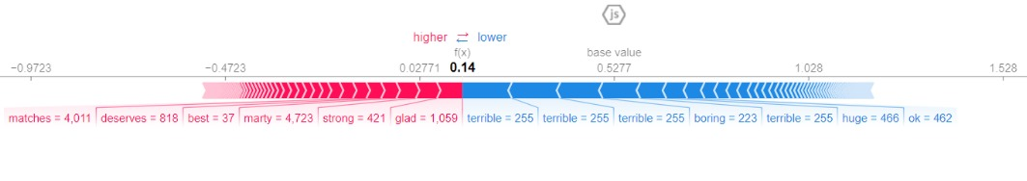
The image shows a SHAP (SHapley Additive exPlanations) plot that illustrates the contribution of specific words to a model's sentiment prediction. The base value starts at 0.5277, and the final prediction score, f(x), is 0.14, indicating a predominantly negative sentiment. Words that pushed the prediction towards a more positive sentiment are on the left in red, while words that contributed to a more negative sentiment are on the right in blue.
Words like "matches," "marty," "deserves," and "best" have higher SHAP values in red, suggesting they influenced the model towards a more positive direction. For example, "matches" contributed 4.011 and "marty" 4.723 to raising the sentiment score. However, words such as "terrible," "boring," "huge," and "ok," shown in blue, pushed the sentiment towards negativity. The repeated use of "terrible" contributed significantly to lowering the sentiment, each occurrence of "terrible" reducing the score by 0.255.
Overall, despite some positive words, the negative words, especially "terrible," had a stronger impact, leading to the overall negative prediction of the text.

Slide 17
Conclusion
Sentiment analysis of IMDb reviews significantly impacts how viewers perceive movies and shows, as it reflects collective opinions about content quality. Predicting movie sentiments based on reviews can help viewers and creators gauge audience reception and improve recommendations. Our proposed model not only provides accurate sentiment predictions but also explains the reasoning behind these predictions using Explainable AI (XAI) through SHAP analysis, making the output more transparent and interpretable. Future research could explore automated sentiment predictions from real-time review platforms and extend to multilingual review analysis. Additionally, integrating visual sentiment indicators could enhance user engagement and understanding. This model could also serve as a recommendation tool for streaming services to personalize content for users.

Slide 18
References
https://ieeexplore.ieee.org/abstract/document/10185138
https://ieeexplore.ieee.org/document/8400040/
https://onlinelibrary.wiley.com/doi/full/10.1155/2021/2939334
https://ieeexplore.ieee.org/document/8466590
https://ieeexplore.ieee.org/document/8976252
GitHub
https://github.com/kalyanchakravarthy1284/Explainable-AI-in-IMDB-movie-review-Sentiment-Analysis

Slide 19
Thankyou

