Slide 1
Pneumonia Diagnosis from Chest X-ray Images using Deep Learning
Team:
Dogiparthi Aasrith -21BAI1702
Yarraguntla Kalyan Chakravarthy -21BAI1759

Slide 2
Abstract
Pneumonia diagnosis from chest X-ray images is crucial for timely treatment and management. This research employs deep learning techniques, specifically VGG19, ResNet50 and Efficientnetb0 architectures with transfer learning, to develop accurate pneumonia detection models. Prior to model training, exploratory data analysis (EDA) is conducted to gain insights into the dataset. The EDA encompasses observing class distribution, pixel intensity analysis, image size exploration, visualization of representative images, and data augmentation to enhance model generalization. A diverse dataset comprising chest X-ray images is utilized, sourced from public repositories. Through extensive experimentation and evaluation, the performance of the models is assessed primarily using accuracy as the evaluation metric. Comparative analysis with existing methods underscores the efficacy of the proposed approach in pneumonia detection. This study contributes to advancing automated diagnostic systems, facilitating prompt and accurate identification of pneumonia cases from chest X-ray images, thereby improving clinical decision-making and patient outcomes.

Slide 3
Problem Statement
To avoid difficulties, pneumonia diagnosis from chest X-ray pictures needs to be made accurately and quickly. Conventional approaches are frequently ineffective. While deep learning models such as VGG19 and ResNet50 present promising answers, they are not without issues such as interpretability and variety in datasets. The objective of this research is to develop and evaluate these models for better diagnosis with an emphasis on usability, performance, and interpretability to improve patient care.
Key Words
Normal, Pneumonia, Chest X-ray images,VGG19,Resnet50,Efficientnetb0, Convolutional Neural Network(CNN), Transfer Learning(TL), Healthcare technology, Image classification

Slide 4
Literature review
The abstract outlines a study focusing on automating pneumonia detection from chest X-ray (CXR) images, given the critical need for early diagnosis, especially in underdeveloped regions with high infection rates and limited healthcare infrastructure. The difficulty and subjectivity of CXR interpretation underscore the necessity for computer-aided diagnosis systems. Leveraging deep transfer learning, the study employs an ensemble of three CNN models—VGG16, MobileNetV2, and DenseNet169—to address data scarcity. Results demonstrate superior performance, with recall rates of 93% for pneumonia and 89% for normal cases, alongside a maximum accuracy of 92% and precision rates of 93% and 89%. Comparative analyses reveal the ensemble's superiority over existing techniques, showcasing its potential for accurate and timely pneumonia diagnosis. The conclusion highlights the effectiveness of the proposed ensemble in correctly classifying CXR images, emphasizing its role in facilitating prompt treatment and potentially saving lives through early diagnosis. Overall, the abstract succinctly summarizes the study's objectives, methodologies, findings, and implications for medical diagnosis.

Slide 5
The paper presents a study focusing on pneumonia diagnosis from chest X-ray images using convolutional neural network (CNN) models, specifically Xception and VGG16, with transfer learning and fine-tuning. The necessity for computer-aided diagnosis systems due to subjective interpretations of X-ray images by radiologists is emphasized. The study compares the performance of the two CNN models, revealing that VGG16 exhibits higher accuracy while Xception demonstrates superior pneumonia detection capabilities. Notably, each network shows distinct strengths in detecting pneumonia and normal cases. The conclusion highlights the comparative analysis of the two networks, indicating VGG16's superiority in overall performance metrics except for sensitivity, where Xception excels. The potential for future work involving ensemble methods to leverage the strengths of both networks is suggested. Overall, the abstract provides a concise summary of the study's objectives, methodologies, findings, and potential directions for further research.

Slide 6
Dataset description & exploration
The dataset utilized in this study comprises chest X-ray images sourced from the Chest X-Ray dataset. This dataset is organized into three main directories: train, test, and validation. Each directory contains subdirectories corresponding to the classes of interest: 'pneumonia' and 'normal'. These classes represent the presence or absence of pneumonia in the chest X-ray images, thus constituting a binary classification problem.
Each image is digitally represented, allowing for computational analysis. Augmentation techniques, including rotation, shifting, and flipping, are applied during training to diversify the dataset and enhance model generalization. Additionally, preprocessing steps such as rescaling and normalization ensure standardized pixel values across the dataset.
Images are resized to a target size of (224, 224) pixels, accommodating the input dimensions required by deep learning models. During training, images are processed in batches, with a batch size of 32 chosen to balance computational efficiency and model stability. These attributes collectively provide a robust foundation for training and evaluating deep learning models for automated pneumonia detection in clinical settings.

Slide 7
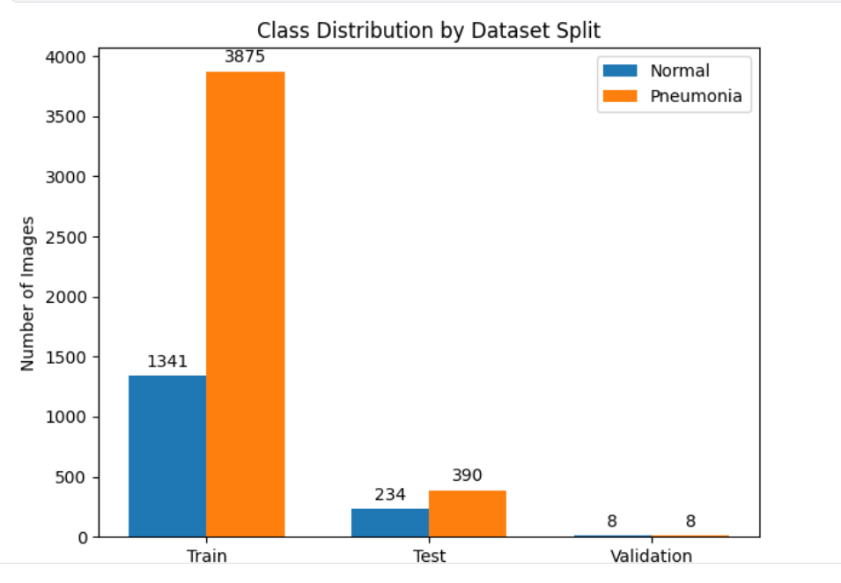
Upon visualizing the class distribution, it was observed that the dataset exhibited an imbalance, with a higher number of images classified as pneumonia-positive compared to normal cases. This imbalance necessitated corrective measures to prevent bias during model training and evaluation such as data augmentation which is performed.

Slide 8
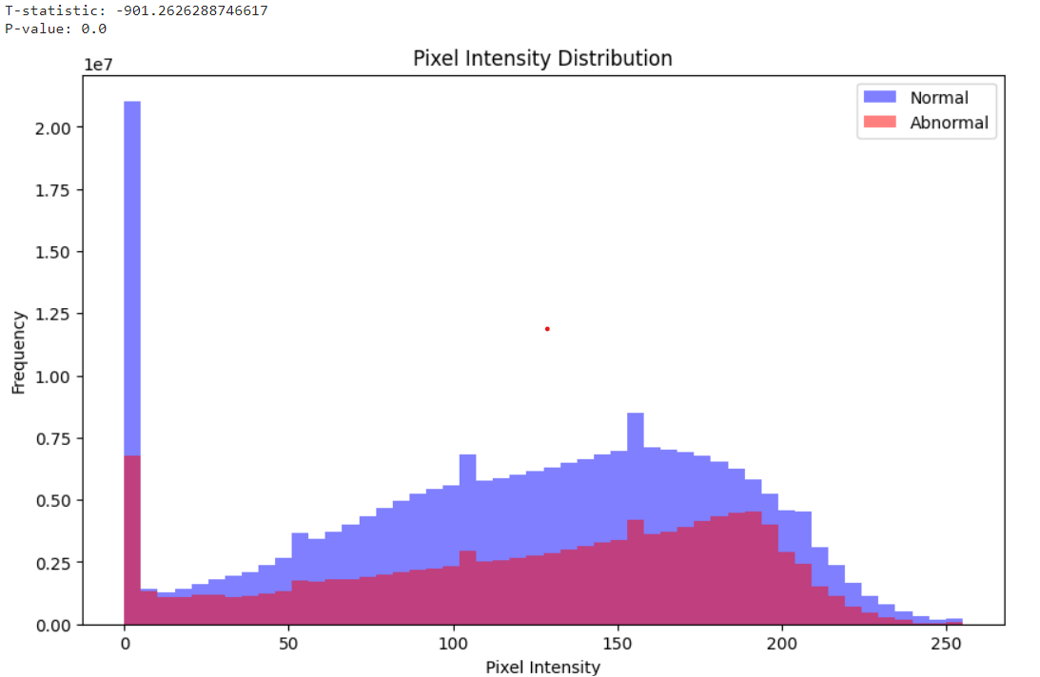
The dataset's pixel intensity analysis showed distinct patterns, with the greatest frequency of pixel values dispersed throughout the 0 to 280 range and focused around 0. The model building and subsequent preprocessing processes were informed by this understanding of the pixel intensity distribution.

Slide 9
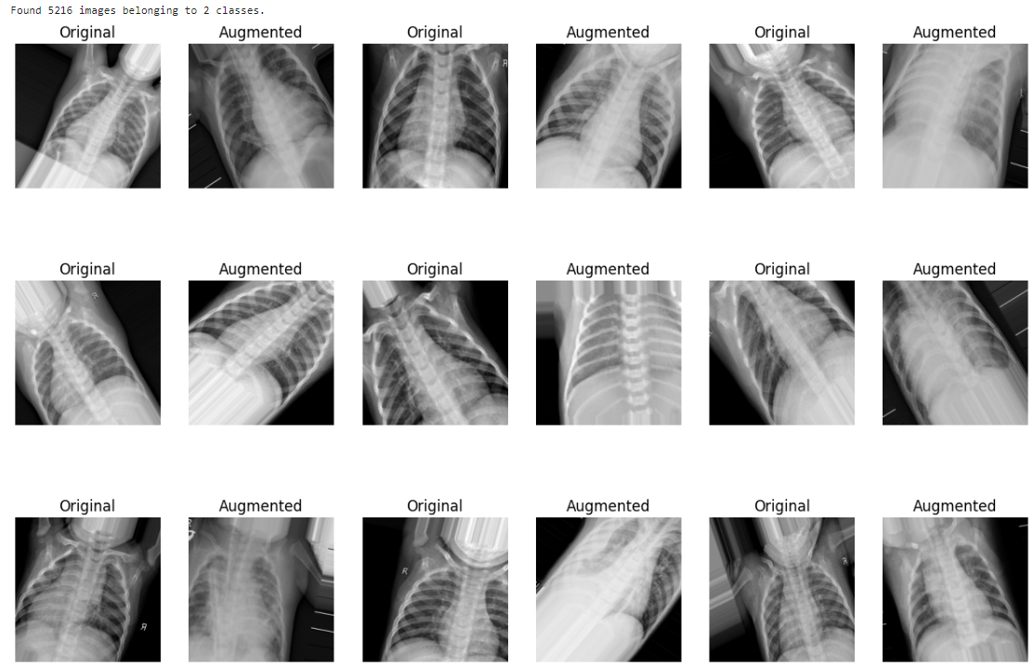
Augmenting the dataset involves generating new training samples by applying transformations to existing images. Augmentation techniques introduce variations to the dataset, helping improve model generalization and performance.
The visualization of augmented images showcased the effectiveness of augmentation techniques in introducing variations to the dataset. Rotated and flipped images were observed, contributing to a more diverse and robust training dataset.

Slide 10
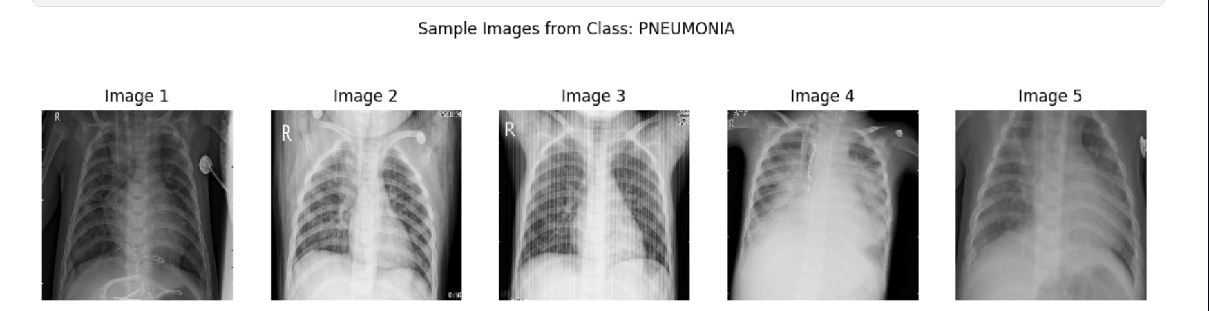
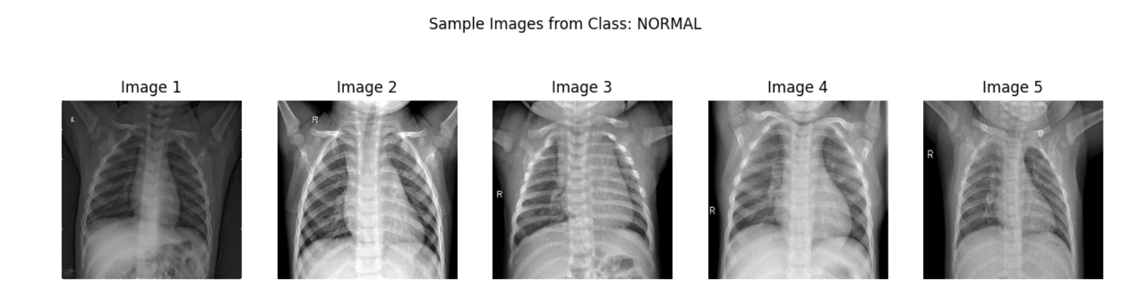
Dataset Visualization
Images of Pneumonia Class
Images of Normal Class
Original chest X-ray images depicting pneumonia-positive cases exhibited characteristic patterns indicative of lung inflammation and fluid buildup. Conversely, images classified as normal displayed clear lung structures without signs of infection or abnormalities.

Slide 11
Methodology
The proposed methodology encompasses several key steps aimed at improving the accuracy of pneumonia detection from chest X-ray images. These steps include preprocessing and exploratory data analysis, followed by the implementation of a deep learning model based on the VGG19 architecture with custom layers. Below is an elaboration of each component:
Data Preprocessing:
Checking Image Heights and Widths: Prior to model training, it is essential to assess the dimensions of the chest X-ray images to ensure consistency. Images with varying heights and widths may require resizing or cropping to a uniform size, such as (224, 224), to facilitate model training.
Pixel Intensity Distributions:
Analyzing the pixel intensity distributions within the images can provide insights into the overall image quality and contrast. This analysis helps identify potential preprocessing steps, such as normalization or contrast adjustment, to improve model performance.

Slide 12
Exploratory Data Analysis (EDA):
Class Distribution: Understanding the distribution of classes ('pneumonia' vs. 'normal') within the dataset is crucial for assessing class imbalance and potential biases. EDA techniques, such as histograms or pie charts, can visually represent the class distribution and guide data preprocessing strategies.
Model Architecture:
VGG19 with Custom Layers: The VGG19 architecture, known for its deep convolutional layers, serves as the backbone of the proposed deep learning model. However, to adapt VGG19 for pneumonia detection, custom layers are added to the model. These additional layers may include dense layers, dropout layers for regularization, and activation functions tailored to the specific task.
Training and Evaluation:
Training Procedure: The model is trained using the preprocessed chest X-ray images from the training dataset. During training, data augmentation techniques such as rotation, shifting, and flipping may be applied to increase the diversity of training samples and improve model generalization.
Validation: The model's performance is evaluated using a separate validation dataset to assess its ability to generalize to unseen data. Evaluation metrics such as accuracy, precision, recall, and F1-score are computed to quantify the model's performance.

Slide 13
Model Evaluation and Validation:
Testing: The final trained model is evaluated on the test dataset to assess its performance in real-world scenarios. Performance metrics are computed, and the model's predictions are compared against ground truth labels to measure its accuracy and reliability.
Interpretability: Techniques such as class activation maps or gradient-based methods may be employed to visualize the regions of the X-ray images that contribute most to the model's predictions, providing insights into its decision-making process.
By following this methodology, it is anticipated that the proposed deep learning model, based on VGG19 with custom layers, will achieve improved accuracy in pneumonia detection from chest X-ray images. Through rigorous preprocessing, exploratory data analysis, model training, and evaluation, the model can provide valuable insights into the diagnosis of pneumonia, thereby enhancing patient care and clinical decision-making.

Slide 14
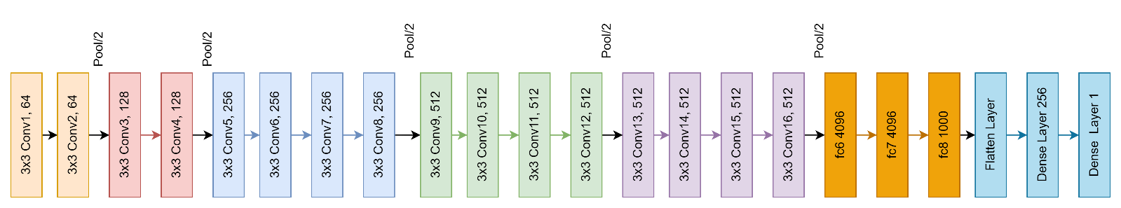
Block Diagram
Justification
The reason we selected VGG19 is the existing papers did not evaluate the dataset on this model.

Slide 15
Identification of Hyperparameters
No of epochs is 20
Initial learning rate is 0.01
Batch size is 32
Optimizer we selected is RMSprop
Activation Function used in the dense layers are relu and sigmod
Dropout rate is 0.5
Weight Initialization is imagenet for VGG19
Data Augmentation is used with Rotation, Scaling, Flipping, Cropping of the images in the dataset

Slide 16
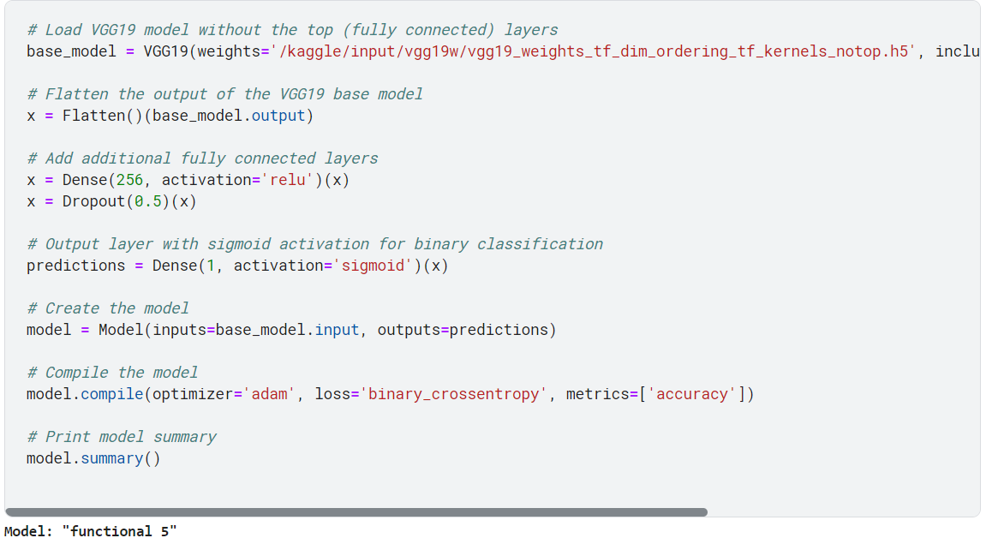
Code
VGG19 Base Model

Slide 17
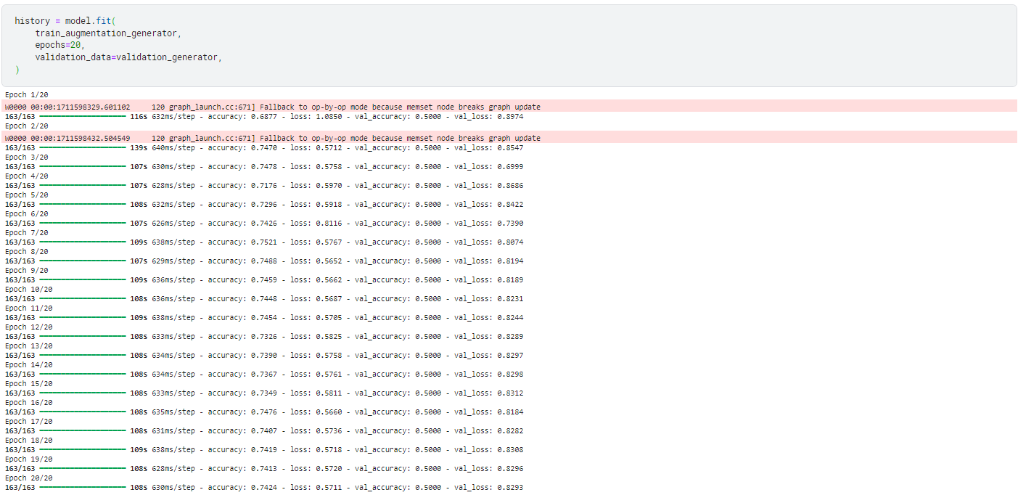

Slide 18
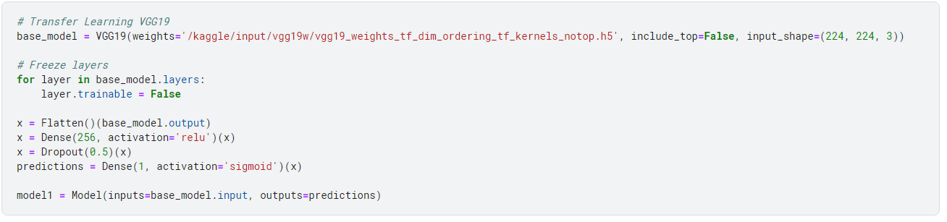
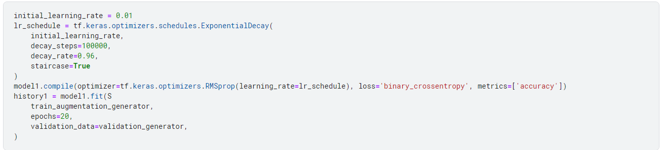
VGG19 with transfer learning

Slide 19
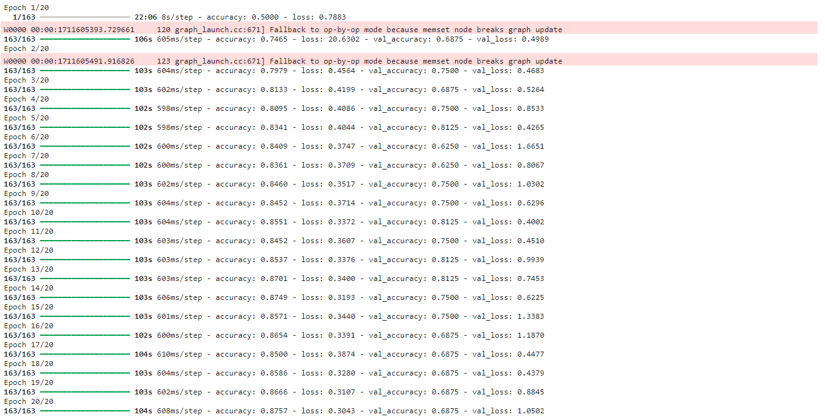

Slide 20
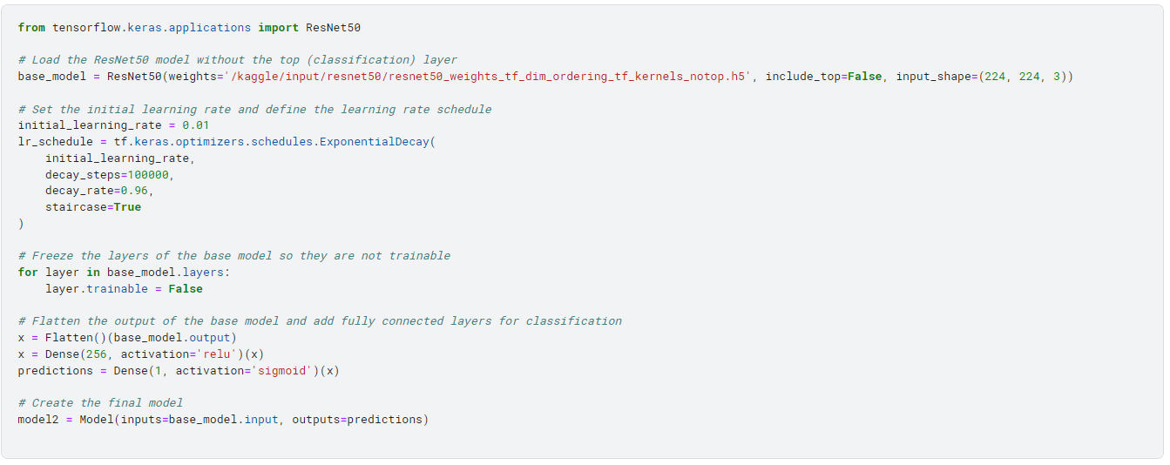
Resnet50 Base Model

Slide 21
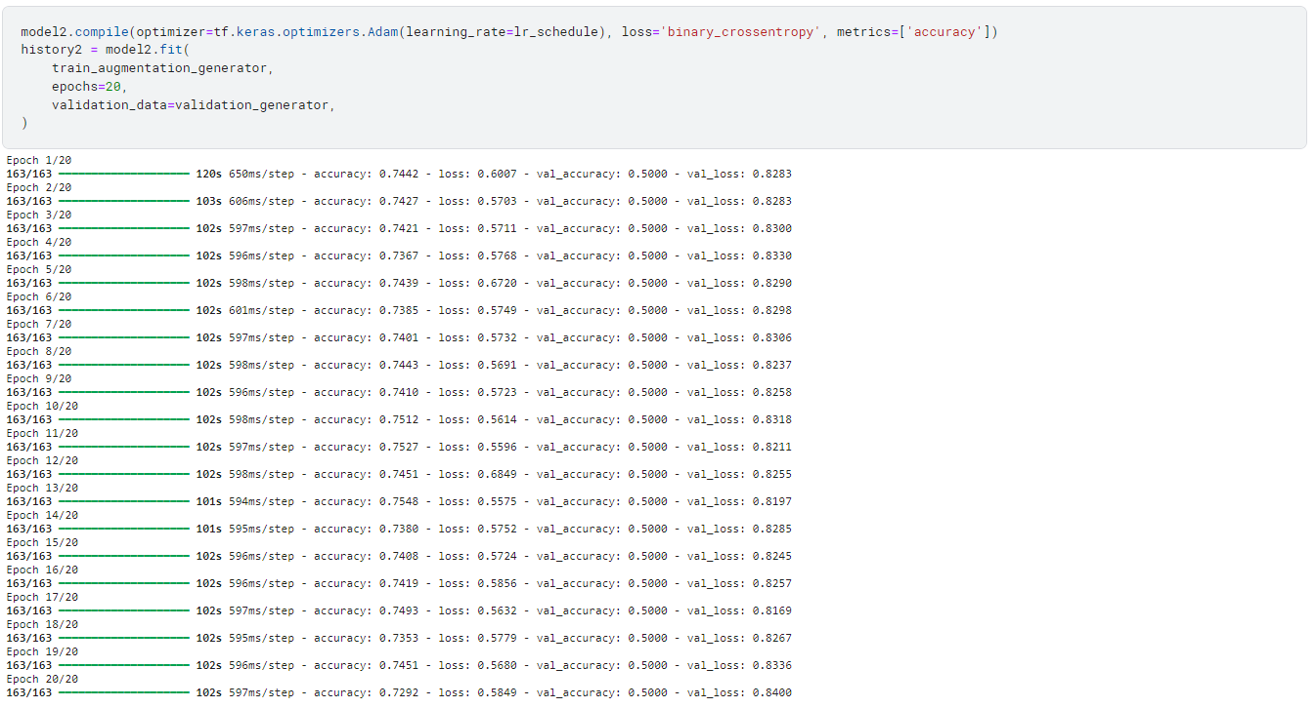

Slide 22
Improvement
First we ran the code using VGG19 with base model and accuracy and loss are 62.5% and 69.4%.
Later we ran the same code using VGG19 with transfer learning and accuracy and loss are 85.5% and 59.7%.
Later on we ran the same code using Resnet50 with base model and accuracy and loss are 62.5% and 69.4%.
The accuracy of the model is achieved freezing the base layers in the model and adding a dropout layer which leads to improve the accuracy and reduce the loss.

Slide 23
Novelty
The novelty of the project is using VGG19 because the existing papers did not evaluate the dataset on this model.
We achieve the novelty of the model by adding custom layers if the accuracy is too low we can the achieve by adding batch normalization, regularization, dense and dropout layers.

Slide 24
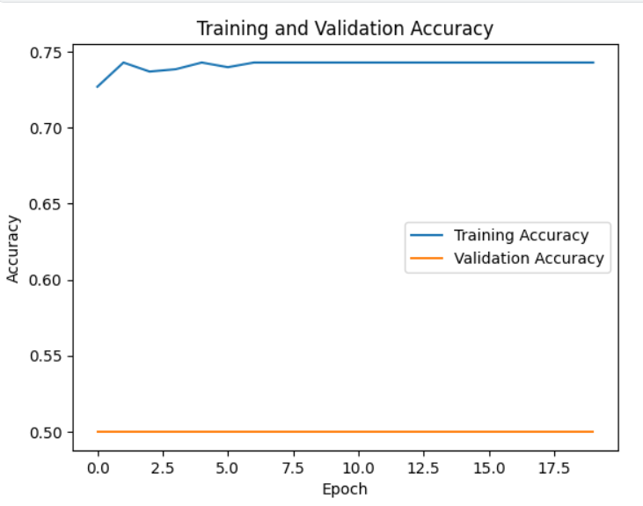
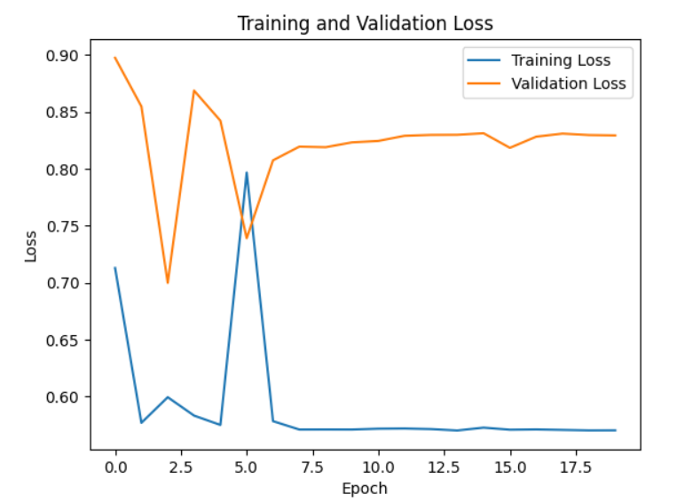
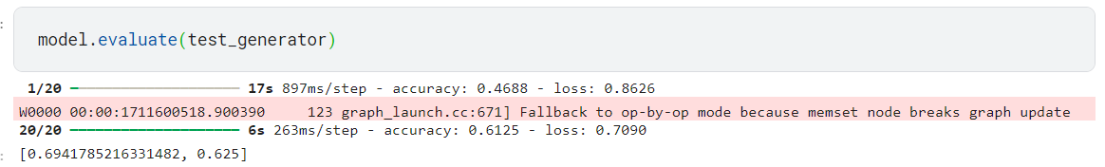
Result
VGG19 Base Model

Slide 25
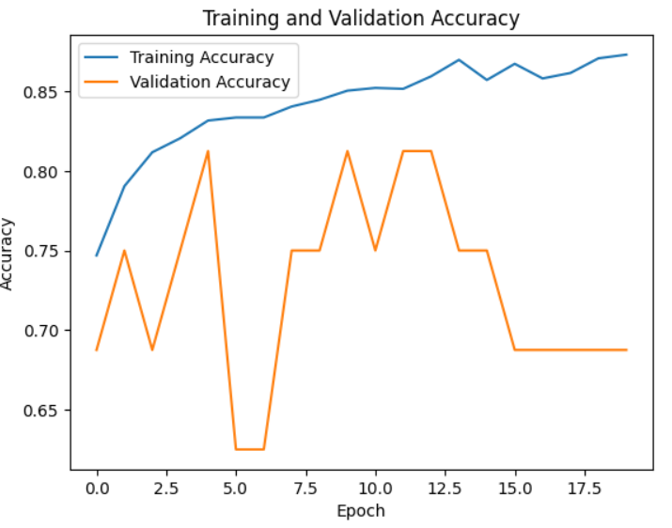
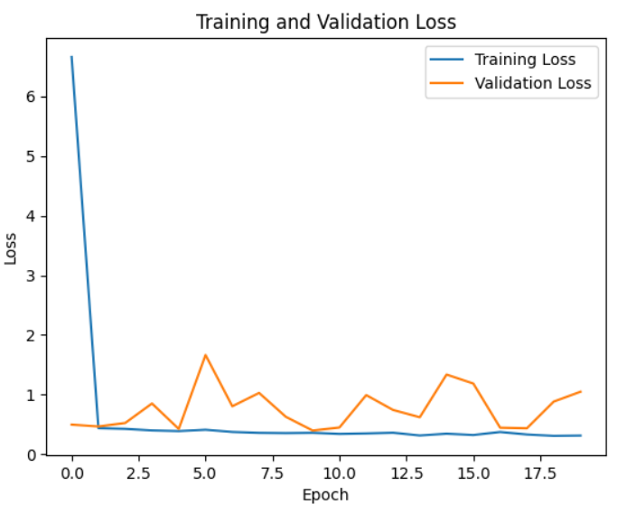
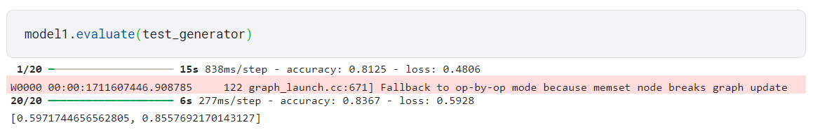
VGG19 with transfer learning

Slide 26
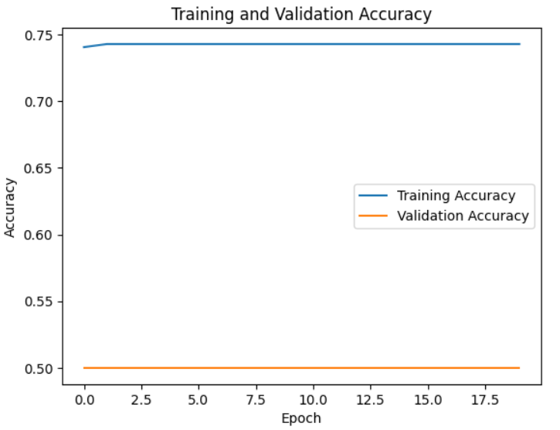
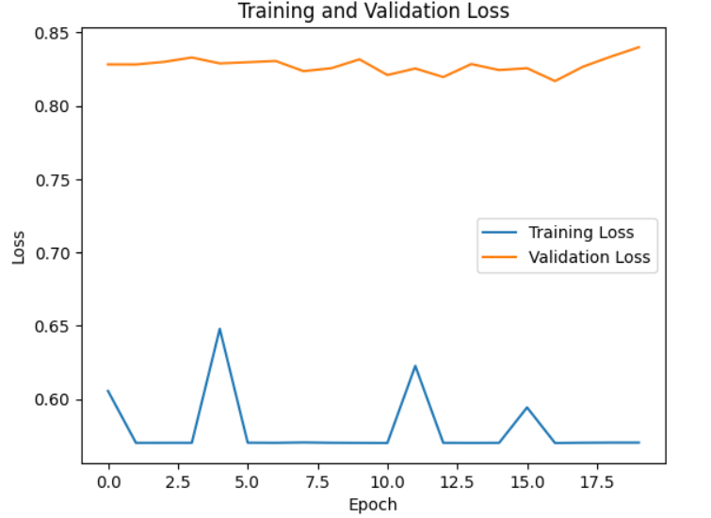
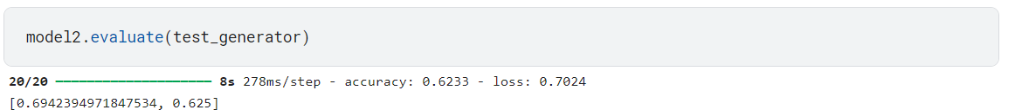
Resnet50 Base Model

Slide 27
References
https://ieeexplore.ieee.org/document/10293523
https://ieeexplore.ieee.org/abstract/document/8741582
https://ieeexplore.ieee.org/document/10303322
https://ieeexplore.ieee.org/document/10391342
https://ieeexplore.ieee.org/abstract/document/10353421

Slide 28
Changes done after DA-2

Slide 29
Methodology for Efficientnetb0
Dataset Consisting of Images of Chest X-rays: This is the initial dataset containing chest X-ray images, serving as input data.
Data Preprocessing and EDA: Images undergo preprocessing (resizing, normalization) and exploratory data analysis for insights.
Model Building: Definition of the deep learning model architecture.
Efficientb0: Utilizing efficientb0 for feature extraction, accelerating training and enhancing performance.
Fine-tuning: Adjusting model parameters for pneumonia detection task and dataset characteristics.
Evaluation: Assessing model performance using metrics like accuracy, precision, recall.

Slide 30
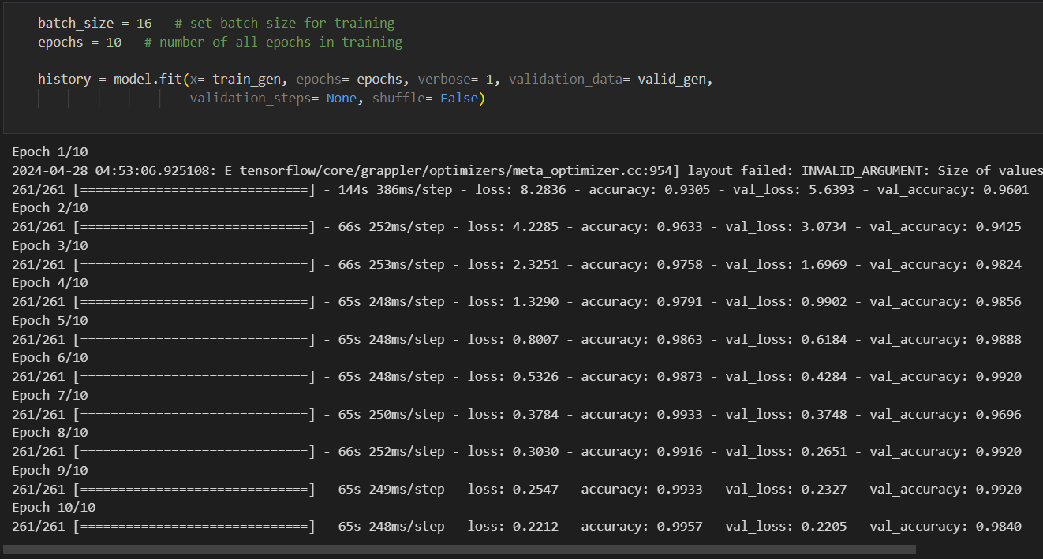
Results
We have trained the model with emphasis on accuracy score as the model’s metrics,
The training accuracy after training for 10 epochs has reached 0.9957 and the loss in the training data is at 0.2212.
The validation accuracy has reached 0.9840 and validation loss is at 0.2205

Slide 31
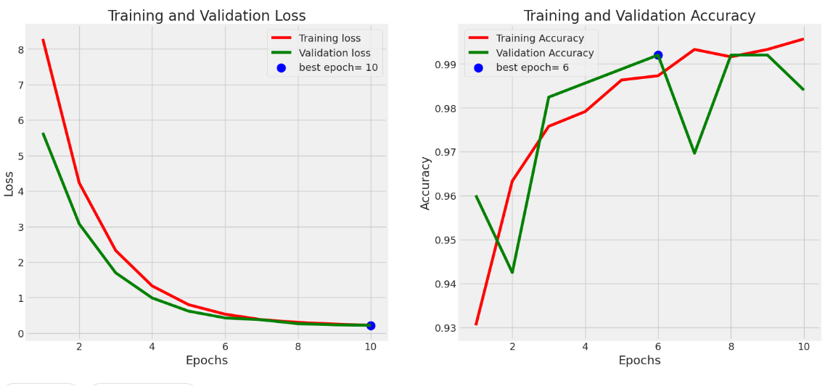
Graphs of Loss and AUC Over the Epochs
Plotting loss over epochs helps us track how well our model is learning from the data, ensuring it minimizes errors effectively during training.
Graphing accuracy over epochs provides insights into the model's ability to discriminate between classes, guiding adjustments to enhance its performance in classification tasks.
Graph depicts the model's decreasing loss over 10 epochs, indicating improved accuracy as training progresses.
Curve shows accuracy stability or increase over epochs, reflecting the model's ability to distinguish between classes.

Slide 32
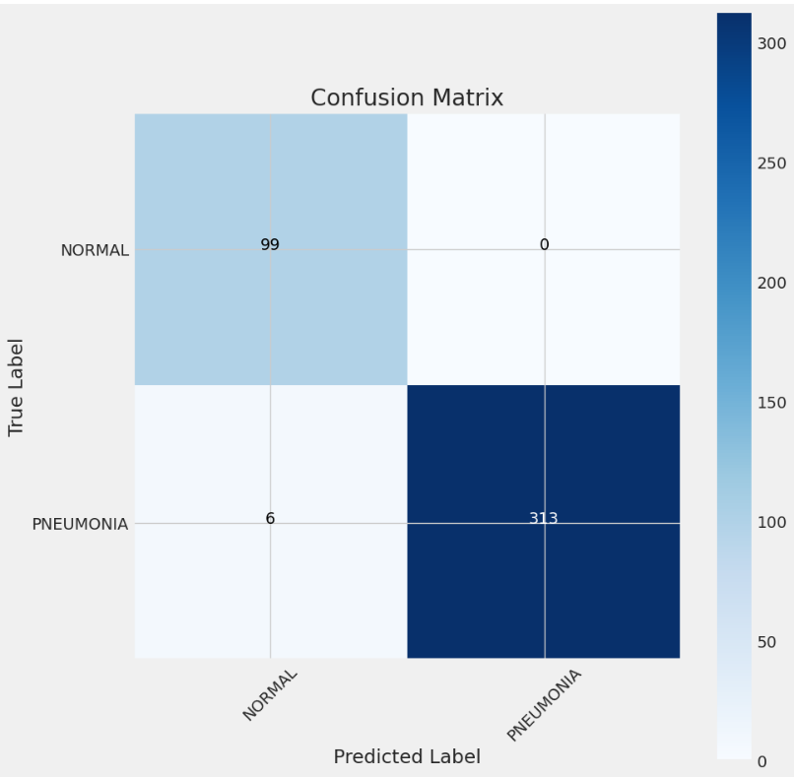
Confusion Matrix
True Positives (TP): The model correctly predicted instances of pneumonia (313 cases).
True Negatives (TN): The model correctly predicted instances of normal (99 cases).
False Positives (FP): The model incorrectly predicted instances as pneumonia when they were actually normal (0 cases).
False Negatives (FN): The model incorrectly predicted instances as normal when they were actually pneumonia (6 cases).
Accuracy: The model demonstrates an accuracy of approximately 99%,
Precision: About 98% of the cases predicted as pneumonia by the model are indeed pneumonia cases.
Recall (Sensitivity): The model identifies around 98.12% of actual pneumonia cases,
F1-score: The F1-score of approximately 99.05%.

Slide 33
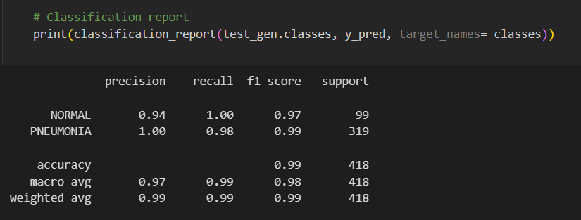
Classification Report
The model achieves an accuracy of 99%, indicating that it correctly predicts the class for 99% of the instances.
The macro and weighted averages provide a balanced view of the model's performance across classes, taking into account the differences in class sizes.
While the macro-average F1-score is 0.98, the weighted average F1-score is slightly higher at 0.99, suggesting that the model performs better when considering the class distribution.
The model shows high precision for both classes, indicating that when it predicts a class, it is usually correct. The high recall for Class 1 suggests that the model effectively captures most of the true positives for this class.
The dataset seems to be imbalanced, with Class 1 (Normal) having more instances (319) compared to (Pneumonia) Class 0 (99).

Slide 34
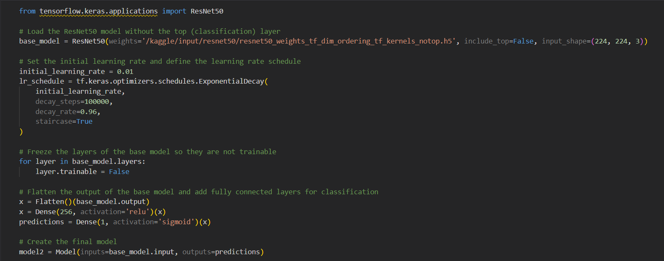
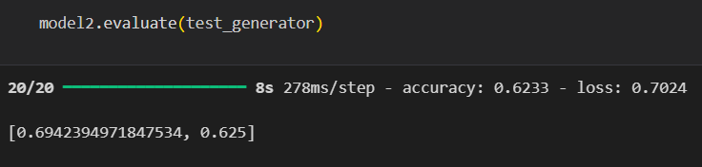
Resnet 50
Comparison with my models
Train Accuracy
Test Accuracy

Slide 35
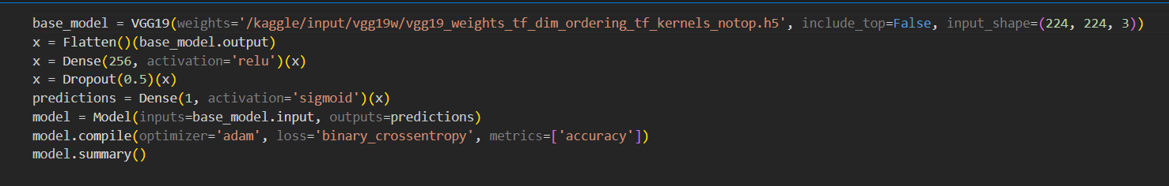
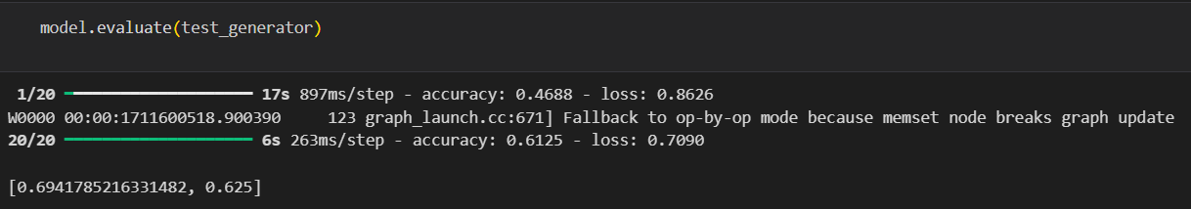
VGG19 Base Model
Train Accuracy
Test Accuracy

Slide 36
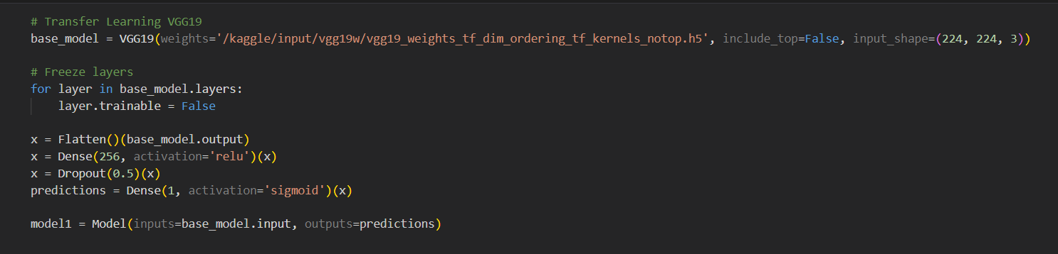
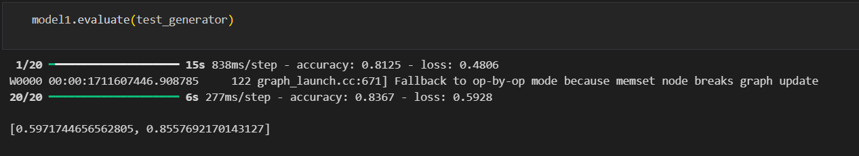
Comparison with my models
Best model submitted in DA_2
VGG19
Train Accuracy
Test Accuracy

Slide 37
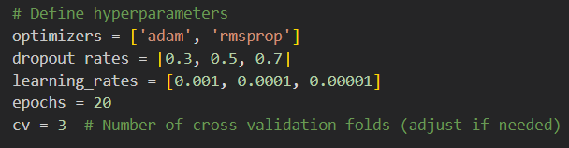
Changes after DA-2
Using hyperparameter tunning for VGG19

Slide 38
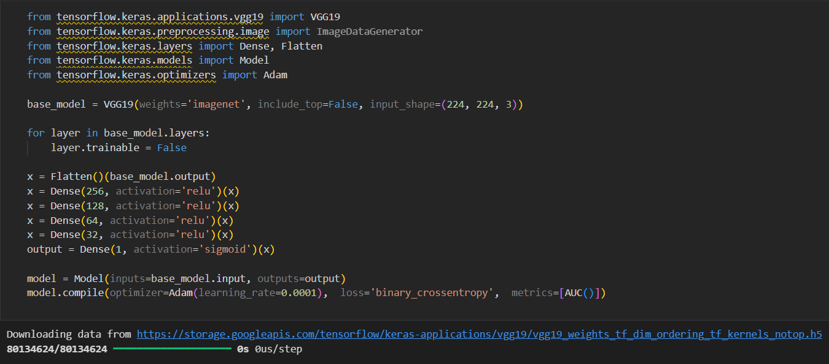
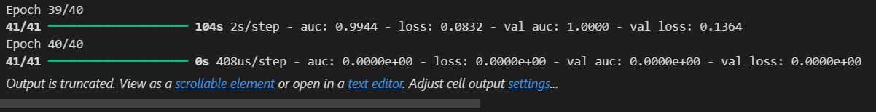
VGG19 after adding Dense layers
Train Accuracy

Slide 39
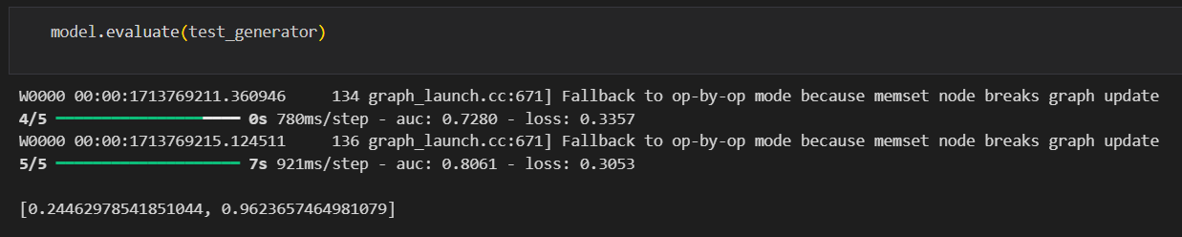
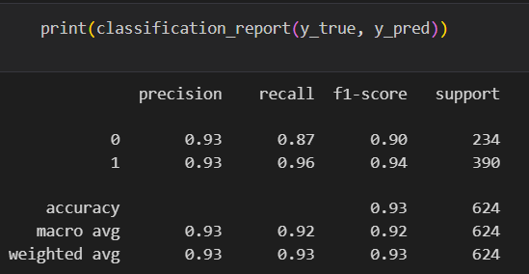
Test Accuracy

Slide 40
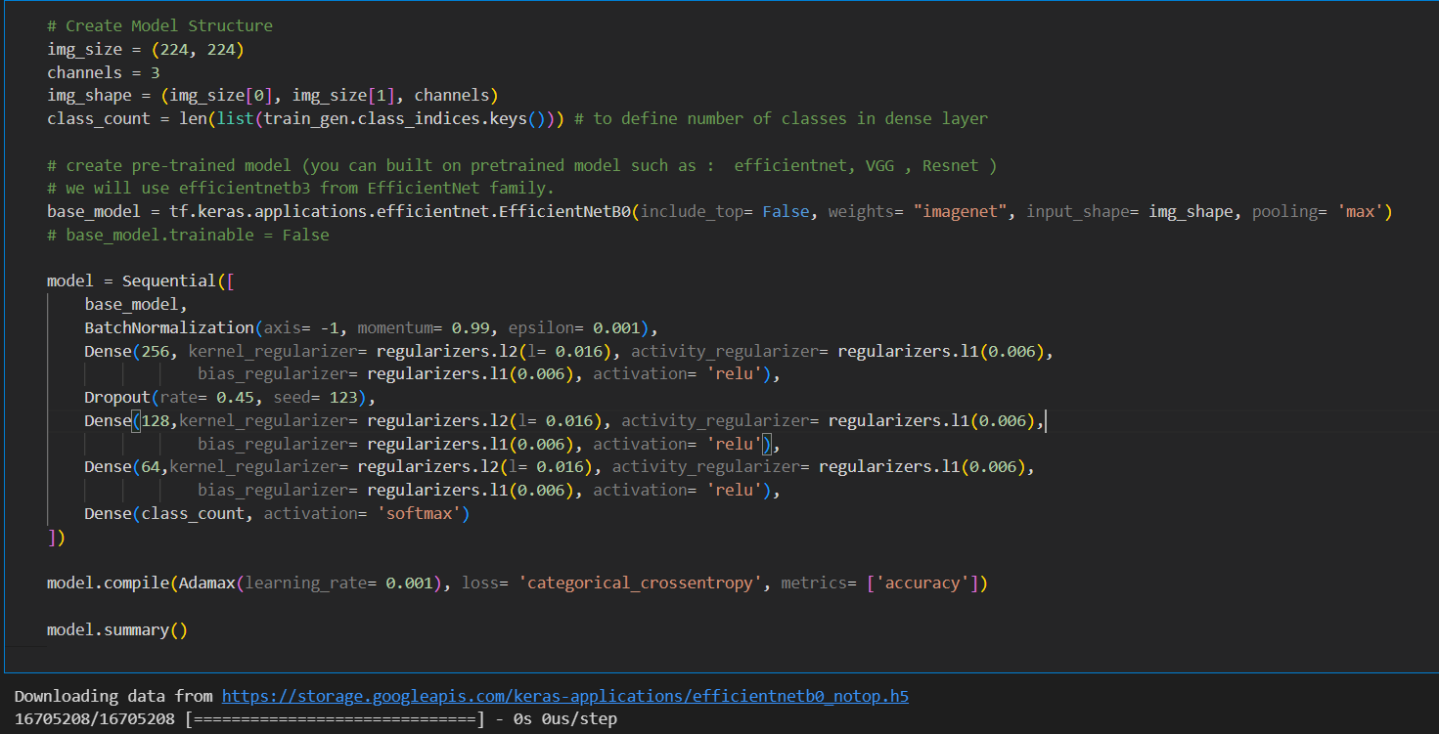
The best model is EfficientNetB0

Slide 41
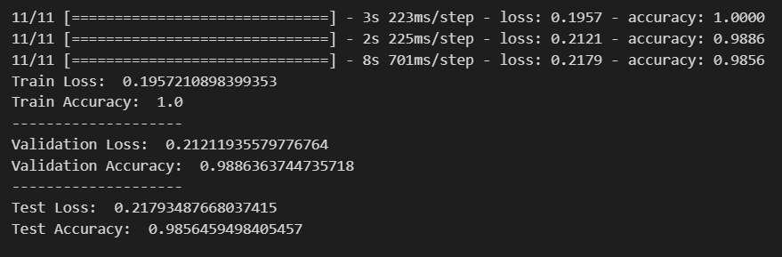
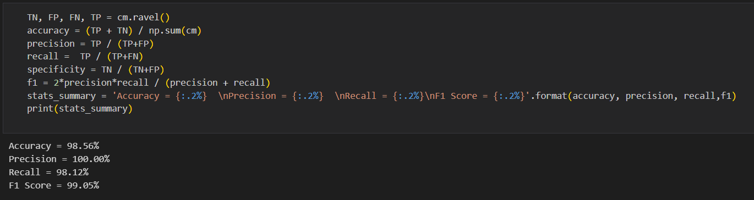
Performance Metrics

Slide 42
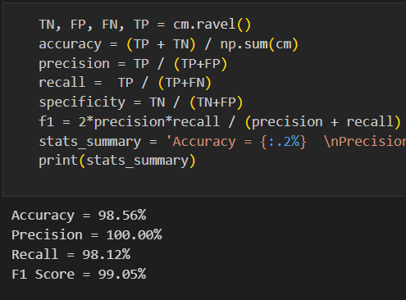
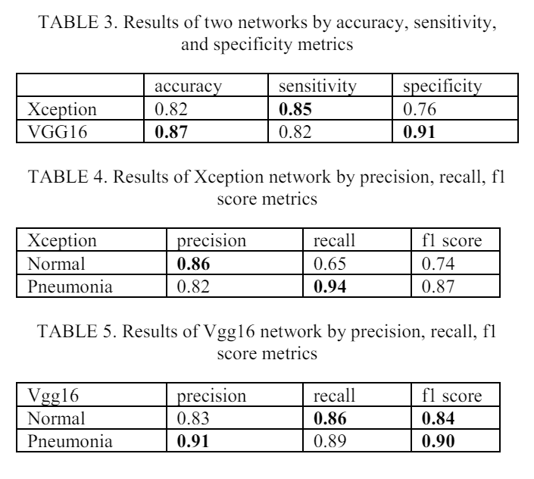
Comparison with other Papers
Paper – 1: https://ieeexplore.ieee.org/abstract/document/8741582
In this paper the highest accuracy is at 87%, the highest precision is at 86%, recall at 94% and f1 score at 90%.
In our model’s classification report we have achieved 90% accuracy, 98% precision, 98% recall and 98% recall.
In all the cases our model is equal to or if not greater than the one in the given research paper.
Results of Our Model
Results in the Paper

Slide 43
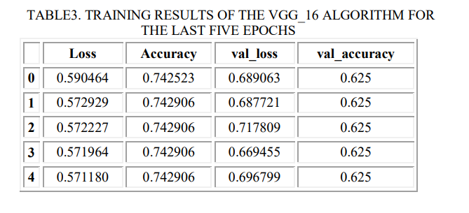
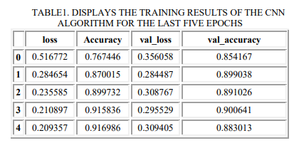
Paper – 2: https://ieeexplore.ieee.org/document/10303322
Results in the Paper
Results of Our Model
In this paper the validation accuracy is only at 62.5% and 88.3%
In our model we have achieved 98% accuracy, 98% precision, 98.12% recall.
Our model has higher accuracy compared the paper’s validation accuracy.

Slide 44
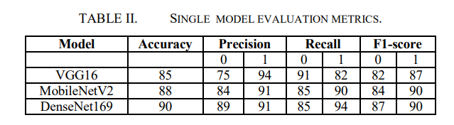
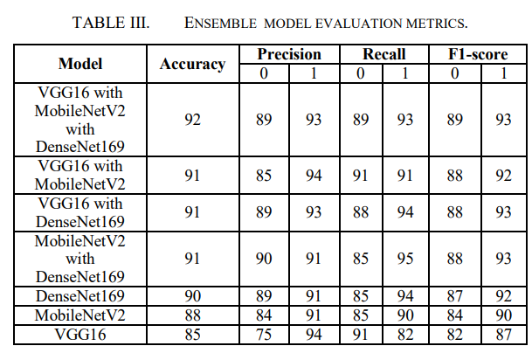
Paper – 3: https://ieeexplore.ieee.org/document/10293523
In this paper, the highest accuracy of the single models is at 90%, the precision is at 90%, recall at 92% and the f1 score 89%.
The highest accuracy of the ensemble models is at 92%, precision at 91%, recall 93% and f1 score is at 91%.
In our model, the accuracy is at 98.56%, the precision is at 98%, the recall at 98.12%, f1 score is at 99.05%
Results of Our Model
Results in the Paper
Our model has surpassed the precision and recall from the paper, and the accuracy is higher than most of the models used in the paper.

Slide 45
Conclusion
The proposed model has surpassed the metrics of the models in the research papers, which can be attributed to solving some of it’s limitations.
The higher accuracy of the proposed model can do more help in practical application of pneumonia detection.

Slide 46
Thankyou

