Slide 1











































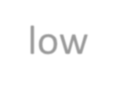


































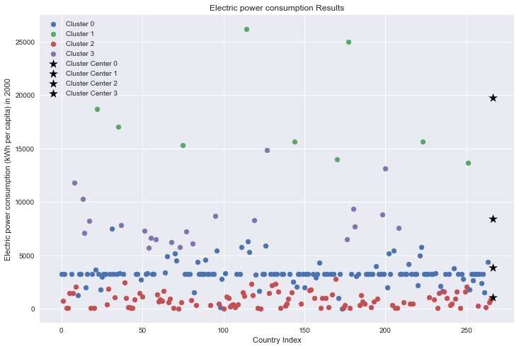

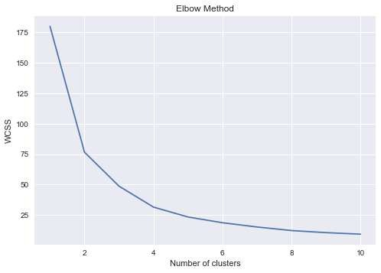
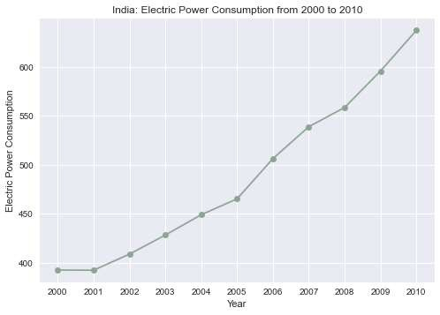
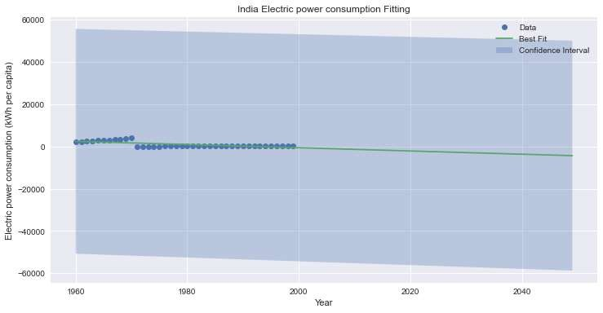
Cluster Analysis of Countries Based on Electricity Consumption
Name:
Student ID: Repo-Link:
Abstract: This report discusses the clustering of countries based on two indicators: forest area and agricultural land. Using k-means clustering, the countries were grouped into three clusters. The results show that the majority of countries have low forest area and high agricultural land, while a small group of countries have high forest area and low agricultural land. The findings provide insight into the varying levels of land use among countries and highlight potential opportunities for improving sustainable land management practices.
To analyze the electric power consumption of various countries, the World Bank's World Development Indicators dataset is used, which provides data on a range of economic and social indicators for countries around the world. The dataset is filtered to include only data on electric power consumption (kWh per capita) for the years 1960 to 2020, and then calculated the average consumption for each country over this period
Introduction
Electric power consumption (kWh per capita) is an important indicator of a country's energy usage and is often used as a proxy for economic development and standard of living. The indicator measures the amount of electricity consumed per person in a country and can vary widely depending on factors such as
and
industrialization, population density,
climate.
The entire data is divided into 4 clusters. The countries in cluster 1, USA, Baharain, Canada, Finland etc consume the highest electricity.
This plot shows that the consumption of electricity of Inida has increased over the years
Elbow method for K- means clustering
Curve Fitting for Inida
Conclusion
Our analysis revealed significant variations in electric power consumption (kWh per capita) across different countries. As of 2020, the top 10 countries with the highest average electric power consumption per capita were Qatar, Iceland, Bahrain, Kuwait, Luxembourg, Trinidad and Tobago, Brunei Darussalam, Canada, the United Arab Emirates, and the United States. In contrast, the bottom 10 countries with the lowest average electric power consumption per capita were Burundi, Congo, Malawi, Somalia, Eritrea, Guinea-Bissau, South Sudan, Chad, Niger, and the Central African Republic.

