Slide 1

Crowdfunding Using Blockchain for StartUp Ventures
DEPARTMENT OF COMPUTER ENGINEERING
PCET's PIMPRI CHINCHWAD COLLEGE OF ENGINEERING
Submitted by
B190334336- Kalyani Khandait
B190334341- Kshitij Kolage
B190334342- Keyur Kolambe
B190334395- Tanvi Nimbalkar
Under the guidance of - Prof S. S. Sambare

Slide 2
Contents
Introduction
Problem Definition
Limitations
Scope
Literature Review
Proposed system
UML Diagrams
Algorithmic Details
Software Specifications
Modules and functionalities
Result and Testing
Conclusion
Paper published details
References

Slide 3
What is crowdfunding?
Crowdfunding is way of raising money from multiple individuals.
Often used by startup companies or growing businesses as a way of accessing alternative funds.
It is an innovative way of sourcing funding for new projects, businesses or ideas.
The blockchain provides an interface to create transparent, traceable, auditable and secure system.

Slide 4
Limitations of current crowdfunding platforms / Motivation
Illegal Transactions
Security
Transparency and Anti-Fraud

Slide 5
Our Problem Definition
A decentralized crowdfunding application built using blockchain that overcomes the limitations of current crowdfunding platform.
As the blockchain is immutable and the public ledger of the transaction is available with all the involved entities it solves the issue of transparency and security from the current blockchain.

Slide 6
Scope
A crowdfunding application where all the details regarding the campaign are stored on blockchain database
All the transactions in certain campaign are visible to all the investors
Collaboration into the project can be done
Funding the project through Indian currency using GPay, only the transactions details are stored on blockchain
Use of ERC220 Tokens.
We have assumed that the campaign creator has already listed their project on Stock Exchange

Slide 7
Literature Review

Slide 8
Provided a decentralized approach to the current crowdfunding system by removing any involvement of middle man and created an easy to use platform for both parties.
Chances of money laundering and fraud as there is no formal banking system
1.
1.
2021
Outcomes
Merits
Limitations
“Decentralized application for crowdfunding using blockchain technology”
Establishes a P2P i.e. peer-to-peer connection between the project holder and the investor

Slide 9
A multi-user web application that provides a reliable, secure and transparent decentralized solution.The application also creates transparency between funders and start-ups.
Mainly focused on startups.Startups can track the status of their projects approval and funds raised in real time.
2.
2021
Outcomes
Merits
Limitations
”Blockchain Based crowdfunding Application”
If the project is canceled prematurely, the funds will be returned to the backers.

Slide 10
Presented an optimized solution on different types of crowdfunding like All-or-nothing,keep-it-all,stretched-goals-scheme using smart contracts.
Implementation cost is high if the company decides to execute the whole blockchain process by themselves.
3.
2020
Outcomes
Merits
Limitations
”Smart Contract and Blockchain for Crowdfunding Platform ”
Detailed research on 3 main types of Crowdfunding use cases and its solution with help of blockchain.

Slide 11
A blockchain based application with the user interface to handle the startup fundraisers, making a startup, adding to a startup, making solicitation, supporting a solicitation and settling a solicitation.
The idea in the starting stages of different legitimate issues should be settled.
4.
2020
Outcomes
Merits
Limitations
Deployed on Metamask successfully with the help of bytecode obtained by compiling the smart contract
“Venturing Crowdfunding using Smart Contracts in Blockchain “

Slide 12
The project venturers provide the idea to the contributors. The contributors contribute to the project and instead have some equity share for themselves in the project.
Only the concepts were mentioned, no solid architectural models presented.
5.
2020
Outcomes
Merits
Limitations
“Blockchain-Based Crowdfunding in Blockchain technology for Industry “
Highlighted the feasibility of using the blockchain concept of decentralization to solve the current crowdfunding based problems.

Slide 13
An application that provides interactive forms for creating, donating, and requesting approval of campaigns, facilitating the creation and funding of campaigns for both campaign creators and donors
Request Approval module is used by donors to give complete control over their invested money.
6.
2019
Outcomes
Merits
Limitations
“CrowdFunding using Blockchain”
Bytecode is provided in blockchain where abi is in JSON form and interacts with the frontend.

Slide 14
Blockchain based crowdfunding stage was provided which connects system to ethereum through infura infrastructure.
ERC-223 tokens not implemented into smart contracts which can have more benefits
7.
2019
Outcomes
Merits
Limitations
”Blockchain based crowdfunding systems”
Increased contributor’s confidentiality, All clients can see the records of every exchange which should be visible to utilizing Etherscan API

Slide 15
Figuring out a less expensive approach to addressing the constraints concerning the powerful use and registering assets by the distributed system utilized by the blockchain.
how blockchain can really and safely handle the connection between pledge drives,stages and the financial backers.
8.
2018
Outcomes
Merits
Limitations
”The Applications of Blockchain Technology in Crowdfunding Contract”
settling the vast majority of the issues related to people regarding the trust.

Slide 16
Analysis of available research paper
Crowdfunding platform where transactions through Cryptocurrency are proposed.
Transaction with the help of Ether is not so feasible.
Only the solutions have been proposed no proper system is yet developed completely.
We have implemented a solution where we leverage ERC 220 token to perform the transactions with the help of blockchain
MONGODB cloud atlas to store the blockchain database .

Slide 17
Proposed System

Slide 18
Project Plan
July-Aug 2022: Finalizing the problem statement and performing literature survey
Sept-Oct 2022: Requirement analysis
Nov-Dec 2022: Finalizing the Design of the project
Jan 2023: Creating Figma designs for UI and Finalizing the end-points for backend
Feb 2023: Building UI and Backend in parallel
March 2023: Integrating UI and Backend through REST API
April 2023: System Testing and Documentation

Slide 19
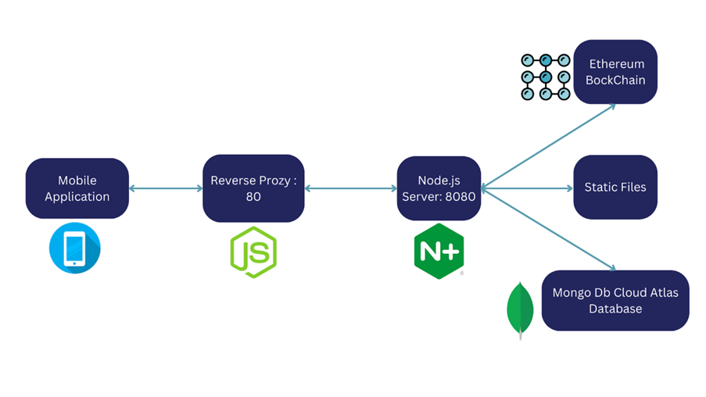
High Level System Design

Slide 20
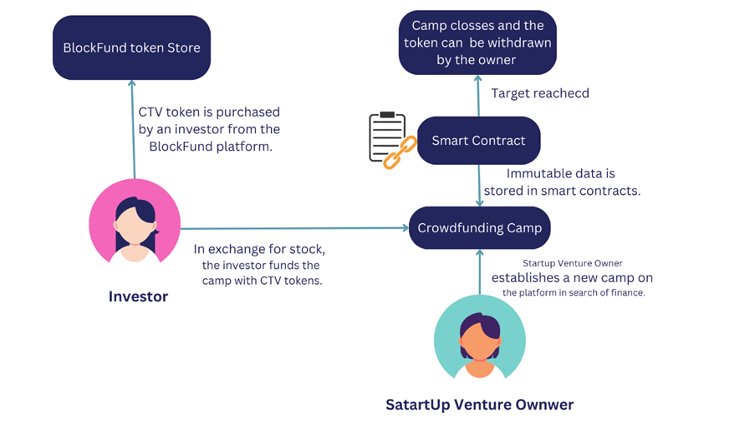
Collecting Investments

Slide 21
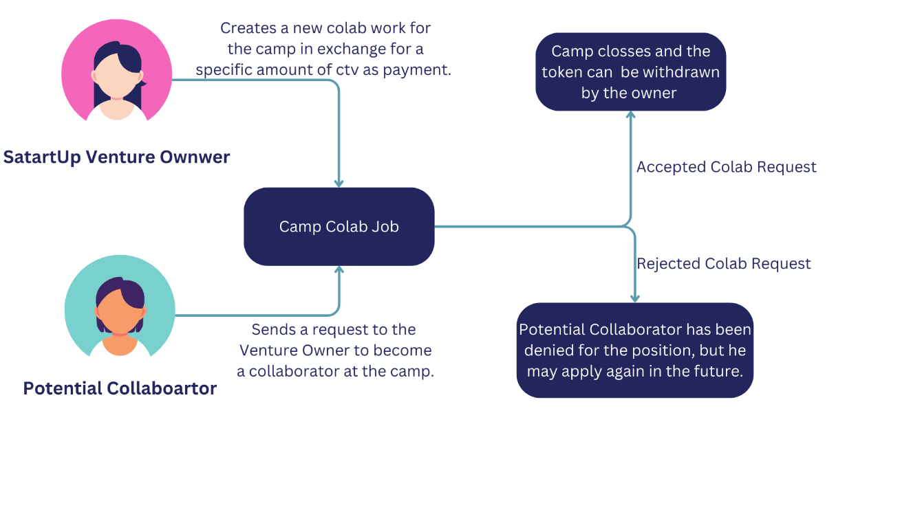
The Collaboration System

Slide 22
UML Diagrams

Slide 23
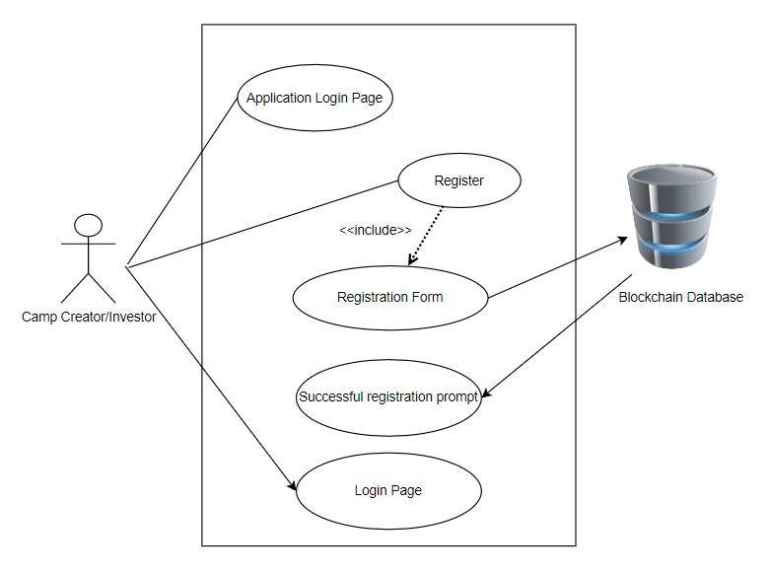
Camp Creator/Investor Registration Use Case Diagram

Slide 24
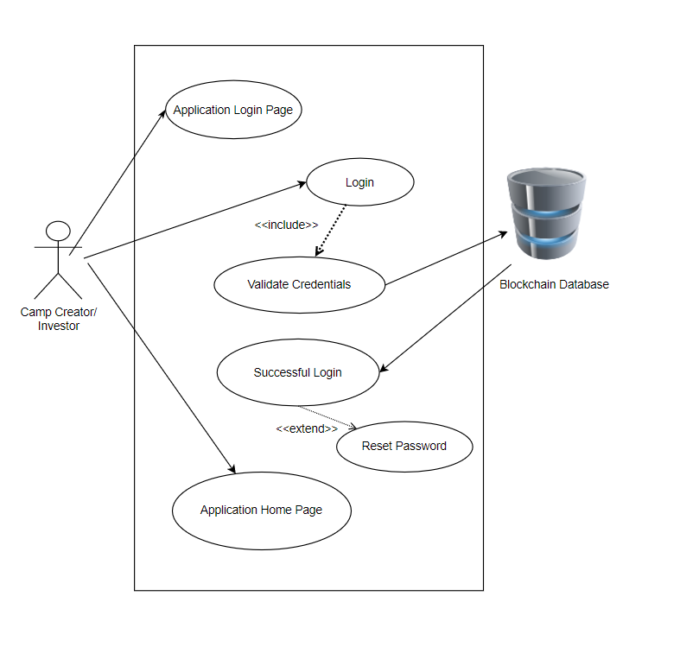
Camp Creator/ Investor Login Page Use case Diagram

Slide 25
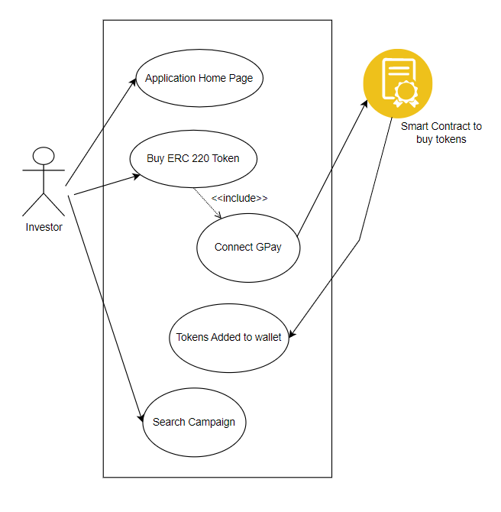
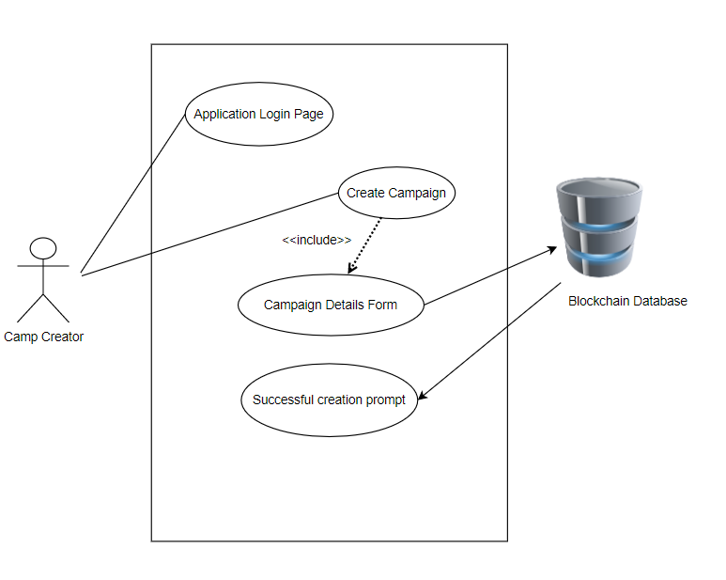
Buy ERC 220 Token Use Case Camp Creation Use Case

Slide 26
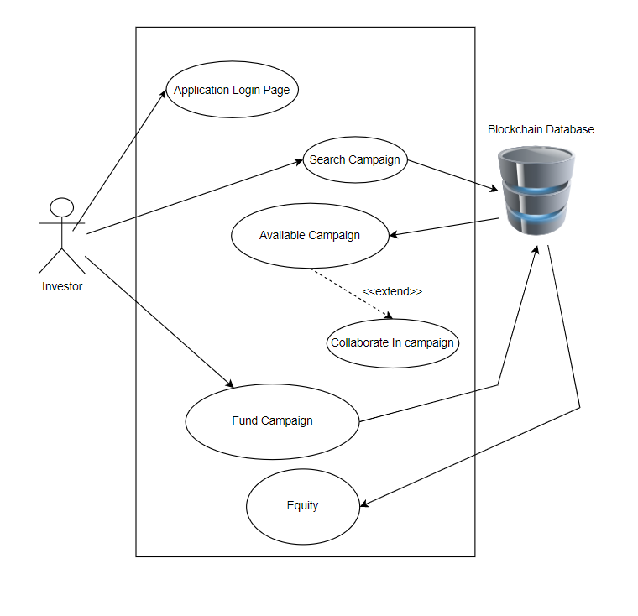
Invest In campaign Use Case

Slide 27
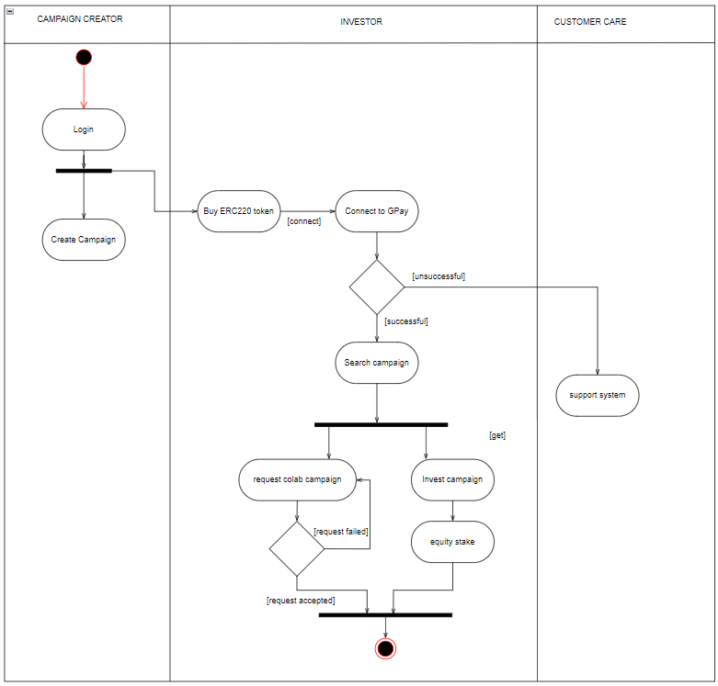
Activity Diagram

Slide 28
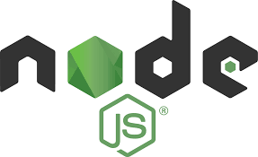

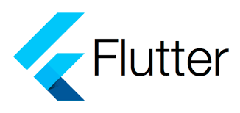

Software Specifications
• NodeJS
• Ethereum
• Infura API
• Flutter
• Solidity
• Mocha
• Gpay API
• MONGODB Cloud Atlas.

Slide 29
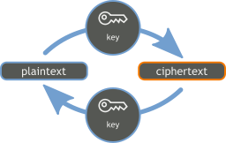
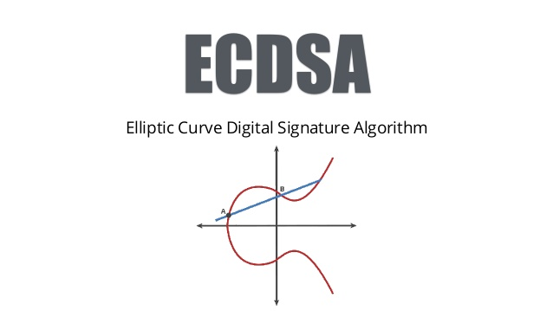
Algorithmic details
Blowfish encryption
ECDSA (Elliptic Curve Digital Signature Algorithm)
RSA algorithm (Rivest- Shamir- Adleman)

Slide 30
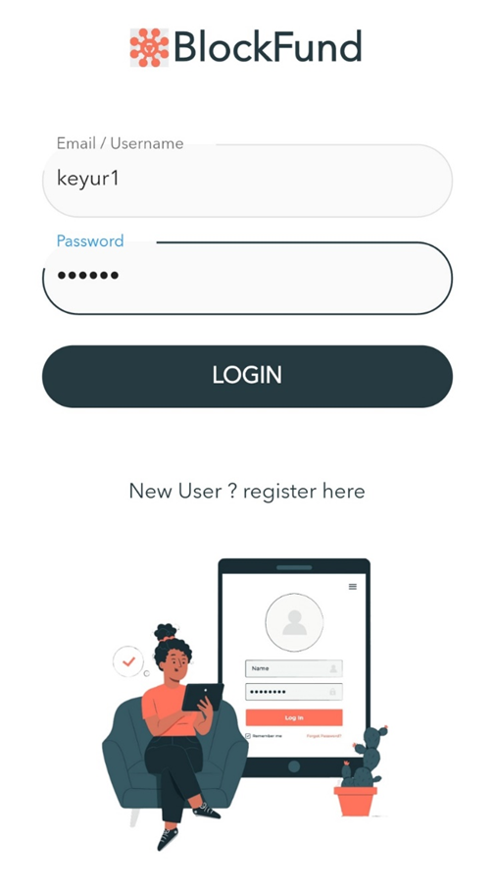
Modules and Functionality
User Registration and Authentication
Add money to your Account
Create Campaign
View Campaign
Search and Discovery
Contributing to the campaign
The collaboration system

Slide 31
Results and Testing
The proposed system has been successfully implemented and all defined functionalities are running smoothly. The system has been thoroughly tested and all identified bugs have been resolved.
In addition to fulfilling all defined requirements, the system has been designed with scalability in mind, allowing for easy future updates and expansion. The development team has also provided thorough documentation and training to ensure that users are able to fully utilize the system's capabilities.

Slide 32
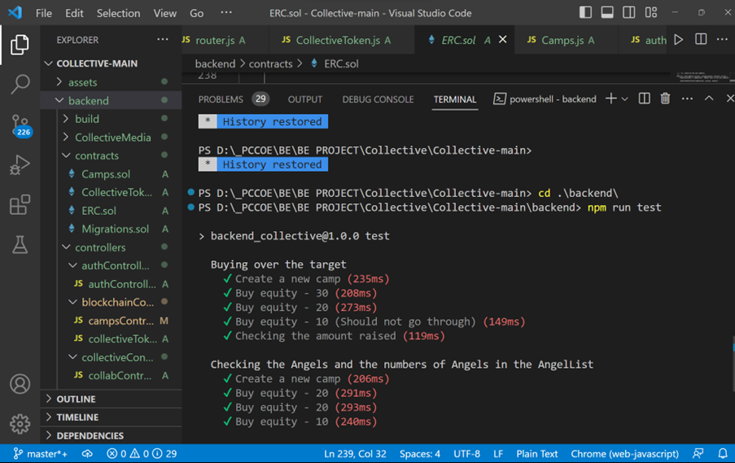
Results and Testing

Slide 33
Conclusion And Future Work
Blockfund is an online equity crowdfunding platform powered by Ethereum smart contracts.The platform allows start-ups and projects to raise funds in exchange for equity.
What distinguishes BlockFund is its decentralized and autonomous approach to crowdfunding, which employs smart contracts deployed on the Ethereum blockchain and a mobile app built with Google's Flutter that can be used on both Android and iOS.
In future we can host the backend and store the startup ventures images on a cloud based system also we can add features like sharing campaign on social media and providing campaign analytics.

Slide 34
Paper Published Details
Review paper submitted to international journal of computer Applications, May 2023 Editions.
Paper Status: Accepted
Venue: Online
Research paper submitted to 7th International Conference on Computing,
Communication, Control and Automation (ICCUBEA-2023)
Paper Status: Not Yet Declared
Venue: Online

Slide 35
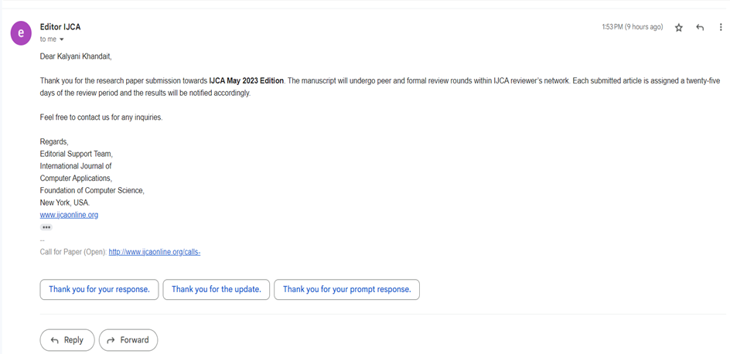
Paper Published Details

Slide 36
References
H.L. Gururaj,V. Janhavi, Abhishek M. Holla, Ashwin A. Kumar and R. Bhumika, “Decentralized application for crowdfunding using blockchain technology”,Int. J. Blockchains and Cryptocurrencies, Vol. 2, No. 1, 2021
Viren Patil,Vasvi Gupta,Rohini Sarode,”Blockchain Based crowdfunding Application” in IEEE 2021
Firmansyah Ashari, Tetuko Catonsukmoro, Wilyu Mahendra Bad, Sfenranto, Gunawan Wangu,”Smart Contract and Blockchain for Crowdfunding Platform ”, published in InInternational Journal of Advanced Trends in Computer Science and Engineering, on June 2020.
Nikhil Yadav Sarasvathi V, Venturing Crowdfunding using Smart Contracts in Blockchain Proceedings of the Third International Conference on Smart Systems and Inventive Technology (ICSSIT 2020) IEEE

Slide 37
References
Hasnan Baber,Blockchain-Based Crowdfunding in Blockchain technology for Industry 4.0 Secure, Decentralized, Distributed and Trusted Industry Environment,2020 Springer.
Md Nazmus Saadat, Syed Abdul Halim, Husna Osman, Rasheed Mohammad Nassr,”Blockchain based crowdfunding systems”,Indonesian Journal of Electrical Engineering and Computer Science Vol. 15, No. 1, July 2019, pp. 409~413 ISSN: 2502-4752, DOI: 10.11591/ijeecs.v15.i1.pp409-413
Ms. S. Benila,V. Ajay,K. Hrishikesh,R. Karthick “CrowdFunding using Blockchain” published in Global Research and Development Journal for Engineering published in March 2019.
Zhao Hongjiang1 Cephas P.K Coffie,”The Applications of Blockchain Technology in Crowdfunding Contract”,SSRN Electronic Journal,January 2018.

