Slide 1
KiddoHub-Day Care Center
Group No : 79
Guide:Prof. Vibhavari Jawale
Kalyani Kadam
Kshitija Kurhade

Slide 2
Introduction
Welcome to Kiddohub Daycare, where we believe in nurturing the minds, bodies, and spirits of our youngest learners. At Kiddohub, we provide a safe, stimulating, and loving environment where children can grow, learn, and thrive. Our daycare is designed to support the holistic development of each child, fostering their intellectual, social, emotional, and physical growth through a range of carefully curated activities and programs.
Our experienced and compassionate staff are dedicated to creating a home-away-from-home atmosphere where every child feels valued and understood.

Slide 3
Problem Statement
Fragmented Systems: Daycare centers often use disjointed systems for managing activities, staff, children, and parent communications, leading to inefficiencies.
Administrative Bottlenecks: Inefficient management processes create administrative challenges, reducing the quality of care and increasing workload for staff.
Parent Engagement: Parents struggle to stay informed about their child's daily activities and progress due to lack of integrated communication channels.
Need for Integration: There's a need for a comprehensive, user-friendly platform that integrates all aspects of daycare management, ensuring better organization, transparency, and effectiveness.

Slide 4
Objective
Streamline Daycare Operations: To simplify and automate the management of daycare activities, staff, child records, and parent communications.
Enhance Child Engagement: To create a platform that supports personalized and engaging activities tailored to each child’s development needs.
Improve Parent Involvement: To provide parents with easy access to their child’s daily activities, progress, and updates, fostering better communication and involvement.
User-Friendly Interface: To design an intuitive, easy-to-navigate interface that meets the needs of both daycare staff and parents.

Slide 5
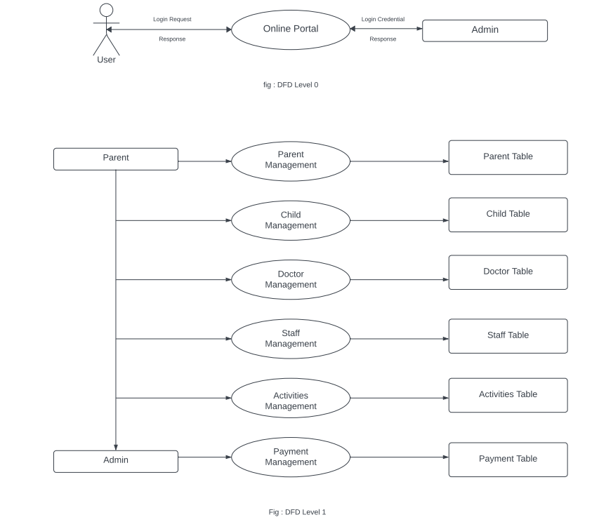
DFD

Slide 6
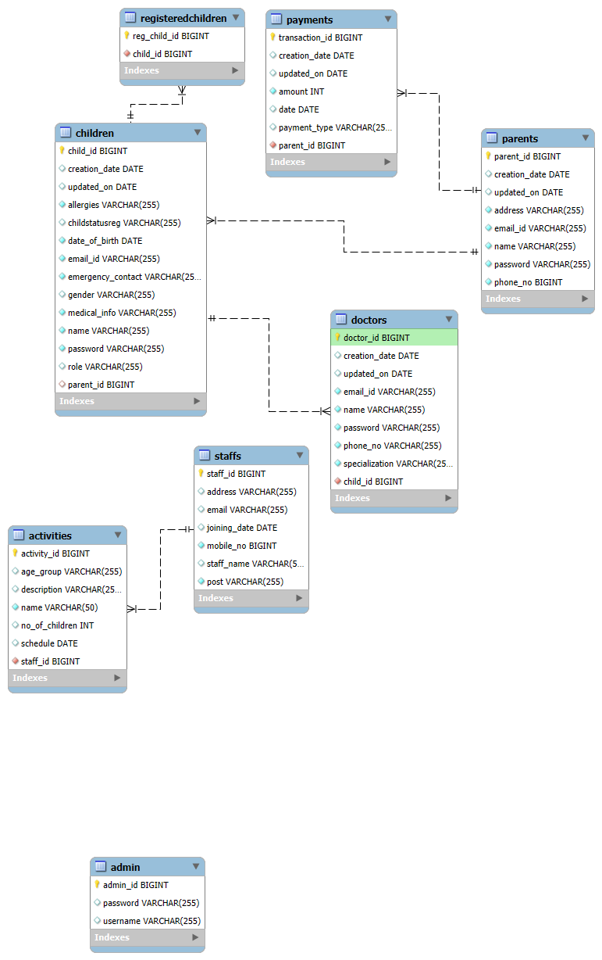
Database Generated ERD

Slide 7
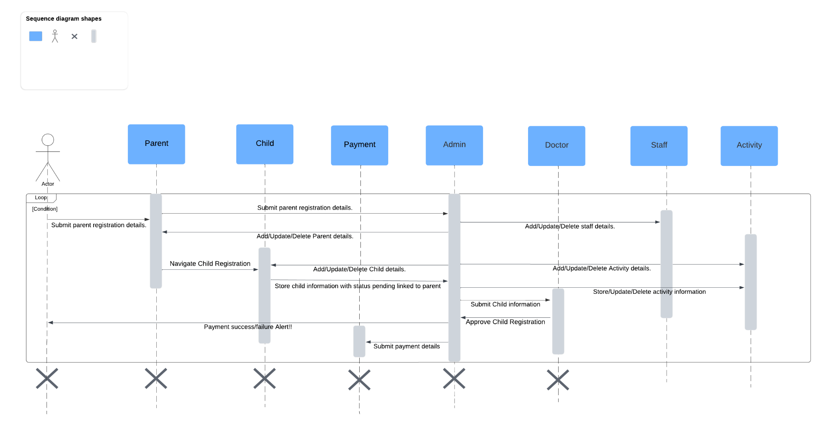
Sequence Digram

Slide 8
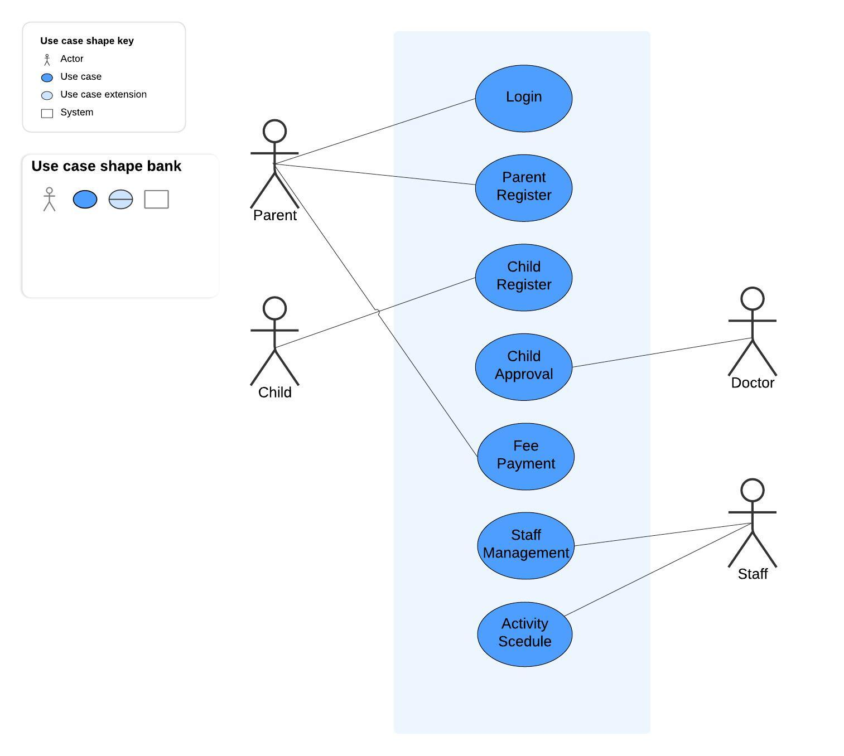
Usecase diagram

Slide 9
Requirements
Functional Requirements
Browser
FRONTEND: React js,Bootstrap
BACKEND: Springboot, MySQL

Slide 10
Conclusion
Kiddohub is your all-in-one solution for modern daycare management. By streamlining operations, enhancing child engagement, and improving parent communication, Kiddohub transforms the daycare experience into a more efficient, personalized, and connected journey for children, parents, and staff alike. It’s not just about managing a daycare—it’s about nurturing the next generation.

Slide 11
Thank You!

