Slide 1

End to end journey of data coming from source systems to predictive modelling output

Slide 2

Predictive Analysis
Big Data
Data Mining
Statistical Modelling

Slide 3
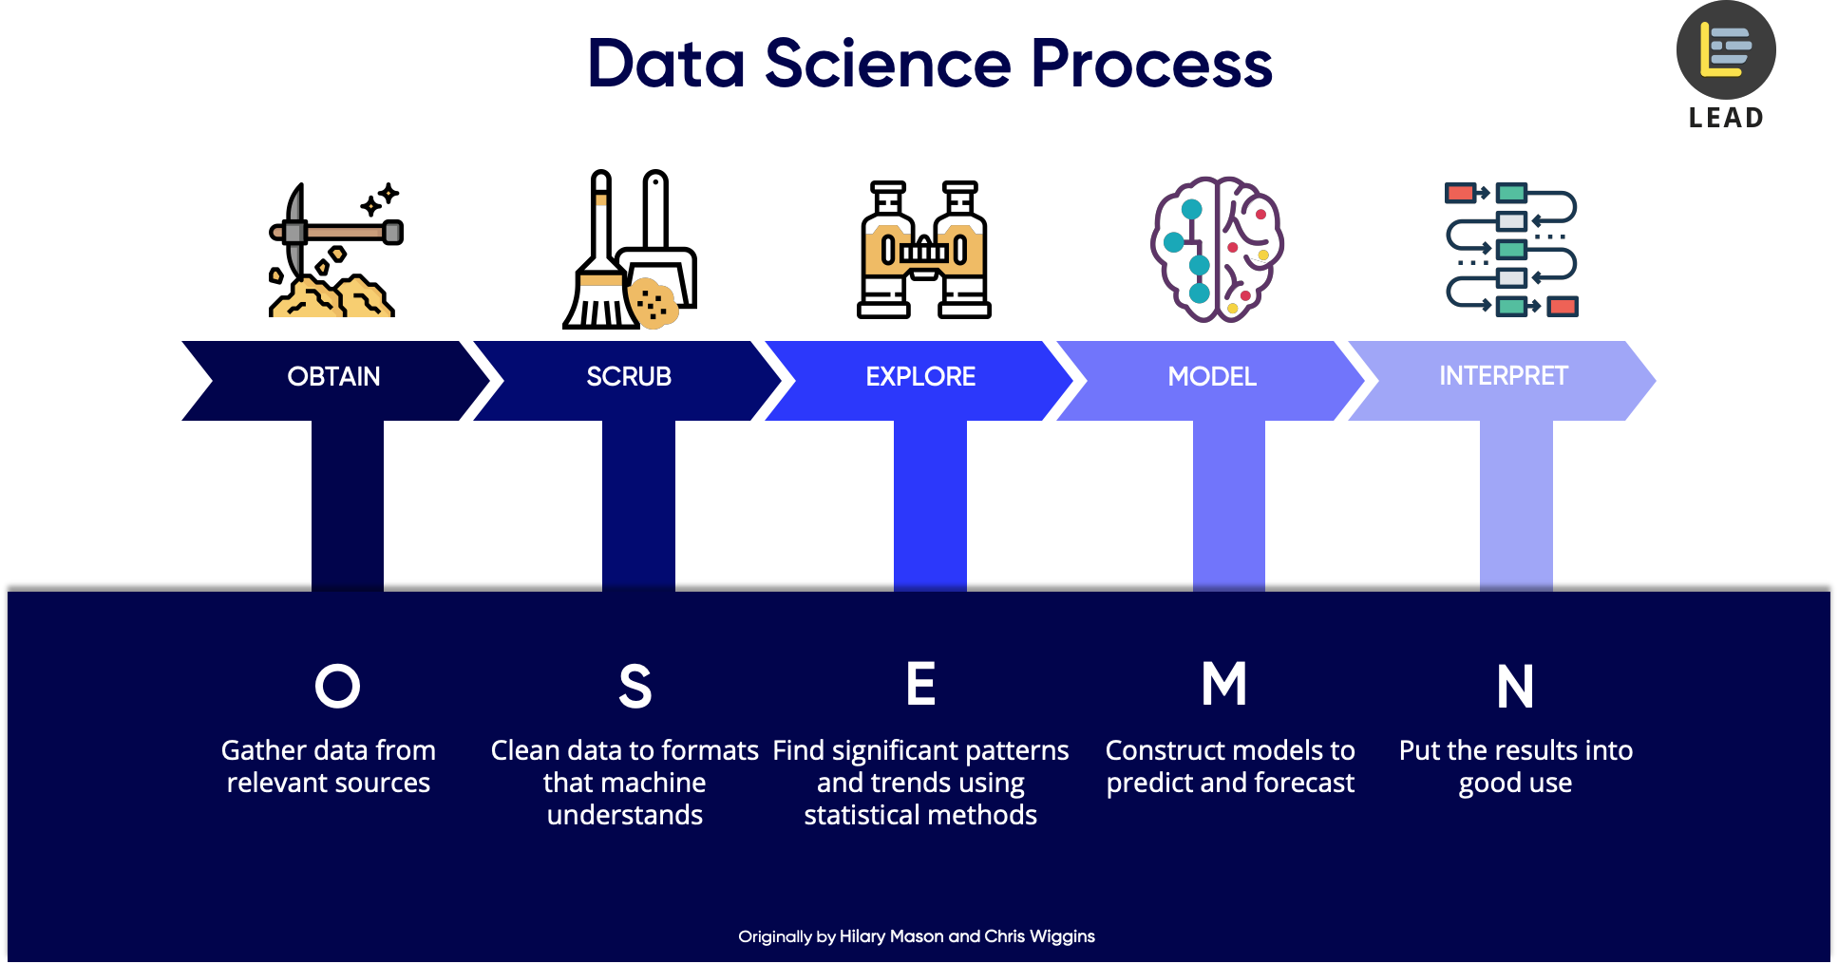

Slide 4

Dubai
Diverse Infrastructure
Diverse Society
Quality of Living

Slide 5
Dubai
Global Competitiveness report 2019
UAE 25th out of 141 countries in infrastructure pillar

Slide 6
List all major parts of Dubai with top existing infra.
Best Locations
Potential for Development
Areas that lack infra facilities
Best place to stay
Dubai

Slide 7
Data Acquisition
List of Communities
Geospace data for Communities
Infrastructure Details

Slide 8
Methodology
Scrape data from webpage
Latitude & Longitude
Dropped neighborhood whose address were not found

Slide 9
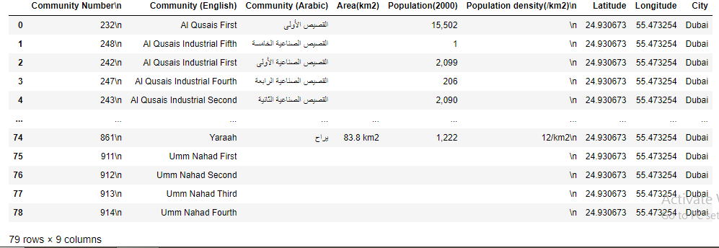
Address

Slide 10
Foursquare API
Top 225 venues within radius of 600 meters for each community
Grouped them into categories

Slide 11
Business Problem
Unique venues category
Lack of infrastructure
Vital infrastructure

Slide 12
Clustering
Cluster 1
Cluster 2
Data
Cluster 3

Slide 13
Observation
Cluster 1- Most concentrated
Cluster 2 – Medium concentrated
Cluster 3 – Low concentrated

Slide 14
Conclusion
Recommendations to stakeholders
Provides information to visitors regarding communities for growth and comfortable living

Slide 15
Thank You.

