Slide 1

Project Title - Seasonal Agriculture Performance Analysis
Student Name: Kalyani Sanapathi
College Name: Aditya Degree College
AICTE STU ID : STU69fb26bfc5b301778067135

Slide 2

PROBLEM STATEMENT
Agricultural activities are influenced by seasonal variations in environmental conditions, farming practices, resource availability and market conditions. As a result, agricultural performance may differ from one season to another. However, raw agricultural data does not clearly explain how agricultural performance changes across seasons or what patterns can be observed in different seasonal conditions. The problem is to analyze the given agricultural dataset and investigate seasonal differences in agricultural performance by identifying meaningful patterns, trends, relationships and variations within the available data.

Slide 3
Project Description
Seasonal Agriculture Performance Analysis is a Data Analytics project that analyzes agricultural data across Kharif, Rabi, and Zaid seasons to identify patterns and factors affecting crop yield, production, water efficiency, and profitability. The project applies data cleaning, exploratory data analysis, statistical techniques, correlation analysis, and visualization to study the influence of environmental conditions, agricultural inputs, irrigation methods, disease and pest risk, and economic factors on agricultural performance. The project concludes with evidence-based insights and recommendations for efficient resource utilization, improved profitability, and better seasonal agricultural planning.

Slide 4

WHO ARE THE END USERS?
Farmers
Farmers can use the insights to understand which seasons, crops, irrigation methods, and resource-use patterns are associated with better yield, profitability, and water efficiency.
Agricultural Planners and Consultants
They can use the analysis to support seasonal crop planning, resource allocation, and identification of conditions that may affect agricultural performance.
Government and Agricultural Departments
The findings can support evidence-based agricultural planning, especially for understanding seasonal variations, resource usage, and agricultural risks.
Agricultural Researchers and Students
Researchers and students can use the project as an analytical reference for studying relationships between environmental conditions, farming practices, crop productivity, and economic outcomes.
Data Analysts and Agricultural Organizations
They can use the analyzed data and visualizations to identify trends, compare seasons, and support data-driven decision-making.

Slide 5

Technology Used
  Python
  Pandas
  NumPy
  Matplotlib
  Seaborn

Slide 6
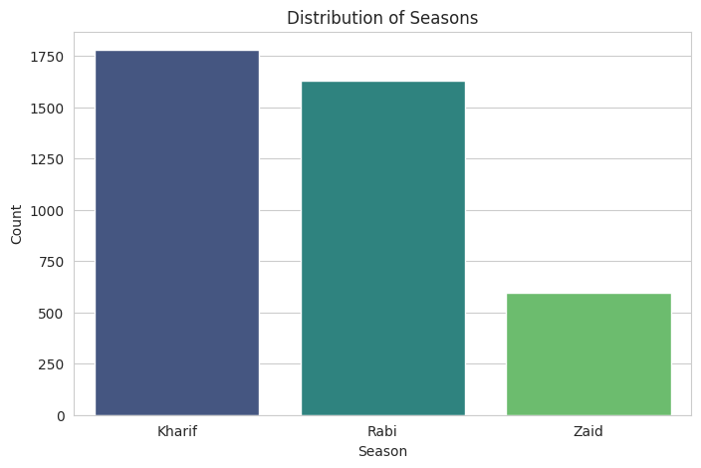
RESULTS
Seasonal Distribution:
The dataset contains three agricultural seasons: Kharif, Rabi, and Zaid. The chart shows that Kharif and Rabi have considerably more records than Zaid, giving us a basis for comparing agricultural performance across seasons.

Slide 7
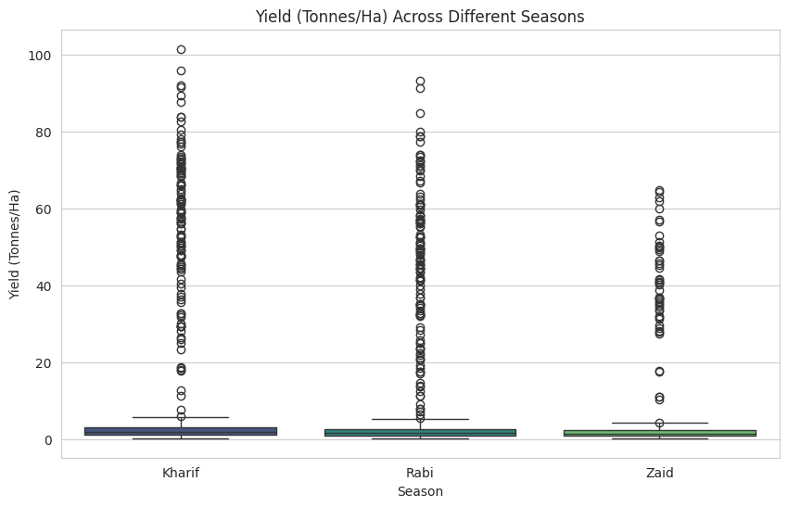
RESULTS
Yield Comparison Across Seasons:
This box plot compares crop yield in tonnes per hectare across the three seasons. It helps identify differences in yield distribution and also highlights unusually high or low yield observations.

Slide 8
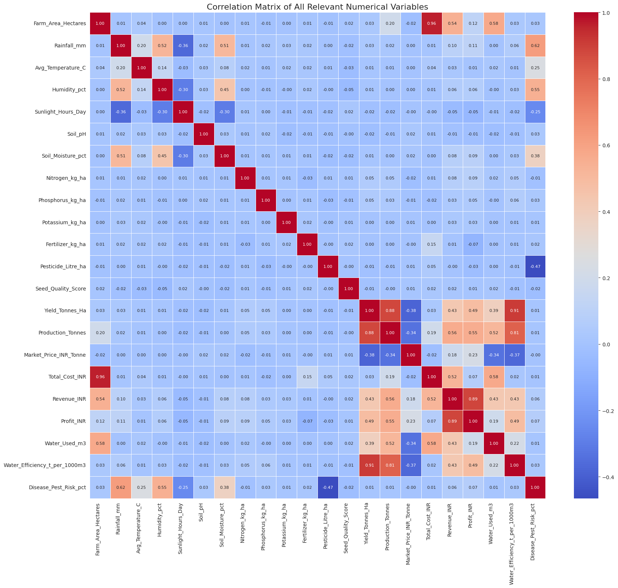
RESULTS
Correlation Analysis:
The correlation heatmap examines relationships among important numerical variables such as rainfall, yield, production, revenue, profit, water usage, and water efficiency. It helps identify which variables have stronger positive or negative relationships with agricultural performance.

Slide 9
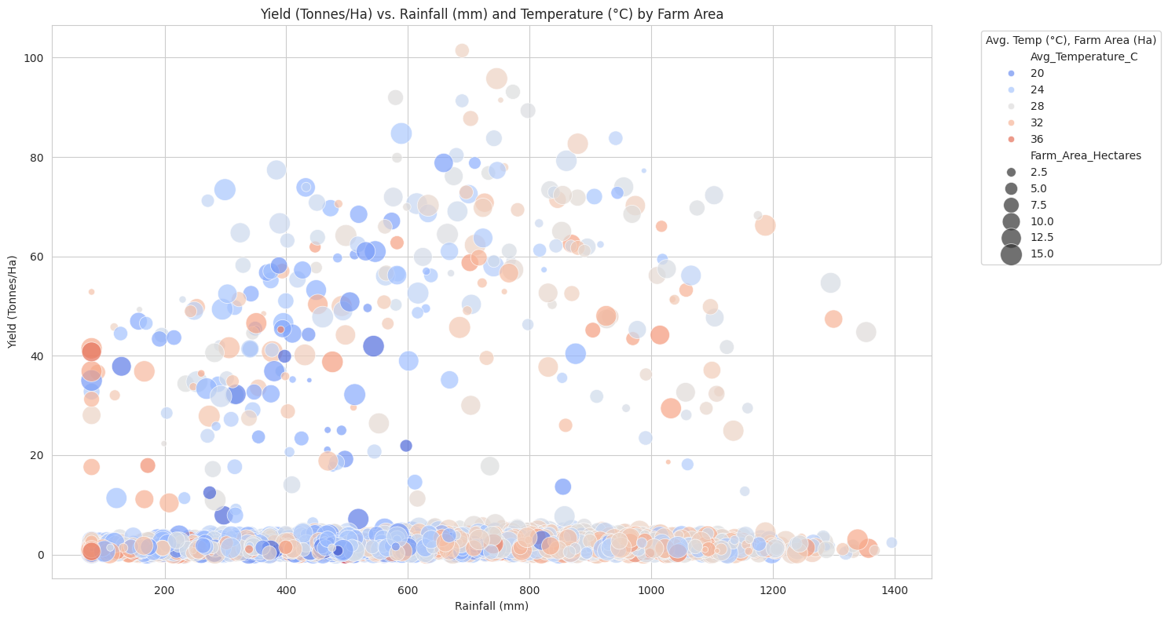
RESULTS
Environmental Conditions and Yield:
This analysis studies the relationship between rainfall, temperature, farm area, and crop yield. The bubble chart helps visualize how yield varies under different rainfall and temperature conditions while also representing farm size.

Slide 10
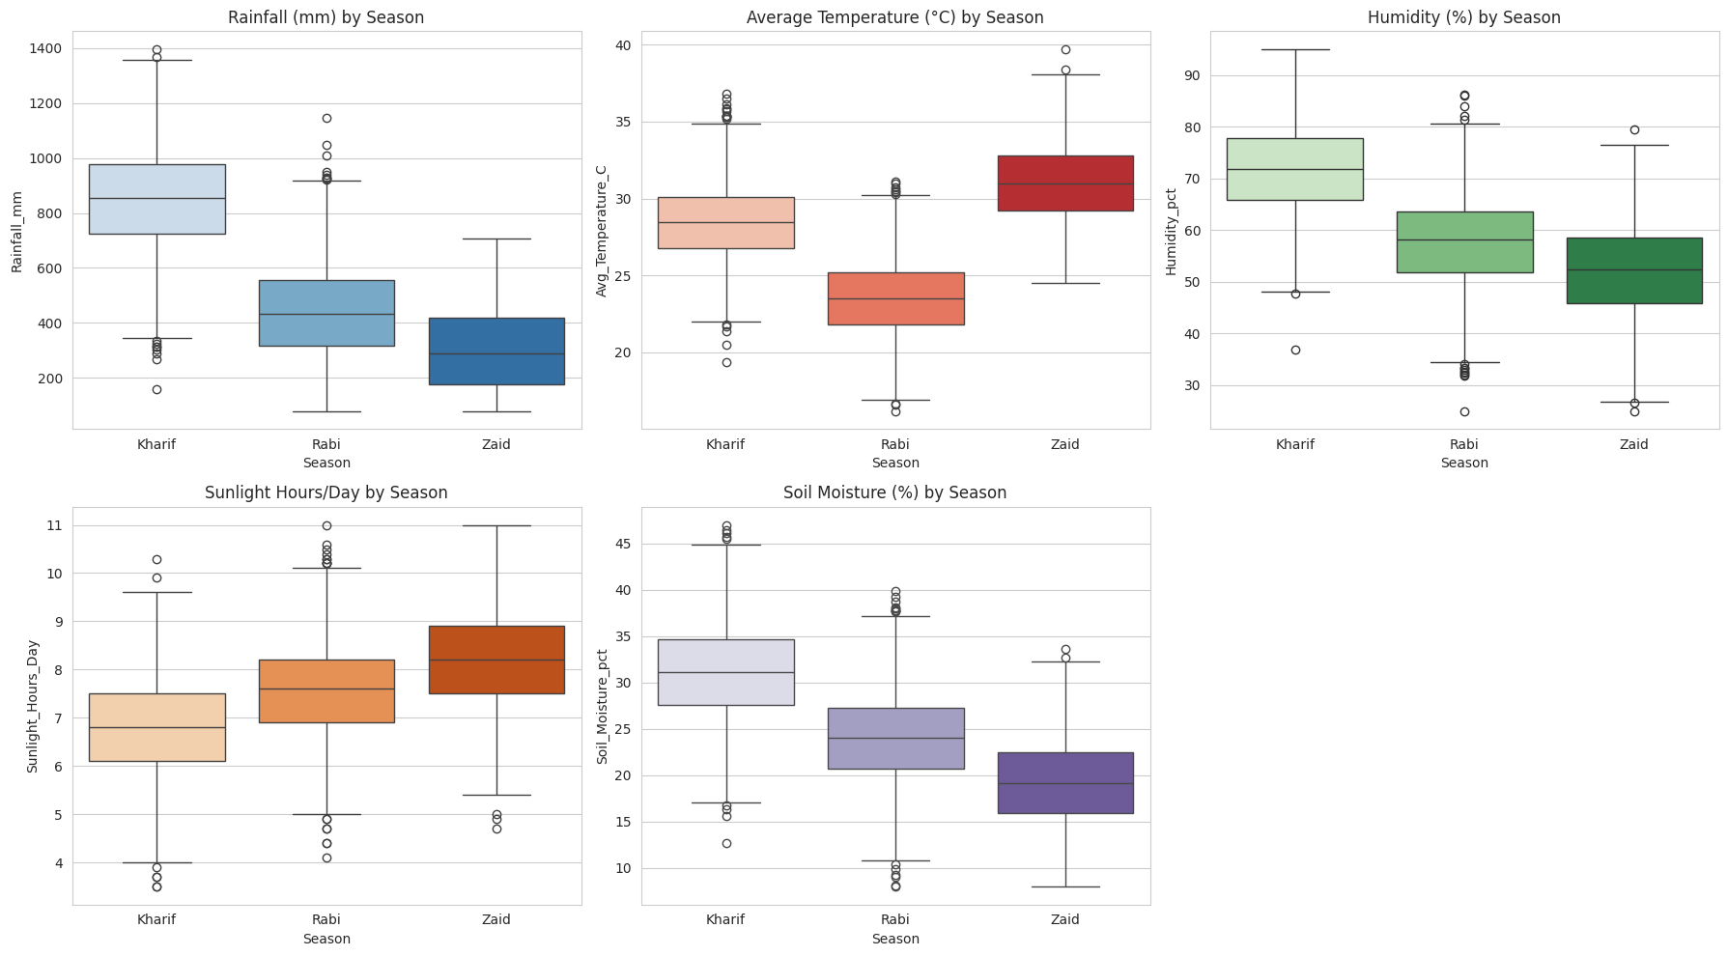
RESULTS
Seasonal Environmental Comparison:
The project compares rainfall, temperature, humidity, sunlight, and soil moisture across Kharif, Rabi, and Zaid seasons. These comparisons help explain how seasonal environmental conditions differ and how they can influence agricultural outcomes.

Slide 11
Future scope
The future scope of our project is to extend the current data analysis into a smart agricultural decision-support system. We can use machine learning to predict crop yield and profit, recommend suitable crops for different seasons, integrate real-time weather data, optimize irrigation and resource usage, and develop an early warning system for disease and pest risks. The project can also be converted into an interactive web or dashboard application for farmers and agricultural departments.

Slide 12
GitHub Link
https://github.com/kalyani-sanapathi26/Seasonal-Agriculture-Performance-Analysis.git

Slide 13

VOIS Course completion certificate -
Course name- Data Visualization

Slide 14
Thank you
.
.

