Slide 1
Restaurant Menu Application
Using Tkinter in Python

Slide 2
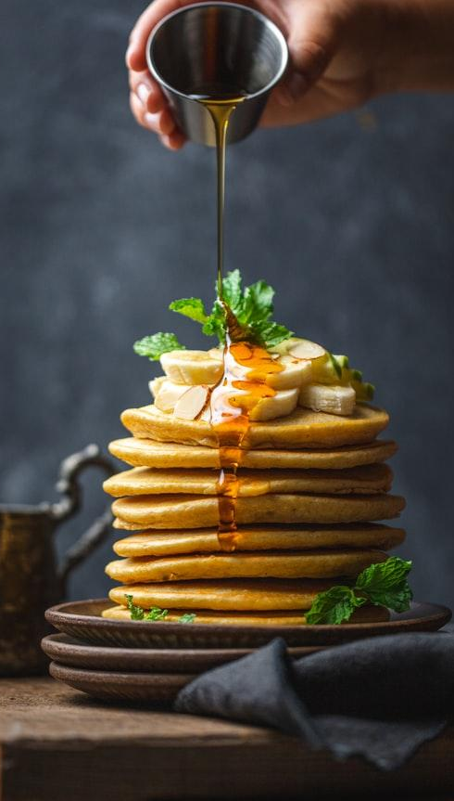
Introduction
Overview: This application allows users to browse a restaurant menu, select items, and view their cart and total price.
Key Features:
Categories for Vegetarian, Non-Vegetarian, Drinks, and Pastries
Cart functionality to display selected items and total price
Payment options for completing transactions

Slide 3
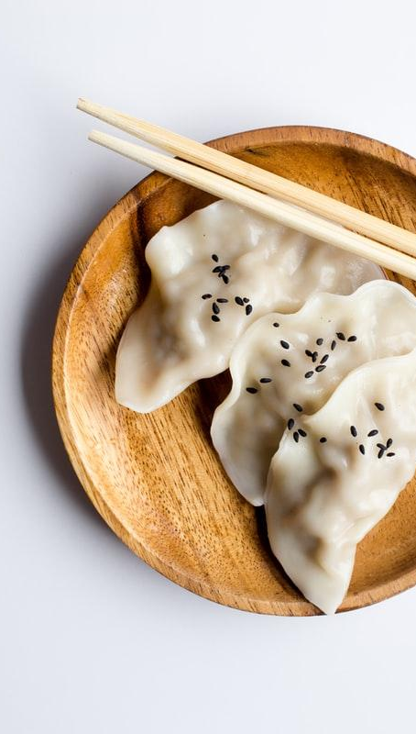
Setting Up the Environment
Library impacts:
from tkinter import *
import tkinter as tk
from tkinter import ttk
from tkinter import font

Slide 4
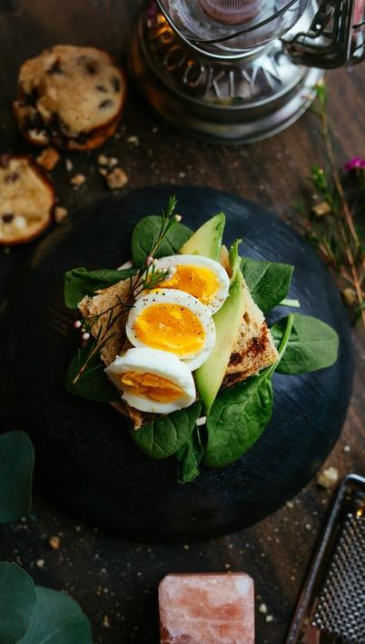
Main Window Initialization
Code Snippet
top = tk.Tk()
top.geometry("400x500")
top.title("Restaurant Menu")
top.configure(bg="#f8f9fa")
Description: Initializes the main window with title and size

Slide 5
Creating the Main Frame
Code Snippet
main_frame = Frame(top, bg="#f8f9fa")
main_frame.pack(pady=10)
Description: Creates a frame to contain all widgets

Slide 6
Title and Subtitle
Code Snippet
title_label = Label(main_frame, text="Dine Divine", font=custom_font, bg="#f8f9fa", fg="crimson")
title_label.grid(row=0, columnspan=2, pady=(0, 10))
Description: Displays the application title using custom fonts and colors

Slide 7
Cart Setup
cart_frame = Frame(main_frame, bg="#f8f9fa")
cart_frame.grid(row=5, columnspan=2, pady=(10, 5))
Description: Sets up the cart frame to display selected items.

Slide 8
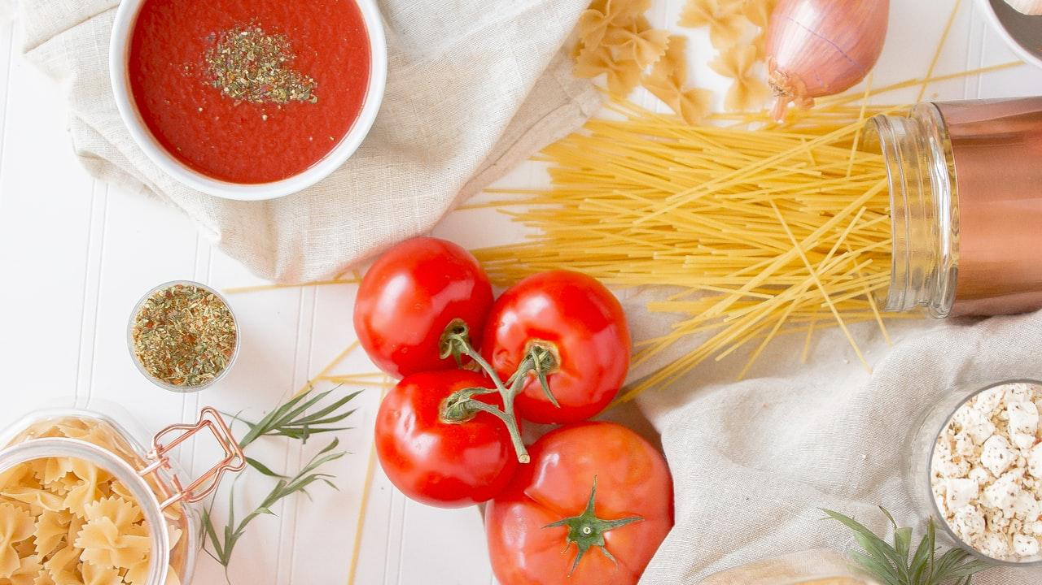
Adding Items to Cart
def add_to_cart(item, price):
global total_price
...
Description: Function to add selected menu items to the cart and update total price.

Slide 9
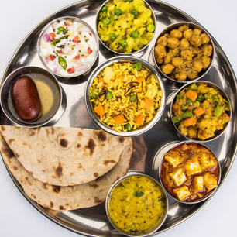
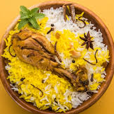
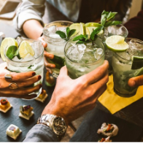

Menu Categories
vegetarian_items
vegetarian_items = {...}
Non-veg
nonveg_items = {...}
Drinks
drinks_items = {...}
Pastries
pastries_items = {...}
Description: Dictionary structures to hold menu items and their prices.

Slide 10
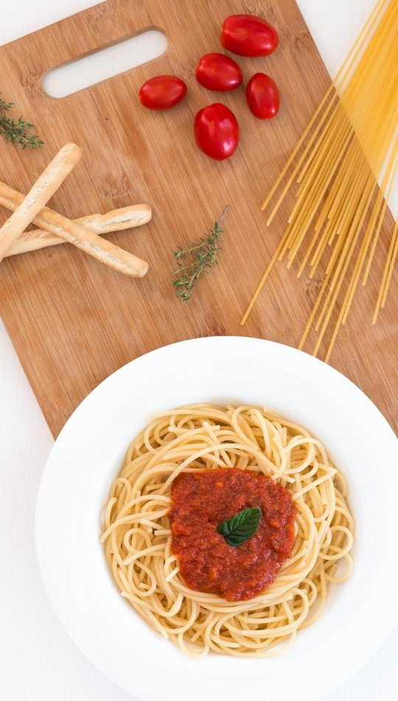
Creating Menu Windows
def create_menu_window(title, items):
...
Description: Function to create new windows for each menu category.

Slide 11
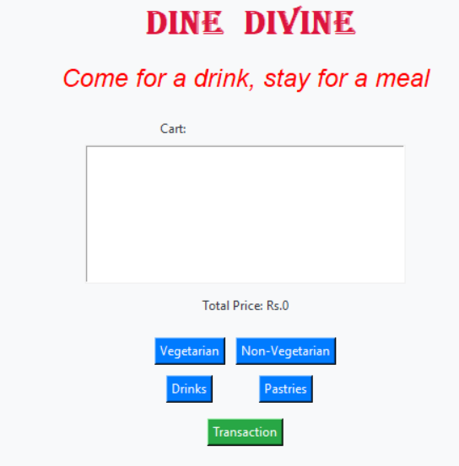
Buttons for Menu Categories
Button(button_frame, text="Vegetarian", ...)
Description: Buttons that open respective
category windows.

Slide 12
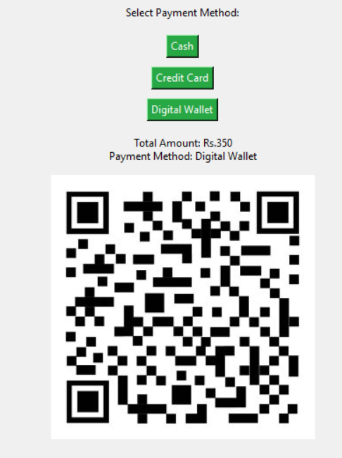
Transaction Window
def show_transaction_window():
...
Description: Function to handle payment options and display the total amount.

Slide 13
Conclusion
Summary: This application demonstrates a simple restaurant menu system using Tkinter, with functionalities for adding items to a cart and processing payments

Slide 14
THANK YOU
Presented by: B.Kalyani Priya

